Slide 1

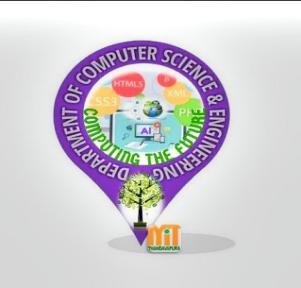
MAHARAJA INSTITUTE OF TECHNOLOGY,THANDAVAPURA
Presentation on
Handwriting Recognition
Phase-2
Presented by:
Sudharshan V
Under the guidance of:
Prof. Mallikarjuna Swamy

Slide 2
Contents
Introduction
Problem Definition
Methodology
Preprocessing
Segmentation
Feature Extraction
Conclusion

Slide 3
Introduction
A computer can detect the only computer text automatically.
For recognition of the handwritten text by humans we need to apply different machine learning algorithms to detect it.
Based on Machine learning algorithms we can detect the text.
The handwritten text identification will help us very much in real time implementations.

Slide 4
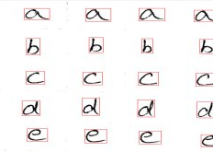
Problem definition
Identification of Character.

Slide 5
Problem Definition(Continue)
Current Approaches:
OCR - What it is ?
Optical Character Recognition, or OCR, is a
technology that enables you to convert different
types of documents, such as scanned paper
documents, PDF files or images captured by a
digital camera into editable and searchable data.

Slide 6
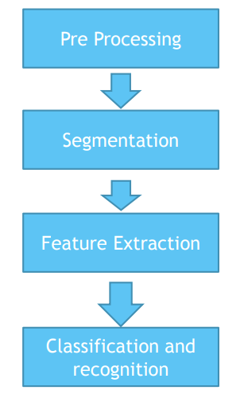
Methodology

Slide 7
Preprocessing
Preprocessing stage has several tasks to be done.
Binarization
Noise Filtration & Smoothing
Normalization

Slide 8
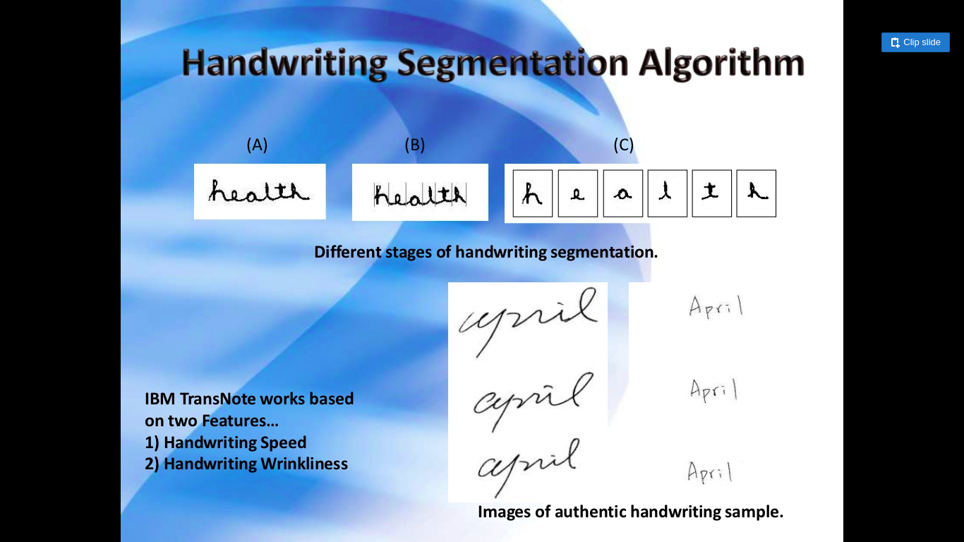
Segmentation
An image of the sequence of characters is decomposed into subimages of individual character.
(A) (B) (C)

Slide 9
Feature Extraction
Feature Extraction Based on Character Geometry.
It extracts different line types that form a particular character.
The feature extraction technique explained was tested using a Neural Network which was trained with the feature vectors obtained from the system proposed.

Slide 10
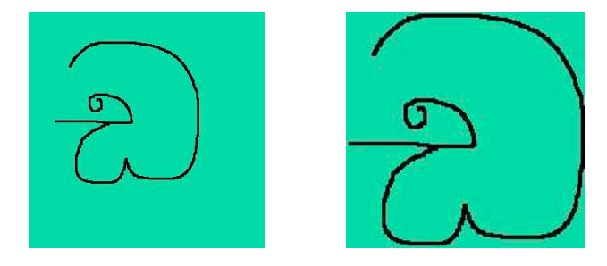
Feature Extraction(Continue)
Processing of Image of Each Character.
Original Image Processed Image

Slide 11
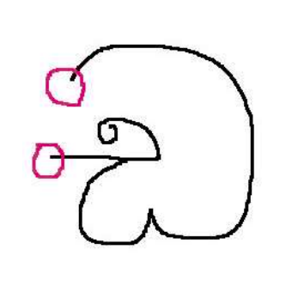
Feature Extraction(Continue)
Identifying Starting Elements of the character.

Slide 12
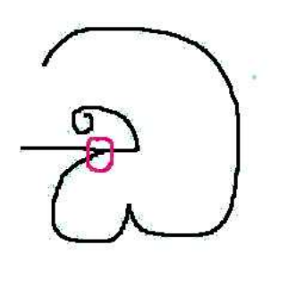
Feature Extraction(Continue)
Identifying Intersection Elements of the character.

Slide 13
Conclusion
An effective way to recognize handwritten character.
High accuracy for the handwriting recognition.

Slide 14
Thank You

