Slide 1
PREDICTIVE ANALYTICS · FINAL REVIEW
F1 Tire Degradation &
Pit Strategy Optimization
Modeling non-linear tire wear and simulating the optimal undercut window — Bahrain Grand Prix 2023
B Sudharshan (23BCE1515)
Dharani Tharan D(23BCE1646)
Kunwar Arush Srivastava (23BCE5024)
Predictive Analytics Project

Slide 2
01 · THE CHALLENGE
Problem Statement
Non-linear tire wear
Tire pace drop-off is not a straight line — grip falls gradually, then collapses sharply near a compound's 'cliff'.
THE CORE QUESTION
Which lap should
we pit on to
maximize our
chance of
winning the
undercut?
High-stakes timing
Pitting one lap too early or too late can swing a race result by several track positions.
Confounded signals
Raw lap time mixes fuel burn, traffic, and tire wear together, hiding the true degradation trend.
Uncertain race context
Rivals, safety cars, and pit-lane delta all affect whether a strategy actually wins on track.
02

Slide 3
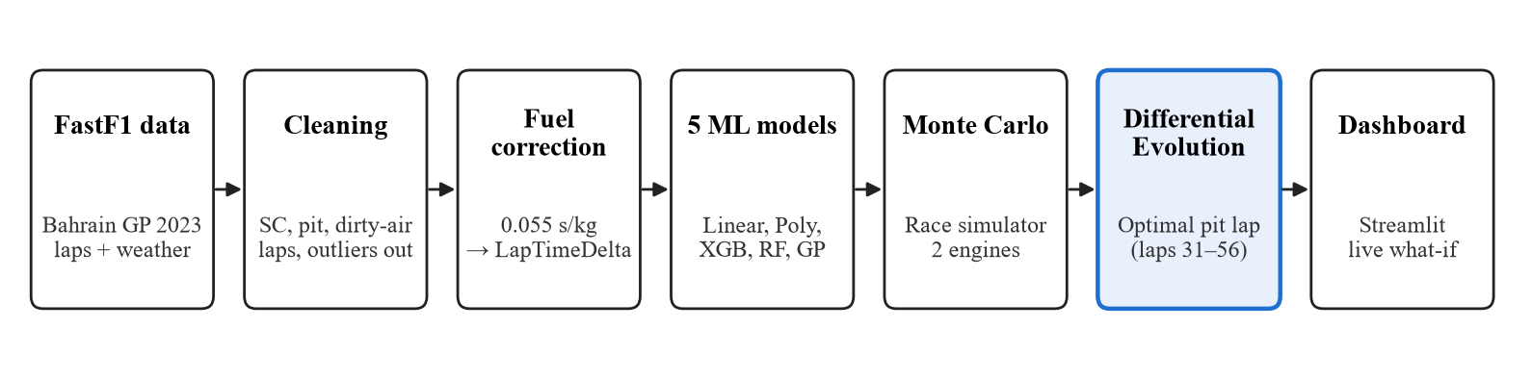
02 · SYSTEM OVERVIEW
End-to-End Pipeline
From raw FastF1 laps to a validated pit-lap decision.
DATA
MODELS
OPTIMIZATION
564 laps · 52 stints
5 models · 2 engines
19 evals · 1.2 s
Baseline grid: 4 points (42–51). Final search: 26 integer laps (31–56).
03

Slide 4
03 · DATA FOUNDATION
Input
Source: FastF1 telemetry API — Session: 2023 Bahrain Grand Prix, Race — Field: 20 drivers, 57 laps
Lap & Timing Data
Weather Telemetry
Race Context
LapTime, LapNumber, Stint, TyreLife, Compound, PitIn/OutTime, TrackStatus, IsAccurate
AirTemp, TrackTemp, Humidity — merged to each lap via nearest-time as-of join
Position data used to derive gap-to-car-ahead, flagging clean-air vs. dirty-air laps
Track Status
Compound & Stint
Derived Constants
Safety Car / VSC flags parsed from TrackStatus codes to isolate representative laps
SOFT / MEDIUM / HARD identity plus stint grouping for per-tire-set trend analysis
Fuel burn model: 110kg load over 57 laps, fuel-effect coefficient 0.055s/kg
04

Slide 5
04 · EXPLORATORY DATA ANALYSIS
EDA — Isolating True Tire Degradation
Clean-air filtering
Laps with <2s gap to the car ahead run slower from dirty air, not tire wear — these were removed before modeling.
DATASET AFTER CLEANING
564
Compound degradation curves
Laps retained
LOWESS-smoothed pace drop-off by compound reveals a visible Soft-tire 'cliff' near lap 16.
19
Track-temperature sensitivity
Drivers
A temperature-binned heatmap shows degradation accelerates at higher track temperatures.
52
Stints
Rigorous cleaning pipeline
361 / 195 / 8
Safety-car laps, pit laps, and 2.5σ outliers removed, keeping only stints with 3+ laps.
Hard / Soft / Medium laps
05

Slide 6
05 · MODELING APPROACH
Five-Model Zoo
Five families, one target: fuel-corrected LapTimeDelta on a stint-grouped split.
Model | Family | Role | Why it matters
Linear Regression | Linear | Baseline | Sanity floor; RMSE 0.680 s.
Polynomial (deg 2) | Polynomial | Interpretable non-linear | AIC/BIC/CV-selected curvature; RMSE 0.822 s.
XGBoost (asymmetric) | Boosting | Primary strategy model | 2.5× optimism penalty; SIS 2.58 s.
Random Forest | Bagging | Accuracy ensemble | Best RMSE 0.648 s / R² 0.511.
Gaussian Process | Kernel / Bayesian | Uncertainty engine | Per-prediction σ; best MAE 0.531 s / SIS 2.15 s.
All five models are evaluated on the same 112 unseen-stint laps. Metrics are on the next slide.
06

Slide 7
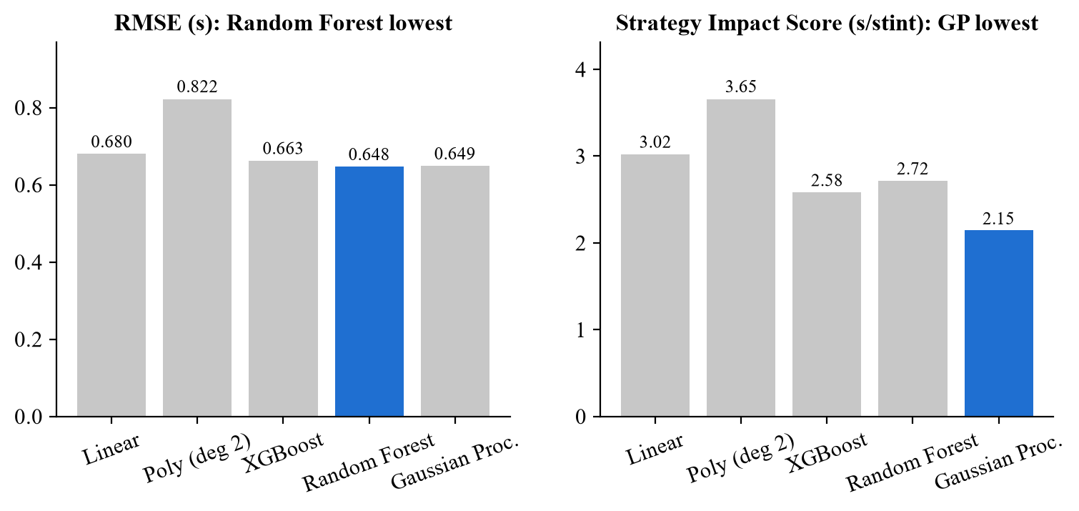
06 · MODEL RESULTS
No Single Model Wins Everything
Random Forest leads raw accuracy; Gaussian Process leads strategy cost.
WHAT THE METRICS SAY
• Random Forest: best RMSE 0.648 s and R² 0.511.
• Gaussian Process: best MAE 0.531 s and SIS 2.15 s, with per-lap σ.
• XGBoost: asymmetric loss keeps SIS at 2.58 s.
• Reality check: 0.58 s cumulative drift over a 20-lap stint.
• Lowest RMSE ≠ lowest strategy cost.
SIS = Strategy Impact Score (race seconds lost to optimistic predictions; lower is better).
07

Slide 8
07 · STRATEGY SIMULATION
Expected Output
A Monte Carlo race simulator scores the four-point baseline grid and surfaces the lap most likely to win the undercut.
1
2
3
Candidate Pit Laps
Race Simulation
Win-Probability Ranking
Several lap options spanning the plausible pit window are proposed for testing.
Each candidate is played out thousands of times against a modeled rival and random safety-car events.
Candidates are ranked by how often that strategy comes out ahead on track.
OUTPUT
One recommended pit lap — the candidate with the highest simulated win probability
Stress-tested against random safety-car deployments
Benchmarked against real-world pit-stop timing
Repeatable for any driver, compound, or race stage
08

Slide 9
08 · OPTIMIZATION
Full-Window Pit-Lap Optimization
Replace the four-point grid with a search over every feasible lap, 31–56.
OBJECTIVE
CONSTRAINTS
p* = arg max J(p)
• One-stop strategy
• Integer pit lap
• Rival pits on lap 45
• 22 s pit loss
• 15% SC hazard per 10 laps
p ∈ {31, 32, …, 56}
J(p) = ½ [P_XGB(win | p) + P_GP(win | p)] + 10⁻⁶ × mean median gap
The second term only breaks ties inside the win-probability plateau. The objective is the average win probability across both engines.
COMMON RANDOM NUMBERS
Every candidate sees the same safety-car and lap-noise draws, so the ranking reflects strategy rather than a lucky seed. Final validation uses five fresh seeds × 20,000 races.
Old grid: 4 points (42–51)
New search: 26 integer laps (31–56)
09

Slide 10
09 · ALGORITHM CHOICE
Why Differential Evolution?
The objective is integer, non-smooth, noisy, and not guaranteed unimodal.
Method | Derivative | Integer p | Global | Noisy black box | Verdict
Newton–Raphson | Yes | No | No | No | Not suitable
Golden-section | No | No (continuous) | No (unimodal) | Weak | Benchmark only
Differential Evolution | No | Yes | Yes | Yes | Selected
• Newton–Raphson: from lap 42 → lap 55 (29.56% ensemble win); roots ranged 5–148.
• Golden-section: full bracket → lap 34; old grid bracket → lap 42. Bracket-dependent.
• Differential Evolution: SciPy differential_evolution, integer bounds 31–56, 3 seeds, 19 evaluations, 3 generations, ~1.2 s; all seeds → lap 34.
10

Slide 11
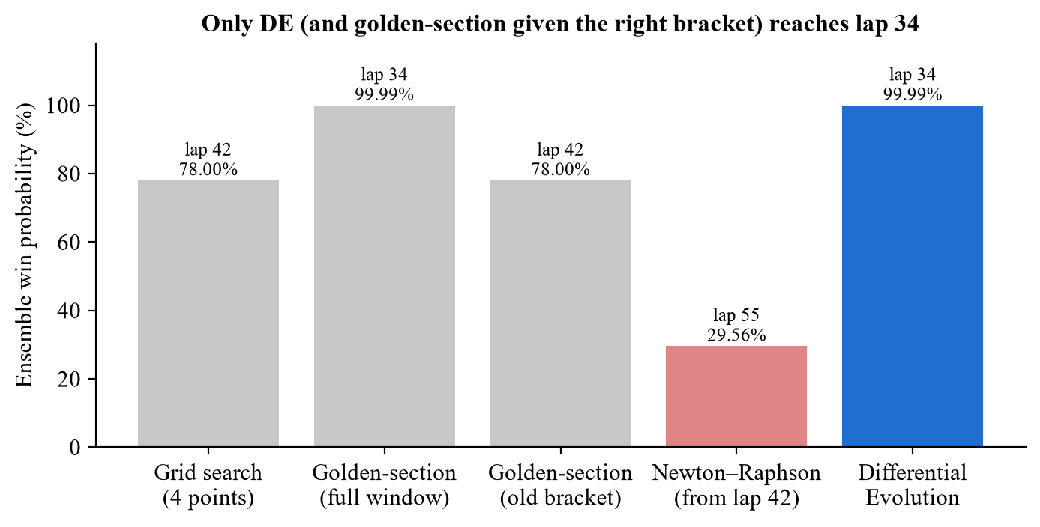
10 · BENCHMARK
Differential Evolution Wins the Benchmark
Same objective, same common-random-number sample, same feasible window.
RESULTS
• Grid: lap 42, 78.00%.
• Newton: lap 55, 29.56%.
• Golden: full bracket 34; old bracket 42.
• DE: lap 34, 99.99%, 19 evaluations.
• Only DE is global, integer-native and assumption-light.
The exhaustive 26-point landscape is a post-hoc check; DE reaches the same optimum without assuming unimodality.
11

Slide 12
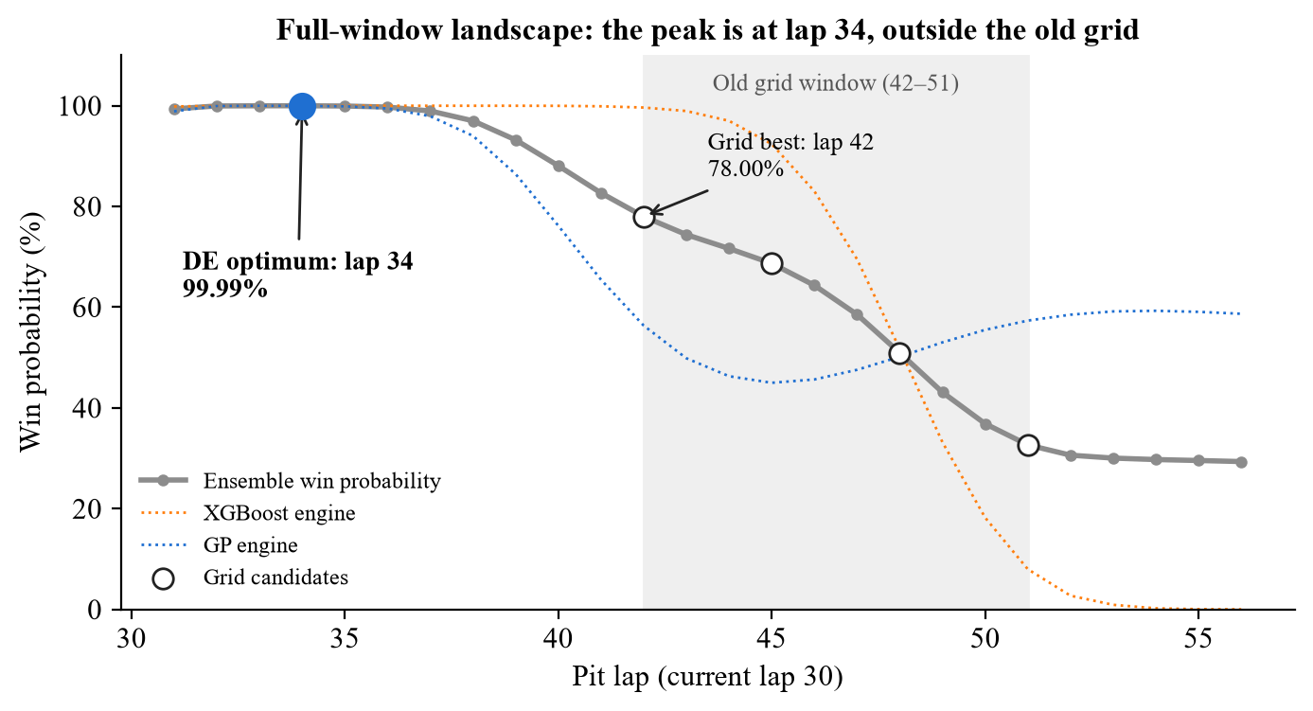
11 · LANDSCAPE
The Peak Is Outside the Old Grid
Full-window win probability for the dual-engine objective.
WHAT IT SHOWS
• Shaded region = old grid 42–51.
• Grid best lap 42 = 78.00%.
• DE peak lap 34 = 99.99%.
• Peak is interior, 8 laps earlier.
• GP has a second local max near lap 54; unimodal search is unsafe.
The objective is flat near the top but not unimodal; the early peak is the global optimum.
12

Slide 13
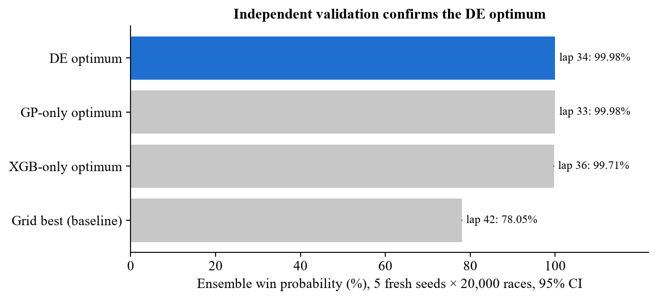
12 · VALIDATION
Validated on Five Fresh Seeds
The gain is not an artifact of the shared optimization sample.
BEFORE → AFTER
• Grid 42: 78.05% ensemble; XGB +12.94 s; GP +1.07 s.
• DE 34: 99.98% ensemble; XGB +18.00 s; GP +19.73 s.
• Gain: +21.93 pp; +5.06 s XGB; +18.68 s GP.
• XGB-only 36, GP-only 33, dual 34 — same neighborhood.
5 fresh seeds × 20,000 races per scenario; 95% confidence intervals.
13

Slide 14
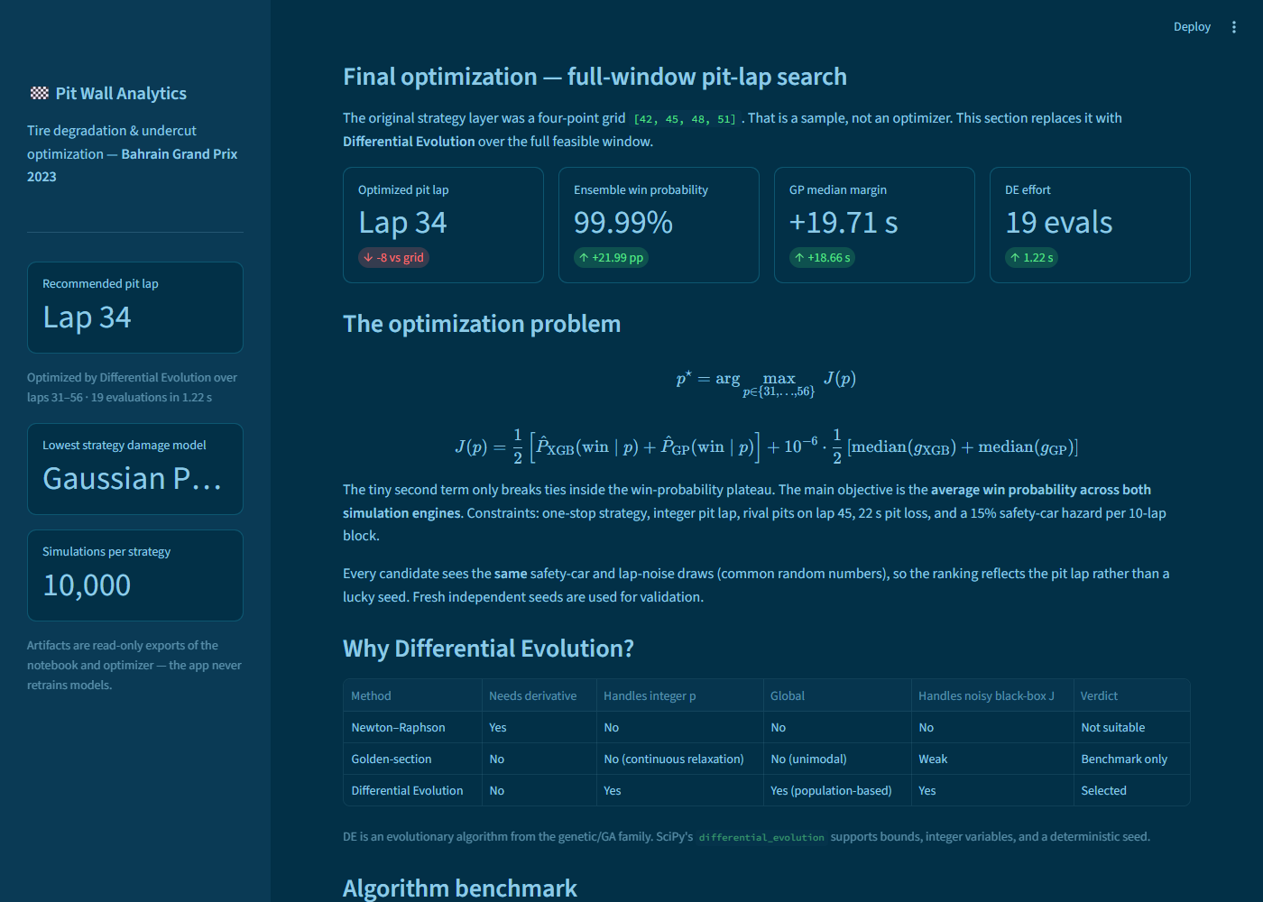
13 · FINAL PRODUCT
Final Recommendation & Live Dashboard
The optimizer is shipped as an interactive Optimizer tab, not just a notebook result.
RECOMMENDED
Pit lap 34
99.99% dual-engine win
Median margin: +18.0 s XGB / +19.7 s GP
vs old grid: +21.99 pp, +5.06 s / +18.66 s
Real stops: 35–50; lap 34 is the aggressive edge.
Validated on five fresh seeds.
Tabs: Overview · Data & Method · EDA · Models · Monte Carlo · Optimizer · Proof
Reproduce: python optimizer.py → streamlit run app.py
Optimizer tab: benchmark, convergence, landscape and validation.
14

Slide 15
14 · WRAP-UP
Limitations, Future Work & Conclusion
What the final system proves — and what it does not.
LIMITATIONS
FUTURE WORK
• Single race (Bahrain 2023); circuit-specific constants.
• One-stop, fixed rival, one-dimensional pit-lap search.
• MEDIUM has only 8 modeling laps.
• Coarse safety-car hazard; GP is O(n³).
• Multi-stop and compound-choice optimization with a higher-dimensional DE.
• Game-theoretic rival model.
• Season-wide multi-circuit model.
• Live telemetry into the dashboard.
FINAL RESULT
Pit lap 34 · 99.99% dual-engine win · +21.99 pp over the old grid · validated on five fresh seeds.
15

Slide 16
THANK YOU
Questions & Discussion
B Sudharshan (23BCE1515)
Dharani Tharan D(23BCE1646)
Kunwar Arush Srivastava (23BCE5024)
F1 Tire Degradation & Pit Strategy Optimization · Bahrain GP 2023 · Review 3

