Slide 1
Review of : Setting Safety-Stock Targets at Intel in the Presence of Forecast Bias
Authors : Matthew P. Manary, Sean P. Willems
INFORMS Journal (2008)

Slide 2
The essence of the paper
What is the problem? : The estimation of safety stock targets is currently inaccurate.
In this paper the focus is on addressing the forecasting bias which helps setting the safety stock targets.
Extra stock in case sales are greater than planned and/or the supplier is unable to deliver the additional units at the expected time.
Safety stock is additional quantity of an item held in the inventory to reduce the risk that the item will be out of stock.
Why solve it? – Unoptimized inventory targets leading to SLA misses + unsold inventory => loss of revenue.

Slide 3
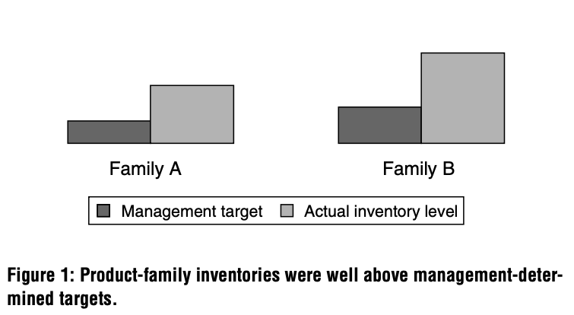
State of inventory at Intel before MEIO
Inconsistency in meeting customer service level targets.
Figure depicts the levels before MEIO.
Initial models from the newly introduced MEIO tool (2004) produced results for the safety stock targets which were counterintuitive.
The model still recommended unnecessarily high inventory levels.

Slide 4
Discoveries when the results were examined
Sales forecasts which was fed into the MEIO tool exhibited bias.
Biased forecasts were loaded as planned demand.
MEIO assumed the demand inputs were unbiased.
Additionally,
  These forecasts were loaded into the MRP system by the Sales & Marketing Team.
  This data was immutable.
Notes:
MRP - Manufacturing Resource Planning

Slide 5
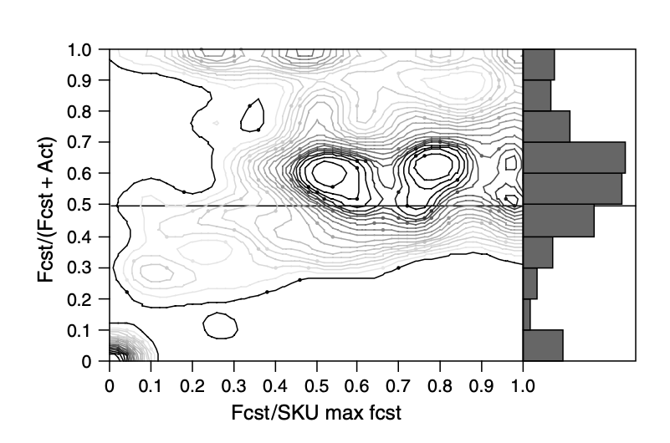
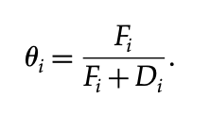
Proof of bias .
The graph indicates over forecasting.
Notes:
Why use this metric – why not relative error…

Slide 6


Demand Characterization.
Demand was random so safety stock was usually majority of all on-hand inventory.
Demand Characterization per period at Intel - > For each SKU, demand is characterized by an average and SD.
The base stock inventory at a stage is - >
The safety stock at that stage would be -> (2)
Approach 1 – used actual historical demand to calculate AVG & SD.
Approach 2 – uses forecast and actual historical demand.
Notes:
- Create mock up distributions

Slide 7
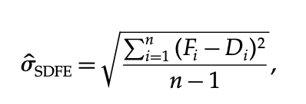
Demand characterization contd..
To calculate the AVG and SD, approach 2 was used.
Sales forecasts (w bias) help in calculation of the deviation.
The MEIO tool/team calculate SDFE for each SKU in the following form : (3)
Notes:
Fi = forecast for demand in period I made in period i-1
Di = demand in period I
LHS is the estimated sd of forecast errors.

Slide 8
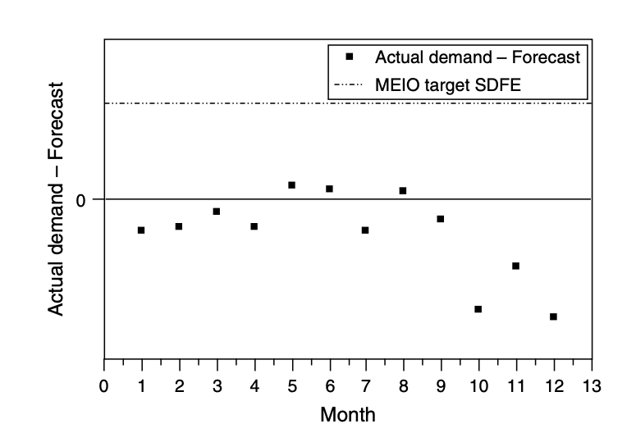
Validation of the MEIO targets w/o modifying.
The figure shows historical snapshot of one SKU’s forecast accuracy,
And the suggested MEIO targets based on SDFE.
Suggestions were more than required to meet under forecasts.
After validating the model’s structure and other data inputs,
we found that the root cause for the unrealistic safety-stock levels was
the use of the variables in (2) to set safety-stock targets by using
Equation (3) to calculate the SDFE in the presence of forecast bias.
Clearly, the forecast bias present in the system had to be addressed.

Slide 9
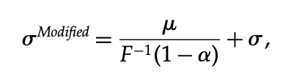
Addressing Bias.
They had to remove the impact of the bias without changing mean demand.
Modified SDFE calculation.
Notes:
1-a -> unfill rate of 1-sla = beta

Slide 10
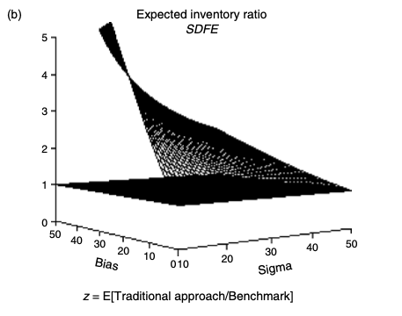
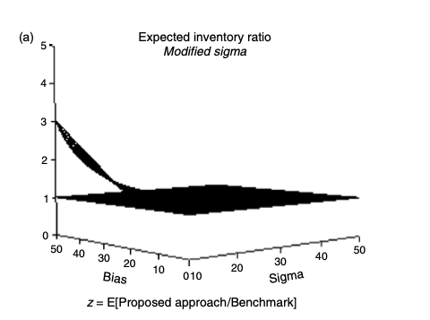
Testing the modifications.
Comparison with 3 approaches.
1st – Removed the systematic bias. (Unfeasible – only used for comparison because it renders unbiased mean)
2nd – Uses the modified SDFE in the previous slide.
3rd – Ignores forecast bias and used below equation.
3rd/1st
2nd/1st

Slide 11
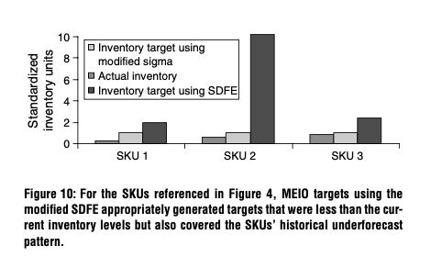
Results
They obtained 17% reduction in the inventory levels at 95% SLA,
when compared to the management specified levels.
71% reduction in targets produced when compared with the MEIO unmodified version.

Slide 12
Future Work.
If an SKU had more historical data – it meant that there exists more forecasting bias leading to over/under forecasted safety stock targets. They plan to work on just the magnitude of the forecasts in the future.

