Slide 1
Development of a data-driven approach for understanding discrepancies between design and implementation of inventory policies.
Sudharshan BR – sb1501@rit.edu
Project Advisor : Dr.Nenad Nenadic – nxnasp@rit.edu

Slide 2
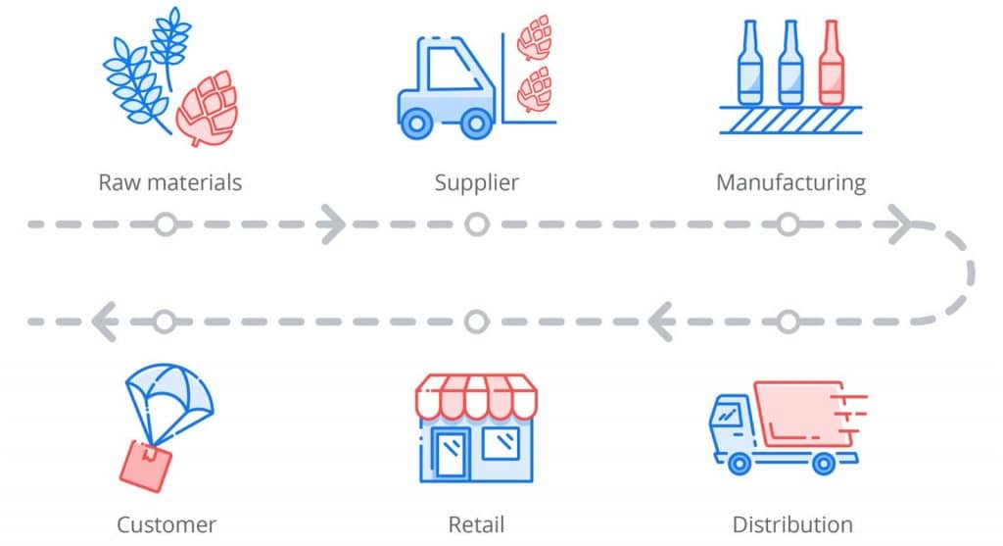
Background
The supply chain is how a company turns raw materials into finished goods and services for the customer.
Ubiquitous timeline process among all businesses.
Highly optimized network can keep operational costs to a minimum, maximum competitive advantage and customer value.

Slide 3
Broader Impact
Businesses can lose customers, revenue.
Global Trade forecasted growth = $28 trillion.
Example : Supply chain squeeze costs Apple $6B in revenue.

Slide 4
Scientific Merit w/ Tasks
Explore the domain by conducting literature survey.
Identify existing datasets and existing optimization methods.
Build synthetic data.
Establish an optimized framework to experiment several probabilistic modeling on data.
Tune and improve model performance to enable accurate representation of data from the industrial partner.
Generate interpretable results which can be utilized to solve partner's problem.

Slide 5
Q & A ?
Thank you

