Slide 1
Development of a data-driven approach for understanding discrepancies between design and implementation of inventory policies.
Sudharshan BR – sb1501@rit.edu
Project Advisor : Dr.Nenad Nenadic – nxnasp@rit.edu

Slide 2
Broader Impact
Businesses can lose customers, revenue.
Global Trade forecasted growth = $28 trillion.[1]
Example : Supply chain squeeze costs Apple $6B in revenue.[2]

Slide 3
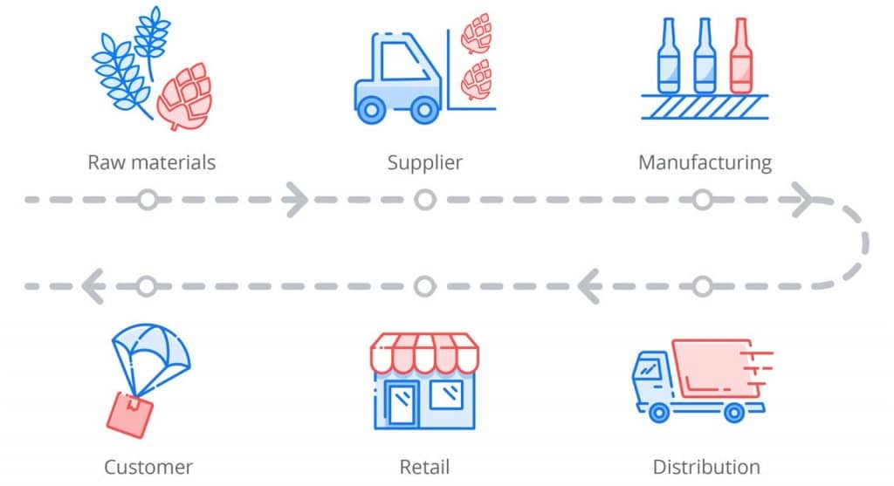
Introduction + Background
The supply chain is how a company turns raw materials into finished goods and services for the customer.
Ubiquitous timeline process among all businesses.
Highly optimized network can keep operational costs to a minimum, maximum competitive advantage and customer value.

Slide 4
Background continued.
Setting inventory target levels are crucial in keeping operational costs to a minimum.
A robust optimized inventory policy which can effectively mitigate the adverse effects uncertainty can prove to be vital to any business.
Demand forecasting, estimation of safety stock levels, order-up-to levels are few of the problems which are common in working towards a fully optimized inventory policy.
Our industrial partner is one such business looking to efficiently manage inventory levels.

Slide 5
Summary of Related Works
Bayesian inference techniques coupled with simulators were observed to be a significant strategy in establishing inventory policies which were optimal [3].
Papers [4,5,6] inform us about the challenges faced by the Planning Organization team at Intel when they work on solving inventory policy problems.
Deep Neural Network based approaches are effective in predicting inventory target levels. [7]
We also learn about the impacts of kernel density approximation techniques being utilized where the forecast errors were non-parametric in nature. [5,8].
The use of several exponential smoothing methods were also experimented on (r,Q) and (s,S) inventory policies.[9]

Slide 6
Scientific Merit w/ Tasks
Explore the domain by conducting literature survey.
Identify existing datasets and existing optimization methods.
Build synthetic data.
Establish an optimized framework to experiment several probabilistic modeling on data.
Tune and improve model performance to enable accurate representation of data from the industrial partner.
Generate interpretable results which can be utilized to solve partner's problem.

Slide 7
Approach
From the available datasets in the existing literature, we aim to generate synthetic data.
Using existing probabilistic libraries like Pyro [10] and Edward [11] we aim to implement probabilistic modeling for an initial set of hypothetical discrepancies.
These trained models will be applied to the real-world anonymized data provided by the industrial partner.
Our next steps will be to fine tune our models to further improve performance while providing accurate target levels.

Slide 8
References
UN News. 2022. World trade reaches all-time high, but 2022 outlook ‘uncertain’: UNCTAD.
TheStreet. 2022. Apple Has a $6 Billion Supply Chain Problem (That May Get Worse).
Atsuki Kiuchi, Haiyan Wang, Qiyao Wang, Takahiro Ogura, Tazu Nomoto, Chetan Gupta,Takaharu Matsui, Susumu Serita, and Chi Zhang. Bayesian optimization algorithm with agent-based supply chain simulator for multi-echelon inventory management. In2020 IEEE 16thInternational Conference on Automation Science and Engineering (CASE), pages 418–425.IEEE, 2020.
Matthew P Manary and Sean P Willems. Setting safety-stock targets at intel in the presence offorecast bias.Interfaces, 38(2):112–122, 2008.
Matthew P Manary, Sean P Willems, and Alison F Shihata. Correcting heterogeneous andbiased forecast error at intel for supply chain optimization.Interfaces, 39(5):415–427, 2009.
Brian Wieland, Pat Mastrantonio, Sean P Willems, and Karl G Kempf. Optimizing inventorylevels within intel’s channel supply demand operations.Interfaces, 42(6):517–527, 2012.
Mohammad Pirhooshyaran and Lawrence V Snyder.Simultaneous decision making forstochastic multi-echelon inventory optimization with deep neural networks as decision makers.arXiv preprint arXiv:2006.05608, 2020.
Juan R Trapero, Manuel Cardos, and Nikolaos Kourentzes. Empirical safety stock estimationbased on kernel and garch models.Omega, 84:199–211, 2019.
T Warren Liao and Pei-Chann Chang. Impacts of forecast, inventory policy, and lead time onsupply chain inventory—a numerical study.International Journal of Production Economics,128(2):527–537, 2010.
Eli Bingham, Jonathan P Chen, Martin Jankowiak, Fritz Obermeyer, Neeraj Pradhan, Theofanis Karaletsos, Rohit Singh, Paul Szerlip, Paul Horsfall, and Noah D Goodman. Pyro: Deep universal probabilistic programming. The Journal of Machine Learning Research, 20(1):973–978, 2019.
Dustin Tran, Alp Kucukelbir, Adji B Dieng, Maja Rudolph, Dawen Liang, and David M Blei. Edward: A library for probabilistic modeling, inference, and criticism. arXiv preprint arXiv:1610.09787, 2016.

Slide 9
Q & A ?
Thank you

