Slide 1
Development of a data-driven approach for understanding discrepancies between design and implementation of inventory policies.
Sudharshan BR – sb1501@rit.edu
Dr. Nenad Nenadic – nxnasp@rit.edu

Slide 2
Overview
What is it?
  Multi-Echelon Inventory Optimization Problem.
What is the goal?
  Build a data driven analytic framework to bring visibility on discrepancies present in the practice of existing inventory policy.
Duration?
  May 2022 – April 2023.
Stakeholders?
  Client – Dow Chemicals.
  Funding Agency – MxD.
  Builders – GIS @ RIT.

Slide 3
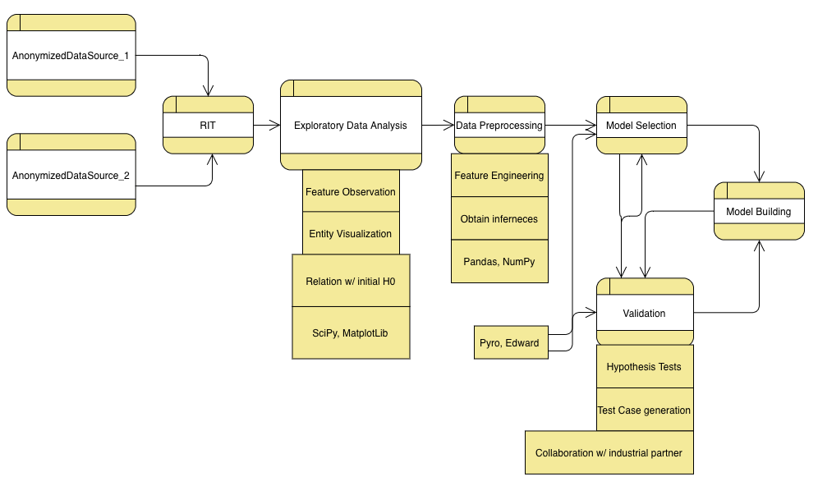
Domain Model
  Anonymized Data Sources :
    Initial set of hypothesis
    Inventory data
  EDA :
    Feature characteristics
    Existing relations with H₀
  Data Pre-processing :
    Feature selection
    Probabilistic testing
  Model :
    Selection
    Evaluation
    Testing

Slide 4
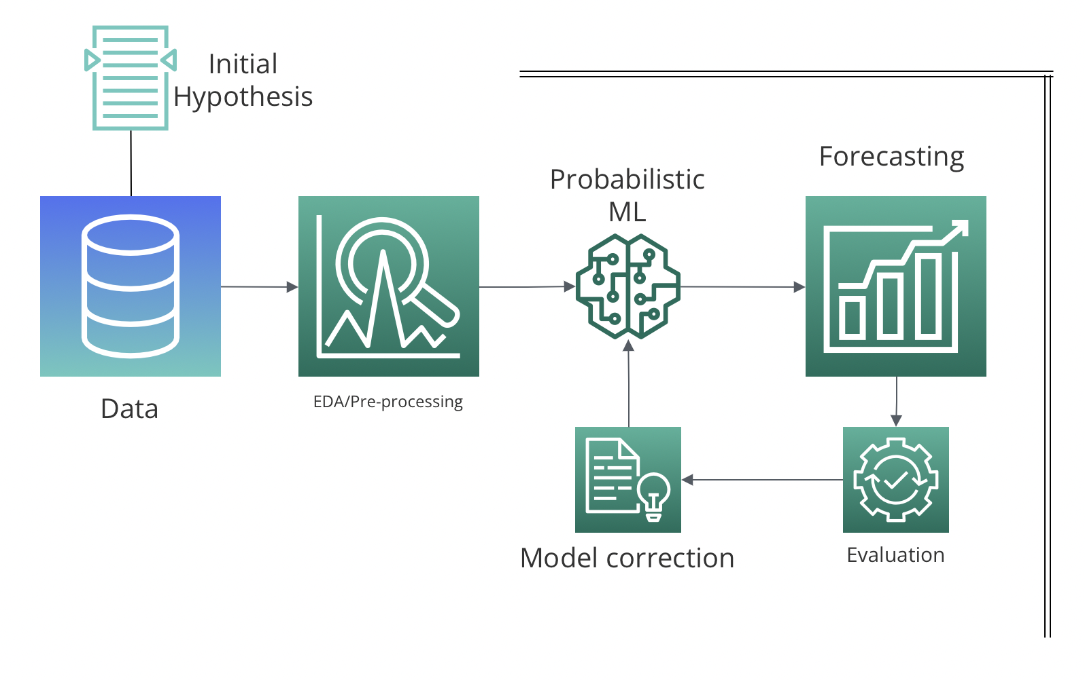
Architecture Setup

Slide 5
Initial Hypothesis + Dataset
H₀ helps us in understanding current issues faced by the client.
  Half knowledge of an inventory manager costing the supply chain $$$.
  Decision taken by a manager leading to a bottleneck elsewhere in the network.
Pending data is estimated to closely follow characteristics of an inventory management system.
  Lead times, order levels, replenishment times, actual demand, forecasted demand, service level, item quantity etc. are some of the features we expect to be working on.

Slide 6
EDA and
Pre-processing.
Discover hidden correlations between H₀ and ground truth.
Extract vital features from dataset based on initial correlations.
Analyze features to unearth underlying distributions.
Research, test distribution correctness with several statistical tests.
Understand the impact of features by collaborating with the client.
Conduct hypothetical observations and experiments with data.

Slide 7
Modeling.
Probabilistic ML
  Build models based on probability.
Forecasting
  Estimate inventory levels.
Evaluating
  Perform tests to learn if the model is alleviating H_{0.}
Tuning
  Increase model quality and accuracy.

Slide 8

Switch to code

Slide 9
Future Work
All aspects of the architecture will be executed in the upcoming semester.

Slide 10
Summary
Work done this semester :
Conduct literature survey.
Understand the domain.
Recreate research objectives present in a paper.
Work planned :
We plan to have an initial connect with our client and obtain data.
Perform all the steps as planned in order to arrive at the end goal.

Slide 11
Thanks!
<Q & A>
<Feedback!>

