Slide 1
Preliminary Literature Review
Project : MxD-21-10-06
Date : 05/25/2022
Sudharshan B R
Nenad Nenadic

Slide 2
Contents
Intel paper
  Main Takeaways
  Associated Dataset
Next steps

Slide 3
Intel Paper - Setting Safety Stock

Slide 4
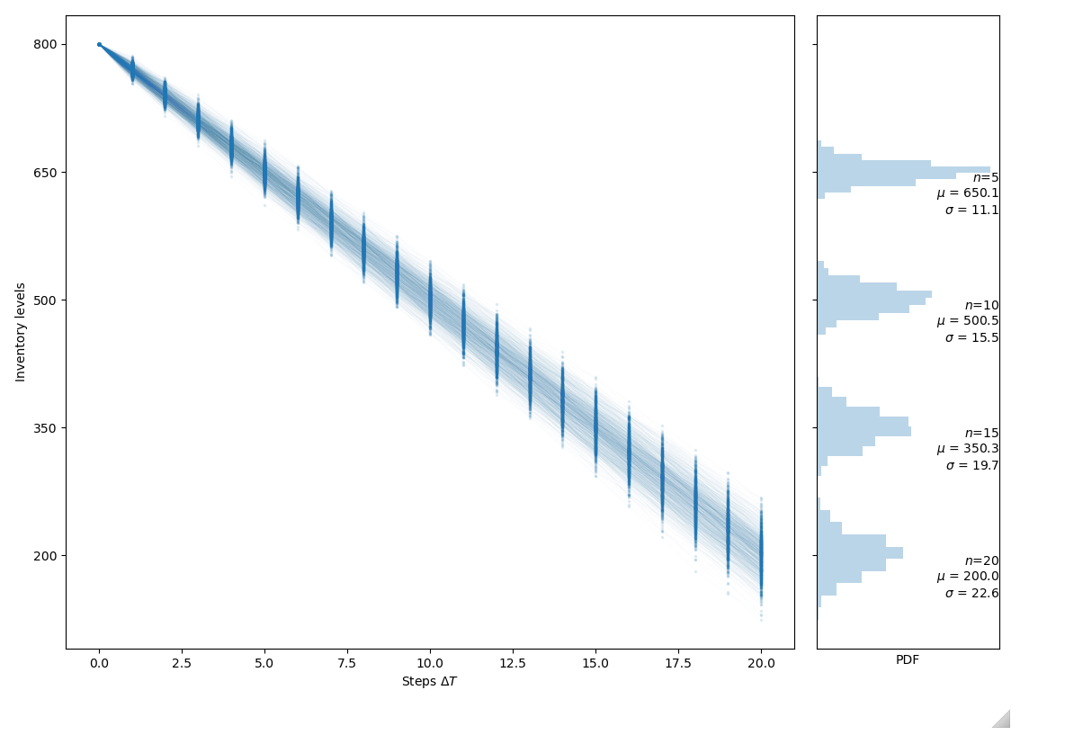
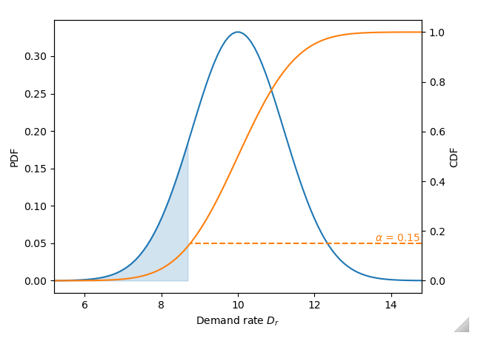
Main takeaways
A numerical Monte Carlo simulation to help settle on a safety stock level.

Slide 5
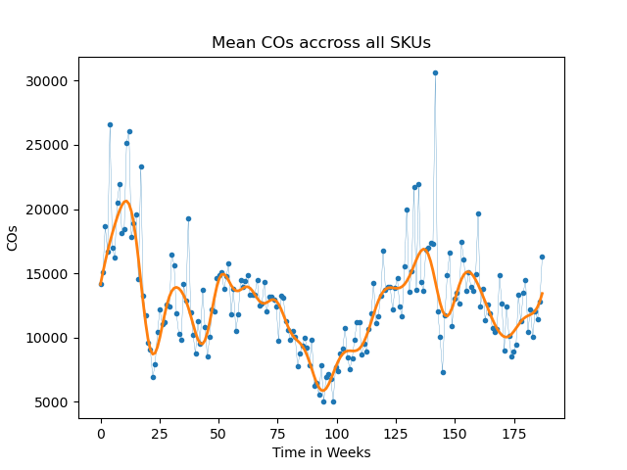
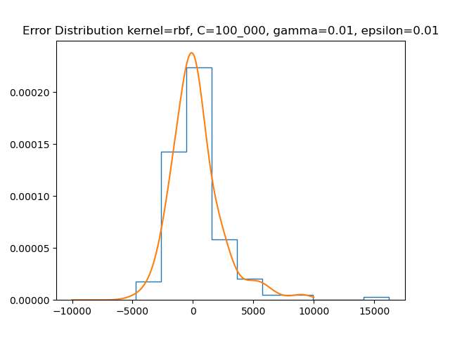
Associated Dataset
Features
  187 Weeks of Customer Orders and Forecasted Demand.
  86 SKUs (25 POs + 22 ASP Groups) , 5 DCs, 5 Generations.
Notes:
SKU = Stock Keeping Unit
DC = Distribution Center
ASP = Average Selling Price
PO = Product Offering

Slide 6
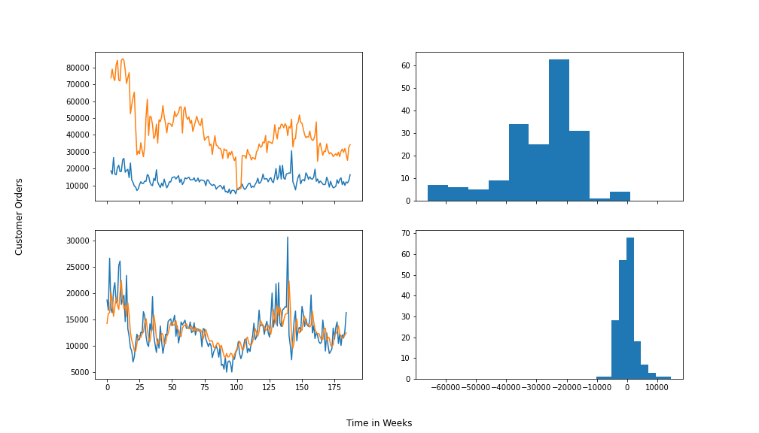
Dataset continued.
Comparing forecasts present in the dataset with a preliminary regression model.
Coefficients are 1st & 2nd order lags of the Customer Orders.
Error distributions indicate significant improvement.

Slide 7
Next Steps:
Acquire data and initial hypothesis.
Perform exploratory data analysis.
Derive correlations/insights, which relate to H₀
Conduct refined literature survey to have a rough POA.
Iteratively collaborate with stakeholders to fit the business need.

