Slide 1
Foundation of Data Science: DSCI-633 : Project Report
Sudharshan Bindiganavale Ramesh

Slide 2
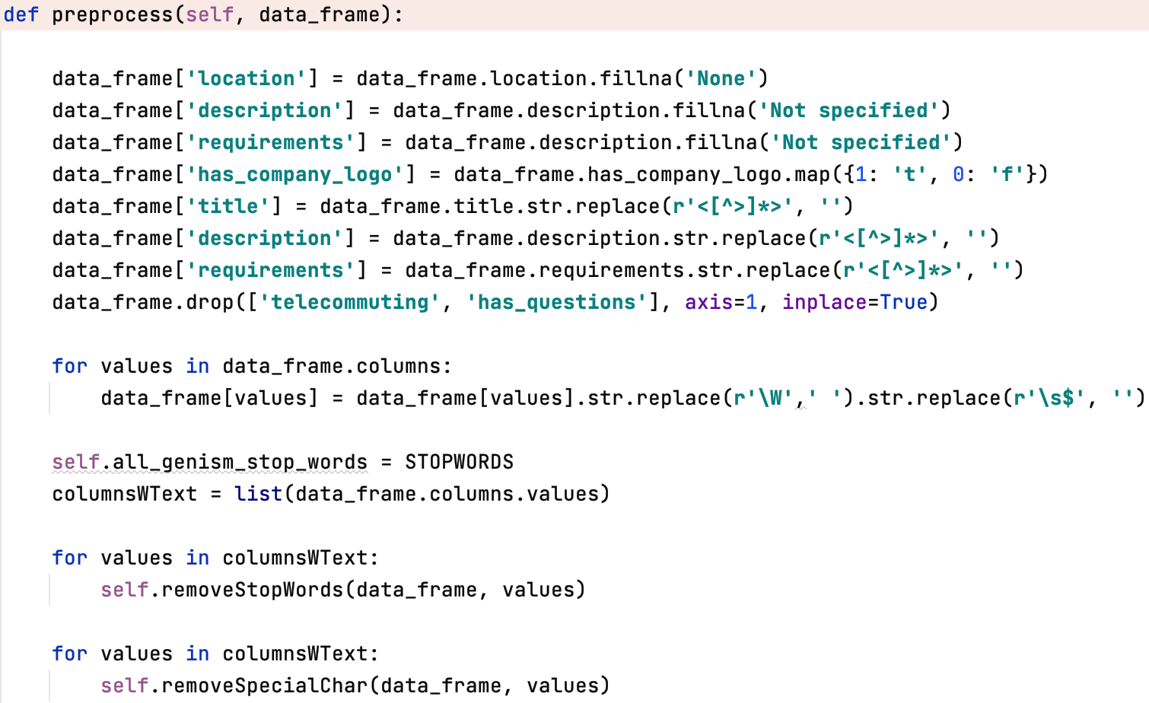
Preprocessing
Fill NaN in location,description & requirements.
Convert 1s and 0s in has_company_logo to T and F.
Ejected STOPWORDS.
Remove special characters, web tags & whitespaces.
Dropped telecommuting and has_questions columns.
The cleaned data is sent to the TF-IDF Vectorizer.
Send only the “description” and “requirements”.

Slide 3
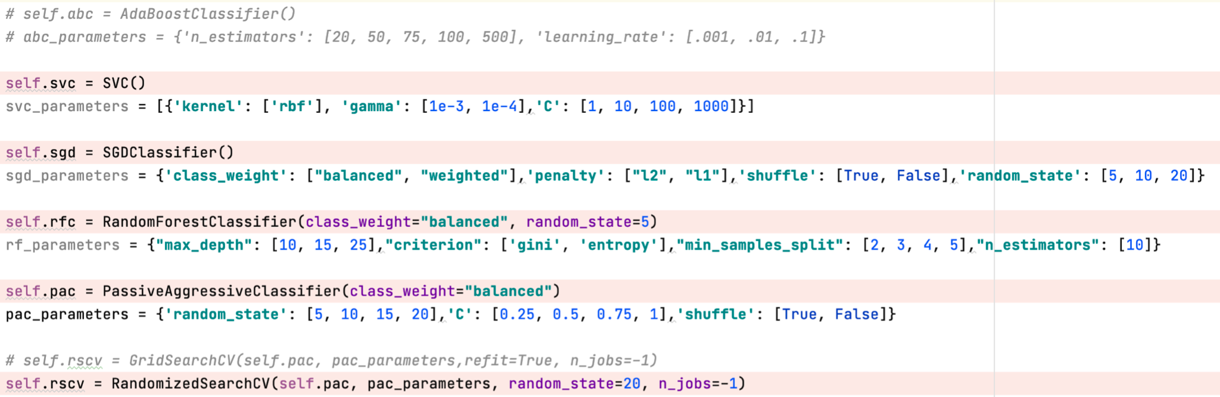
Model Selection

Slide 4
Model Training
Model | SVC | SGD | RFC | PAC
Grid | F1 = 0.712 | F1 = 0.746 | F1 = 0.585 | F1 = 0.755
Random | F1 = 0.712 | F1 = 0.754 | F1 = 0.569 | F1 = 0.755
Model | SVC | SGD | RFC | PAC
Grid | 4.203 mins | 0.344 mins | 3.070 mins | 0.330 mins
Random | 4.482 mins | 0.221 mins | 1.681 mins | 0.240 mins

Slide 5
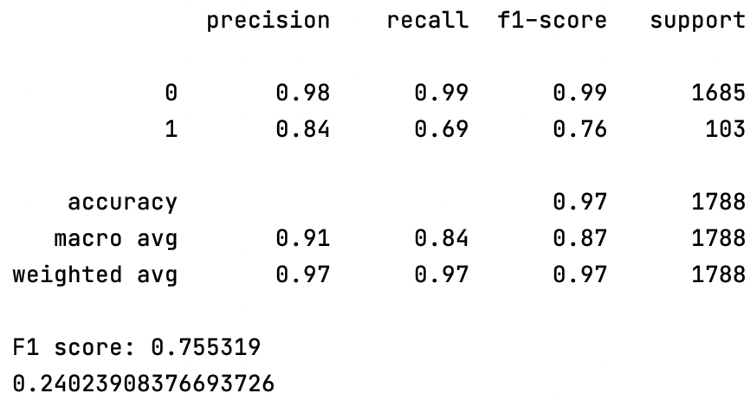
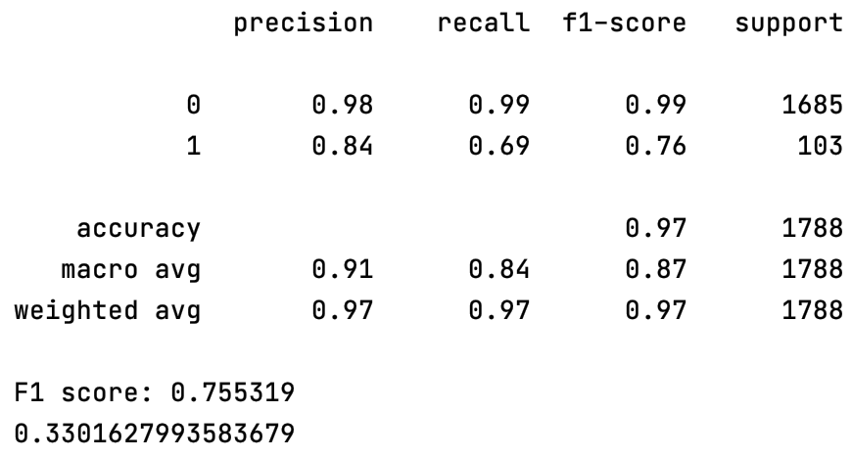
Model Training
PAC
Random
Grid
Matching statistics for PAC.
Random is chosen due to the lower runtime.

Slide 6
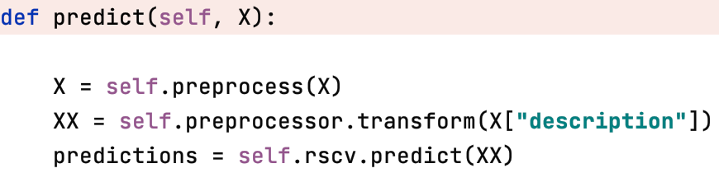
Prediction
Perform the same preprocessing steps on the test data.
Perform TF-IDF Vectorization on the test data.
Used Random Search CV’s predict method for the cleaned test data.

Slide 7
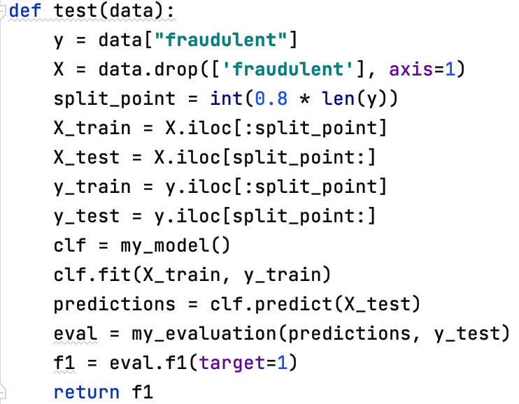
Model Evaluation
F1 score: 0.755319
Runtime: 0.240 mins

Slide 8
The End.
Questions? : E-Mail to sb1501@rit.edu
Thank you! :)

