Slide 1
KEYLOGGER
CYBER SECURITY PROJECT
Presented By:
SUDHARSUN S- Jeppiaar Institute of Technology – B.E/ CSE

Slide 2
OUTLINE
Problem Statement
Proposed System/Solution
System Development Approach
Algorithm & Deployment
Result
Conclusion
Future Scope
References

Slide 3
PROBLEM STATEMENT
The growing dependence on digital communication and online interactions has intensified worries about data security and privacy. Yet, both individuals and organizations encounter hurdles in overseeing and safeguarding sensitive information shared via digital platforms. Among these challenges is the difficulty in efficiently tracking user activity and identifying potential security risks, including unauthorized access or data breaches.

Slide 4
PROPOSED SOLUTION
Our proposed system involves creating a keylogger utilizing Python's Tkinter library for the GUI and the pynput library for capturing keyboard inputs. This keylogger records keystrokes and stores them in both text and JSON formats to facilitate thorough analysis.

Slide 5
SYSTEM APPROACH
Technology Used:
Python: For programming the keylogger functionality.
Tkinter: For building the graphical user interface (GUI).
pynput: For capturing keyboard inputs.
JSON: For storing keystroke data in a structured format.

Slide 6
ALGORITHM & DEPLOYMENT
Initialization: Initialize necessary variables and flags.
Event Handling:
on_press(key): Records pressed and held keys.
on_release(key): Records released keys and manages flag state.
Logging:
generate_text_log(key): Saves keystrokes in a text file.
generate_json_file(keys_used): Saves keystrokes in a JSON file.
Keylogger Control:
start_keylogger(): Initiates keylogging process.
stop_keylogger(): Stops keylogging.

Slide 7
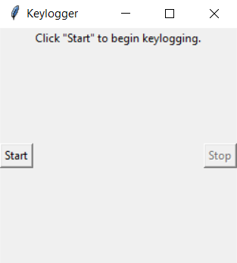
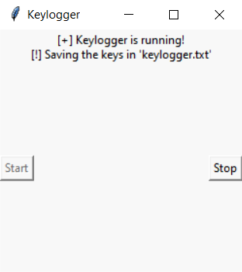
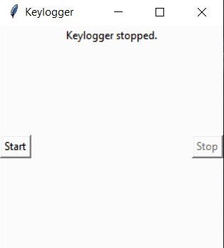
RESULT
The GUI presents "Start" and "Stop" buttons to control the keylogging process. Upon starting, the keylogger captures keystrokes and saves them in designated files. Stopping the keylogger halts the logging process.

Slide 8
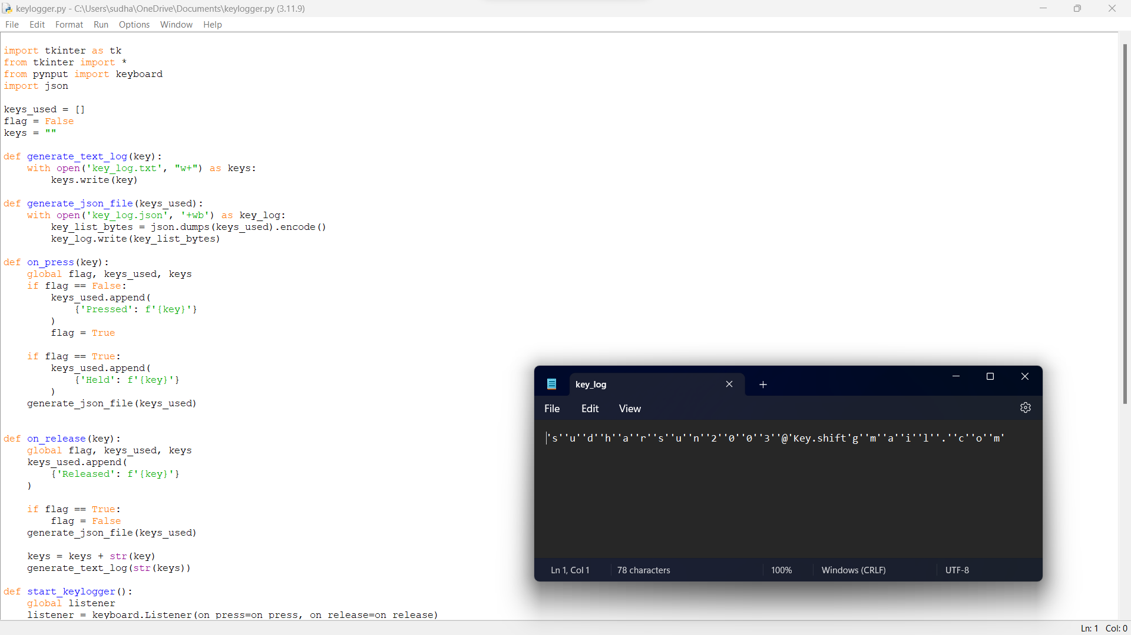
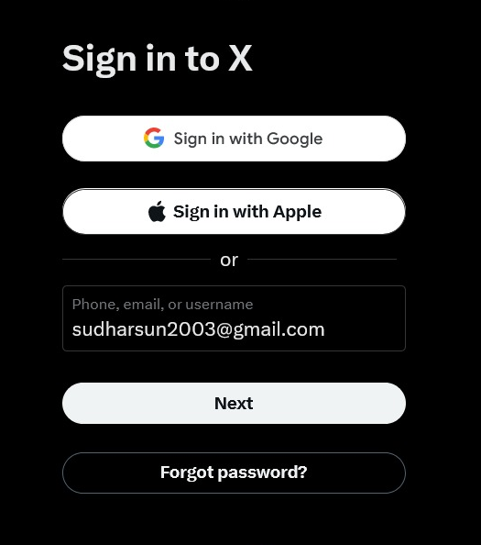
OUTPUT

Slide 9
CONCLUSION
Implementing a keylogger highlights the ease of capturing keyboard inputs and underscores the importance of robust security measures to prevent unauthorized access to sensitive information. Understanding keylogging techniques aids in fortifying systems against potential threats.

Slide 10
FUTURE SCOPE
Advanced Security Features: Future iterations of keyloggers are likely to integrate enhanced encryption and security measures to safeguard captured data. This might entail deploying robust encryption algorithms and secure communication protocols to thwart unauthorized access to logged keystrokes.
Innovative Utilizations: Beyond traditional user activity monitoring, keyloggers could find innovative applications in fields such as behavior analysis, user experience enhancement, and cybersecurity threat identification.
Advanced Logging Capabilities: Enhance logging functionalities by incorporating features like timestamping and window tracking for more comprehensive data collection and analysis.

Slide 11
REFERENCES
A Survey on Keylogger and its Detection Techniques by Vishal Bharti, Aditya Kumar Gupta, and Shailendra Mishra https://www.ijcaonline.org/archives/volume75/number5/12835-1514
Analysis of Keylogger Attacks and Countermeasures by Hongliang Liu, Ruiying Du, and Quansheng Zhuang https://www.semanticscholar.org/paper/Analysis-of-Keylogger-Attacks-and-Countermeasures-Liu-Du/54c7255bace229c82e4a5fd812ba8dd8829180c1
Detection of Keyloggers: A Review by Shukor Abd Razak, Ku Ruhana Ku-Mahamud, and Ramlan Mahmod https://www.researchgate.net/publication/220955239_Detection_of_Keyloggers_A_Review
A Comprehensive Study on Keylogger Attack and Defense by Shuo Chen, Rui Wang, XiaoFeng Wang, and Kehuan Zhang https://www.usenix.org/legacy/events/sec11/tech/full_papers/Chen.pdf

Slide 12
THANK YOU

