Slide 1
Internet of Things Essentials (CS19P11)
SMART DUSTBIN
TEAM MEMBERS:
SUBBALAKSHMI N (210701263)
SUDHASHREE M (210701268)
SWETHA P (21070177)

Slide 2
AGENDA
ABSTRACT
INTRODUCTION
OBJECTIVE
LITERATURE SURVEY
KEY CHALLENGES
MOTIVATION
EXISTING SYSTEM
PROPOSED SYSTEM VII.MODULES
SYSTEM ARCHITECTURE
CONCLUSION AND FUTURE ENHANCEMENTS
REFERENCES

Slide 3
ABSTRACT
In the era of rapid urbanization and increasing environmental concerns, efficient waste management systems are essential for sustainable development. Traditional waste management methods often suffer from inefficiencies, leading to environmental pollution and resource wastage. To address these challenges, the Smart Dustbin project proposes an innovative IoT-enabled waste management solution.
The Smart Dustbin integrates Internet of Things (IoT) technology with traditional waste bins to create a connected and intelligent waste management system. Each dustbin is equipped with sensors to detect the level of waste accumulation in real-time. These sensors transmit data to a centralized server using wireless communication protocols such as Wi-Fi. The centralized server employs advanced data analytics algorithms to process the incoming data and generate actionable insights.

Slide 4
INTRODUCTION
In the era of rapid urbanization and technological advancement, the Internet of Things (IoT) has emerged as a revolutionary paradigm, redefining the way we interact with our surroundings. One of the innovative applications of IoT technology is the development of smart dustbins, which offer an intelligent solution to waste management challenges in urban environments.
Smart dustbins leverage the power of IoT to enhance the efficiency and effectiveness of waste collection and disposal processes. These intelligent bins are equipped with various sensors and connectivity features, allowing them to communicate with central management systems and other connected devices in real-time. In this report, we delve into the design, functionality, and potential benefits of smart dustbins in the context of IoT-based waste management systems.

Slide 5
OBJECTIVE
To modernize waste management system.
To address challenges of urban waste management accumulation.
To optimize waste collection routes, minimize overflowing bins by integrating smart dustbin with IoT sensors..
To promote sustainable waste practices by proper disposal mechanisms.
To facilitate data-driven decision making for waste management authorities.
To create cleaner, healthier and more livable cities by mitigating environmental impact.

Slide 6
LITERATURE SURVEY
1. "Smart Garbage Monitoring System Using Internet of Things (IOT)“ published in the year 2021 explains how garbage system is integrated using IR sensor.
2. “A Review on Smart Dustbin" published in the year 2021 tells us why smart dustbins are required at most to promote sustainable development .
3. "Intelligent Garbage Monitoring System Using IoT“. This paper discusses the design and implementation of an intelligent garbage monitoring system utilizing IoT technologies. It covers aspects such as sensor integration, data communication, and real-time monitoring for efficient waste management.literature proposed that the dust collection was the major inference in the model.

Slide 7
4. "Smart Waste Management System with IoT Enabled Garbage Bins”.This paper presents a smart waste management system utilizing IoT-enabled garbage bins. It discusses the integration of sensors, wireless communication technologies, and cloud-based data analytics for efficient waste collection and management.
5. "Smart Dustbin: A Review of Smart Waste Management Systems".This paper provides a comprehensive review of various smart waste management systems, with a focus on smart dustbins. It discusses different technological approaches, challenges, and potential solutions in the field of waste management.

Slide 8
KEY CHALLENGES
Accuracy of sensor.
Power life of battery.
Data transmission and connectivity.
Environmental factors.
Integration with existing system.

Slide 9
MOTIVATION
The motivation behind the Smart Dustbin IoT project is to revolutionize traditional waste management practices by harnessing the power of technology. By deploying intelligent sensors and connectivity, the project aims to optimize waste collection processes, reduce environmental pollution, and enhance public health and hygiene. Real-time monitoring and data-driven insights enable efficient resource allocation and promote sustainable urban development, fostering a cleaner and healthier living environment for communities.

Slide 10
EXISTING SYSTEM
The existing system for Smart Dustbin IoT projects typically relies on conventional waste management methods, which lack real-time monitoring and optimization capabilities. Manual waste collection schedules are often inefficient and prone to delays, leading to overflowing bins, environmental pollution, and increased operational costs. Moreover, limited data availability and insights hinder effective resource allocation and planning. Without IoT integration, the system lacks the ability to detect fill levels, track usage patterns, or provide timely alerts for maintenance. Overall, the existing system lacks the efficiency, scalability, and sustainability required for modern urban waste management needs.

Slide 11
PROPOSED SOLUTION
The automation of smart dustbin using Arduino UNO, Ultrasonic sensors, 9V battery with wireless Wi-Fi connection for easy and automatic disposal of wastes.
Advantages:
Efficient waste management.
Environmental sustainability.
Improved public health and hygiene.
Enhanced user experience.

Slide 12
MODULES AND COMPONENTS
Zinc Chloride 9V battery
Plastic dustbin (any size without lid)
UNO R3 SMD board compactible with Arduino
GG042 HC-SR04 Ultrasonic Module Distance measuring Transducer Sensor.
Micro Digital Servo Motor.
Jumper Wires for connection.

Slide 13
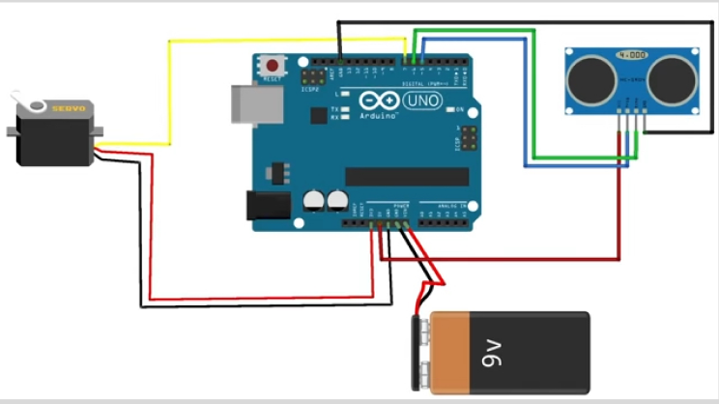
SYSTEM ARCHITECTURE

Slide 14
CONCLUSION
The Smart Dustbin IoT project represents a significant advancement in modern waste management systems. By integrating Internet of Things technology with traditional waste bins, the project addresses key challenges such as inefficient collection, overflowing bins, and environmental pollution. Through real-time monitoring of fill levels, optimization of collection routes, and data-driven decision-making, the Smart Dustbin system offers numerous benefits including cost savings, environmental sustainability, and improved operational efficiency. As cities continue to grow and face increasing waste management challenges, solutions like the Smart Dustbin project pave the way for smarter, more sustainable urban environments.

Slide 15
FUTURE ENHANCEMENTS
Advanced Analytics: Incorporating machine learning and artificial intelligence algorithms to analyze historical data and predict future waste generation patterns.
Sensor Technology: Researching and implementing advanced sensor technologies to improve the accuracy and reliability of fill-level detection.
Integration with Smart City Infrastructure: Integrating the Smart Dustbin system with other smart city initiatives, such as intelligent traffic management or environmental monitoring systems.
Waste Sorting and Recycling: Expanding the capabilities of Smart Dustbins to include waste sorting and recycling functionalities. This could involve integrating sensors and actuators to sort different types of waste automatically, thereby promoting recycling and reducing landfill waste.

Slide 16
REFERENCES
[1] "Smart Garbage Monitoring System Using Internet of Things (IOT)" - Nishchitha M., Pooja M., Rashmi M., Sushma S., and Rashmi K, 2021.
[2] "Design and Implementation of a Smart Garbage Monitoring System Using Arduino Uno“- Sameer Kumar Singh, Jitendra Kumar Singh, Alok Kumar, and Ajay Kumar Singh,2021.
[3] "A Review on Smart Dustbin”- Ayushi V. Chaure and Prof. S. P. Akarte,2021.
[4] "Intelligent Garbage Monitoring System Using IoT“- R. Hemalatha, S. J. Suganya, K. Praveen Kumar, and Dr. T. Ravi,2021.
[5] "Smart Waste Management System with IoT Enabled Garbage Bins“- S. R. Navaneethan, A. S. K. Priya, and Dr. S. Kiruthika,2020.

