Slide 1
TEXT SUMMARIZER USING NATURAL LANGUAGE PROCESSING (NLP)
TEAM MEMBERS:
SUBBALAKSHMI.N (210701263)
SUDHASHREE.M (210701268)
SWETHA.P (210701277)

Slide 2
ABSTRACT
Effective summarizing methods are essential in the legal arena due to the large volume of textual information, as it allows for rapid comprehension and analysis. Text Summarizer presented in this project uses a variety of NLP libraries and approaches to produce clear and insightful summaries of legal materials. The summarizer uses spaCy for strong tokenization and linguistic processing, and the stop_words package to filter out common but unimportant words.By eliminating unnecessary symbols from the text, the punctuation module improves the readability of the summaries. The summarizer's main function is to compute word_frequency, which determines a word's relevance in the text by using FrequencyCounter. To make sure that the most enlightening sentences are chosen for the summary, sentences are then graded according to the weighted frequency of important words they contain. While tkinter offers an easy-to-use graphical interface for text input and result presentation, the integration of pandas enables effective data manipulation and management. This project shows how to use natural language processing (NLP) to the task of summarizing literature. It also emphasizes how to combine various libraries and approaches to improve the accuracy and usability of automated summary tools.

Slide 3
INTRODUCTION
Introducing text summarizer, a complex text summarization tool specifically designed for complex data. This uses a variety of modern libraries and technology to provide brief and relevant summaries. We employ SpaCy, stop_words to filter out common terms, and punctuation aims to improve textual content evaluation. Word_Frequency from Frequency Counter are used to examine specific phrase frequencies, while sentence scoring algorithms help identify crucial statistics within files. Tkinter is used for user friendly interface. The tool's adaptability to various research demands is further enhanced by its opportunities for customization to different domains. To further enhance its use and functionality, This allows interface with pre-existing documents in addition to supporting a broad variety of document types. This project shows how to use natural language processing (NLP) to the task of summarizing literature. It also emphasizes how to combine various libraries and approaches to improve the accuracy and usability of automated summary tools.

Slide 4
Literature survey
“Literature Review of Automatic Single Document Text Summarization Using NLP “ explains that automatic text summarizing is needed for salient information retrieval from electronic texts.
“Text Summarization Using Natural Language Processing” presents how text summarization came into effect since manual summarizing became tough and also explains how it is intergrated using NLP with Python or R.
“NLP based Machine Learning Approaches for Text Summarization” explains the methods described in this paper produce Abstractive (ABS) or Extractive (EXT) summaries of text documents. Query-based summarization techniques are also discussed.

Slide 5
LITERATURE SURVEY
4. A Review: Abstractive Text Summarization Techniques using NLP explains that as data grows, the importance of semantic density does as well and conversion of lengthy texts into short and meaningful sentences is the main idea behind text summarization. To achieve this, various algorithms are present. Machine Learning models are trained, first to understand the given document and then create a summary of it. These models achieve this task either by extracting important words out of the document or by creating human-like sentences to form the summary.
5. A Gravitational Search Algorithm Study on Text Summarization Using NLP presents that text summarization is one technique that is frequently used in research to aid in the management of massive amounts of data. Automated summarization is a well-known technique for distilling the main points of a document.

Slide 6
Research gap
Traditional libraries and methods such as stop_words for removing common words, and tokenization for breaking down text. However, there is a need for more research into how these traditional techniques can be effectively integrated with modern ML models to improve summarization quality.
Tools like spaCy offer comprehensive NLP capabilities including tokenization. However, the impact of fine-tuning these preprocessing steps on the performance of text summarization models remains underexplored. Research is needed to optimize preprocessing steps to enhance the input quality for summarization models.
Punctuation and special characters can significantly affect the structure and meaning of text. There is a gap in research focused on sophisticated handling of punctuation and special characters, ensuring they contribute meaningfully to the summarization process.
The heapq module, which provides an efficient way to manage priority queues. However, there is limited research on optimizing heap-based approaches for real-time or large-scale text summarization tasks, where computational efficiency is critical.
tkinter is a library used for creating graphical user interfaces. There is a need for more research on how to best present summarization outputs to users, especially non-technical users, and how interactive features can enhance user experience and control over the summarization process.

Slide 7
PROPOSED METHODODLOGY
DATA COLLECTION: The initial step is to collect the enormous volume of data that is cut short into precise information. It is then fed to the text extraction part. Full stop is used to indicate the end of a sentence.
TEXT EXTRACTION: The next step is text extraction in which keywords are extracted using naive bayes and SVM(Support Vector Machine). Keywords extraction is important because they help in providing better comprehension.
DATA PREPROCESSING: The next step is data preprocessing in which the data collected is processed using Tokenization stop_words, punctuation and normalization libraries of NLP(Natural Language Processing). This part takes care of punctuation (Punctuation, end of one sentence(stop_wotrds)(, breaking down of text into smaller text.
PARTS OF SPEECH (POS): The next step is parts of Speech (POS). This past is used to retain important information and leaves out unwanted information that leads to confusion.

Slide 8
PROPOSED METHODODLGY
FREQUENCY CALACULATION: This is the next step that includes calculating frequency of key terms, weights of terms. At the end of the summary the total of words is also mentioned. This is done by FrequencyCounter library.
SCORING SENTENCE: The next step is scoring sentences that involves calculating frequency of terms in each sentence so as to check the importance of the terms in a text. Scoring sentence part also facilitates important terms filtering, priority of sentence and quality of summary that is provided as output.
SUMMARIZATION: This the next step in text summarization project where the information from original text are condensed, key terms are extracted and retained, readability of the text is improved so that the summary provides improved comprehension so as to reduce confusion, decision is made between words that are important and words that are less important and whom to retrain and whom to leave out.
SUMMARY: This is the last step of our project where the data collection, text extraction, data preprocessing, parts of speech, frequency calculation, scoring sentence, and summarization steps are combined along with GUI(Graphical User Interface) to provide the output that is a summary of original text.

Slide 9
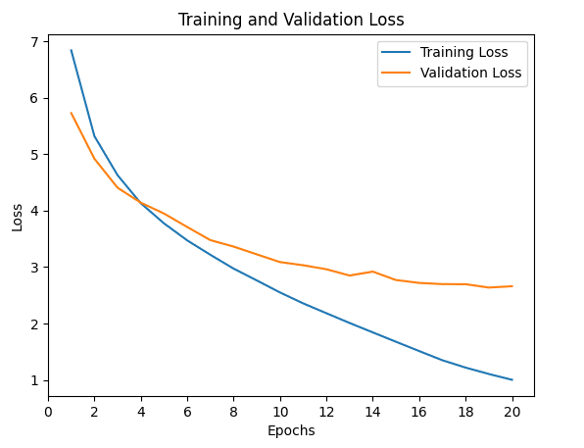
PROPOSED METHODODLGY

Slide 10
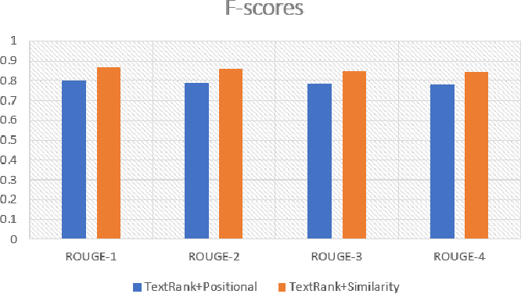
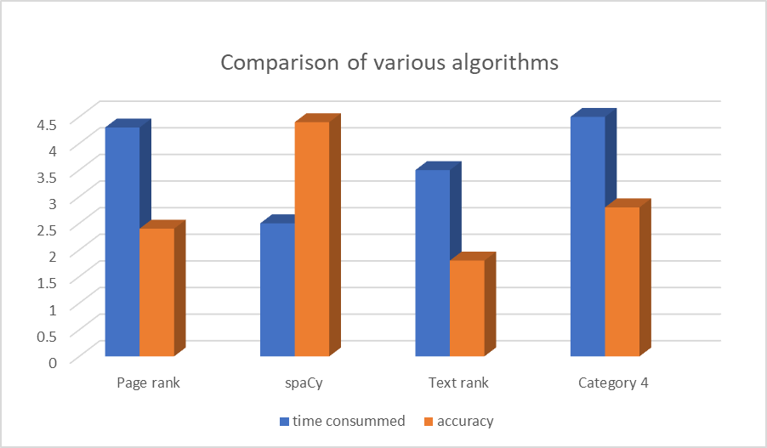
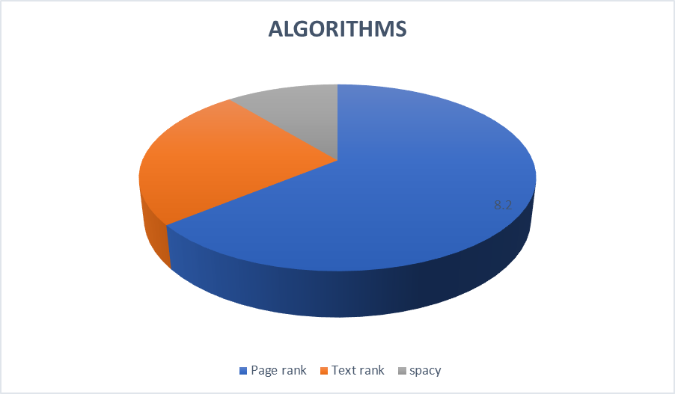
RESULTS AND DISCUSSION
Textrank+positional rank gives us the frequency of the words that were detected by spaCy. Whereas Textrank+similarity gives us the similarity of the text that were found in the model of the text. The similar words in the text are found and analyzed.
The above graph shows us the comparison of various algorithms especially page rank, text rank and spaCy. The graph depicts us that the time consumed is more in page rank compared to text rank and SpaCy. Whereas the time consumed in spaCy is less compared to pagerank and textrank. The accuracy level of spaCy is higher compared to other algorithms both the text rank and page rank algorithms.
The above figure describes the algorithms that are in usage till now. Pagerank and text rank algorithms are widely in use. In future the demand for spacy will increase for text summarization depending upon the needs.

Slide 11
RESULTS AND DISCUSSION
Text summarizer helps in summarizing the content of the text from any sources such as article, newspaper, journal, researc paper, books using extractive summarization technique. The Extraction summarization technique is used for extracting the words from various resources such as books, etc and the sentences in the resources are tokenized and are assigned weights. Based upon the weights assigned to them the frequency is calculated, for each word in the sentence. The frequency is allotted based on the number of times the word appears on the text. Finally by using Parts of Speech (POS) and Sentence scoring the summarized text is displayed in the GUI. Parts of Speech helps in reducing the noise, helps in removing the unwanted words from the sentence thereby helps in shortening of the text. Sentence scoring is done after Parts of speech [POS] which helps in assigning scores for the sentences of the text. Thus the summarized text is displayed.

Slide 12
Comparative analysis
The below graph shows us the comparison of various algorithms especially page rank, text rank and spaCy. The graph depicts us that the time consumed is more in page rank compared to text rank and SpaCy. Whereas the time consumed in spaCy is less compared to pagerank and textrank. The accuracy level of spaCy is higher compared to other algorithms both the text rank and page rank algorithms.

Slide 13
CONCLUSION AND FUTURE WORK
Thus our solution aims at providing a summary of enormous volumes of text that gives better comprehension of text that is easy to read and does not confuse people. This is very useful in this world as people are busy in their jobs and they have little time to spare. To all these people this project is a one time solution that provides crisp information. The goal of this project is to cut short massive text and to provide a glimpse of text that is given as input so as to improve understanding along with saving time and improving user satisfaction. Further the project can be adopted in various fields such as in education, law, etc. Those people who find it difficult to read large content of text, generally the common public people who at times feel very lethargic to read large content of the text can use this tool to read large text in less time. Thereby text summarizer is useful and is adopted in various domains.
FUTURE WORK:
The future scope of Text summarizer is it can be adopted with videos such as youtube, netflix, entertainment videos such as OTT channel videos can be uploaded and the text can be summarized. Especially for those people who feel very lazy to watch the full video or people who need to know the climax of a video soon can use the extension of Text Summarizer.

Slide 14
references
[1] Literature Review of Automatic Single Document Text Summarization Using NLP - Md. Majharul Haque, Suraiya Pervin, and Zerina Begum, International Journal of Innovation and Applied Studies, 2013.
[2] Text Summarization Using Natural Language Processing- Kota Prudhvi, A. Bharath Chowdary, P. Subba Rami Reddy & P. Lakshmi Prasanna, Intelligent Design System, 2020.
[3] NLP based Machine Learning Approaches for Text Summarization-Rahul, Surabhi Adhikari, Monika- IEEE, 2020 (4th Conference)
[4] A Review: Abstractive Text Summarization Techniques using NLP-Pooja Batra, Sarika Chaudhary, Kavya Bhatt, Saloni Varshney, Srashti Verma-IEEE, 2020 (1st Conference)
[5] A Gravitational Search Algorithm Study on Text Summarization Using NLP-Chatti Subbalakshmi, Piyush Kumar Pareek & M. V. Narayana- 1st International Conference KAIDS, 2021.

Slide 15
THANK YOU!

