Slide 1
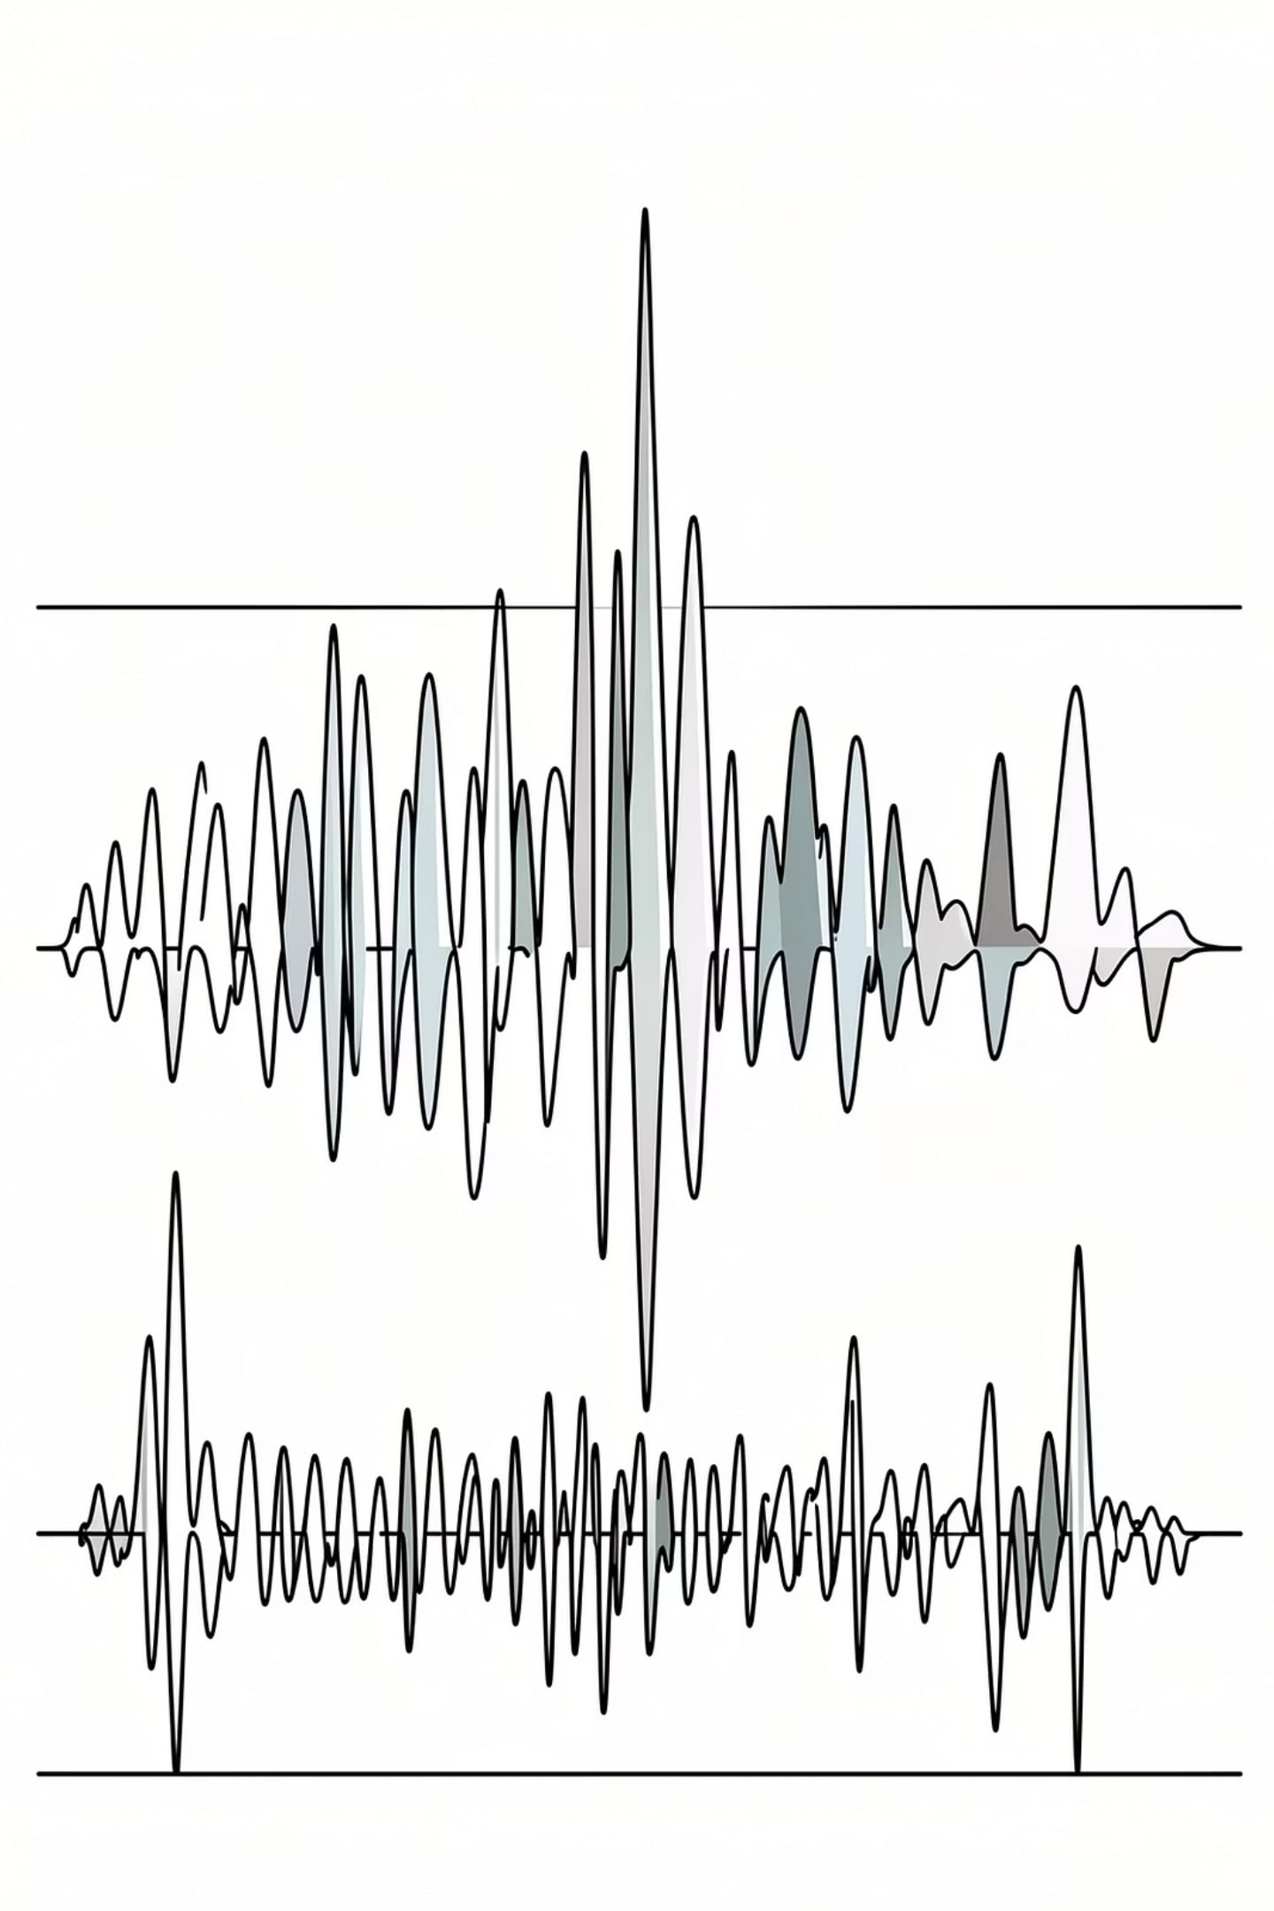
AURACAST AUDIO CLASSIFICATION AND CONTENT MODERATION
Presented by: Sudheendra Thatikonda
Internship / project domain

Slide 2
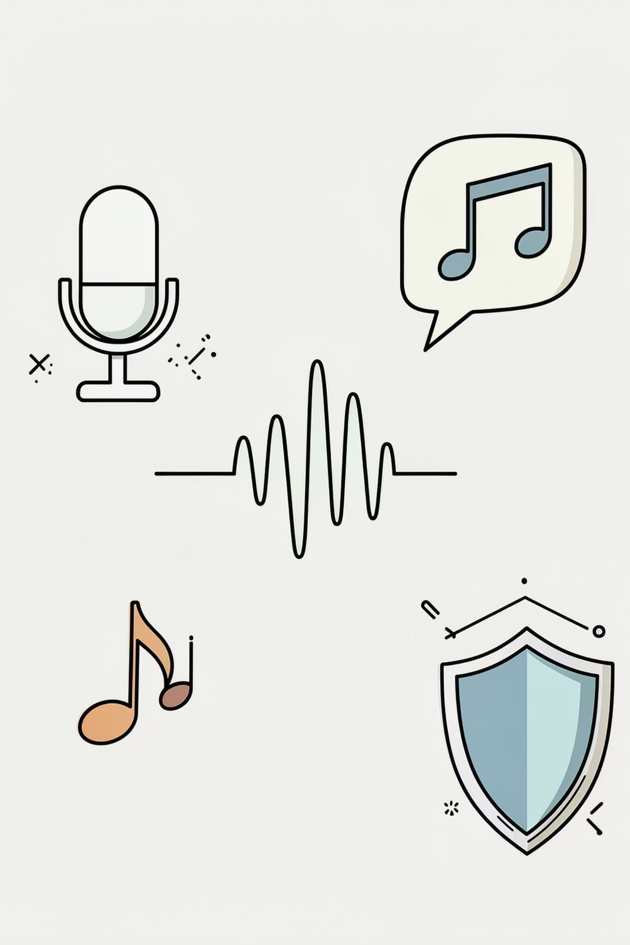


PROBLEM STATEMENT
Audio broadcasts are continuous and difficult to interpret manually.
A single audio stream may contain music, speech, noise, or mixed content.
Some speech content may also include inappropriate language.
An automated system is needed to classify audio and generate metadata.

Slide 3




PROJECT OBJECTIVE
AUDIO CLASSIFICATION
LANGUAGE DETECTION
Classify audio into music, speech, and noise.
Detect the language of speech content.
PROFANITY DETECTION
METADATA DISPLAY
Provide optional profanity detection.
Display the final metadata clearly in the application.

Slide 4
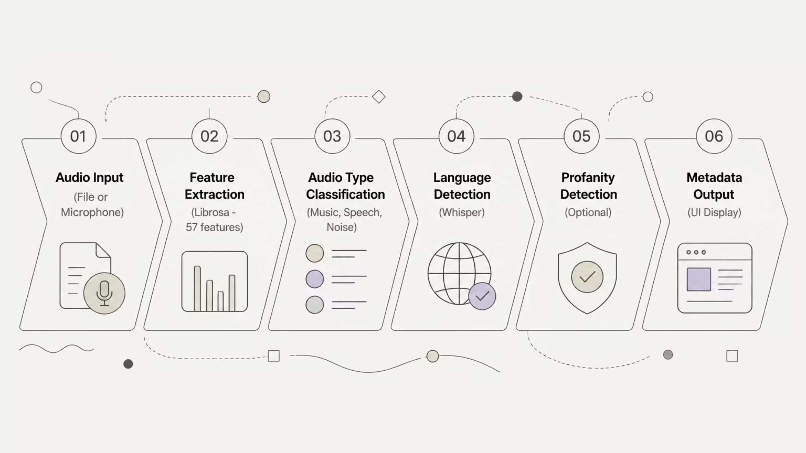
OVERALL WORKFLOW

Slide 5
OVERALL WORKFLOW
01
02
AUDIO INPUT
FEATURE EXTRACTION
Audio is taken as input from a file or microphone prototype.
Audio features are extracted from the signal.
03
04
AUDIO TYPE CLASSIFICATION
LANGUAGE DETECTION
The first model classifies the audio type.
Speech content is passed to language detection.
05
06
PROFANITY DETECTION
METADATA OUTPUT
Profanity detection is applied optionally.
The final output is shown in the UI as metadata.

Slide 6
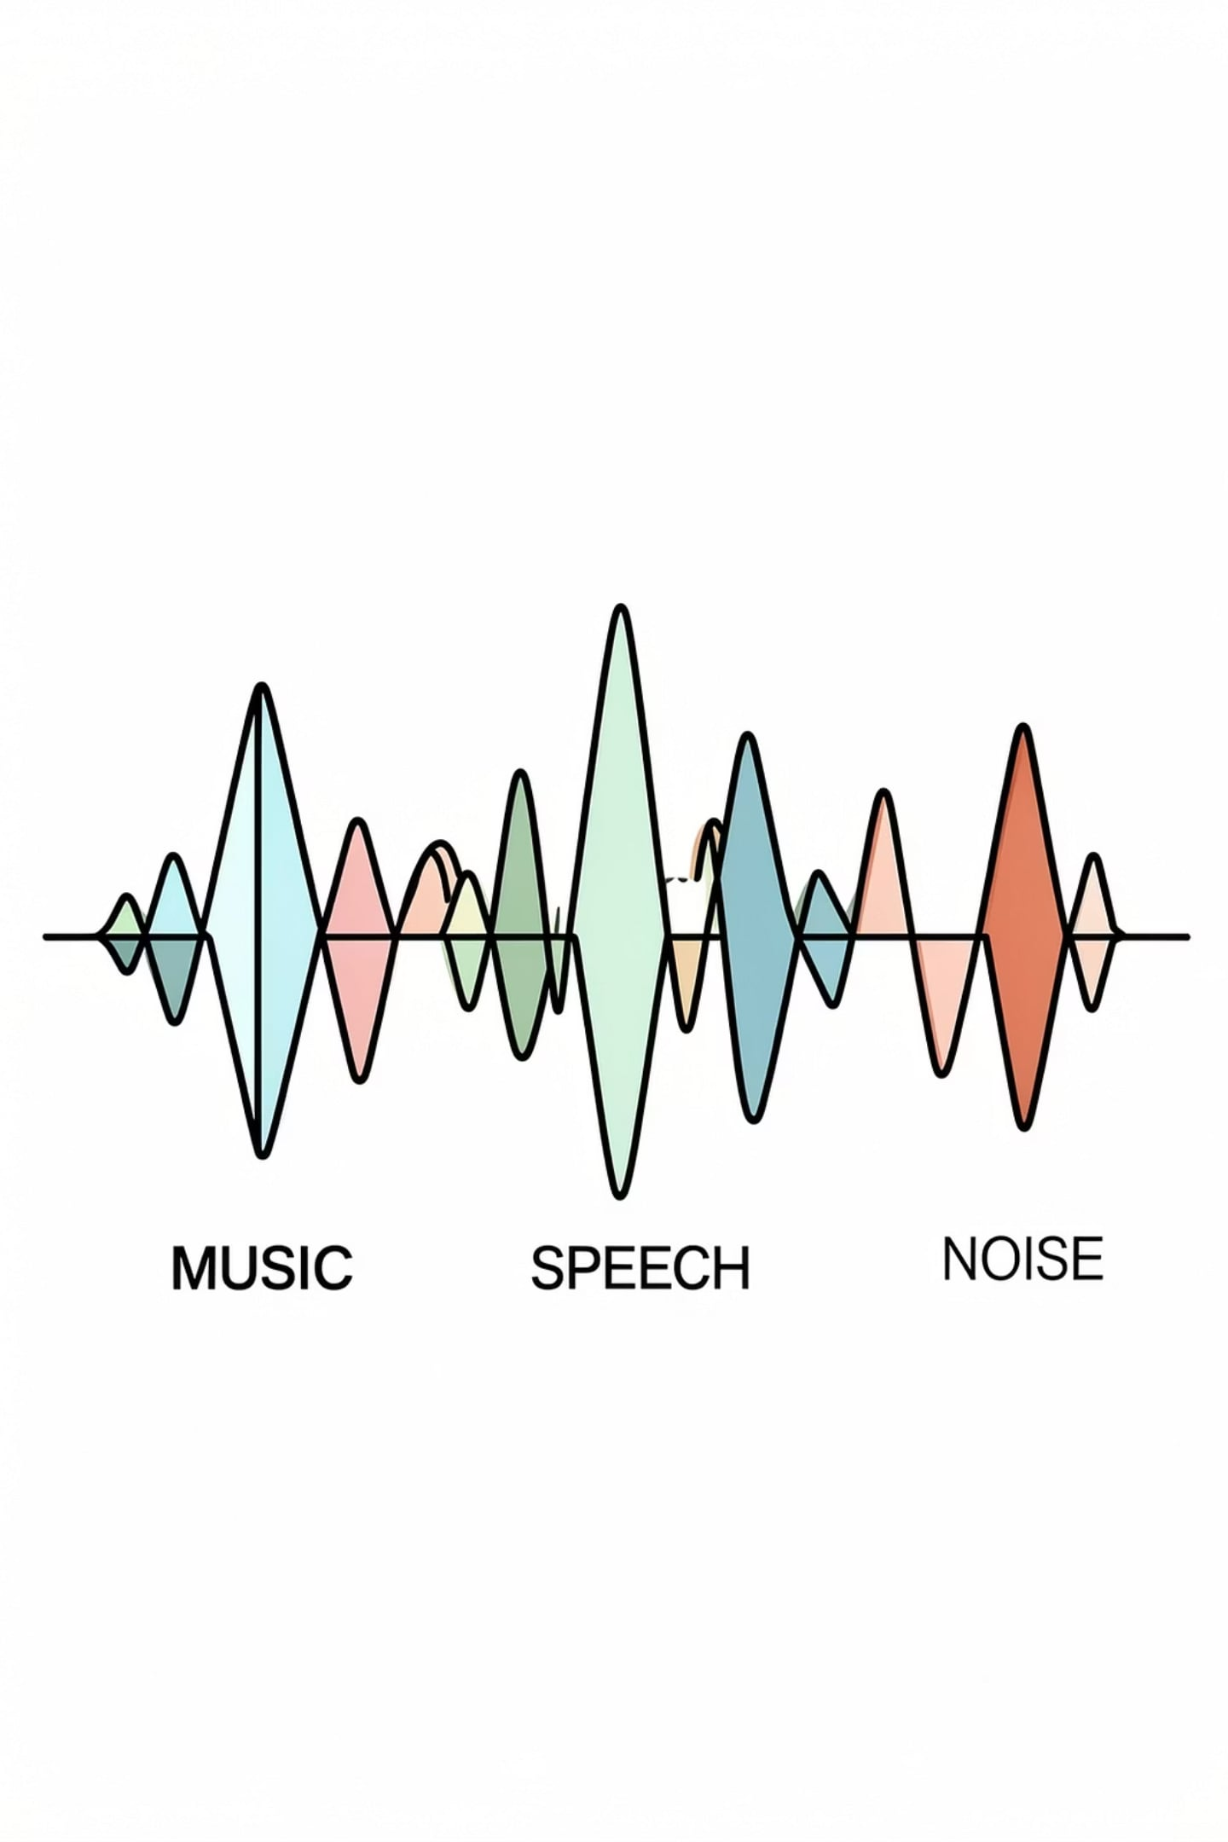
AUDIO TYPE CLASSIFICATION
FIRST STAGE OF THE PIPELINE
This is the first stage of the pipeline.
GOAL
The goal is to identify whether the sample is music, speech, or noise.
SEPARATION
It helps separate broad audio categories before further processing.
EFFICIENCY
It improves the accuracy and efficiency of the next stages.

Slide 7
DATASET USED
MUSAN DATASET
WHY IT WAS CHOSEN
The MUSAN dataset was used for audio type classification.
It contains samples of music, speech, and noise.
It provided a strong baseline dataset for model training.
It was useful for testing different machine learning models.

Slide 8

MODEL COMPARISON
Multiple models were tested for audio type classification. The models evaluated included:
XGBOOST
RANDOM FOREST
EXTRA TREES
SVM
Among these, SVM gave the best performance on the tested data. Therefore, SVM was selected as the final model.

Slide 9
FEATURE EXTRACTION
Raw audio was converted into numerical features using Librosa. A total of 57 feature columns were extracted for each audio sample. The extracted features were:
20 MFCC mean features
20 MFCC standard deviation features
12 Chroma STFT mean features
1 Spectral Centroid
1 Spectral Bandwidth
1 Spectral Rolloff
1 Zero Crossing Rate
1 RMS Energy
These features capture spectral, frequency, and energy information. They help the model distinguish between speech, music, and noise.

Slide 10
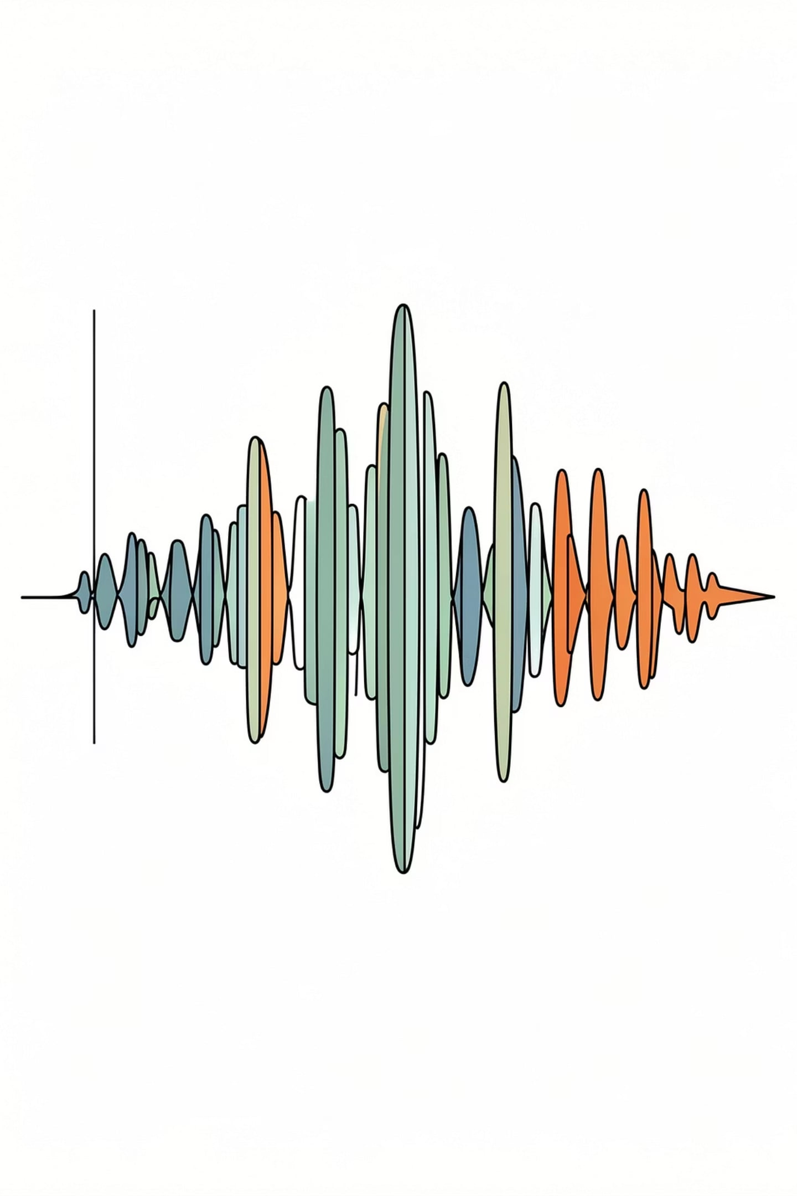




WHY THESE FEATURES MATTER
MFCC
MFCC captures the timbral structure of audio.
CHROMA FEATURES
Chroma features help represent harmonic content.
SPECTRAL FEATURES
Spectral features capture frequency spread and shape.
ZCR & RMS
Zero Crossing Rate and RMS help represent signal intensity and texture.
Together, these features form a strong input for classical ML models.

Slide 11
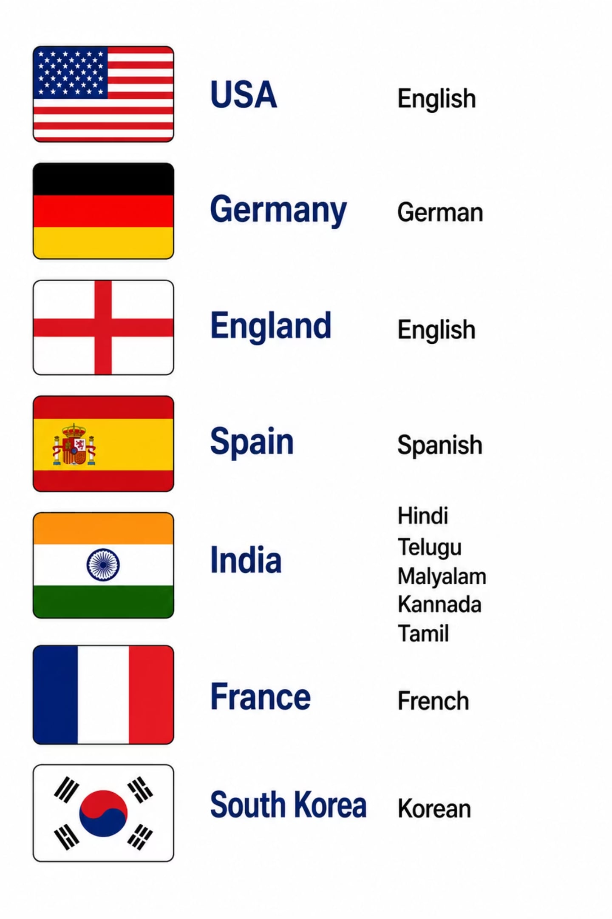

LANGUAGE DETECTION
After audio type classification, speech is passed to language detection.
1
Whisper was used for transcription and language identification.
2
This adds another level of metadata to the analysis pipeline.
3
It makes the system useful for multilingual speech content.
4

Slide 12
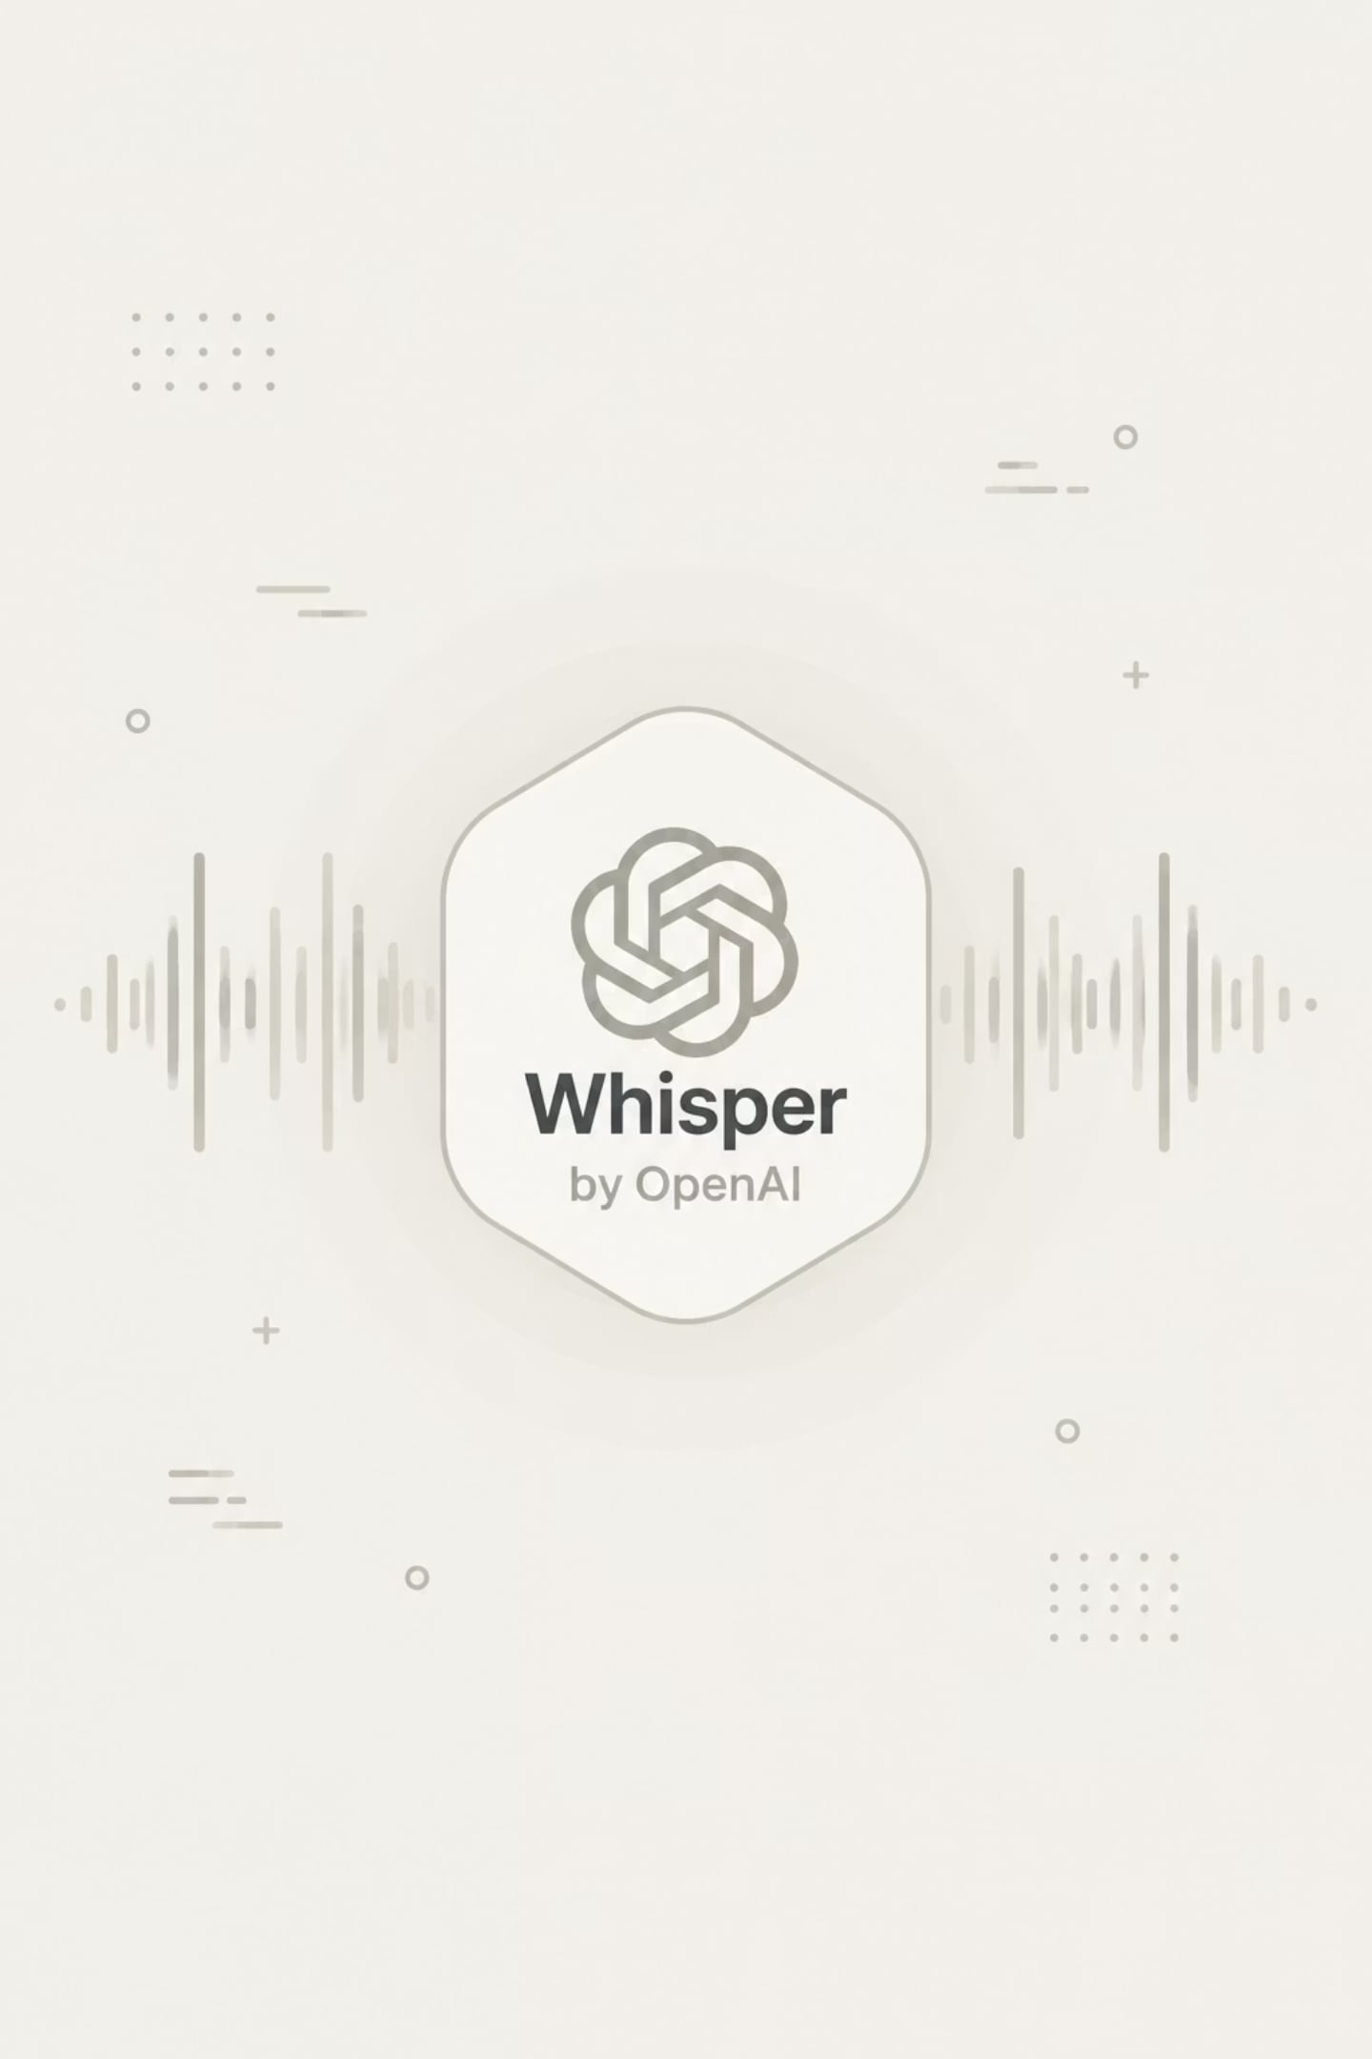
WHY WHISPER WAS CHOSEN
A custom language model was not selected at this stage.
The available language data was not diverse enough.
Accent variation and voice modulation were not sufficiently covered.
This caused incorrect predictions between closely related languages.
Confusion was seen in cases such as English, French, German, and some South Indian languages.
Whisper was chosen because it provides a more reliable baseline until better labeled data is available.

Slide 13
LANGUAGES CONSIDERED
ENGLISH
FRENCH
GERMAN
HINDI
KANNADA
KOREAN
MALAYALAM
SPANISH
TAMIL
TELUGU

Slide 14
OPTIONAL PROFANITY DETECTION
HOW IT WORKS
WHY IT MATTERS
Profanity detection is available as an optional feature.
It is enabled through a button in the application.
This keeps the feature flexible instead of forcing it on every sample.
It is useful when moderation is required.

Slide 15

Profanity Model Used
Model Name
The model used in the code is unitary/multilingual-toxic-xlm-roberta.
Type
It is an open-source multilingual toxicity detection model.
How It Works
It works on text after transcription.
Purpose
It helps detect toxic or inappropriate language in speech.

Slide 16
PROFANITY DETECTION FLOW
Audio is first transcribed into text
The text is translated when required
The translated text is analyzed for profanity
The moderation result is then returned to the app
This makes the moderation step language-aware

Slide 17
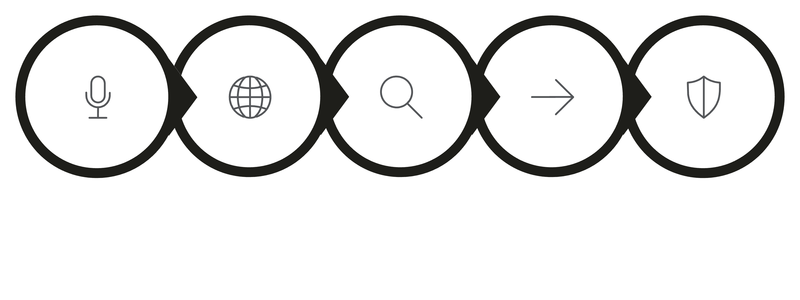
PROFANITY DETECTION FLOW
LANGUAGE AWARE
TRANSCRIBE
TRANSLATE
ANALYZE
RESULT
THIS MAKES THE MODERATION STEP LANGUAGE-AWARE.

Slide 18

APPLICATION PAGES
HOME
LIVE
HISTORY
The app includes a Home page for file upload and analysis.
It includes a Live page for microphone-based prototype testing.
It includes a History page to view past results.
ANALYTICS
SETTINGS & ABOUT
It includes an Analytics page for summary statistics.
It includes a Settings page and an About page.

Slide 19
HOME PAGE
Landing page of the application.
Users can upload an audio file for analysis.
Provides a Profanity Detection toggle before uploading.
If enabled, the uploaded audio is also checked for profanity.
If disabled, the analysis skips the profanity detection stage.

Slide 20
RESULT PAGE
Displays the predicted Audio Type (Music, Speech, or Noise).
Shows the detected Language.
Displays Profanity Detection Status (Enabled/Disabled).
If profanity detection is enabled, the result also indicates whether inappropriate content was detected.
Presents all extracted metadata in a clear and organized format.

Slide 21
LIVE PAGE
Used for testing microphone-based audio capture.
Captures audio in small packets.
Sends packets through the existing processing pipeline.
Developed as a prototype for validating packet-based processing.
Serves as the foundation for future Auracast integration.

Slide 22
HISTORY PAGE
Stores previous analysis results.
Displays audio type, detected language, and timestamp.
Shows profanity detection results if that option was enabled during analysis.
Allows users to revisit earlier analyses without reprocessing files.

Slide 23
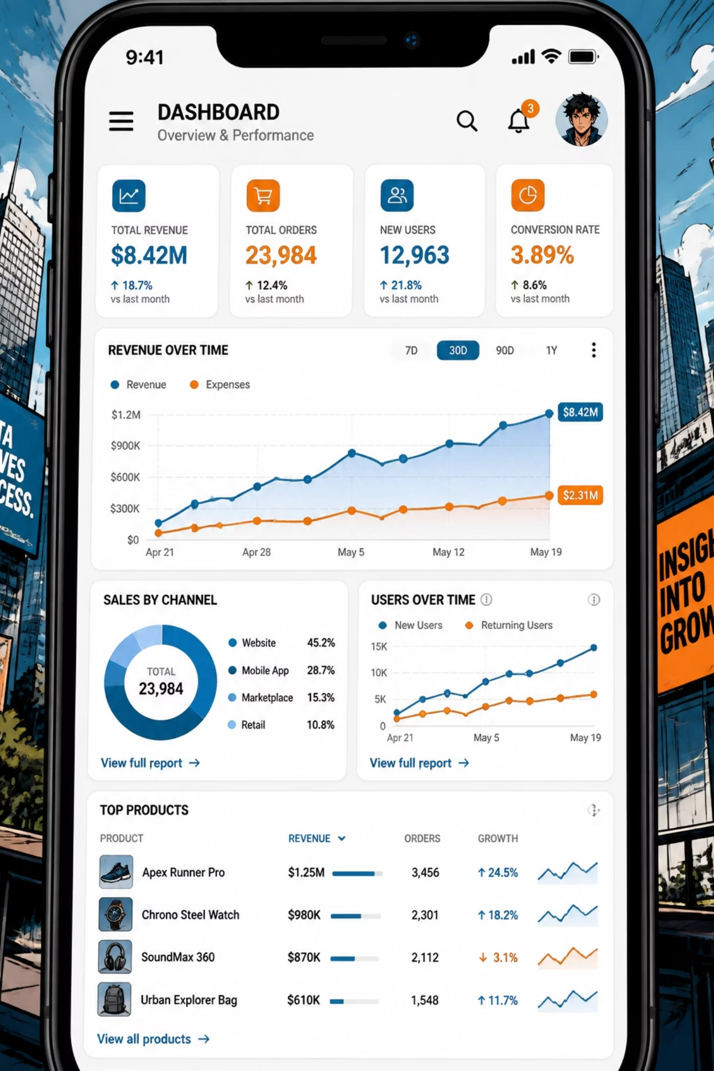
ANALYTICS PAGE
Displays summary statistics of analyzed files.
Shows distribution of Music, Speech, and Noise classifications.
Displays language-wise analysis statistics.
Provides an overview of historical analysis data.

Slide 24
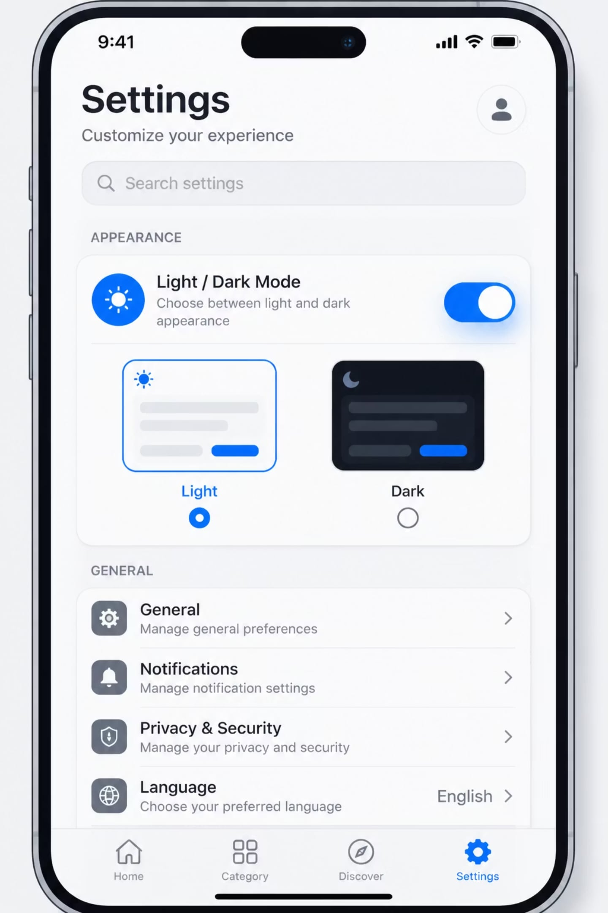
SETTINGS PAGE
Allows switching between Light and Dark themes.
Provides application customization options.
Includes options related to stored analysis data.
Improves overall user experience.

Slide 25
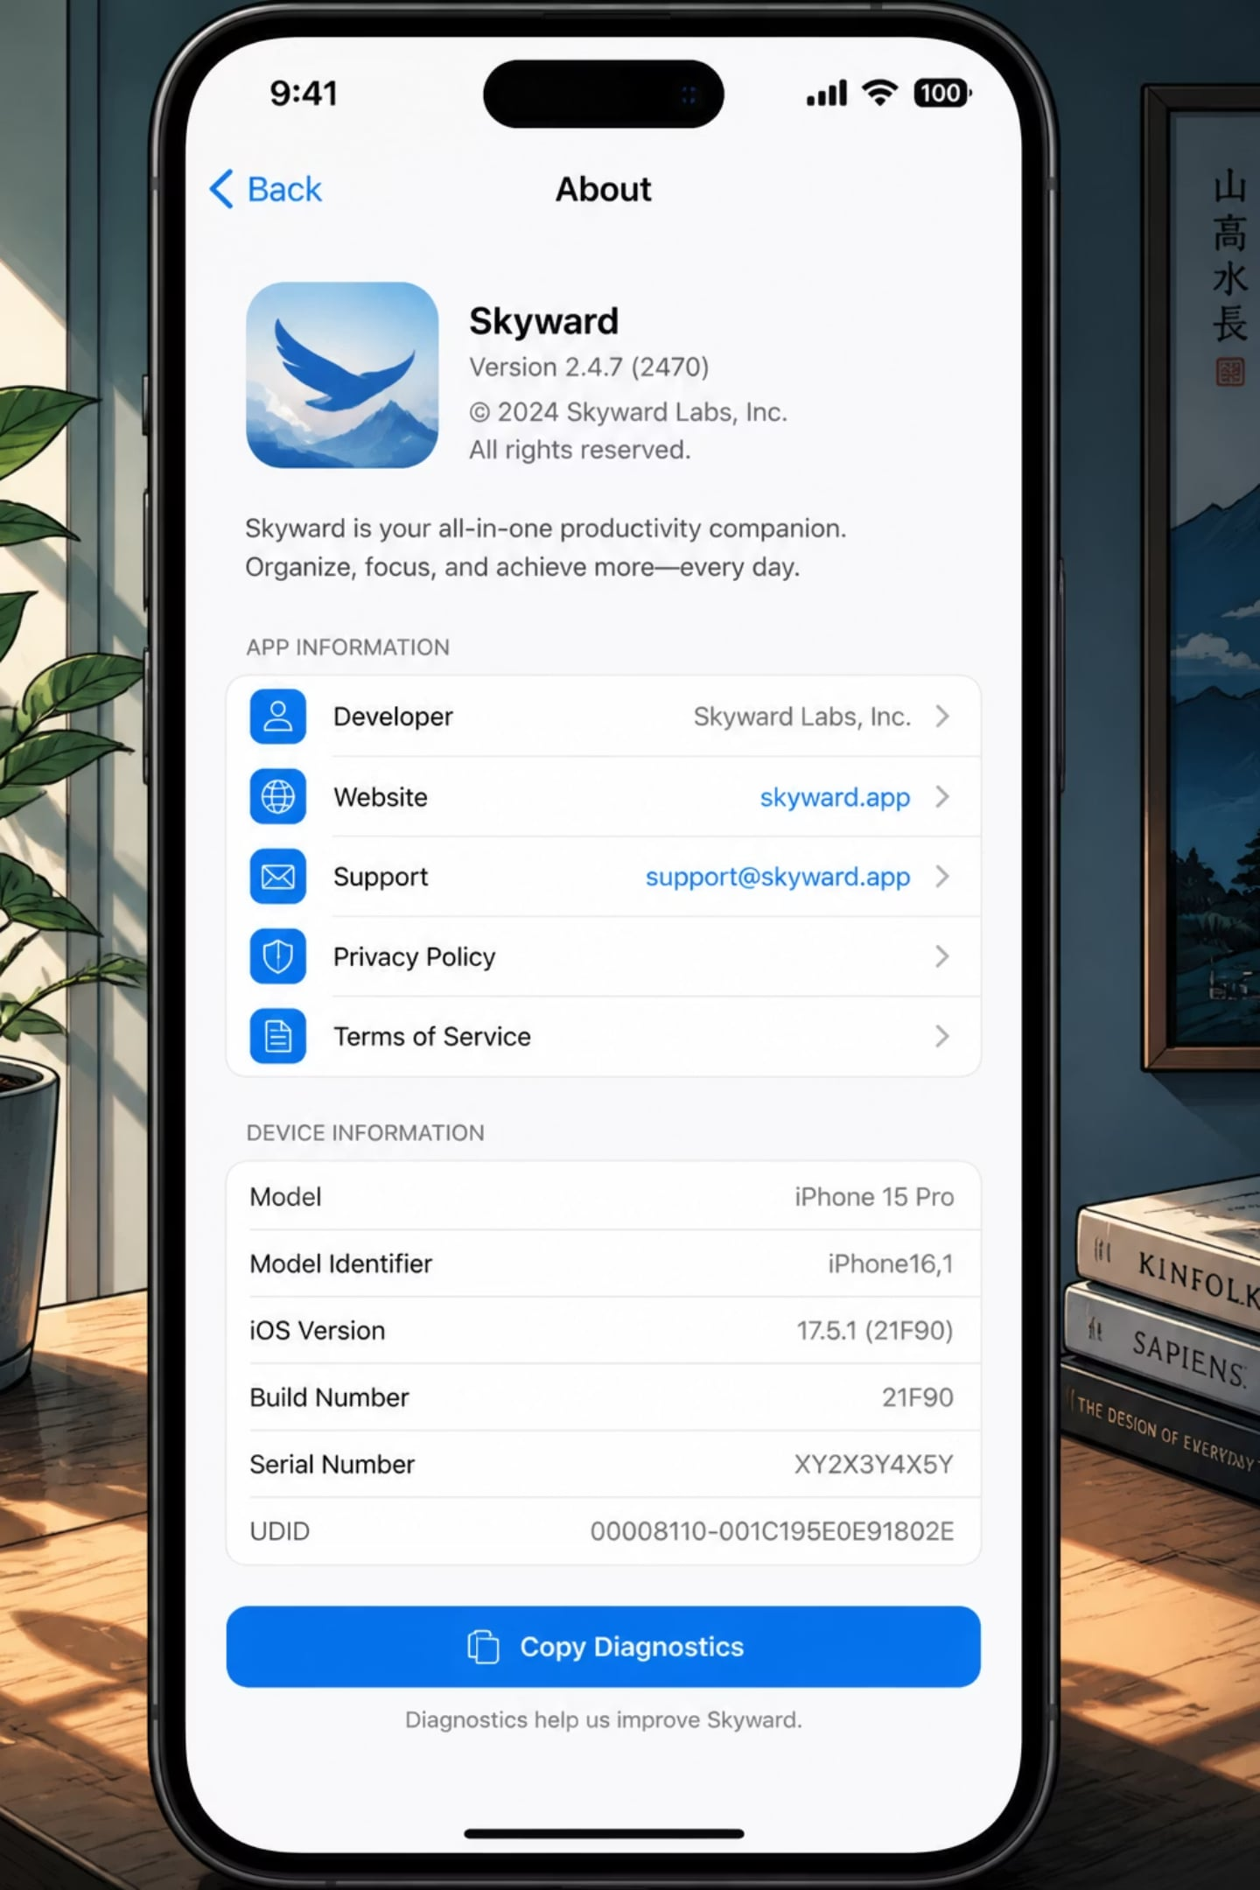
ABOUT PAGE
Provides information about the project.
Lists the machine learning models used.
Displays supported languages and application version.
Gives a brief overview of the application's functionality.

Slide 26
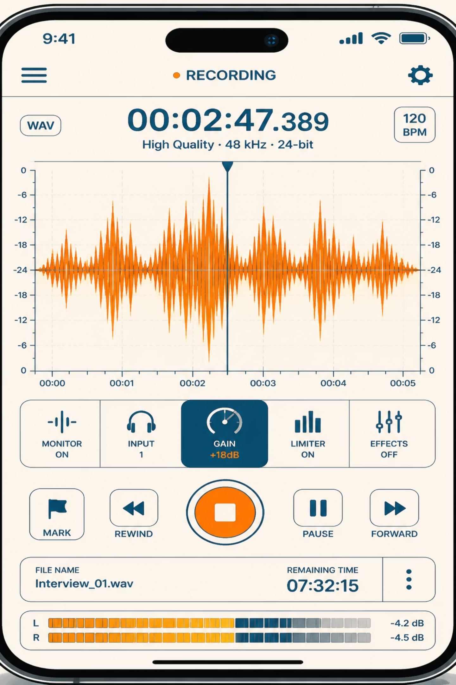
PROTOTYPE FOR MICROPHONE INPUT
A microphone-based prototype was created for packet-level testing.
The audio is captured in chunks and passed through the pipeline.
This was used to validate the processing logic.
It is best presented as a prototype, not as a fully deployed live streaming system.

Slide 27

CURRENT LIMITATIONS
The language dataset was not diverse enough.
Accent variation and voice modulation were not covered sufficiently.
This caused confusion between some closely related languages.
Packet-based processing also adds delay because transcription and translation take time.

Slide 28
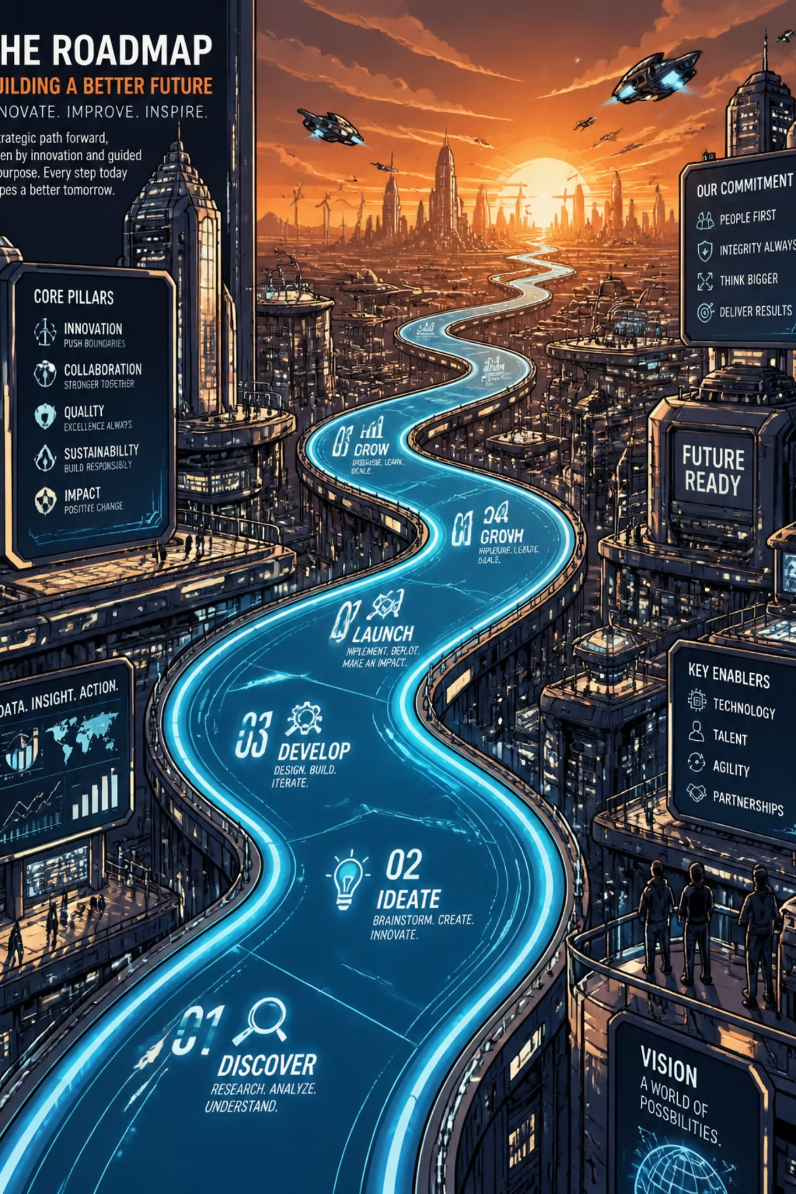
FUTURE IMPROVEMENTS
Collect more diverse labeled language data.
Improve robustness across accents and speaking styles.
Train a dedicated audio-based profanity detection model.
Reduce dependence on transcription for moderation.
Improve latency and make the pipeline more efficient.

Slide 29

MICROPHONE-BASED PROCESSING PIPELINE
OBJECTIVE
Developed a microphone-based processing pipeline to validate the end-to-end audio analysis workflow.
Used as an intermediate step before integrating Auracast broadcast reception.
Demonstrates that the AI pipeline can process streaming audio in small chunks.
PROCESSING FLOW
Captures audio continuously from the microphone.
Splits the incoming audio into fixed-duration packets.
Processes each packet through the existing classification pipeline.
Generates metadata after processing multiple packets instead of every individual packet.
Acts as a proof of concept for future broadcast audio processing.

Slide 30
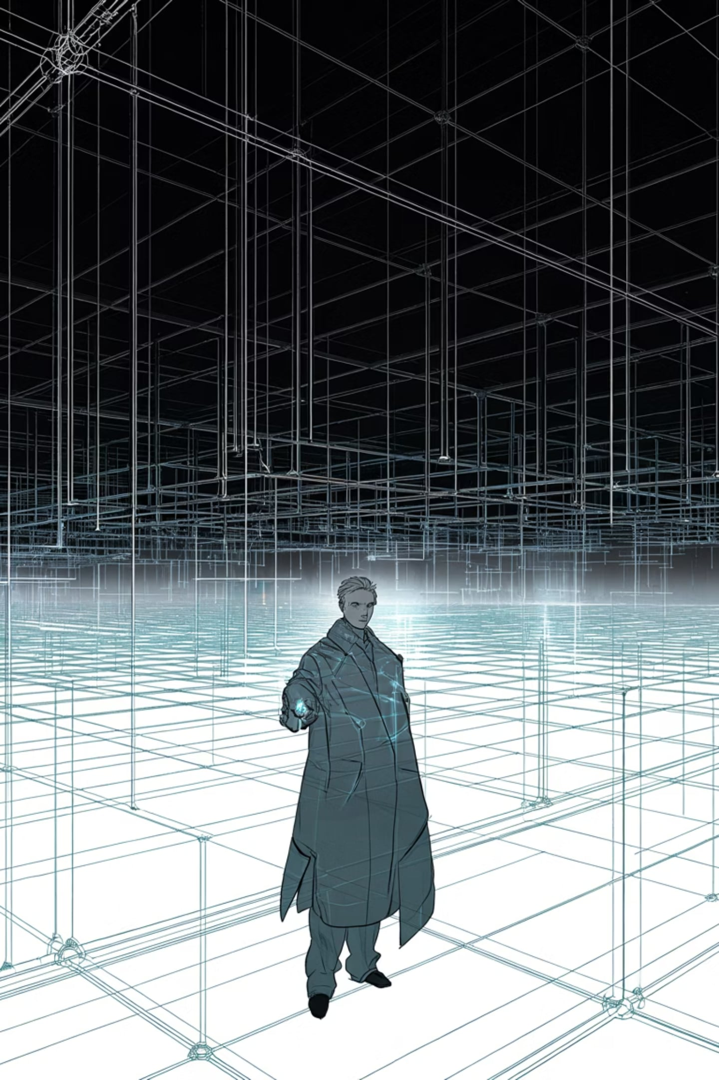


CURRENT CHALLENGES
DATASET CHALLENGES
LIMITED DIVERSITY
Available language datasets lacked sufficient diversity.
ACCENT & STYLE GAPS
Limited representation of different accents and speaking styles.
LANGUAGE CONFUSION
Closely related languages (English, French, German) occasionally produced incorrect predictions.
REGIONAL SIMILARITIES
Similar pronunciation patterns also caused confusion among some South Indian languages.

Slide 31
CURRENT CHALLENGES
PROCESSING CHALLENGES
HARDWARE CHALLENGES
The profanity detection pipeline depends on transcription before classification.
Transcription and translation introduce additional processing overhead.
Metadata cannot be updated instantly because audio must first be buffered.
Longer processing pipelines increase overall response time.
Auracast reception requires Bluetooth LE Audio compatible hardware.
Existing development hardware did not support complete Auracast reception.

Slide 32
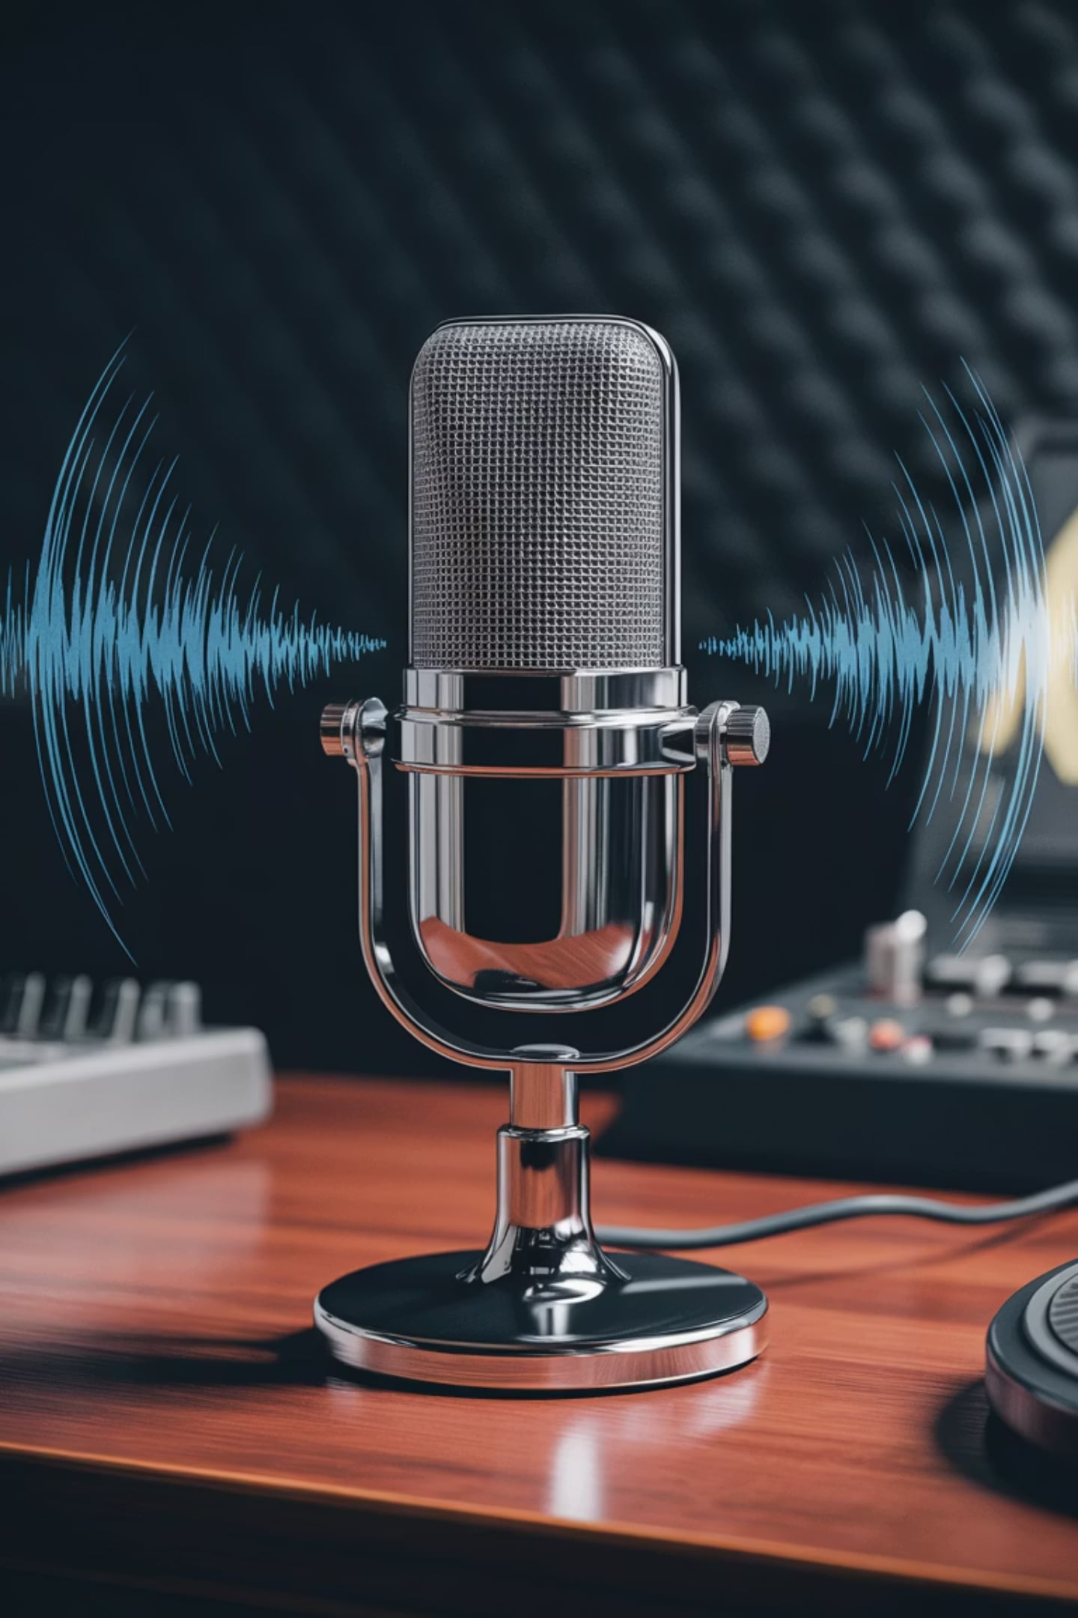
WHY WHISPER WAS USED
1
INITIAL APPROACH
Initially explored training a custom language classification model.
2
DATA LIMITATIONS
The available datasets were not sufficiently diverse.
Accent variations significantly reduced prediction accuracy.
Insufficient multilingual speech data affected model generalization.
3
WHISPER AS BASELINE
Whisper already provides robust multilingual transcription and language identification.
It served as a reliable baseline while custom datasets continue to improve.

Slide 33
FUTURE IMPROVEMENTS
PHASE 1
PHASE 2
Improve dataset diversity by collecting recordings from different speakers.
Include different accents, pronunciations, age groups, and speaking styles.
Balance the dataset across all supported languages.
Train a dedicated language model using the improved dataset.
Replace Whisper with an in-house model for greater customization.
Improve language classification accuracy.

Slide 34
FUTURE IMPROVEMENTS
PHASE 3
PHASE 4
Integrate Auracast broadcast reception using Bumble.
Later migrate to Android Bluetooth LE Audio APIs.
Connect live broadcast audio directly to the existing AI pipeline.
Develop an audio-based profanity detection model.
Eliminate dependency on transcription.
Reduce latency significantly.
Enable accurate word-level beeping instead of muting an entire packet.

Slide 35
FUTURE VISION
PLANNED METADATA EXPANSION
CURRENT METADATA
FUTURE METADATA
Audio Type
Language
Optional Profanity Detection
Announcement detection
Podcast detection
Conversation detection
Lecture detection
Speaker identification
Emotion recognition
Background noise estimation
Audio quality analysis

Slide 36
RESULTS & ACHIEVEMENTS
AUDIO CLASSIFICATION
MODEL EVALUATION
FEATURE EXTRACTION
Successfully classified audio into Music, Speech, and Noise using an SVM classifier.
Evaluated multiple machine learning models, including Random Forest, Extra Trees, XGBoost, and SVM, with SVM achieving the best performance.
Extracted 57 handcrafted audio features for robust classification.
MULTILINGUAL DETECTION
PROFANITY MODULE
WEB APPLICATION
Added an optional profanity detection module controlled by a user toggle before file upload.
Designed a modern web application with analysis, history, analytics, settings, and microphone prototype pages.
Integrated Whisper for multilingual language detection.
MODULAR PIPELINE
Built a modular pipeline that can be extended to support Auracast broadcast reception in future.

