Slide 1
Fake News Detection
Batch No: 2
Koushik Kyadari

Slide 2
AGENDA
Introduction
Abstract
Proposed system
Software and Hardware Requirements
System architecture(Modules Explanation)
UML Diagrams
Algorithms and technologies
Output screens/ Results
Conclusion
Future scope

Slide 3
Abstract
the project delves into the realm of machine learning to tackle the pressing issue of fake news detection. As digital platforms become breeding grounds for deceptive narratives, the need for a sophisticated and efficient system to differentiate between authentic and misleading information is paramount. Leveraging advanced algorithms and comprehensive datasets, this project aims to develop a model capable of identifying fake news.

Slide 4
Proposed system
The proposed system introduces a significant change by using machine learning to detect fake news. It will autonomously analyze linguistic patterns and contextual cues, distinguishing between authentic and misleading information. Through thorough training and validation, the system aims to improve accuracy and adaptability, effectively countering evolving tactics used by those spreading fake news. This approach provides a more efficient and scalable solution, contributing to the broader goal of strengthening information channels and fostering a discerning and informed society.

Slide 5
Software and Hardware Requirements
SOFTWARE REQUIREMENTS :
Anaconda and Python 3
NumPy, Pandas and tkinter
HARDWARE REQUIREMENTS :
4 GB RAM
OS - Windows 10

Slide 6
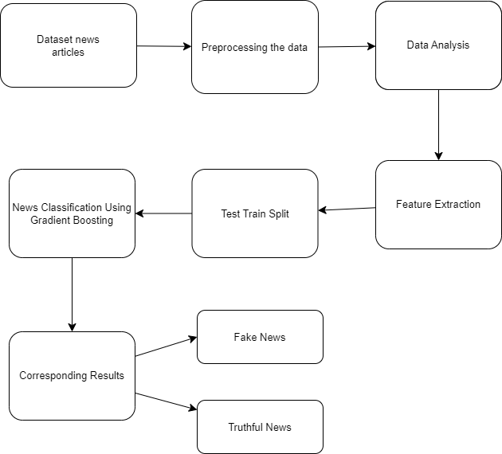
System Architecture

Slide 7
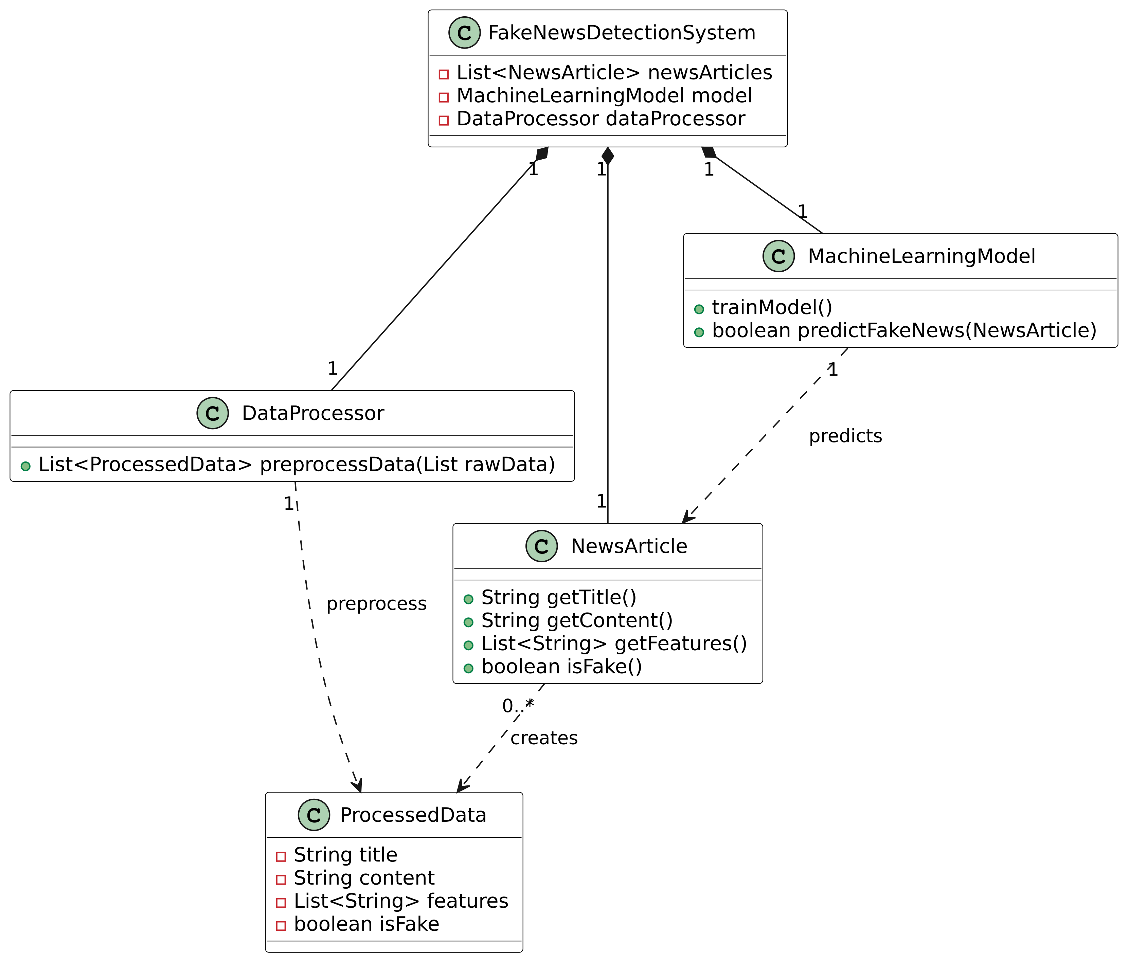
UML Diagrams

Slide 8
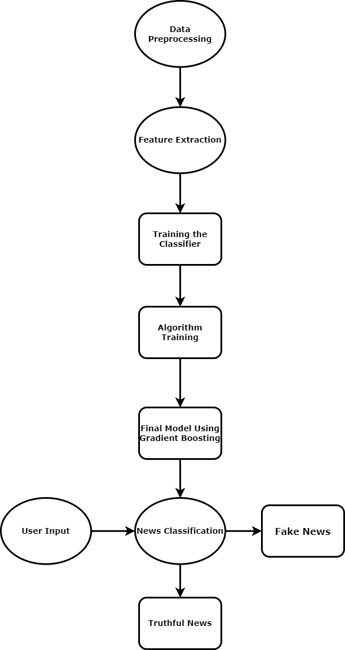
DATA FLOW DIAGRAM

Slide 9
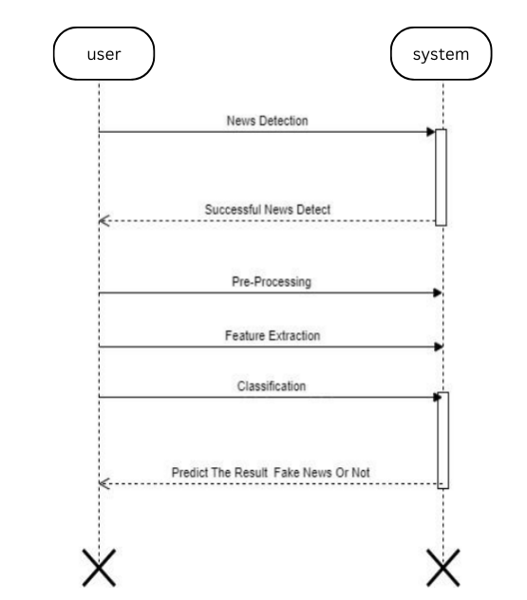
SEQUENCE DIAGRAM

Slide 10
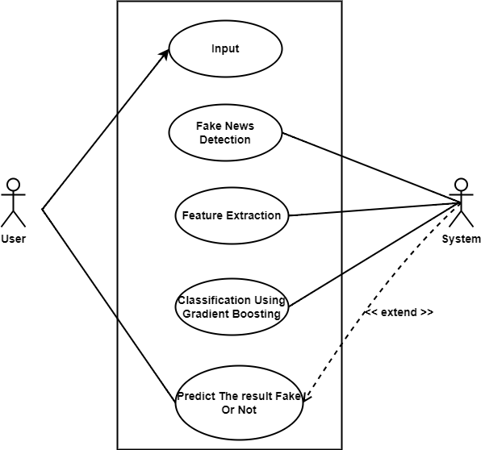
USE CASE DIAGRAM

Slide 11
Algorithms and Technologies
Algorithms : Gradient Boosting Classifier - Gradient Boosting is a powerful boosting algorithm that combines several weak learners into strong learners, in which each new model is trained to minimize the loss function such as mean squared error or cross-entropy of the previous model using gradient descent. In each iteration, the algorithm computes the gradient of the loss function with respect to the predictions of the current ensemble and then trains a new weak model to minimize this gradient. The predictions of the new model are then added to the ensemble, and the process is repeated until a stopping criterion is met.
Technologies:
Packages and imported modules :
Pandas : Pandas is a widely used open-source Python library for data manipulation and analysis.
Seaborn : Seaborn is a Python data visualization library based on Matplotlib that provides a high-level interface for drawing attractive and informative statistical graphics.
Matplotlib : Matplotlib is a comprehensive Python library for creating static, animated, and interactive visualizations.
Tqdm : Python library that provides a fast, extensible progress bar for loops and iterables.
Nltk : NLTK (Natural Language Toolkit) is a comprehensive Python library for natural language processing (NLP) tasks. It provides a wide range of tools and resources for processing and analyzing human language data.
WordCloud : Represents the importance of words.

Slide 12
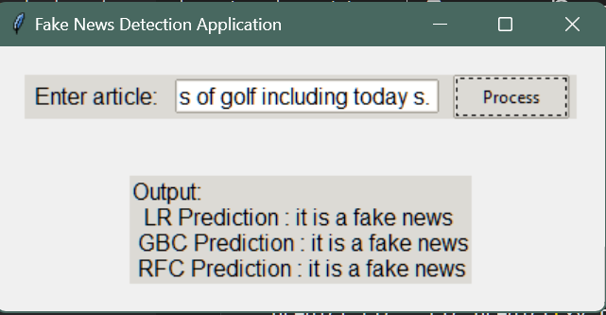
Output Screens

Slide 13
Conclusion
In conclusion, the application of the Gradient Boosting algorithm to fake news detection has demonstrated promising results in distinguishing between real and fake news articles. By leveraging an ensemble of weak learners, the algorithm effectively captures the complex patterns within the dataset, leading to high levels of accuracy in classification tasks.
Throughout this project, we utilized a diverse set of features derived from the textual content of news articles, including n-grams, TF-IDF vectors, and other linguistic indicators. The Gradient Boosting model was trained and optimized using these features, resulting in a well-performing model that generalizes effectively to unseen data.

Slide 14
Future Scope
The future scope for a fake news detection project using the Gradient Boosting algorithm encompasses several avenues for further research and development. Advanced feature engineering, including the use of word embeddings and contextual language models, can enhance model performance. Integrating multimodal data such as images and videos can lead to more comprehensive detection systems.
Hybrid models combining Gradient Boosting with other algorithms may improve robustness. Real-time detection, cross-lingual and multicultural analysis, and continuous model updating are crucial for practical application and adaptability.

Slide 15
Reference
Fake News Detection Using Machine Learning Approaches
by Z Khanam¹, B N Alwasel¹, H Sirafi¹ and M Rashid^{2 .} Published under licence by IOP Publishing Ltd.
GeeksForGeeks website – Fake news detection using machine learning https://www.geeksforgeeks.org/fake-news-detection-using-machine-learning

Slide 16
THANK YOU

