Slide 1

BANKRUPTCY PREVENTION
Group-6

Slide 2
INTRODUCTION
What is Bankruptcy?
Bankruptcy is a legal process where a company or individual is unable to repay their debts.
It often results in the liquidation of assets to pay creditors or restructuring to regain financial stability.
A major indicator of financial distress that impacts stakeholders like employees, investors, and the economy.
What is Bankruptcy Prediction?
Identifying companies at risk of going bankrupt before it happens.
Helps stakeholders take preventive actions to minimize losses and mitigate risks.
Why is it Important?
Risk Mitigation: Reduces financial losses for banks, creditors, and investors.
Informed Decisions: Enables smarter investment and financial planning.
Economic Stability: Prevents ripple effects that could destabilize the economy.

Slide 3
PROBLEM STATEMENT
The Challenge:
Bankruptcy significantly impacts companies, investors, creditors, and the overall economy.
Early identification of companies at risk of bankruptcy is crucial to reduce financial losses and ensure economic stability.
Key Issues:
Financial data is complex, with diverse structures and varying indicators across industries.
Economic conditions change rapidly, impacting prediction accuracy.
Traditional statistical methods fail to capture non-linear relationships and dynamic trends in data.

Slide 4
OBJECTIVE
Main Objective: To develop a robust and accurate bankruptcy prediction system using advanced machine learning techniques.
Specific Objectives:
Analyze Financial Data: Collect and preprocess financial and operational data from companies.
Feature Identification: Identify critical financial and non-financial factors influencing bankruptcy.
Build Predictive Models: Design and evaluate machine learning models for accurate bankruptcy prediction.
Support Decision-Making: Ensure the model’s outputs are interpretable and actionable for stakeholders like banks, investors, and policymakers

Slide 5
DATA OVERVIEW
Business Objective:
This is a classification project, since the variable to predict is binary (bankruptcy or non-bankruptcy). The goal here is to model the probability that a business goes bankrupt from different features.
The data file contains 7 features about 250 companies
The data set includes the following variables:
industrial_risk: 0=low risk, 0.5=medium risk, 1=high risk.
management_risk: 0=low risk, 0.5=medium risk, 1=high risk.
financial flexibility: 0=low flexibility, 0.5=medium flexibility, 1=high flexibility.
credibility: 0=low credibility, 0.5=medium credibility, 1=high credibility.
competitiveness: 0=low competitiveness, 0.5=medium competitiveness, 1=high competitiveness.
operating_risk: 0=low risk, 0.5=medium risk, 1=high risk.
class: bankruptcy, non-bankruptcy (target variable)

Slide 6
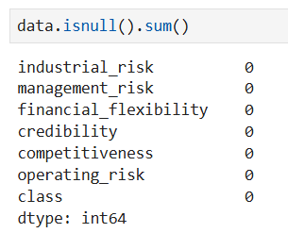
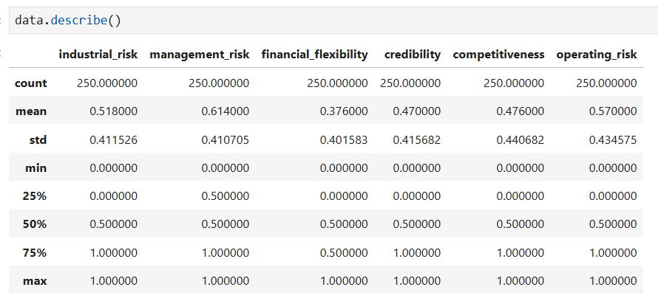
CODE
Check for Null Values:
"Ensured no missing values."
Statistical Summary:
"Summarized data statistics."

Slide 7
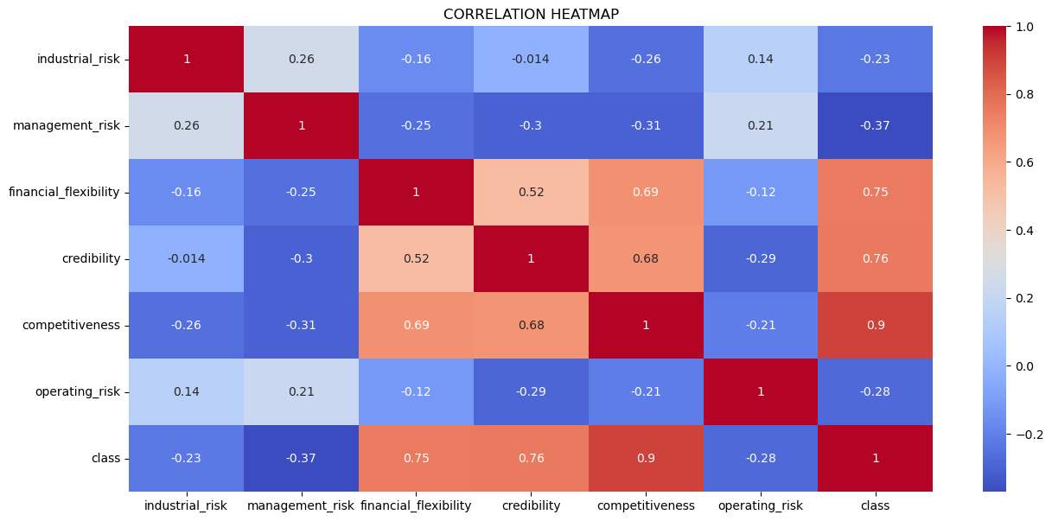
Correlation Heatmap:
Strong Positive Correlations:
Competitiveness and Class (0.9):
Credibility and Class (0.76)
Financial flexibility and Class (0.75)
Weak/Negative Correlations:
Industrial Risk and Class (-0.23)
Management Risk and Class (-0.37)
Operating Risk and Class (-0.28)

Slide 8
MODEL BUILDING
1. Logistic Regression
Predicts bankruptcy probability with a linear approach.
Simple and interpretable, but struggles with non-linear data.
2. Random Forest
Combines decision trees for robust predictions.
Handles non-linear data well; provides feature importance.
3. Support Vector Machine (SVM)
Separates data using an optimal hyperplane.
Effective for non-linear data with kernels but slow on large datasets.
4. K-Nearest Neighbors (KNN)
Classifies based on nearest neighbors.
Easy to implement but sensitive to scaling and computationally heavy.
5. XGBoost
Advanced gradient boosting for high accuracy.
Fast and handles missing data but requires careful tuning.
Approach:
Train and evaluate all models; select the best based on performance metrics.

Slide 9
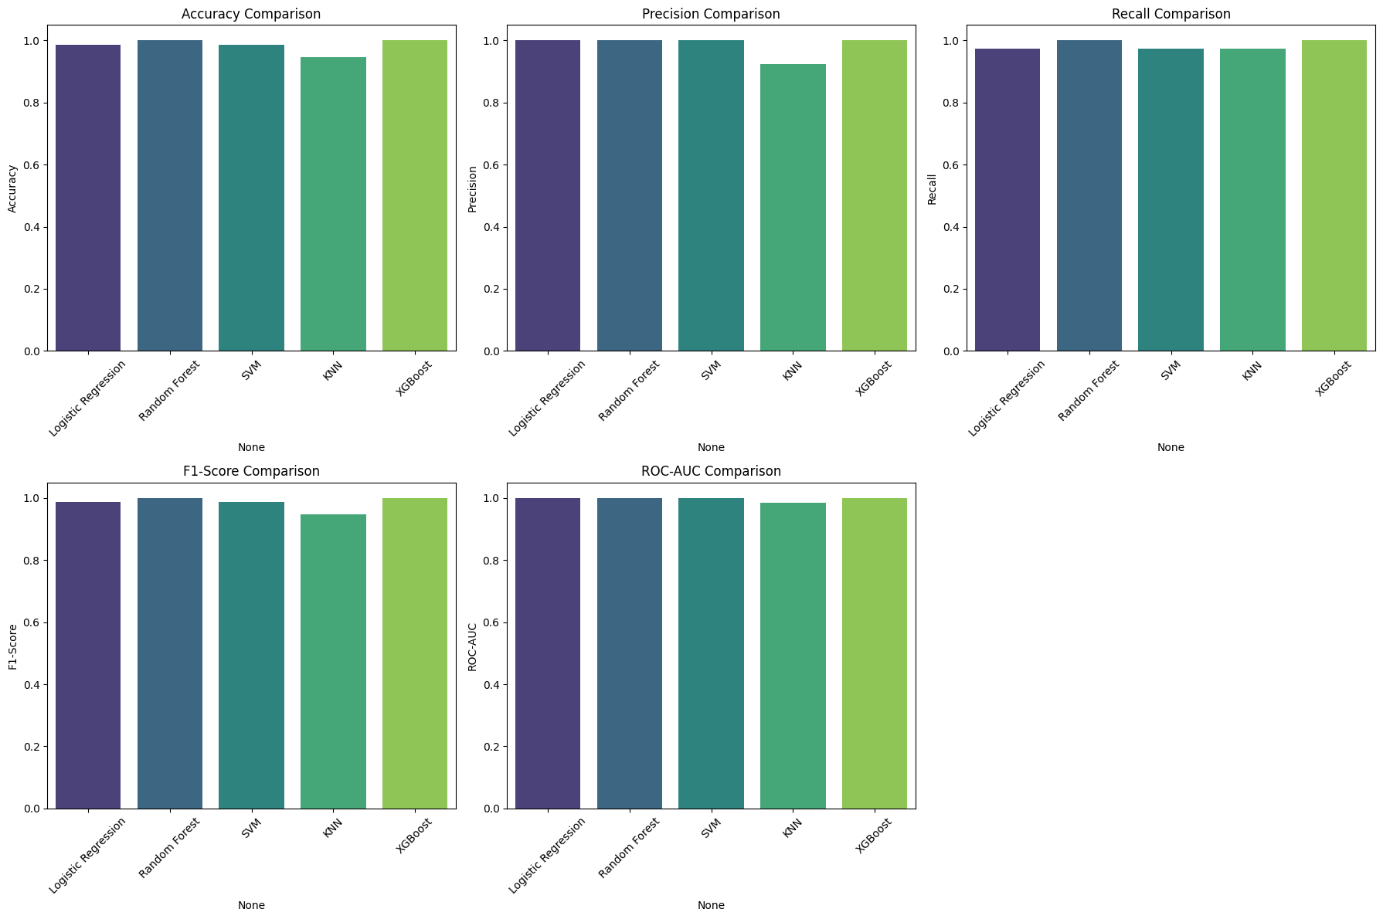
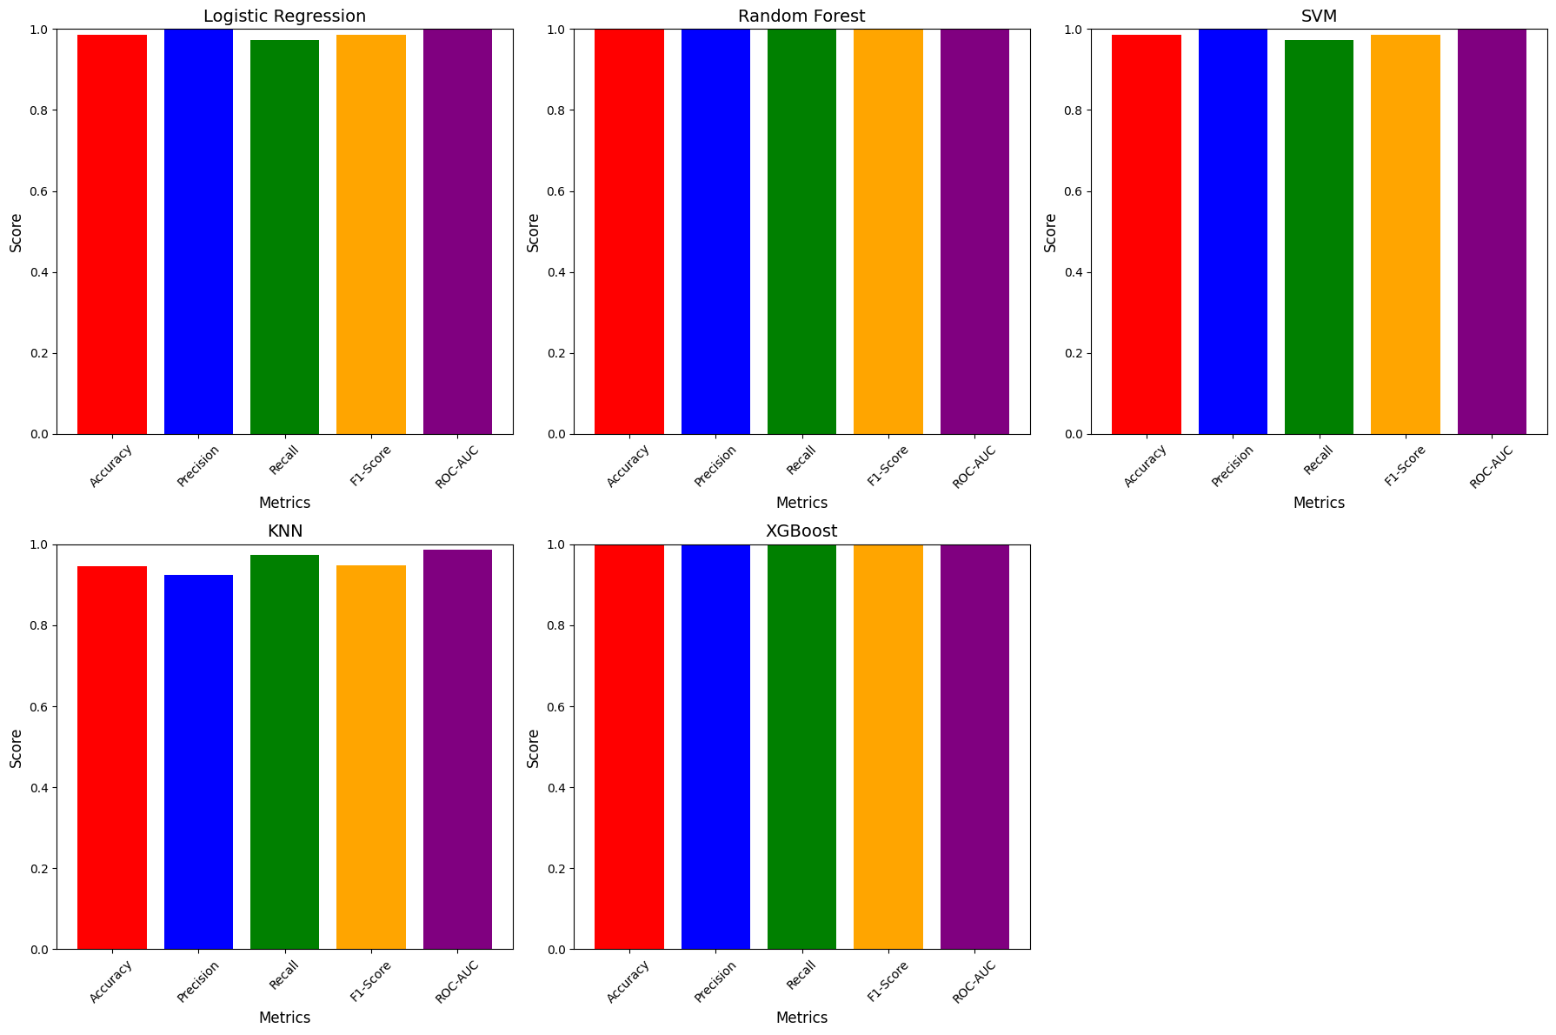
Model Evaluation:
Comparison of Model performance

Slide 10
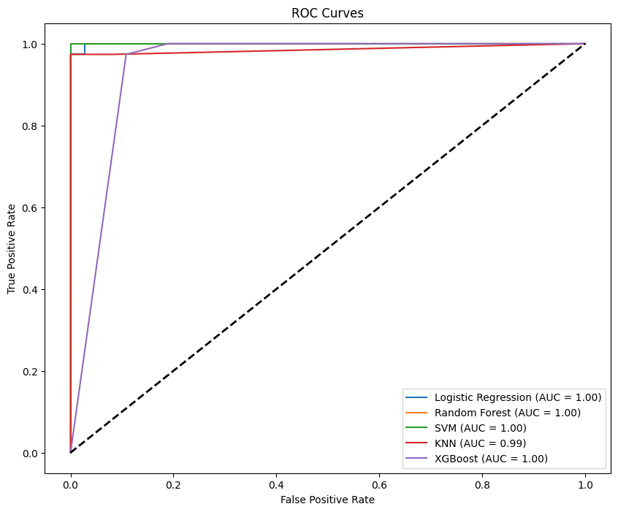
ROC Curve

Slide 11

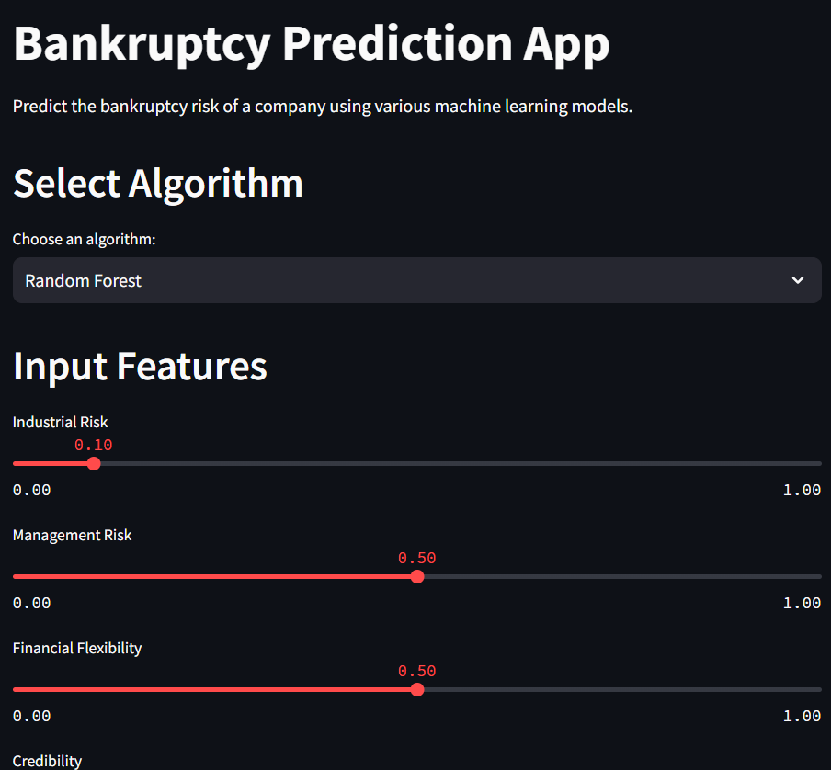

DEPLOYMENT

Slide 12
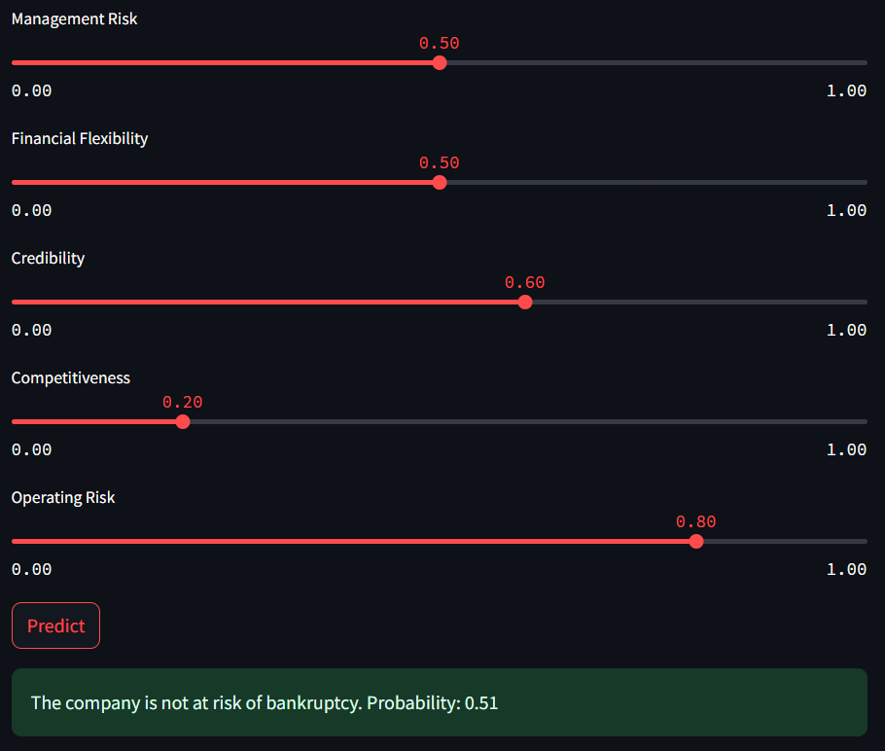

Slide 13


