Slide 1
Confidential, CTI One Corp, 2017-2-13
JetsonPCB Design
Nathan Lin and Harry Li, Ph.D.
Jan 5, 2017 Version: x0.10
Jan 12, 2017 Version: x0.20
Feb 13, 2017 Version: x0.30
CTI One Corporation
3679 Enochs Street
Santa Clara, CA 95051

Slide 2
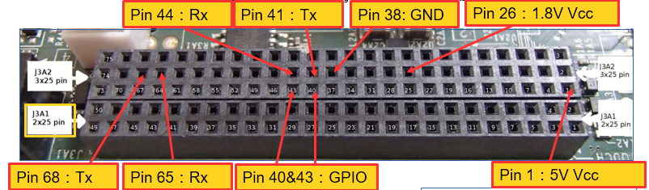
Jetson J3A2 Pins Functionality
Jetson J3A2 General Expansion Connector
Confidential, CTI One Corp, 2017-2-13

Slide 3
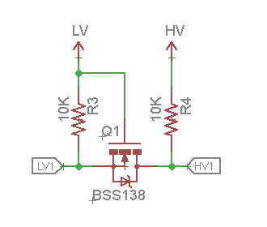
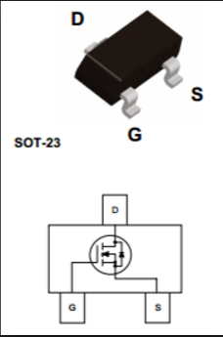
Confidential, CTI One Corp, 2017-2-13
Level Shifter Design
Note (Nathan Lin 2017-2-13):
Using package SOT-23 SMD BSS138
6 channel required:
2 for Rx/Tx (ARNOD)
2 for Rx/Tx (LTC485)
2 for GPP debugging purpose

Slide 4
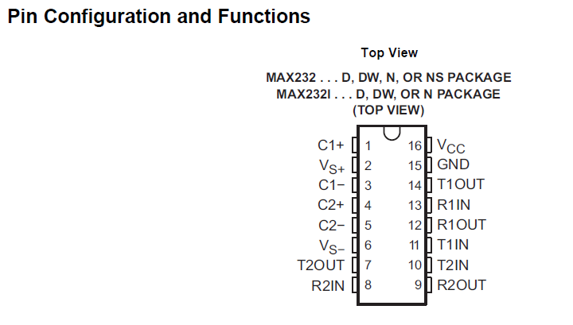
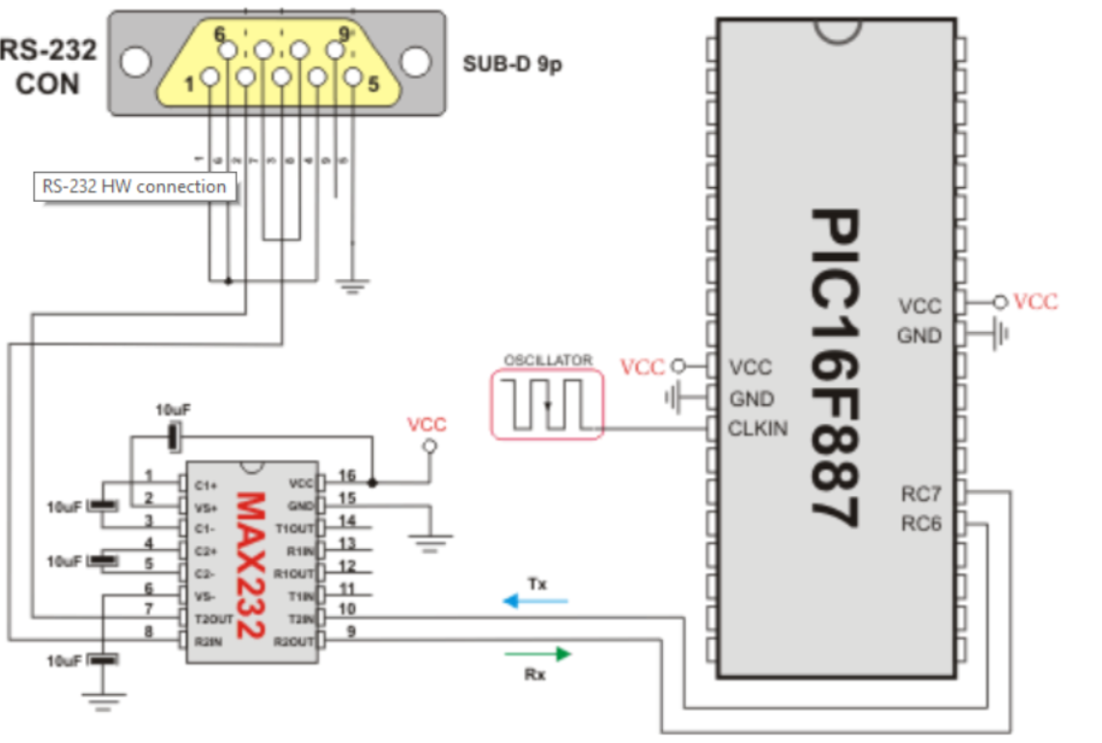
MAX232 Circuit
Confidential, CTI One Corp, 2017-2-13
Pin Layout from Max232 datasheet
Note (Nathan Lin 2017-2-13):
1. Using SO16 package 16-pin SMD;
2. All the polarized 10uf capacitor (in the left hand side schematic) can be replaced by 1uf Ceramic capacitors in this application;
Schematic from internet

Slide 5
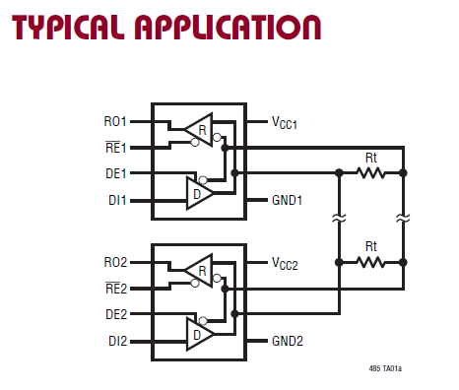
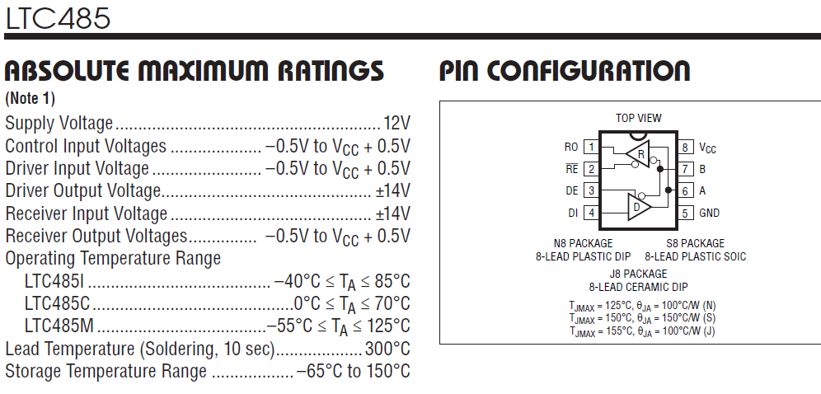
LTC 485 Circuit
Confidential, CTI One Corp, 2017-2-13
Application schematics from LTC485 datasheet
Note (Nathan Lin 2017-2-13):
1. Using S8 package 8-pin SMD
2.The receive and drive are controlled by GPP (P2.12 and P2.13) from LPC1769

Slide 6
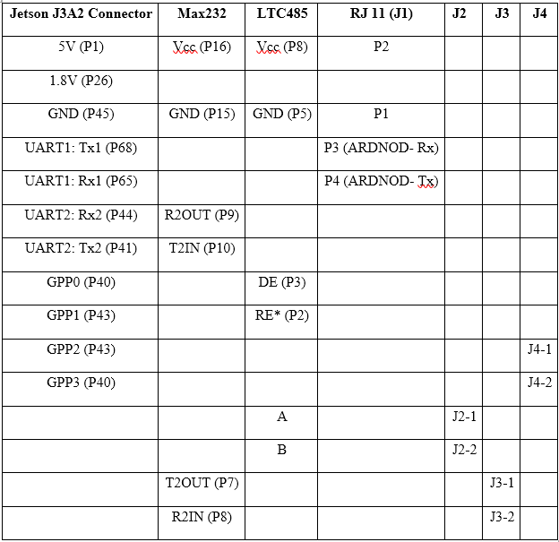
Confidential, CTI One Corp, 2017-2-13
GPUSVR Pin Connectivity
GPUSVR Pin Connectivity

Slide 7
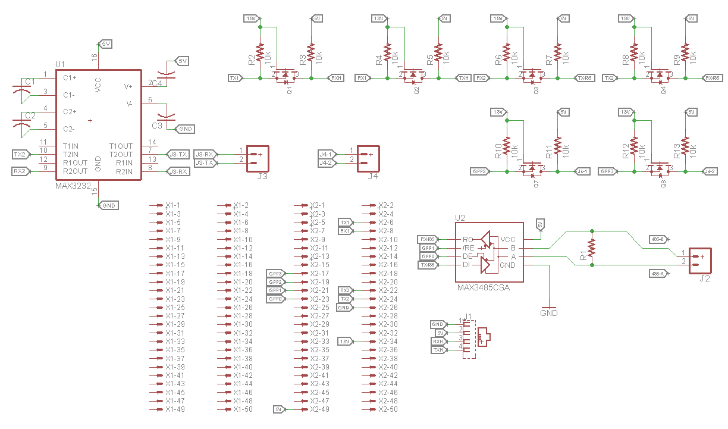
Confidential, CTI One Corp, 2017-2-13
Jetson PCB Design Schematic
Jetson PCB Schematic design on Eagle

Slide 8
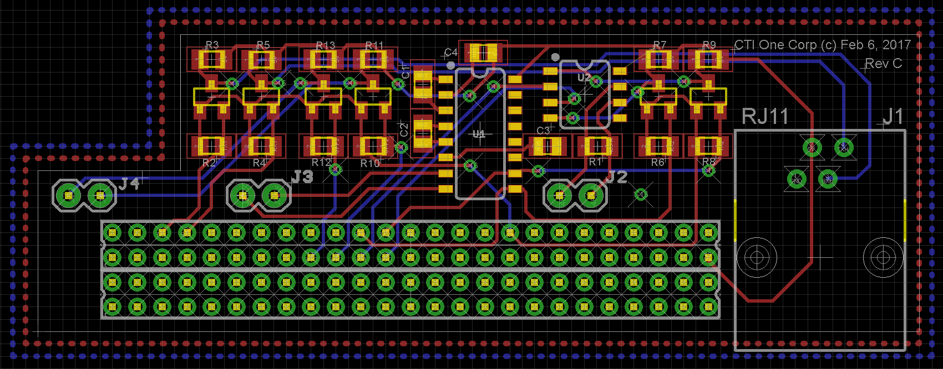
Confidential, CTI One Corp, 2017-2-13
Jetson PCB Board Layout
ARDNOD PCB Board Layout on Eagle

Slide 9
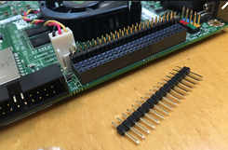
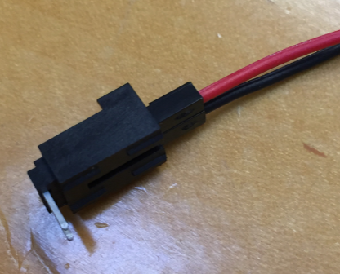
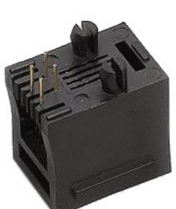
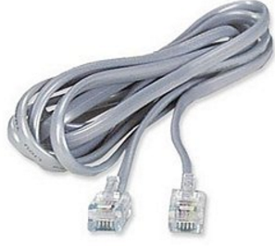
Confidential, CTI One Corp, 2017-2-13
Cable and Connectivity Solution
Jetson J3A2 to Jetson PCB:
2 mm pitch dual row header pin
J2&J3&J4:
2 Pin JST 2.54 mm pitch wire-to-board connector
J1:
RJ 11 4 Pin connector and cable

