Slide 1

SJSU Washington Square
Embedded Sensor Fusion Enhanced AGV
Guidance Technique
Team Members:
Sudheer Doddapaneni
Sujeeth Krishna Emmadi
Veena Manasa Kanakamalla
Sree Harsha Chowdary Gorantla
Project Advisor: Dr. Hua Harry Li

Slide 2
Problem Statement
Current available AGVs have the following problems:
→ Obstacle Avoidance
→ Connectivity issues due to Mono-channel Wireless connection
→ Settling of Dirt/Oil on Magnetic path
No Error correction and No Feedback control of AGV.

Slide 3
Objective
To develop a high power AGV that can avoid obstacles using vicinity visualization.
To create an adaptive algorithm using sensor fusion of Magnetic, Wheel speed and Ultrasonic sensors to guide AGV using vicinity visualization.
To interface all the sensors (Magnetic, Wheel Space and Ultrasonic sensor) with the LPC 1769.
Error correction and Feedback control of AGV along the magnetic path.

Slide 4
Magnetic Sensor
SJSU Washington Square
MGS 1600GY Pin Description
15-pin DSub connector.
Sensor works with 5V power supply through the USB connector.
Input voltage of 4.5V to 30V is applied between the ground(black) and power input wire(red).
Yellow wire is used as the output analog signal on Pin 4 (0-3V Analog track position)
The voltage varies from : 1.50V when tape is centered or when no tape is detected
:1.20v and 1.80v when tape is at one end or the other end of the sensor.

Slide 5
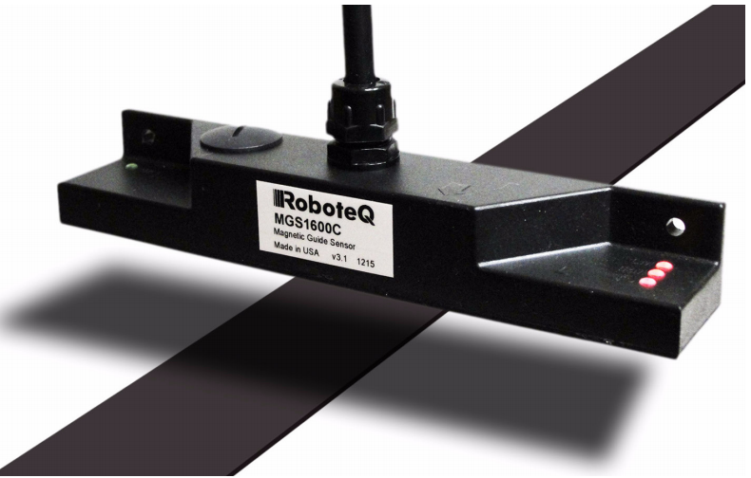
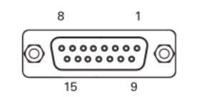
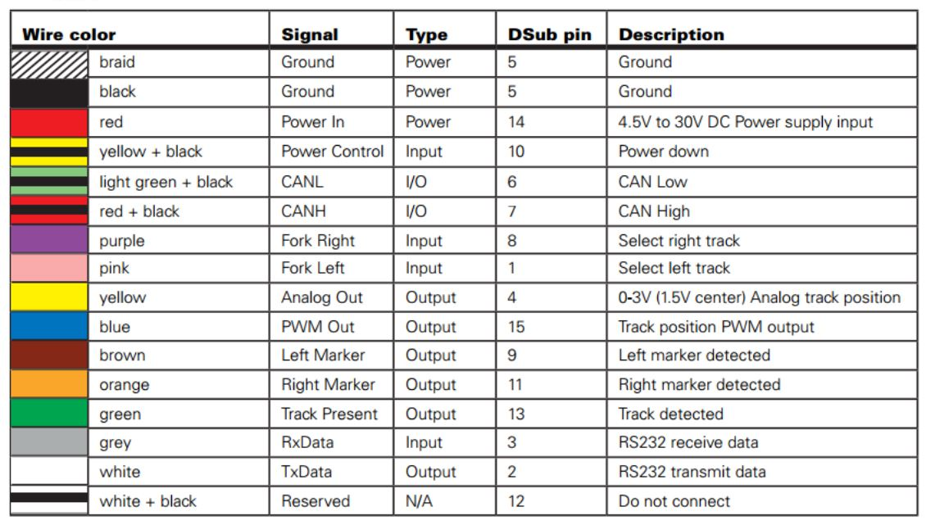
Magnetic Pin-Out
SJSU Washington Square
RoboteQ MGS 1600 GY Magnetic Sensor
DB-15 Connector

Slide 6
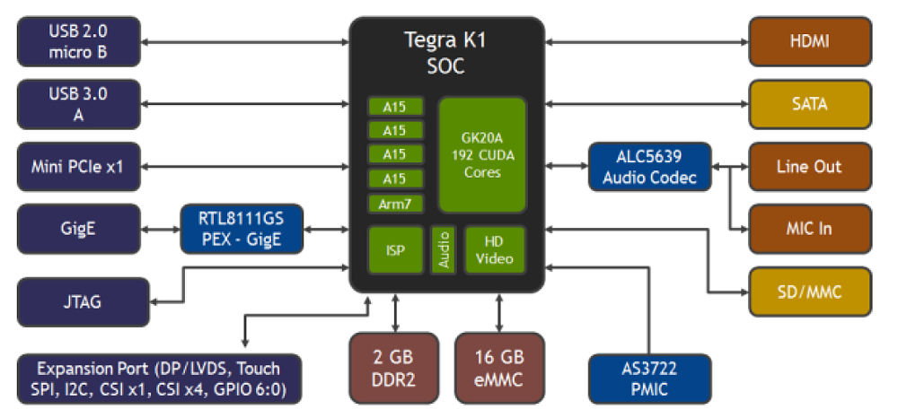
Jetson TK1
SJSU Washington Square
Tegra K1 SOC with 192-CUDA cores with NVIDIA Kepler Architecture(upto 326 GFLOPS)
Nvidia 4-Plus-1 2.32 GHz ARM quad-core Cortex-A15 CPU
DRAM: 2 GB DDR3L 933MHz EMC x 16 using 64-bit Width
1 SATA Data Port
SPI 4 Mbyte Boot Flash
16 GB fast 4.51 eMMC Memory
1 Half Mini-PCIE slot
1 Full-Size SD/MMC Connector
1 Full-Size HDMI Port
1 RTL8111GS Realtek GigE LAN
JTAG-2x10-pin0.1 port(for debugging)
1 X USB 3.0, 1 X USB 2.0,1 RS232 Serial Port
Independent HDMI 2.0/ DP 1.2 and DSI/eDP 1.4
1 ALC5639 Realtek Audio Codec with Mic In and Line Out
Signals available through expansion port:
2 fast CSI-2 MIPI camera ports, UART, HSIC, I2C(3 ports), GPIO(7X GPIO pins)
Nvidia TK1 Architecture

Slide 7
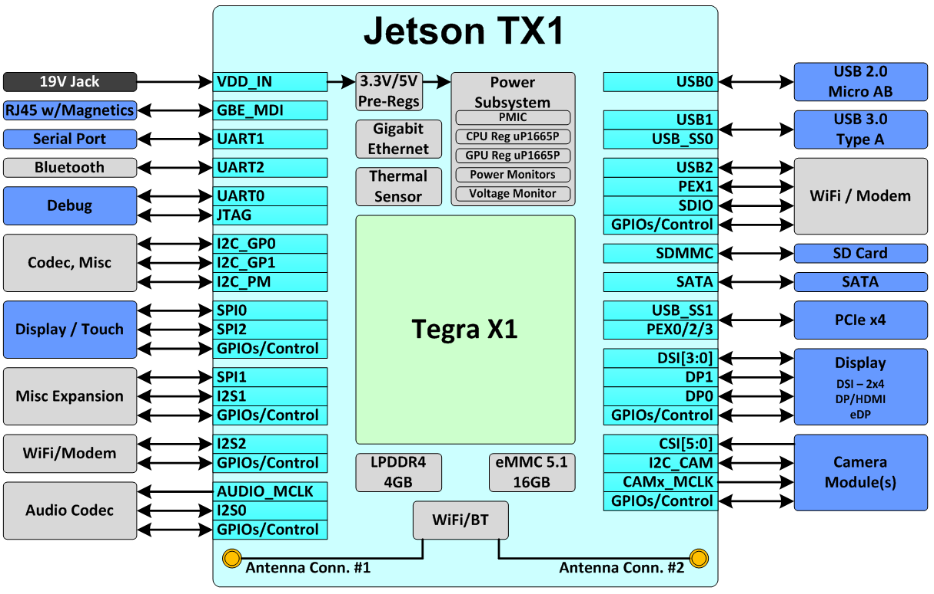
Jetson TX1
SJSU Washington Square
1 TFLOP/s 256-core with NVIDIA Maxwell Architecture
64-bit quad-core ARM cortex-A57 CPU
4 GB LPDDR4
3 X UART
3 X SPI
4 X I2C, 4 X I2S
H.265 encoder/decoder
GPIOs
Upto 6 MIPI CSI-2 cameras
802.11ac Wi-Fi
Bluetooth 4.0
16 GB eMMC flash
SDIO, SATA
1 Gigabit Ethernet
2 X USB 3.0, 3 X USB 2.0
Independent HDMI 2.0/ DP 1.2 and DSI/eDP 1.4
Nvidia TX1 Architecture

Slide 8
Jetson Tx1 Vs Tk1
SJSU Washington Square
Category | Specification | Jetson Tk1 | Jetson Tx1
SoC | SoC | Nvidia Tegra K1 | Nvidia Tegra K1
CPU | CPU | 32 bit ARM Cortex-A15 | 64 bit ARM cortex-A57
 | Cores | 5 (4+1) | 8 (4+4)
 | CPU Frequency | 2.3 GHz | 1.9 GHz
GPU | GPU cores | 192 CUDA cores | 256 CUDA cores
 | Microarchitecture | GK20A (Kepler) | GM20B (Maxwell)
 | GPU Frequency | 852 MHz | 1000 MHz
 | Performance | 326 GigaGLOPs | 1 TeraFLOP
Storage | On-board Storage | 16 GB eMMC | 16 GB eMMC
 | Flash slots | SD | SD
 | SATA | Yes | Yes
USB | USB 3.0 | 1 | 2
 | USB 2.0 | 1 | 3
RAM | RAM Size | 2 GB | 4 GB
Memory | Type | DDR3L | LPDDR4
 | Amount | max 8 GB | 2 GB
 | Bus width | 64-bit | 64-bit
 | Bandwidth (GB/s) | 17 | 25.6

Slide 9
Jetson Tx1 Vs Tk1
No | Specification | Jetson Tk1 | Jetson Tx1
Peripheral Component Interconnect Express | PCIe | 1 mini | 5 (1+4)
Networking | Ethernet | GbE | GbE
 | WiFi | No | Yes
Communication | Bluetooth | No | Yes
 | I2C | Yes | Yes (4)
 | SPI | Yes | Yes (3)
 | RS232 serial port | 1 | 1
Generic I/O | GPIO | 7 (Available through Expansion port) | Yes
 | Analog | No | Yes
Audiovisual Interfaces | Mic In | Yes | Yes
 | Audio Out | Yes | Yes
 | HDMI | Yes | Yes
 | LVDS | LCD Header | No (supported via HDMI or eDP)
 | 4k Display | No | Yes
Physical & Electrical comparison | Size (mm) | 127 X 127 | 170 X 170
 | Input Voltage | 9.5 V - 13.5 V | 5.5 - 19.6 V
 | Max power consumption | 60 W | 15 W
 | Power source | DC jack | DC jack

Slide 10
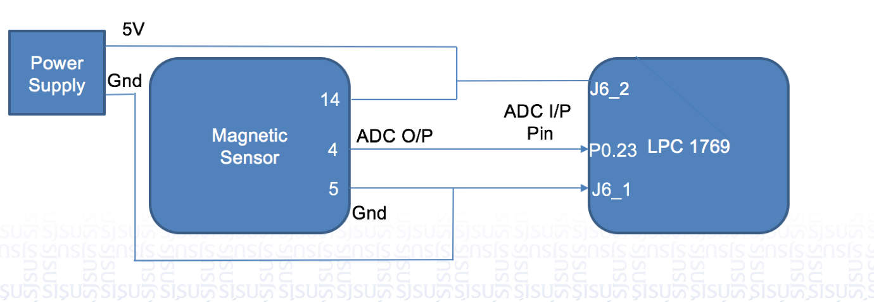

LPC1769 ADC Implementation
SJSU Washington Square
LPC1769 : ADC input pin → J6_15 (P0.23)
Ground pin → J6_1
Power Supply → J6_2
Magnetic sensor: ADC output pin → 4
Power supply pin → 14
Ground pin → 5
14
4
J6_2
P0.23
5
J6_1
J6_15
LPC 1769 Magnetic Sensor HW connections

Slide 11
LPC1769 ADC Pseudo Code
SJSU Washington Square
1) ADC Initialization
/*Initialize the ADC controller*/
InitADC();
2) Data Acquisition
/*Start ADC conversion*/
LPC_ADC->ADCR |= (1<<START_BIT);
/* Time delay to allow the ADC channel voltage to stabilize*/
DELAY_us;
/* wait till conversion completes i.e 'DONE' bit is set*/
while(((LPC_ADC->ADGDR >> DONE_BIT) & 1)==0);
/*Read the 12bit ADC data from ADGDR register*/
adcData = (LPC_ADC->ADGDR >> RESULT_BIT) & 0xfff;
/*Convert the ADC data into corresponding voltage*/
adc_voltage = (adcData*VOLTAGE_RANGE) /ADC_RES ;

Slide 12
LPC1769 ADC Special Purpose Registers
SJSU Washington Square
/* Enable CLOCK for ADC peripheral controller */
LPC_SC->PCONP |= (1 << 12);
/*Set the clock and Power ON ADC module. PCLK_ADC0/3 => ~6.5KHz sampling rate*/
LPC_ADC->ADCR = ((1<<PDN_BIT) | (10<<CLCKDIV_BIT));
/* Select the Port0 Pin23 (P0_23) AD0[0] (J6_15) for ADC function */
LPC_PINCON->PINSEL1|= 0x01<<14;
/* Select ADC Channel 0 by setting 0th bit of ADCR */
LPC_ADC->ADCR |= 0x01;

Slide 13

Laplace of Gaussian
SJSU Washington Square
Laplace of Gaussian filter is the leading data manipulation technique used in image processing to remove noise and other disturbances.
We take advantage of this technique to process and enhance the sensor data of our AGV, which greatly influences the overall operation.
Laplace of Gaussian is obtained by the double derivative of Gaussian function.
The 1-D Gaussian function is as follows:
The Laplace of Gaussian function is as follows:

Slide 14
SJSU Washington Square
Thank you !!

