Slide 1

Crime Hotspot Detection
Bhuvan Sudheer Akula

Slide 2
Introduction
Background: Crime is a persistent issue that impacts community safety, resource allocation, and public trust in law enforcement. Understanding and predicting crime patterns is essential for implementing proactive security measures.
Objective: The primary aim of this project is to develop a machine learning model that can identify crime hotspots within Los Angeles using LAPD crime data. By predicting high-risk areas, this project seeks to enhance security efforts and improve community safety.
Purpose:
Provide actionable insights to law enforcement and clients in high-risk areas.
Enable a data-driven approach to allocate resources effectively.
Support long-term crime prevention strategies through technology.

Slide 3
Project Approach
Understanding the data
Data Preprocessing
Exploratory Data Analysis (EDA)
Machine Learning Modelling
Recommendations and Reporting

Slide 4

Understanding the Data
Several features, such as Crm Cd 2, Crm Cd 3, Crm Cd 4, and Cross Street, have a high percentage of missing values (e.g., over 87%), making it more efficient to drop these features instead of imputing them. Other missing values will be treated appropriately.
Some features, like Crm Cd and Crm Cd Desc, provide redundant information (e.g., one is a code, and the other is its description). Similar columns with duplicate descriptions will be dropped to simplify the dataset.
A mismatch between the data dictionary and actual data types exists for a few features, requiring data type adjustments to ensure consistency.

Slide 5
Data Pre-Processing
Feature Reduction: Removed features with high percentages of null values (over 90%), such as "Crm Cd 2," "Crm Cd 3," "Crm Cd 4," and "Cross Street," as they contribute little to the analysis. Additionally, dropped redundant descriptive columns like "Crm Cd Desc" and "Premis Desc," which provide textual descriptions of existing numerical features. This simplification reduced complexity and enhanced dataset efficiency.
Handling Minimal Null Values: For features like "Premis Cd" and "Crm Cd 1," the number of missing values was minimal compared to the total dataset size (901,357 rows). Instead of imputing these values, the corresponding rows were dropped, ensuring that the data retained its integrity without significant loss of information.
Filling Categorical Nulls: Missing values in categorical features such as "Vict Sex" and "Vict Descent" were filled using the most frequent value (mode). This method ensured that these features remain consistent with the overall distribution, preserving the dataset's representativeness.
Predicting Missing Numerical Values: For the feature "Weapon Used Cd," which had some missing values, a machine learning approach was employed. A regression model was trained using rows with non-missing values to predict and fill the missing entries. This approach leveraged relationships with other features (e.g., "Crm Cd 1") to provide accurate estimations while maintaining data integrity.

Slide 6
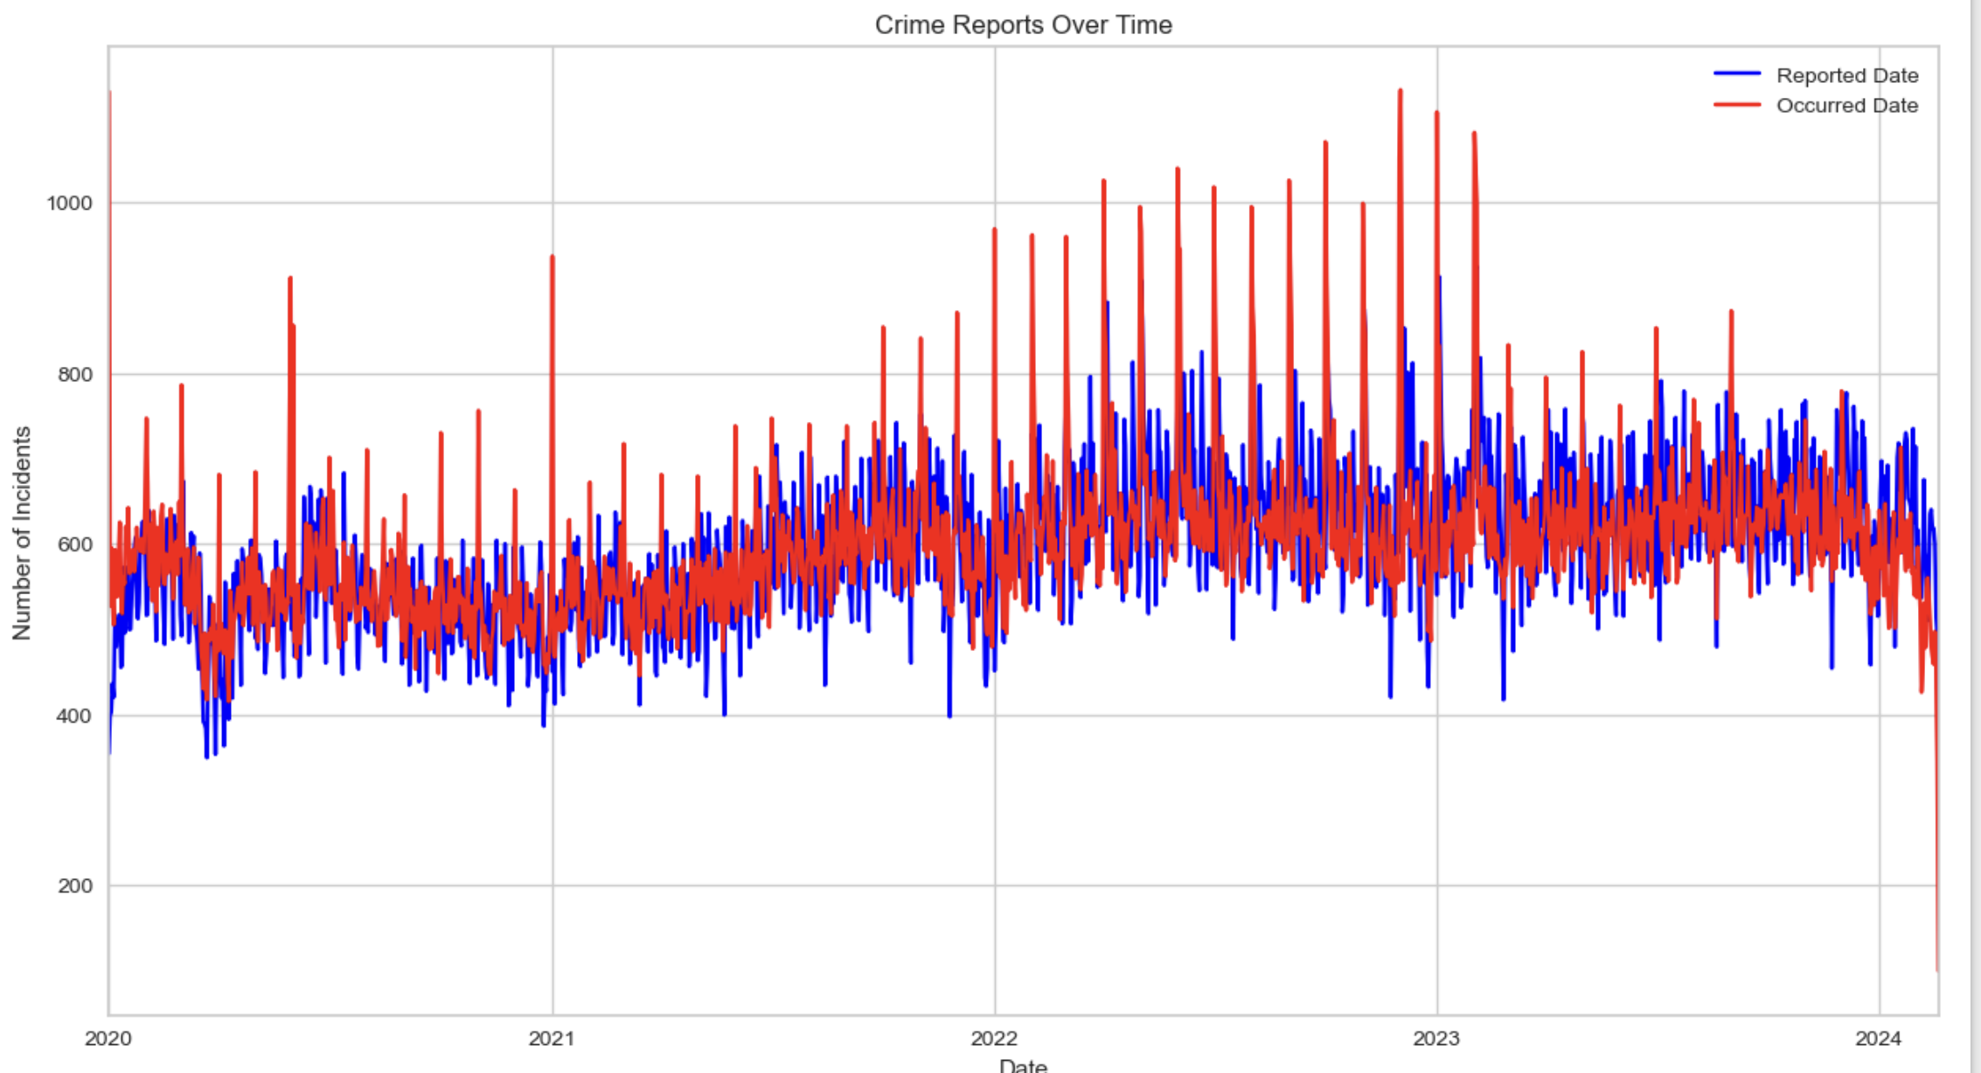
Exploratory Data Analysis
Crime Trends Over Time: The red line shows when crimes occurred, while the blue line represents when they were reported. The two lines are closely aligned, but there are occasional delays between occurrence and reporting. Crime incidents increased steadily until 2023, followed by a slight decline, highlighting potential seasonal or yearly patterns.

Slide 7
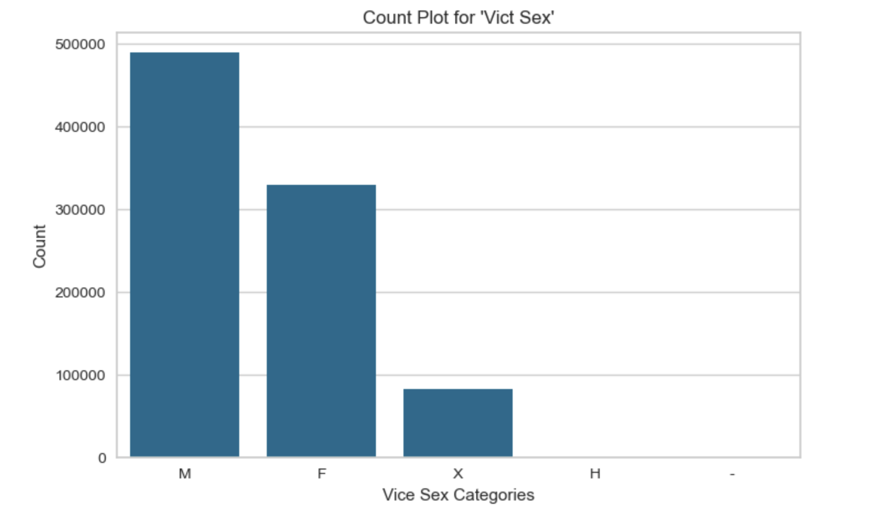
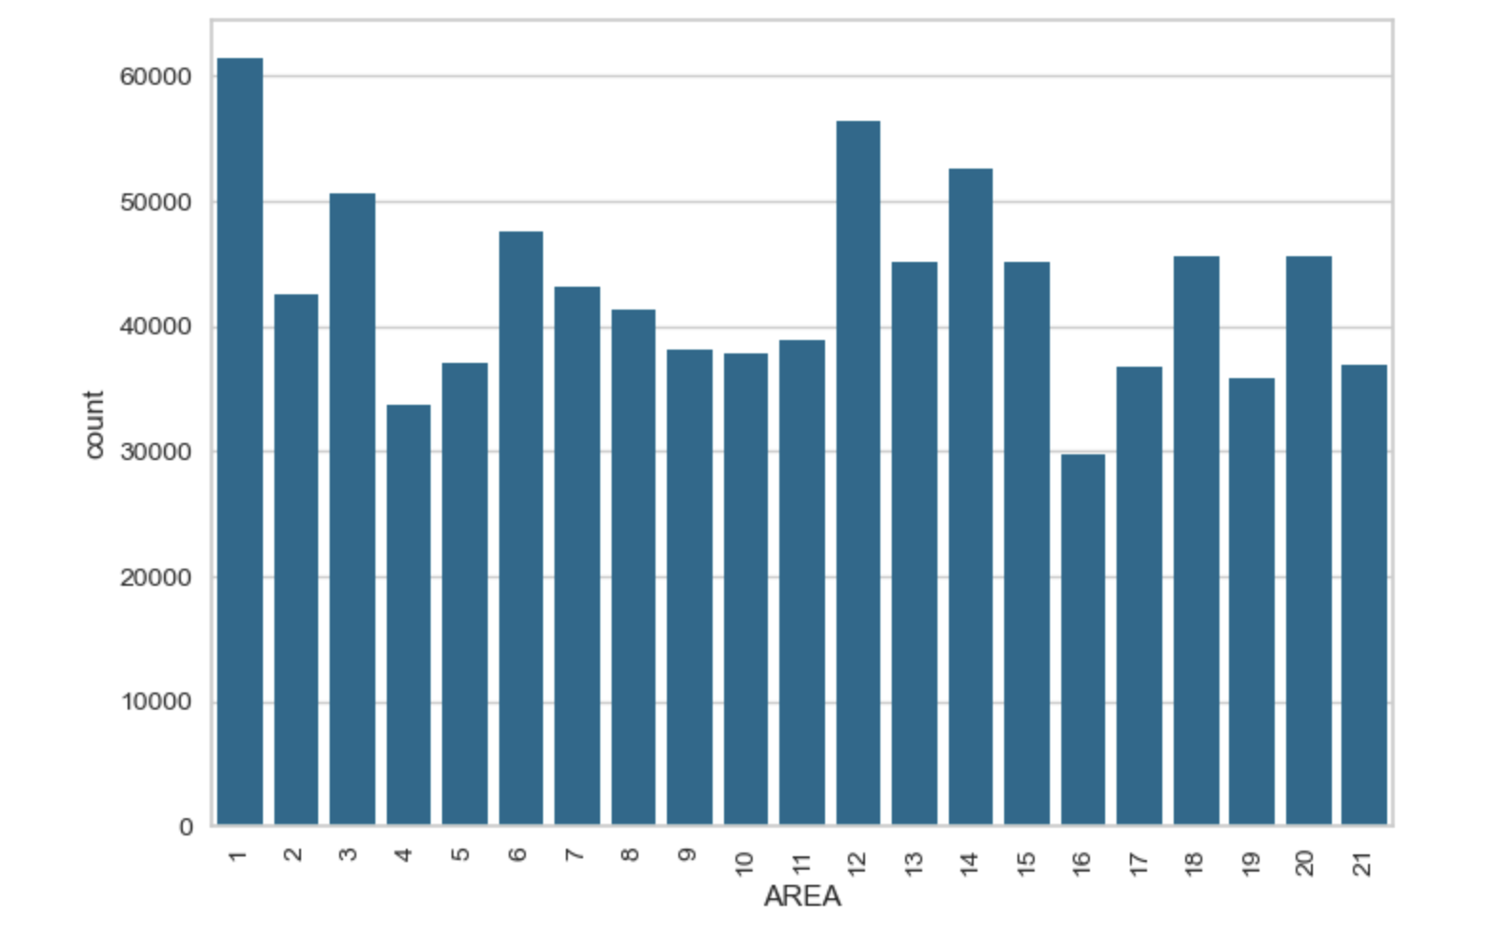
This chart shows the count of victims by gender. Male victims (M) are the most common, followed by female victims (F). Other categories like "X" and "H" have significantly fewer counts, suggesting they might represent unknown or less common classifications.
This bar chart shows the number of crimes reported in each area. Area 1 has the highest crime count, while Area 16 has the lowest. The variation indicates some areas experience significantly more incidents, possibly due to population density, socioeconomic factors, or other regional characteristics.

Slide 8
Standardization and Label Encoding
Standardization of Numerical Features: Used StandardScaler to scale numerical features, ensuring they all fall within the same range. This is important for models like linear regression or KNN, where features with larger scales could dominate the model's performance.
Label Encoding for Categorical Features: Applied Label Encoding to categorical features, which converts each category into a unique numerical value. This method avoids the dimensionality problem associated with techniques like one-hot encoding, ensuring a simpler and more efficient representation of categorical variables.
Data Readiness for Model Training: With the numerical features standardized and categorical features encoded, the dataset is now clean and transformed, making it ready for model training to identify crime hotspots effectively.

Slide 9

Model Training
I will be using the following four models for the analysis
Logistic Regression: A linear model used for binary classification, predicting the probability of an event occurring based on input features.
Decision Tree: A tree-like structure that splits data at each node to classify or predict outcomes, based on feature values.
Random Forest: An ensemble of multiple decision trees that combines their predictions to improve accuracy and reduce overfitting.
K-Nearest Neighbors (KNN): A non-parametric algorithm that classifies data points based on the majority class of their nearest neighbors.

Slide 10
Results
Model | Accuracy
Logistic Regression | 15%
Decision Tree | 100%
Random Forest | 100%
KNN | 79.5%
Logistic Regression (15%) shows poor performance, likely due to its assumption of a linear relationship, which doesn't capture the non-linear patterns in the data.
Decision Tree and Random Forest (100%) show unusually high accuracy, suggesting overfitting, where the models are memorizing the training data instead of generalizing.
K-Nearest Neighbors (79.5%) provides a reasonable and balanced accuracy, performing better by capturing local patterns in the data without overfitting.

