Slide 1
DEPARTMENT OF ELECTRONICS AND COMMUNICATION ENGINEERING
DOMAIN : MEDICAL IMAGE PROCESSING
Lung Cancer Detection With Deep Learning
Using CT Scan Images
Team Members Under the Guidance of
K.N.SUDHEER SAI – 226M1A0442 Mr. N P U V S N PAVAN KUMAR,M.Tech
D.PRAVALLIKA – 226M1A0419 ASSISTANT PROFESSOR
D.T.V.V.ROHITH KUMAR – 226M1A0420 DEPARTMENT OF ECE
M.SAI KUMAR – 226M1A0445
K.SIVA SAI – 226M1A0437

Slide 2
CONTENTS
ABSTRACT
OBJECTIVE
LITERATURE SURVEY
EXISTING SYSTEM
PROPOSED SYSTEM
IMPLEMENTATION
MODEL DESCRIPTION
ARCHITECTURE
OUTPUT
CONCLUSION
FUTURE SCOPE
WORK FLOW
REFERENCES

Slide 3
1. ABSTRACT
This project focuses on lung cancer detection using deep learning on CT scan images. Lung cancer is one of the leading causes of death worldwide, and early detection is essential to improve survival rates.
The dataset consists of CT scan images categorized into four classes: Adenocarcinoma, Large Cell Carcinoma, Squamous Cell Carcinoma, and Normal. These images are preprocessed and classified using deep learning models such as ResNet-50, ResNet-101, GoogLeNet, and EfficientNet-B0.
The performance of the models is evaluated using accuracy and ROC curves. Among all models, GoogLeNet achieved the best accuracy of 91.75%.

Slide 4
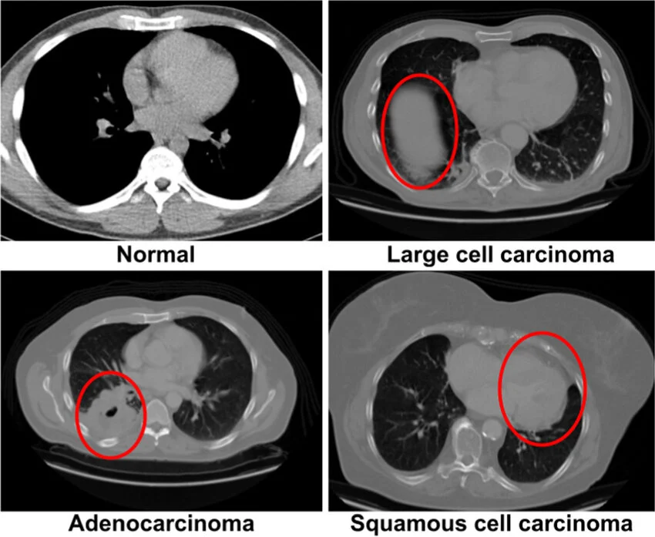
2. OBJECTIVE
To develop an accurate deep learning-based system for detecting and classifying lung cancer using CT scan images.
The system classifies images into the following categories:
Adenocarcinoma
Large Cell Carcinoma
Squamous Cell Carcinoma
Normal
Fig1: Classification of lung cancer

Slide 5
3. LITERATURE SURVEY
AUTHOR | YEAR | TITLE | MODALITY | DATASET | ALGORITHM | FINDINGS
Ardila et al. | 2019 | End-to-End Lung Cancer Detection | CT Scan | NLST | 3D CNN | High accuracy in prediction
Setio et al. | 2016 | Pulmonary Nodule Detection | CT Scan | LUNA16 | CNN | Improved nodule detection
Shen et al. | 2015 | Multi-scale CNN | CT Scan | LIDC-IDRI | CNN | High sensitivity
Hussein et al. | 2017 | Lung Cancer Risk Prediction | CT Scan | LIDC | Deep CNN | Better classification
Mohammad et al. | 2020 | Lung Cancer Detection using Deep Learning | CT Scan | Kaggle | CNN | Achieved high accuracy in classification

Slide 6
AUTHOR | YEAR | TITLE | MODALITY | DATASET | ALGORITHM | FINDINGS
He et al. | 2016 | Deep Residual Learning | Image | ImageNet | ResNet | Solved vanishing gradient
Szegedy et al. | 2016 | Inception Model | Image | ImageNet | GoogLeNet | Better feature extraction
Tan & Le | 2019 | EfficientNet | Image | ImageNet | EfficientNet | High efficiency
Ronneberger et al. | 2015 | U-Net Segmentation | Medical | Biomedical | U-Net | Accurate segmentation
Selvaraju et al. | 2017 | Grad-CAM | Image | ImageNet | Grad-CAM | Visual explanation
Zhao et al. | 2021 | Lung Cancer Detection | CT | Medical Dataset | CNN | High accuracy

Slide 7
4. EXISTING SYSTEM
Use a global learning approach, where the entire CT image is processed
Rely on a single CNN model for classification
Segmentation is either absent or not integrated into the pipeline
Follow a partial pipeline, mainly focused on classification
Provide low clinical trust, as predictions are not interpretable

Slide 8
Input Image
5. PROPOSED SYSTEM
Image preprocessing
Uses an ROI-based learning approach by segmenting lung regions using U-Net
Implements a multi-model CNN framework (ResNet, GoogLeNet, EfficientNet)
Integrates segmentation and classification into a unified pipeline
Provides model explainability using Grad-CAM heatmaps
Follows a complete end-to-end pipeline
Achieves high clinical trust through accurate and interpretable results
CNN model(Feature Extraction)
Segmentation (U-Net)
Grad cam
Classification output
Fig:2 Block diagram of proposed system

Slide 9
6. IMPLEMENTATION
The implementation of the proposed system is performed using lung CT scan images and consists of the following steps:
Lung CT Image Processing Noise removal, contrast enhancement, and resizing of CT scan images
Segmentation The U-Net model is used to detect lung nodules from CT scan images
Classification CNN models classify lung CT images into cancer types
Output Generation Displays prediction results along with Grad-CAM heatmaps

Slide 10
7. MODEL DESCRIPTION
The proposed system uses multiple deep learning models for accurate classification of lung CT scan images.
GoogLeNet (InceptionV3) Uses inception modules for multi-scale feature learning
ResNet-50 & ResNet-101 Deep residual networks used for feature extraction
EfficientNet-B0 Optimized model with high accuracy and efficiency
U-Net Used for segmentation of lung nodules
Grad-CAM Provides visual explanation using heatmaps

Slide 11
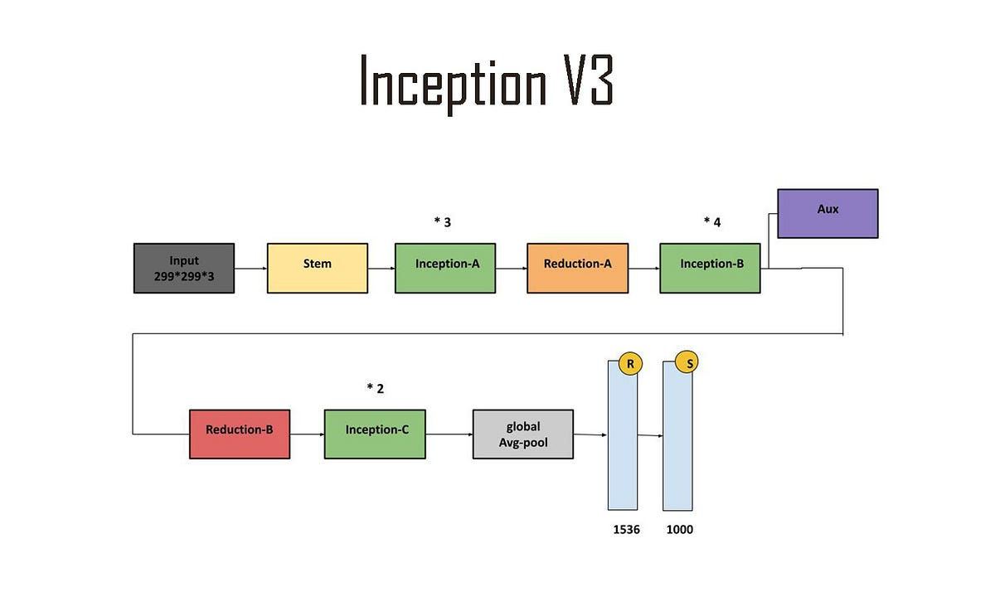
8. ARCHITECTURE (Best Model)

Slide 12
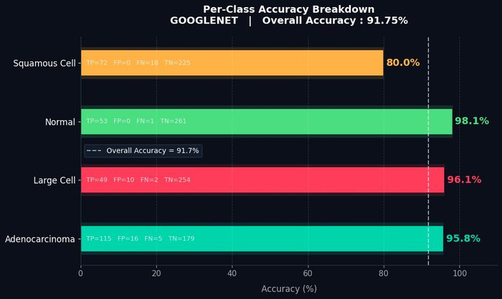
9. OUTPUTS
GOOGLENET**

Slide 13
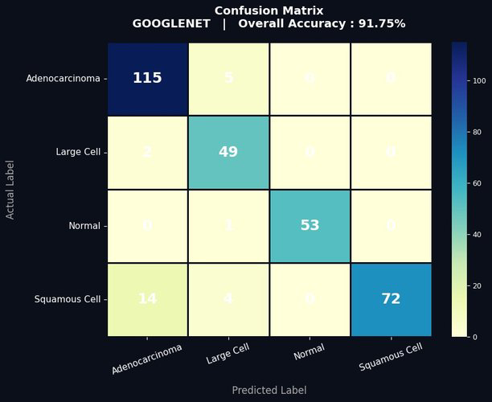
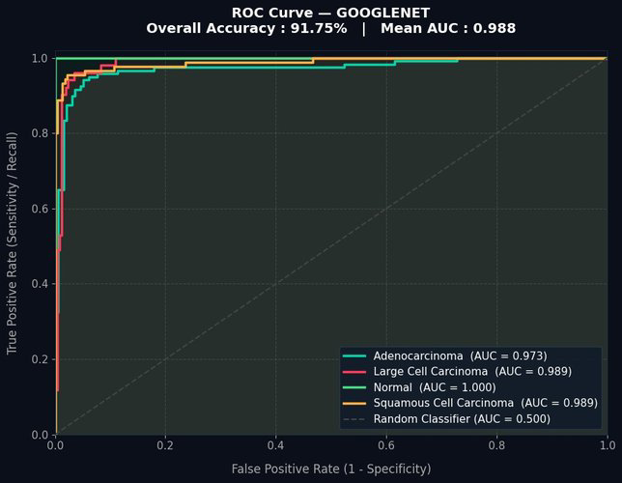
CONFUSION MATRIX ROC CURVE

Slide 14
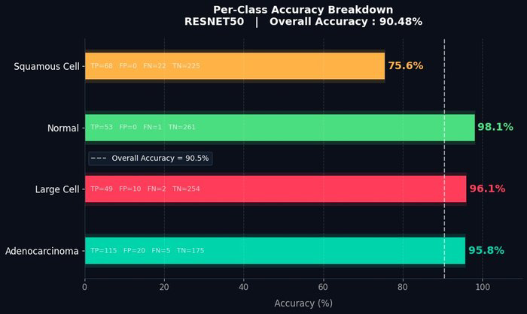
RESNET 50

Slide 15
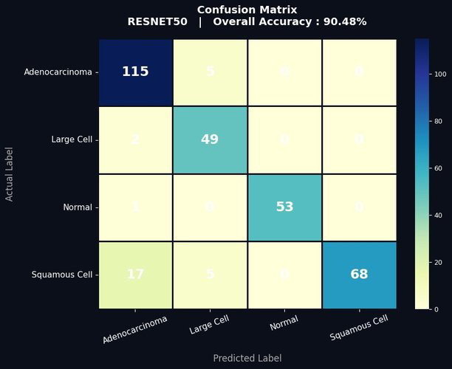
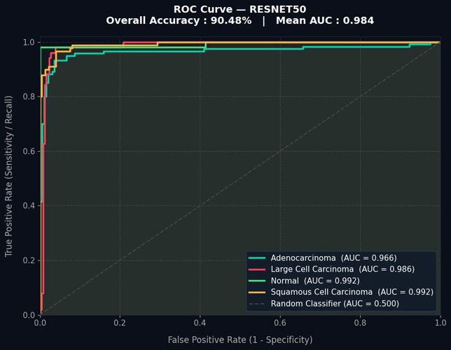
CONFUSION MATRIX ROC CURVE

Slide 16
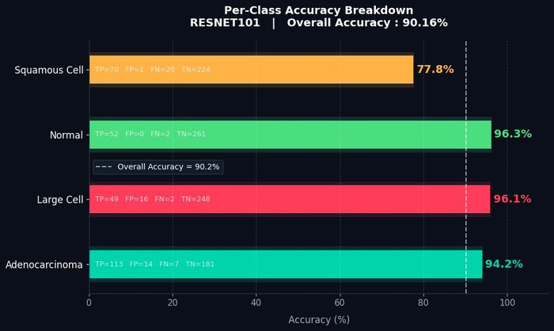
RESNET 101

Slide 17
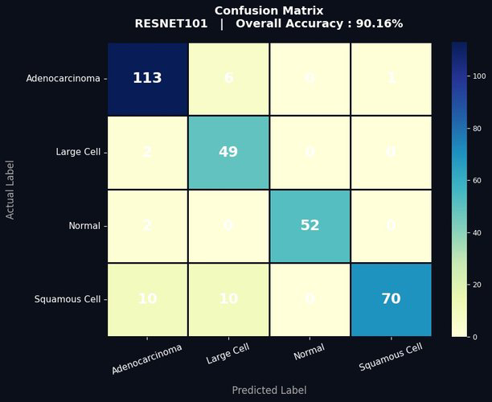
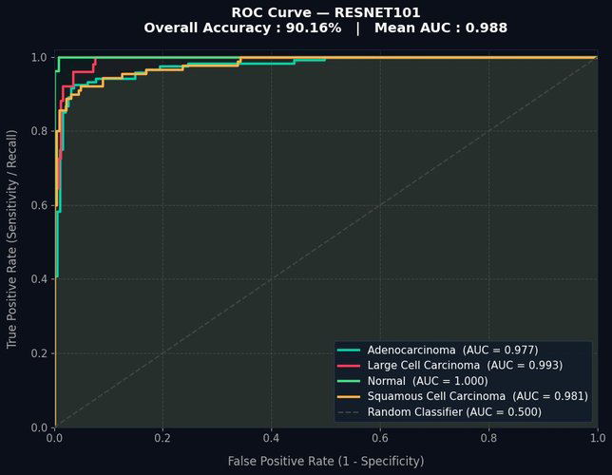
CONFUSION MATRIX ROC CURVE

Slide 18
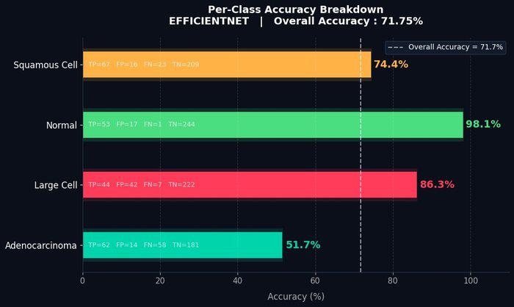
EFFICIENTNET B0

Slide 19
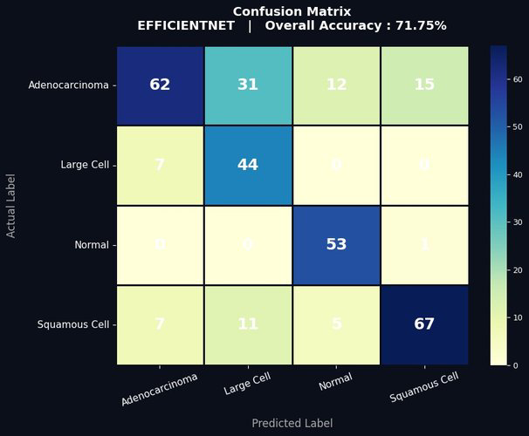
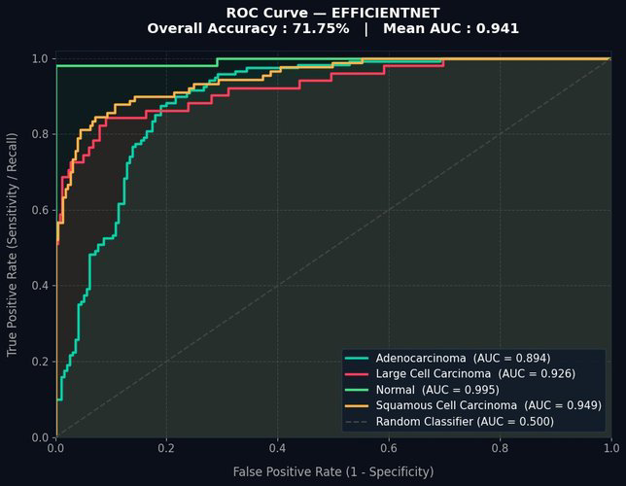
CONFUSION MATRIX ROC CURVE

Slide 20
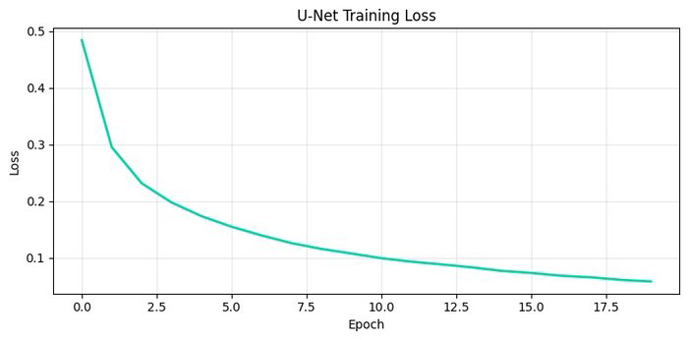
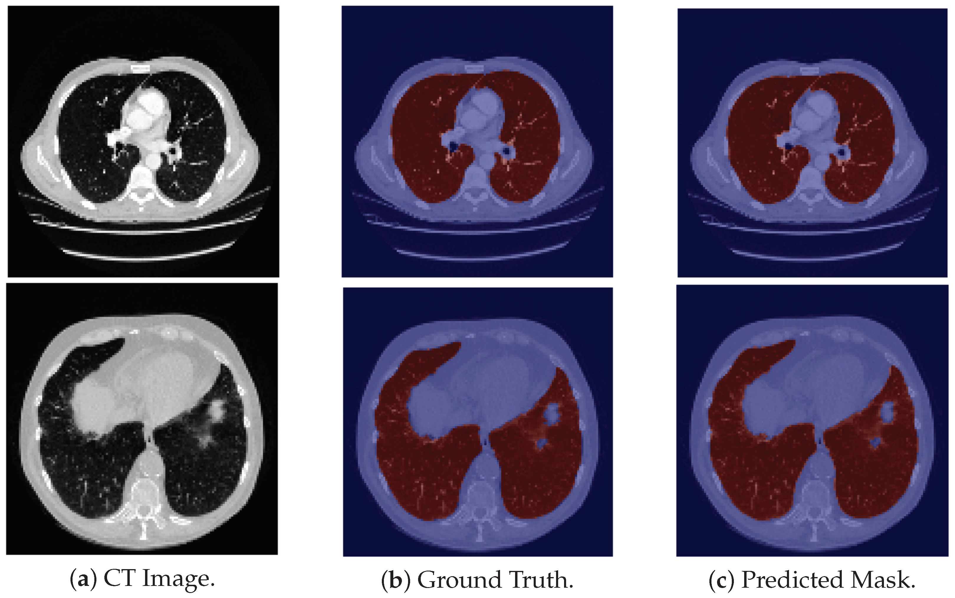
SEGMENTATION MODEL UNET

Slide 21
10. CONCLUSION
Successfully developed a deep learning-based system for lung cancer detection
Achieved high accuracy using multiple CNN models
GoogLeNet provided the best performance (91.75%)
U-Net effectively segmented lung regions
Reduced human effort and improved diagnosis accuracy

Slide 22
11. FUTURE SCOPE
Can be implemented in real-time hospital systems
Can be extended to 3D CT scan analysis
Improve accuracy using larger datasets
Integration with cloud-based healthcare systems
Early-stage detection improvements

Slide 23
12. WORK FLOW
Data Set collection and Literature survey
Algorithm Implementation
Results
Report Submission
REVIEW - 1
REVIEW - 2
REVIEW - 3

Slide 24
13. REFERENCES
K. He, X. Zhang, S. Ren, and J. Sun, "Deep Residual Learning for Image Recognition," in Proceedings of the IEEE Conference on Computer Vision and Pattern Recognition (CVPR), Las Vegas, USA, pp. 770-778, 2016. DOI: 10.1109/CVPR.2016.90
O. Ronneberger, P. Fischer, and T. Brox, "U-Net: Convolutional Networks for Biomedical Image Segmentation," in Medical Image Computing and Computer-Assisted Intervention (MICCAI), Munich, Germany, Lecture Notes in Computer Science, vol. 9351, pp. 234-241, 2015. DOI: 10.1007/978-3-319-24574-4_28
C. Szegedy, V. Vanhoucke, S. Ioffe, J. Shlens, and Z. Wojna, "Rethinking the Inception Architecture for Computer Vision," in Proceedings of IEEE CVPR, Las Vegas, USA, pp. 2818-2826, 2016. DOI: 10.1109/CVPR.2016.308
M. Tan and Q. V. Le, "EfficientNet: Rethinking Model Scaling for Convolutional Neural Networks," in Proceedings of the 36th International Conference on Machine Learning (ICML), Long Beach, USA, vol. 97, pp. 6105-6114, 2019.
R. R. Selvaraju, M. Cogswell, A. Das, R. Vedantam, D. Parikh, and D. Batra, "Grad-CAM: Visual Explanations from Deep Networks via Gradient-based Localization," International Journal of Computer Vision, vol. 128, no. 2, pp. 336-359, 2020. DOI: 10.1007/s11263-019-01228-7
P. de Groot and R. I. Munden, "Lung Cancer Epidemiology, Risk Factors, and Prevention," Radiologic Clinics of North America, vol. 50, no. 5, pp. 863-876, 2012. DOI: 10.1016/j.rcl.2012.06.006

Slide 25
D. Ardila, A. P. Kiraly, S. Bharadwaj et al., "End-to-end Lung Cancer Screening with Deep Learning on Low-dose CT," Nature Medicine, vol. 25, pp. 954-961, 2019. DOI: 10.1038/s41591-019-0447-x
X. Y. Jin, Y. C. Zhang, and Q. L. Jin, "Pulmonary Nodule Detection based on CT Images using Convolution Neural Network," in Proceedings of the 2016 9th International Symposium on Computational Intelligence and Design (ISCID), Hangzhou, China, vol. 1, pp. 202-204, Dec. 2016. DOI: 10.1109/ISCID.2016.1053
J. J. Chabon, E. G. Hamilton, M. S. Kurtz et al., "Integrating Genomic Features for Non-invasive Early Lung Cancer Detection," Nature, vol. 580, no. 7802, pp. 245-251, Apr. 2020. DOI: 10.1038/s41586-020-2140-0
S. S. Ramalingam, T. K. Owonikoko, and F. R. Khuri, "Lung Cancer: New Biological Insights and Recent Therapeutic Advances," CA: A Cancer Journal for Clinicians, vol. 61, no. 2, pp. 91-112, 2011. DOI: 10.3322/caac.20102
L. A. Torre, R. L. Siegel, and A. Jemal, "Lung Cancer Statistics," in Lung Cancer and Personalized Medicine, Advances in Experimental Medicine and Biology, vol. 893, pp. 1-19, 2016. DOI: 10.1007/978-3-319-24223-1_1
M. Mustafa, A. J. Azizi, E. Illzam, A. Nazirah, S. Sharifa, and S. Abbas, "Lung Cancer: Risk Factors, Management, and Prognosis," IOSR Journal of Dental and Medical Sciences, vol. 15, no. 10, pp. 94-101, Oct. 2016. DOI: 10.9790/0853-1510049401
M. S. Al-Tarawneh, "Lung Cancer Detection using Image Processing Techniques," Leonardo Electronic Journal of Practices and Technologies, vol. 11, no. 20, pp. 147-158, 2012.

Slide 26
THANK YOU

