Slide 1


Yoytube Data Analysis
YouTube Data Analysis for Effective Advertising

Slide 2
Team 15
Sudheer Kumar Tatavalu
Data Modelling & Story Telling
Anji Reddy Sattaru
Team leader
Sridhar Jurapala
Dashboard

Slide 3
The Problem
Explain the current problem – Problem worth solving
Problem #1 Limited audience targeting leads to wasted resources and decreased ad effectiveness.
Problem #2 Suboptimal ad campaigns result from generic targeting strategies.
Problem #3 Uncertain ROI due to challenges in measuring ad campaign effectiveness.
01
02
03

Slide 4
The Solution
Explain the solution that your product / service will provide
Solution #1 Limited audience targeting:
Implement data engineering for precise audience segmentation based on YouTube user demographics and behavior.
Solution #2 Suboptimal ad campaigns:
Utilize data engineering to tailor ad content by analyzing YouTube data for trends and viewer preferences
Solution #3 Uncertain ROI:
Employ data engineering to track and measure YouTube ad campaign performance for accurate ROI calculation.
01
02
03

Slide 5
DATA REQUIREMENTS
Data Needed:
Video metadata: Title, description, tags, category, upload date, etc.
Video engagement metrics: Views, likes, comments, shares, watch time, traffic sources
Audience demographics: Age, gender, interests, location, device
Ad performance metrics: Impressions, clicks, CTR, conversions, spend
Data Sources:
YouTube Content API: Pull latest video metadata via API integrations
YouTube Analytics API: Access engagement metrics and audience analytics
Google Ads API: Track ad performance data from campaigns
Third party consumer survey data: Audiences interests, demographics

Slide 6
CRISP-DM Framework
Business Understanding
Data Understanding
Data Preparation
Modeling
Evaluation
Deployment
The CRISP-DM framework provides a structured approach for data mining projects. By applying its various phases, we can systematically analyze YouTube data to gain insights for effective ad targeting.

Slide 7
Business Understanding
Optimize audience targeting
Maximize ad campaign performance
Improve ROI based on YouTube data insights
Our primary goals are to refine our audience targeting, enhance ad campaign performance, and ultimately improve our return on investment (ROI) by leveraging the valuable insights gleaned from YouTube data analysis.

Slide 8
Data Understanding
YouTube video metadata
User analytics
Comments and other engagement signals
To gain a comprehensive understanding of user behavior and preferences, we will utilize various data sources from YouTube, including video metadata, user analytics, comments, and other engagement signals.

Slide 9
Data Preparation
Data ingestion into AWS
ETL processing using Glue
Data cataloging
Creating analysis-ready datasets
The data preparation phase involves ingesting YouTube data into AWS, processing it using Glue for data extraction, transformation, and loading (ETL), and finally, organizing and cataloging the data for efficient analysis. This ensures we have clean and accessible datasets ready for exploration.

Slide 10
Modeling
Classification algorithms
Clustering
Forecasting models
Audience and content taxonomy
During the modeling phase, we will employ various analytical techniques such as classification algorithms to segment audiences, clustering to identify content groups, forecasting models to predict future trends, and develop an audience and content taxonomy to categorize users and content effectively.

Slide 11
Deployment
Athena and QuickSight dashboards
Insights for optimal audience targeting
Continuous ad performance evaluation
The deployment phase involves operationalizing the insights gained from data

Slide 12
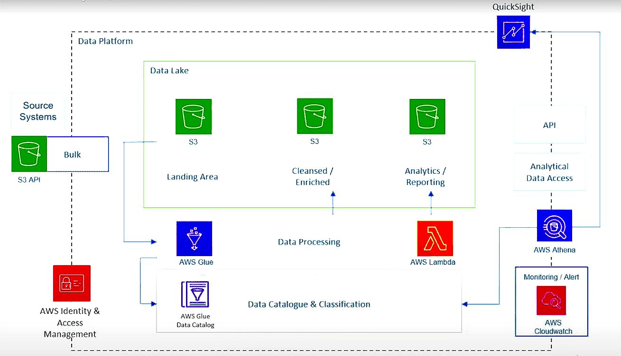
Graphical view of ETL Tools

Slide 13
Roadmap
Ingest YouTube data into S3 buckets using tools like AWS Data Pipeline for automated scheduling and data transfer. Relevant data could include video metadata, user analytics, comments, etc.
Implement AWS Glue ETL jobs to transform and enrich the YouTube data, cleaning invalid records and joining related datasets to generate analysis-ready datasets.
Schedule and automate the AWS Glue jobs using triggers to ensure fresh data is processed as it arrives in S3.
Create AWS Glue crawlers to catalog the processed datasets from S3 into the AWS Glue Data Catalog. This indexes data for querying.
Use AWS Athena to query the processed datasets using standard SQL for ad-hoc analysis. This avoids having to set up data warehouses.
Build visualizations and dashboards with metrics in AWS QuickSight connected to AWS data sources like Athena to surface insights.

Slide 14
Evaluation/ Metrics milestones
Number of YouTube video metadata/analytics records ingested.
Data throughput rates and data volume trends.
Glue ETL job success rates.
Data quality checks on completeness, duplication etc.
Usage trends of enriched datasets in Athena and QuickSight.
Dashboard usage and insight action rates.

Slide 15
THANK YOU

