Slide 1

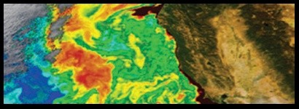
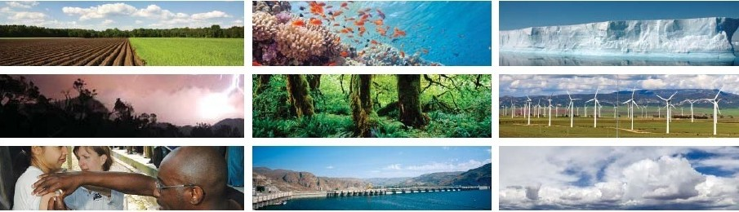

PACE
PACE IN THE CLASSROOM
TEAM NAME: sudheer_student
Collaborators:
Mr. JAGADISH ITIKALA
Mr. PARASARA BANDARU
Ms. SAI KALYANI DUNUKU
Ms. KAVYA DEVISETTY
Mr. ROSHAN BONAGIRI
Mr. SUDHEER REDDY BANDI

Slide 2
PACE WORK OVERVIEW
PACE
OBJECTIVES
PROPOSED SOLUTIONS
Create materials that teachers can use in classrooms across the world to integrate PACE data and the science it is enabling into curriculums and lessons.
How the information could best be translated for these various target audiences ?
We create an providing exciting and captivating materials to be integrated into the classroom, our project can help ensure that students know about the great discoveries PACE has made.
set of lesson plans, an informative video, a resource that allows PACE data access to be “kid friendly” and easy to use and understand, or something entirely different.
APPROACHES
Various teaching strategies for different grade levels
Multimedia data from PACE’s instruments—the Ocean Color Instrument (OCI), SPEXone polarimeter, and Hyper-Angular Rainbow Polarimeter #2 (HARP2)

Slide 3







MOTIVATION OF THE PACEVision
PACE
The PACE mission gives students a chance to explore how the oceans and atmosphere work together to support life on Earth. By using real data, students can learn about how clouds and plankton affect climate change and how light interacts with the environment. This project brings exciting science into the classroom, helping students understand the world better and inspiring them to think creatively about how to protect our planet for the future.

Slide 4
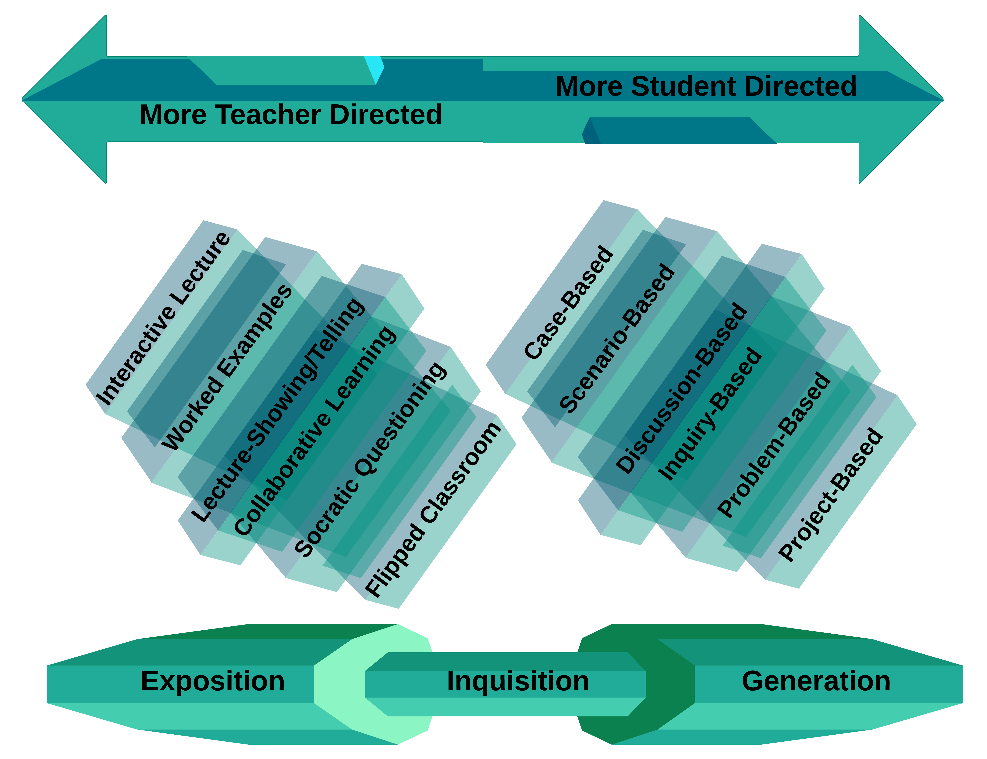

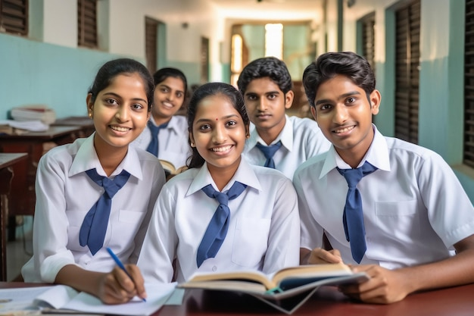
PACE TEACHING STRATEGY
PACE

Slide 5



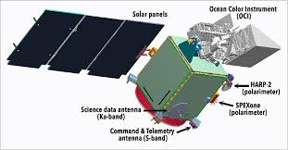
PACE PROCESS FLOW
PACE
Plankton
Material Type-I
Aerosol
Cloud
Material Type-II
Ocean-Ecosystem

Slide 6
TOOLS USED
PACE
API
Wget
Zipﬁle
Front end
Html
Css
JavaScript
Back end
FLASK

