Slide 1
Implementing Mask R-CNN
Sudheeradh | Chaitanya | Afreed | Abhishek

Slide 2
Instance Segmentation
Detecting objects and identifying boundaries at pixel level

Slide 3
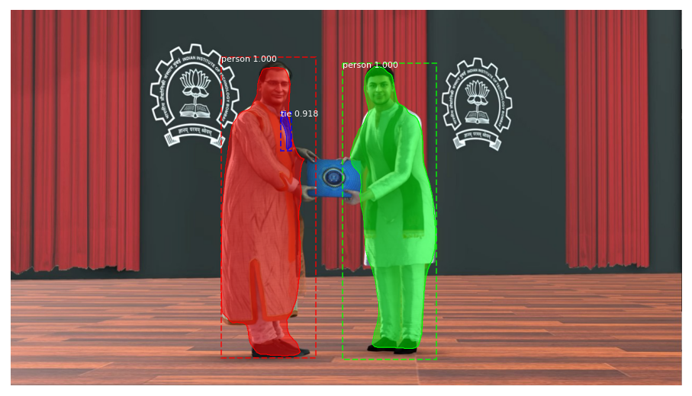

Slide 4
Background Study
RCNN
Fast RCNN
FasterRCNN

Slide 5
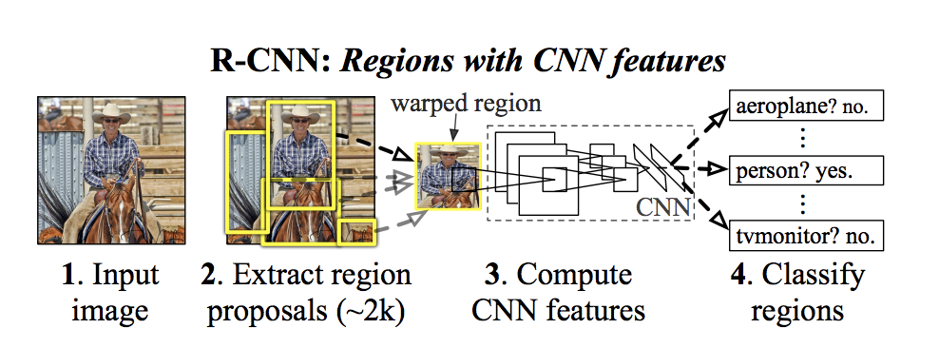
RCNN
S
SVM for classification
Selective search for Region proposals

Slide 6
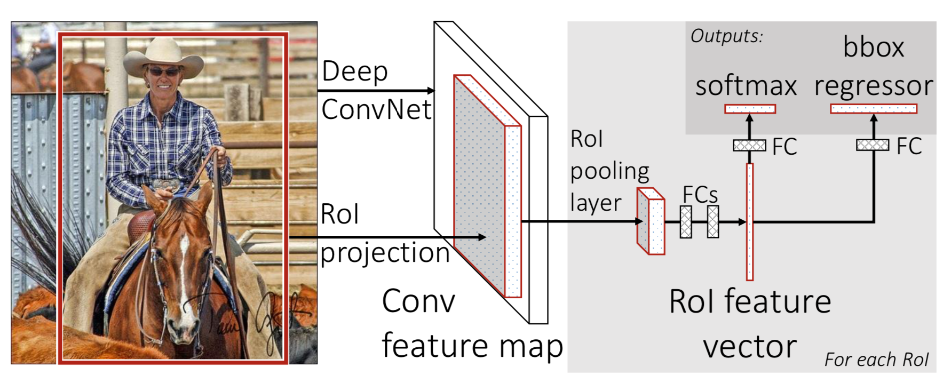
Fast RCNN
Ṣoftmax classifier
Bounding Box regressor
RoI Pooling Layer

Slide 7
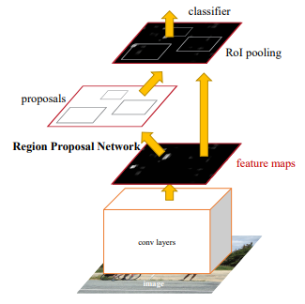
FasterRCNN
FastRCNN
+
Region Proposal Network

Slide 8
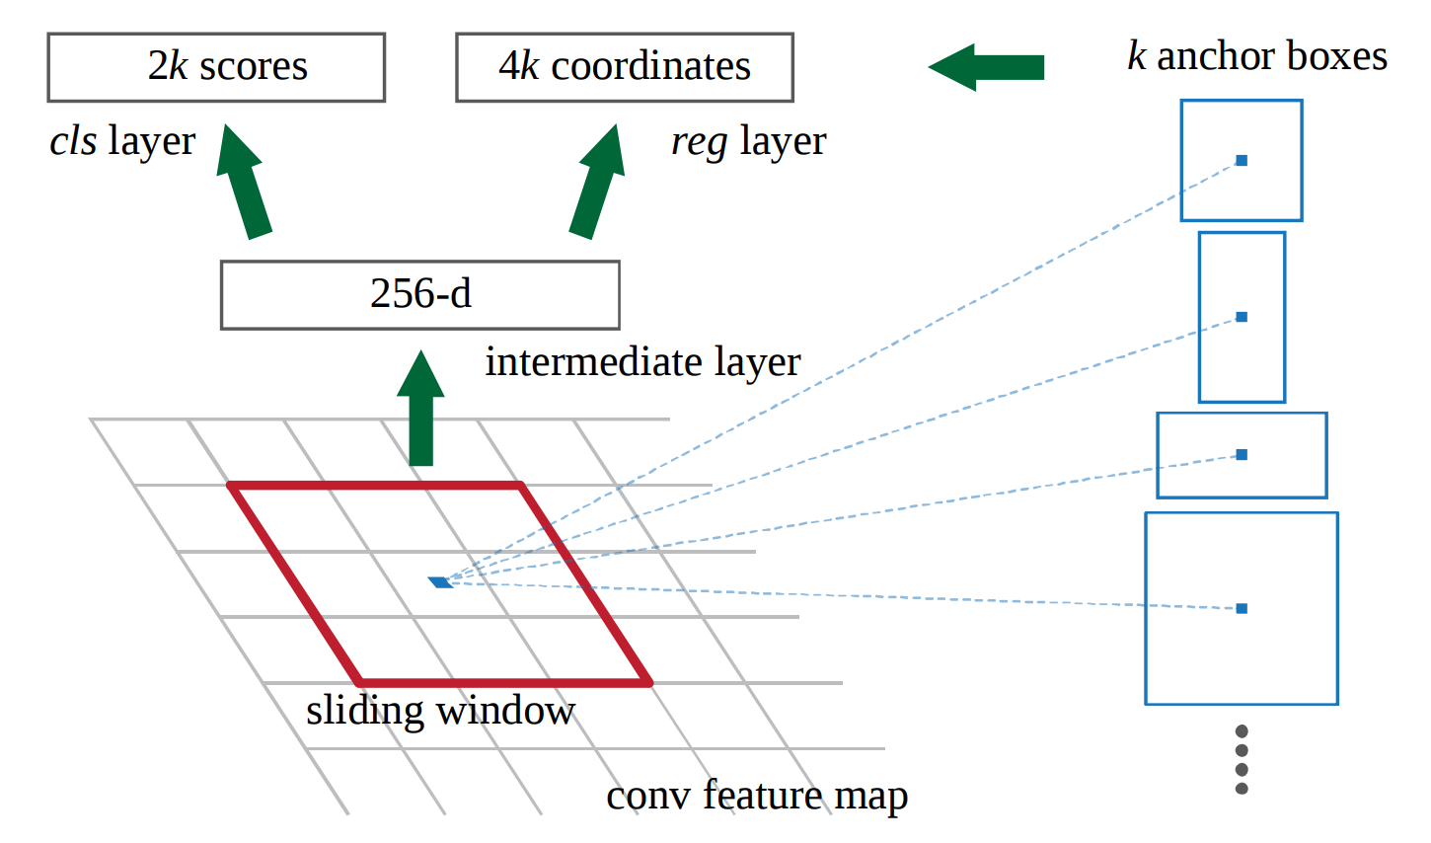
Region Proposal Network

Slide 9
MaskRCNN is an extension of
FasterRCNN by adding a branch
for mask prediction
MaskRCNN solves the problem of misalignment of region proposals by using RoIAlign

Slide 10
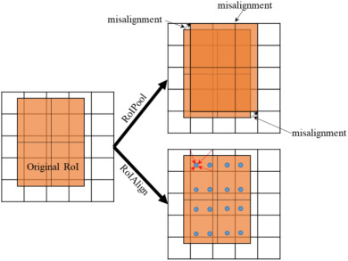
RoIPool -> RoIAlign
Increased accuracy of
mask prediction
from 10% -> 50%
Notes:
Avoids quantization of RoI boundaries done in RoI pool to remvove the harshness and uses bi-linear interpolation to compute exact values of the input features at regularly sampled locations

Slide 11
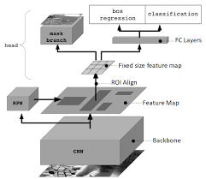
Model Architecture

Slide 12
Loss Function
Loss = (Classifcation loss) + (Bounding box loss)+(Mask Loss)
Mask loss is pixel-wise binary cross entropy loss. The definition of mask loss of MaskRCNN allows network to generate masks without competition among classes and thus decoupling mask and class prediction

Slide 13
Extension to Pose estimation
Mask R-CNN can be extended to pose-estimation by modeling a keypoint’s location as a one-hot mask and use MaskRCNN to pred

