Slide 1
Implementing Mask R-CNN for Instance Level Segmentation
Sudheeradh(18D070016)
Chaitanya(180070021)
Afreed(180070036)
Abhishek(180070052)

Slide 2
Instance Segmentation
Detecting objects and identifying boundaries at pixel level

Slide 3
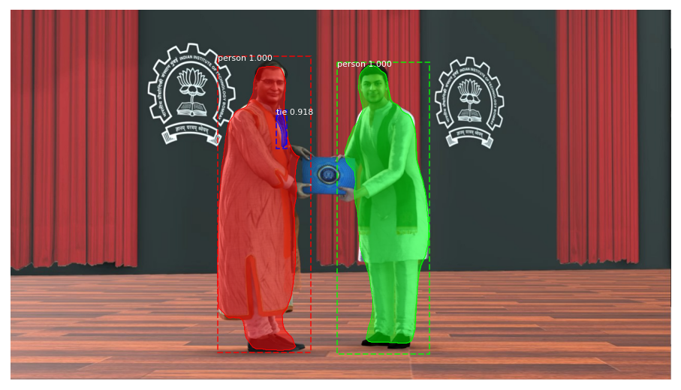

Slide 4
Background Study
RCNN
Fast RCNN
FasterRCNN

Slide 5
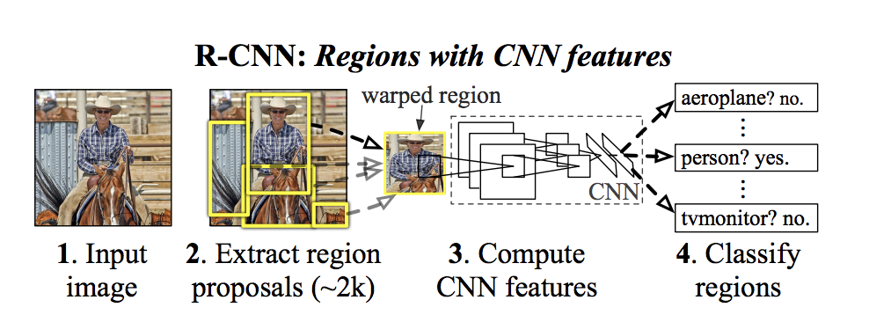
RCNN
S
SVM for classification
Selective search for Region proposals

Slide 6
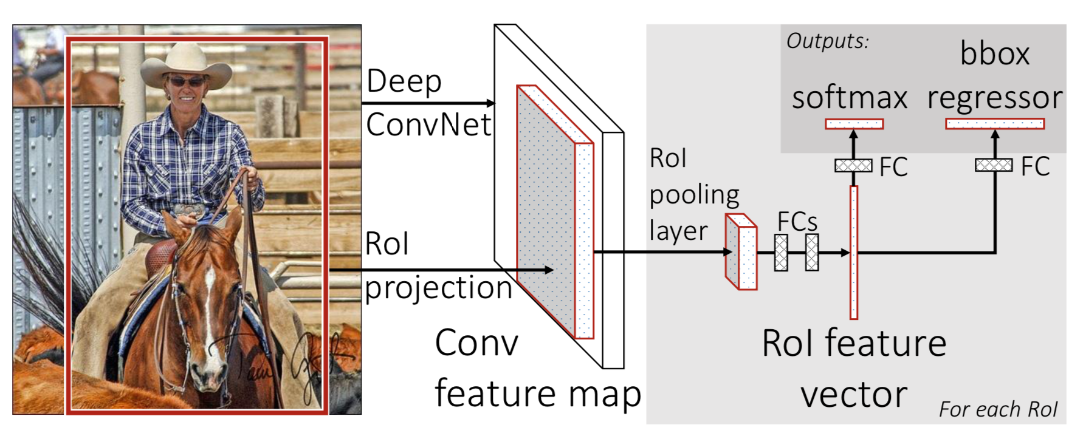
Fast RCNN
Ṣoftmax classifier
Bounding Box regressor
RoI Pooling Layer

Slide 7
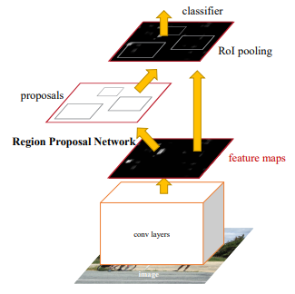
FasterRCNN
FastRCNN
+
Region Proposal Network

Slide 8
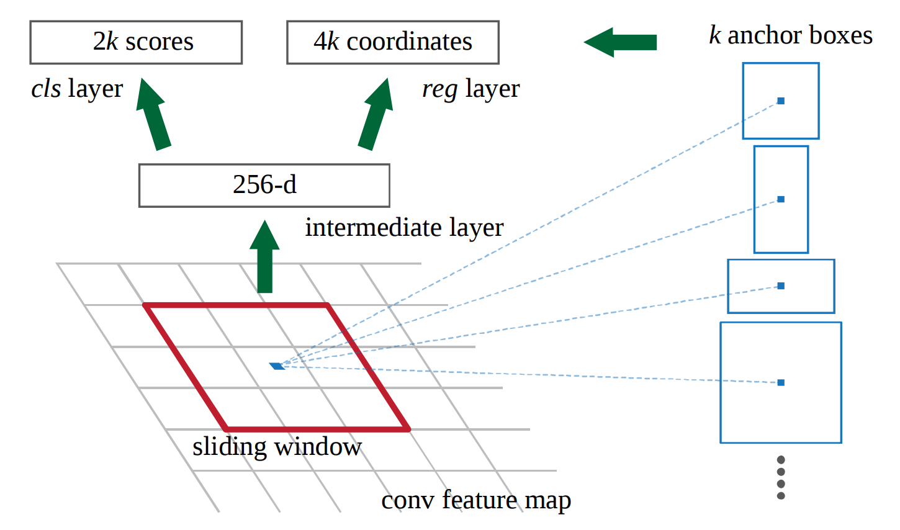
Region Proposal Network

Slide 9
MaskRCNN is an extension of
FasterRCNN by adding a branch
for mask prediction
MaskRCNN solves the problem of misalignment of region proposals by using RoIAlign

Slide 10
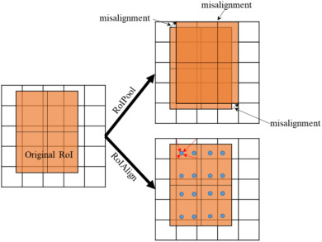
RoIPool -> RoIAlign
Increased accuracy of
mask prediction
from 10% -> 50%
Notes:
Avoids quantization of RoI boundaries done in RoI pool to remvove the harshness and uses bi-linear interpolation to compute exact values of the input features at regularly sampled locations

Slide 11
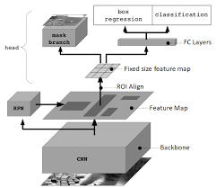
Model Architecture

Slide 12
Loss Function
Loss = (Classifcation loss) + (Bounding box loss)+(Mask Loss)
Mask loss is pixel-wise binary cross entropy loss. The definition of mask loss of MaskRCNN allows network to generate masks without competition among classes and thus decoupling mask and class prediction

Slide 13
Extension to Pose estimation
Mask R-CNN can be extended to pose-estimation by modeling a keypoint’s location as a one-hot mask and use MaskRCNN to predict K masks for each of the K keypoints

Slide 14
Future Work:
MaskRCNN is a robust baseline for instance level segmentation it was used for later models like:
Detect and Track: Efficient Pose Estimation in Videos

Slide 15
Contributions
K. Sudeeradh : Read the paper and adapted the code for Tensorflow 2 referring to the tensorflow 1 implementation, contributed to the topic selection.
Abhishek Sara: Collected resources for reference, referred to the previous research and later works done, made the slides and presentation, contributed to the implementation, contributed to the topic selection
Gardas Chaitanya, Afreed: Contributed to the topic selection, read the relevant papers, read the code and tested the inference for different images.

Slide 16
References
He, K., Gkioxari, G., Dollar, P. and Girshick, R., 2017, October. Mask R-CNN. In 2017 IEEE International Conference on Computer Vision (ICCV) (pp. 2980-2988).
https://github.com/matterport/Mask_RCNN

