Slide 1

EXPLORATORY DATA ANALYSIS
(AMCAT Dataset)

Slide 2
About me
Hi there!! Myself MADUGULA SUDHEER(IN9240750) I am a Recent B.Tech Graduate in Computer Science from Malla Reddy College of Engineering and Technology, Hyderabad
I want to learn Data Science because it combines my interest in problem-solving with the ability to derive meaningful insights from data. With my background in programming and engineering, I'm particularly drawn to the application of machine learning and analytics to solve real-world problems, helping organizations make data-driven decisions.
Fresher with hands-on experience in Python and data analysis tools like NumPy, pandas, Matplotlib, and Seaborn through projects and internships.
Feel free to reach out! You can do so by following the below links:
LinkedIn - https://www.linkedin.com/in/sudheermadugula/
GitHub - https://github.com/sudheerm18

Slide 3
Business Problem and Use Case-
Business Problem:
Context: The recruitment landscape is competitive, and organizations rely on academic metrics to evaluate candidates.
Challenge: Fresh graduates struggle to secure jobs, with a lack of clarity on the relationship between academic performance (AMCAT scores) and salary outcomes.
Objective:
Data-Driven Decisions: Inform hiring practices and salary negotiations through analysis of the AMCAT dataset.
Identifying Trends: Uncover trends to improve recruitment strategies regarding specialization and expected salaries.
Industry Relevance:
Tech Industry Focus: Understanding salary influences is crucial for candidates and employers in fast-growing fields.
Regional Insights: Analyze how geographical factors impact salary outcomes.

Slide 4
Objective of the Project-
Analyze Salary Trends:
Investigate how academic performance, specifically AMCAT scores, affects salary outcomes for fresh
graduates.
Identify Relationships:
Explore correlations between various factors such as specialization, college tier, and gender, and how
they influence salary expectations.
Validate Claims:
Assess the claim regarding salary expectations for Computer Science graduates as stated in the Times
of India article.
Determine whether graduates in technical roles meet the expected salary range of 2.5-3 lakhs.
Provide Insights:
Offer data-driven insights to stakeholders, including recruiters and educational institutions, to inform
hiring strategies and curriculum improvements.

Slide 5
Summary of the Dataset-
There are 38 columns in total that are used to find the individual impacts on salary.
Out of 38 columns, there are 29 numerical columns and 9 categorical columns.
With 3998 Data points that make our analysis to the optimal insights with all the necessary
Information.

Slide 6
Data Checks to Perform-
Check missing values, duplicated values and various different columns.
Check the data types and also look at the unique number of columns.
Check statistics of data set
Check various categories present in the different categorical column.
Drop unnecessary columns

Slide 7
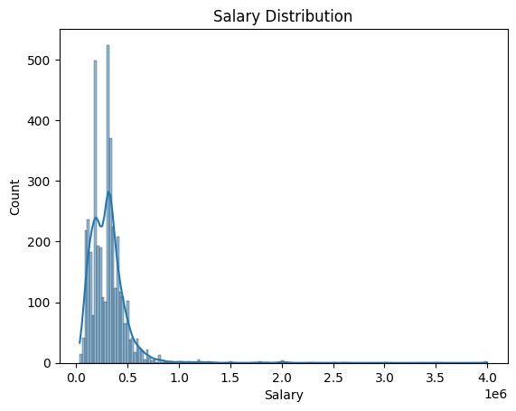
UNIVARIATE ANALYSIS-
Distribution:
Right-Skewed: Most candidates earn lower salaries; few earn significantly higher.
KDE Plot: Confirms concentration in lower salary range.
Outlier Detection:
Outliers: Several high-salary outliers indicate candidates in senior roles or high-paying industries.
Median Salary: Central value, with a narrow IQR suggesting most earn similar lower to mid-range salaries.
Insights:
Majority earn lower salaries; only a few command much higher pay.
Outliers suggest specific roles or locations warrant further analysis.

Slide 8
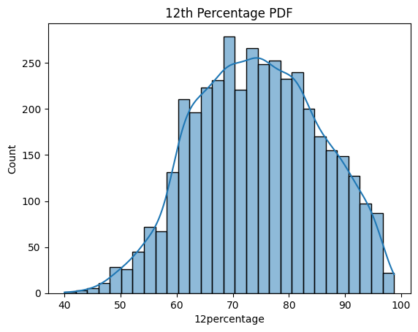
The PDF of 12TH Percentage Column-
Distribution:
Right-Skewed: Most students scored high, with a majority above 60%.
KDE Plot: Peaks between 70-90%, indicating strong academic performance.
Score Range:
Fewer students at the lower end (below 50%) and higher end (above 95%), suggesting extreme scores are less common.

Slide 9
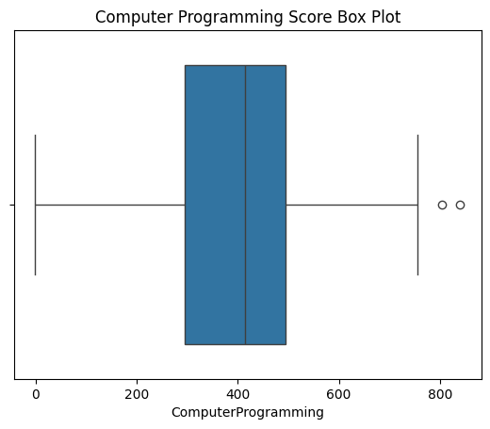
Outliers Detection on computer Programming Column-
Median Score: Around 75, with half of students scoring below and half above.
Interquartile Range (IQR): Spans from 65 to 85, indicating consistent performance among the central 50% of scores.
Outliers:
High Outliers (above 90): Indicate exceptional
performance, likely from students with strong programming skills.
Low Outliers (below 50): Suggest significant struggles, raising concerns for technical roles.

Slide 10
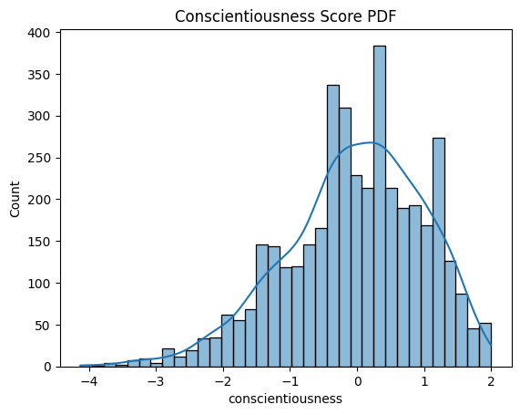
Conscientiousness Score PDF-
Distribution:
Right-Skewed: Most scores concentrated between 70-90, indicating high levels of conscientiousness among candidates.
KDE Peak:
Most common score is around 80, reflecting reliability and responsibility.
Low Scores:
Fewer candidates score below 50, suggesting that most students have at least a moderate level of conscientiousness.

Slide 11
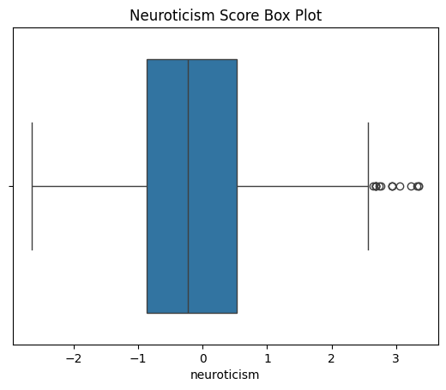
Finding Outliers on Neuroticism Column-
Median Score: Around 60, indicating half the students scored below and half above.
Interquartile Range (IQR): Spans from 50 to 70, suggesting moderate neuroticism among most candidates.
Outliers:
High Outliers (above 80): Indicate significantly higher levels of neuroticism, reflecting anxiety or emotional instability.
Low Outliers (below 40): Few candidates exhibit extremely low levels, suggesting that most have some degree of neuroticism.

Slide 12
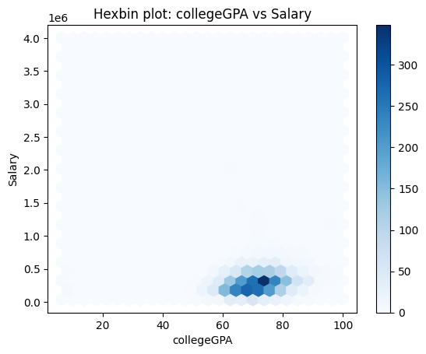
BIVARIATE ANALYSIS- (Numerical vs Numerical):
Data Density:
Darker hexagons indicate high concentration of data points, particularly around College GPA values between 7-8 and Salary values between 2-3 lakhs.
Weak Correlation:
The plot shows a weak positive relationship; higher GPAs do not consistently lead to higher salaries, with data points scattered across ranges.
Outliers:
Lighter hexagons indicate outliers where some candidates with lower GPAs earn higher salaries and vice versa.
Conclusion:
The weak density pattern suggests that College GPA has limited influence on Salary, indicating that other factors may significantly affect salary outcomes.

Slide 13
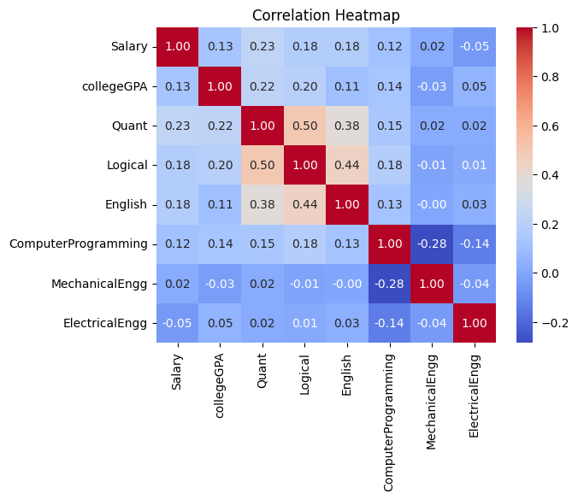
Correlation Heatmap across several Numerical columns and considering salary as target variable-
Correlation Coefficients:
Displays relationships between selected numerical variables.
Strongest Correlation:
Quant and Logical: Strong positive correlation (0.63).
Salary Correlations:
Moderate positive correlation with:
Quant (0.23)
Computer Programming (0.12)
Suggests higher scores in these areas may lead to higher salaries, but they are not strong predictors.
Weak Correlation:
Salary has weak correlations with college GPA (0.13) and Mechanical Engineering (0.14), indicating minimal influence.
Overall Insights:
While some variables show positive relationships, the overall correlation with Salary is weak, suggesting other factors may significantly affect salary outcomes.

Slide 14
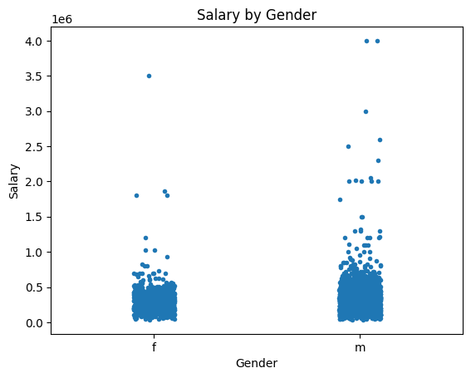
Let us see how salaries are vary’s in Gender- (Categorical VS Numerical):
Salary Distribution:
Males generally earn higher salaries, with most clustering above 3 lakhs.
Trends:
Female salaries show a broader spread, with some as low as 1.5 lakhs.
Outliers:
Both genders have outliers, especially among males with significantly higher salaries.
Variability:
Greater variability in female salaries indicates a wider range of earnings.
Conclusion:
The plot highlights a disparity in salary distribution, with males typically earning more than females.

Slide 15
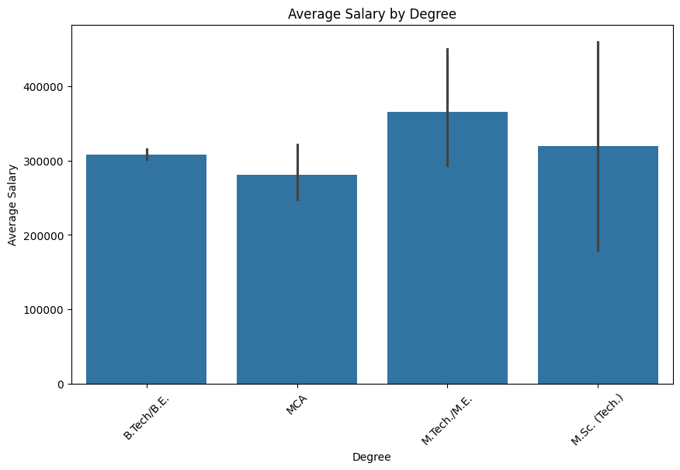
Checking Average Salary by Degree-
Average Salary Comparison:
Displays average salaries for different degrees; height indicates higher salaries.
Highest Average Salary:
Degrees like Master’s and B.Tech in Computer Science command the highest salaries, reflecting demand for technical skills.
Lowest Average Salary:
Diploma and B.A. degrees typically show lower average salaries, suggesting less lucrative job prospects.
Variability Among Degrees:
Some degrees have a wide range of salaries, indicating varied career paths.
Trends:
Engineering and technology degrees consistently show higher average salaries, reinforcing demand for technical skills.
Conclusion:
The plot highlights salary disparities across degrees, emphasizing the influence of educational qualifications on earning potential.

Slide 16
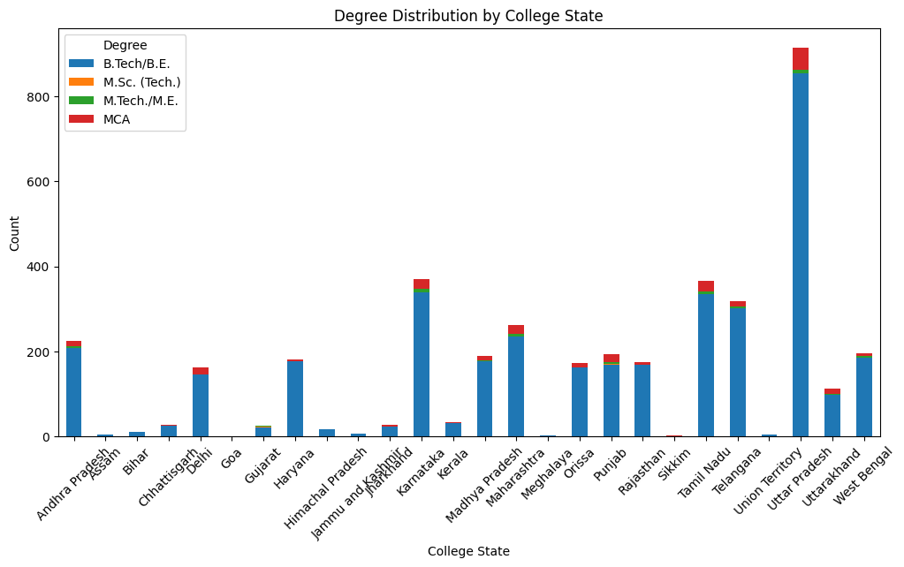
Stacked Bar Plot: Degree by College State- (Categorical VS Categorical):
Degree Dominance:
Degrees like Engineering and Management are more common in specific states, indicating regional popularity.
State Preferences:
States such as Maharashtra and Karnataka show diverse degree representation, suggesting a variety of educational programs.
Imbalance:
Some states exhibit clear dominance in certain degrees (e.g., Computer Science in Maharashtra), reflecting local industry demands.
Low Representation:
Low counts for degrees like Arts or Commerce may indicate fewer institutions or less interest in those fields.
Overall Trends:
Highlights variations in educational preferences by state, influenced by local job markets and industry presence.
Conclusion:
Provides insights into the correlation between College State and degree selection, identifying educational trends across regions.

Slide 17
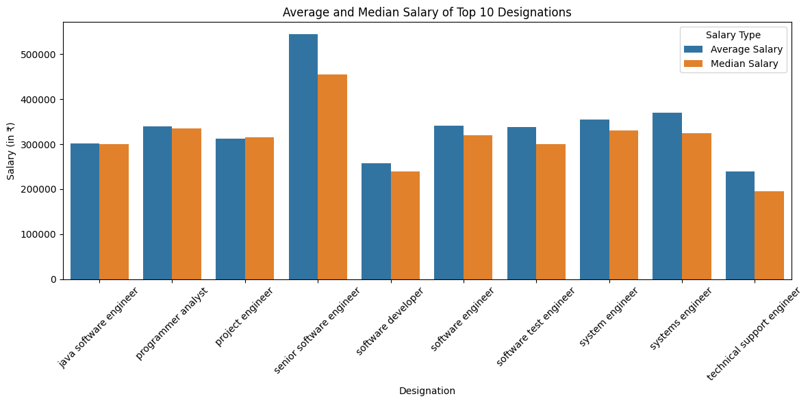
Research Question:1 (Determine whether fresh graduates earn 2.5-3 lakhs annually as stated in the article.)
Average vs. Median:
Average salaries are higher than median salaries, indicating some outliers with significantly high earnings.
Highest Salaries:
Roles like Software Engineer and Data Scientist command the highest salaries, reflecting high demand.
Lowest Salaries:
Intern and Trainee positions have significantly lower salaries, typical for entry-level roles.
Salary Variability:
A wider gap between average and median salaries indicates variability within certain designations.
Trends:
Technical roles generally offer higher salaries compared to non-technical roles.
Career Path Implications:
Highlights potential career paths, suggesting that specific specializations lead to better salary outcomes.

Slide 18
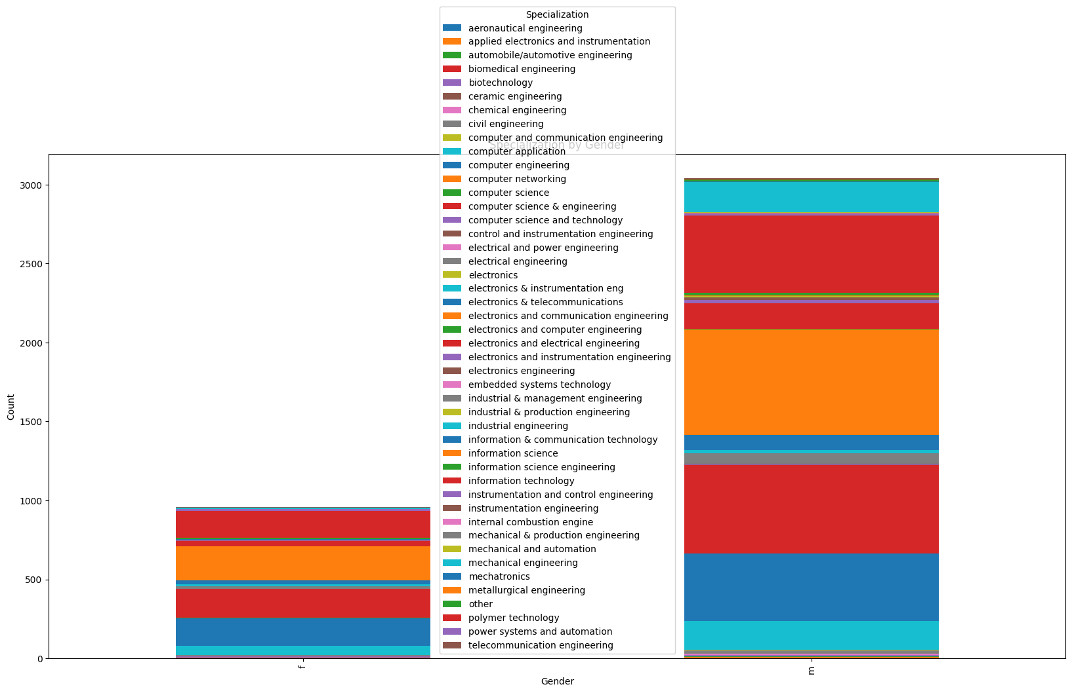
Research Question:2 (Is there a relationship between gender and specialization? (i.e. Does the preference of Specialisation depend on the Gender?) -
The graph shows that most specializations have a higher number of male graduates than female graduates.
There are a few specializations with a higher number of female graduates, but they are outnumbered by those with more male graduates.
The highest number of graduates is in Computer Science and Engineering, followed by Electronics and Communication Engineering.

Slide 19
Conclusion-
This project conducted an Exploratory Data Analysis (EDA) of the AMCAT Dataset to uncover insights regarding the relationships between academic performance, gender, specialization choices, and salary outcomes for fresh graduates.
Salary Trends:
Average salary for top 10 designations is ₹798,696, significantly exceeding the claimed ₹2.5-3 lakhs for Computer Science
graduates.
Right-skewed salary distribution indicates a few high earners influence the average.
Academic Performance:
Weak correlations found between College GPA and salary, suggesting other factors impact salary outcomes.
Gender and Specialization:
No significant relationship (p-value: 0.423) between gender and specialization preferences, indicating parity in choices.
Earnings Variability:
Outliers in salary data suggest certain roles command significantly higher pay.
Insights for Stakeholders:
Findings provide valuable benchmarks for recruiters and educational institutions to align curricula with industry demands.
Future Research:
Further studies could explore additional factors like work experience and geographic location affecting salary.

Slide 20

THANK YOU

