Slide 1

SMS SPAM CLASSIFIER
NATURAL LANGUAGE PROCESSING PROJECT
BATCH NO: 9
TEAM MEMBERS:
M. SYAM PRASAD – 25B21CS018
K. SAI RAHUL RAJ – 25B21CS043
M. NAGA ABHILASH – 24B11CS267
CH.V.SUDHEESH TEJA – 24B11CS063

Slide 2
CONTENTS
Introduction
Problem Definition
Proposed Solution
Proposed Workflow
Data Used
Modules :
Text Preprocessing/Preprocessing
Feature Extraction(Vector Representation)
Python Implementation(NLTK concepts)
NLP / ML Algorithm
Output/ Result
Conclusion and Future Scope

Slide 3
Introduction
SMS Spam Classifier is an NLP-based system designed to classify SMS messages into two categories: Spam and Ham. The system takes an SMS message as input and applies Natural Language Processing techniques to clean and prepare the text for analysis. This helps the system handle different words, sentence patterns, and message formats in a consistent way. The main goal is to automatically identify unwanted, promotional, or suspicious messages and distinguish them from genuine messages, thereby reducing the need for manual checking.
After preprocessing, the cleaned SMS text is converted into numerical feature vectors using TF-IDF (Term Frequency–Inverse Document Frequency). These features represent the importance of words in the messages and are provided as input to a Machine Learning classification model. In our project, Multinomial Naive Bayes is used to classify the message as Spam or Ham. The system provides a simple and practical application of NLP and Machine Learning.

Slide 4
PROBLEM DEFINITION
Nowadays, users receive a large number of SMS messages, including promotional, unwanted, and suspicious messages. Manually checking every message to identify spam is time-consuming and difficult. Spam messages can contain different words, offers, links, and message patterns, which makes automatic identification challenging. Therefore, there is a need for a system that can automatically analyse SMS content and distinguish Spam messages from genuine (Ham) messages. The proposed SMS Spam Classifier addresses this problem by using Natural Language Processing (NLP) techniques and Machine Learning to analyse incoming SMS messages and classify them as Spam or Ham. This helps users identify unwanted messages more efficiently, reduce manual checking, and improve overall message management.

Slide 5
PROPOSED SOLUTION
The proposed system is an SMS Spam Classifier that automatically classifies SMS messages into Spam or Ham. The system takes an SMS as input and first performs text preprocessing to clean and standardize the message. The cleaned text is then converted into numerical features using TF-IDF (Term Frequency–Inverse Document Frequency), which helps represent important words in the message. These features are given to a Machine Learning classification model, specifically Multinomial Naive Bayes, which predicts whether the message is Spam or Ham. The overall process is SMS Input → Text Preprocessing → TF-IDF → ML Model → Spam / Ham. The system helps users identify unwanted and suspicious messages automatically, reduces manual checking, and improves message management. It also provides a practical application of Natural Language Processing and Machine Learning for SMS classification.

Slide 6
MODULES
MODULES
1. Text Preprocessing
Converts SMS text into a clean and standard format.
Converts text to lowercase.
Removes unnecessary symbols and characters.
Prepares the text for further processing.
2. Feature Extraction
Uses TF-IDF (Term Frequency–Inverse Document Frequency).
Converts the processed SMS text into numerical feature vectors.
Identifies important words and patterns in the messages.
3. Python Implementation
Python is used to implement the NLP preprocessing and Machine Learning steps.
Libraries such as Pandas, Scikit-learn and NLTK can be used for data processing and text analysis.
The processed data is given to the classification model for prediction.
Overall Module Flow
SMS Input → Preprocessing → Feature Extraction → ML Classification → Spam / Ham

Slide 7
NLP/ML ALGORITHM
NLP ALGORITHM
1. Text Preprocessing
Cleans the SMS text before classification.
Converts text into a standard format.
Removes unnecessary symbols and characters.
2. TF-IDF
TF-IDF (Term Frequency–Inverse Document Frequency) converts text into numerical feature vectors.
It represents the importance of words in the SMS messages.
These numerical features are used by the Machine Learning model.
3. Multinomial Naive Bayes
A supervised Machine Learning classification algorithm.
It is used to classify text into Spam or Ham.
The model learns patterns from labelled SMS messages.
After training, it predicts the category of a new SMS.
Overall Process
SMS → Preprocessing → TF-IDF → Multinomial Naive Bayes → Spam / Ham
This matches the NLP/ML section of the review structure you shared, while using the algorithm planned for your SMS Spam Classifier.

Slide 8
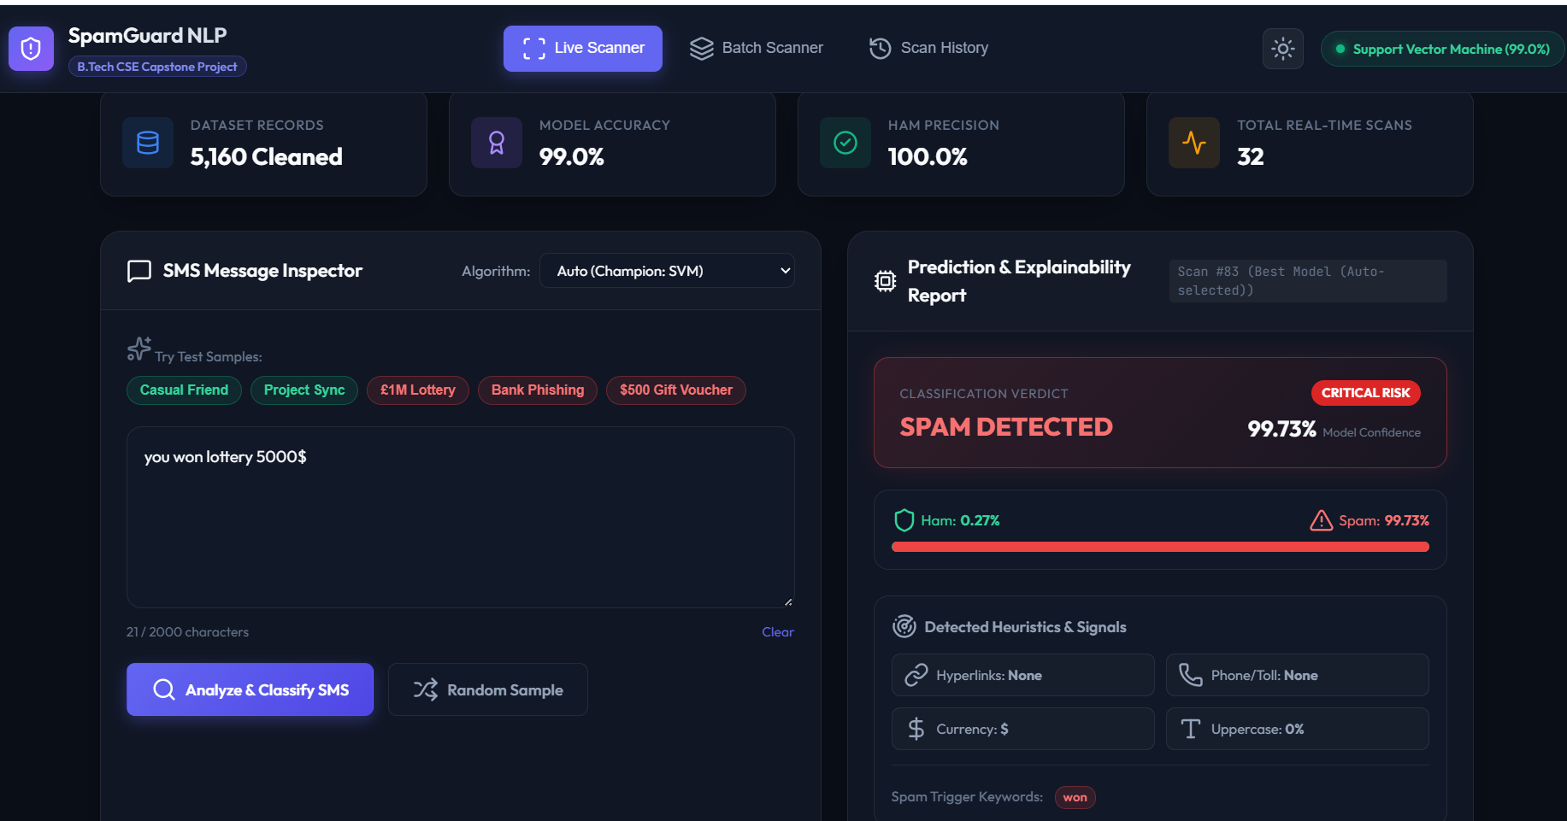
OUTPUT/RESULT
OUTPUT / RESULT
The developed SMS Spam Classifier takes an SMS message as input and predicts whether it is Spam or Ham.
The input SMS is cleaned using text preprocessing techniques.
The processed text is converted into numerical features using TF-IDF.
The trained Multinomial Naive Bayes model classifies the message.
The final output is displayed as SPAM or HAM.
The model performance can be evaluated using Accuracy, Precision, Recall and F1-Score.
Sample Output
Input:
“Congratulations! You won a free prize. Claim now!”
Result: SPAM
Input:
“Hi, I will come to college at 10 AM.”
Result: HAM
Note: Actual accuracy/result values should be added after running your final project; we shouldn't put a guessed accuracy in the PPT.

Slide 9
FUTURE SCOPE
Future Scope
Improve the classifier using advanced NLP and Machine Learning models.
Detect phishing messages and malicious links.
Support real-time SMS filtering and automatic spam detection.
Extend the system to detect spam emails.
Develop a web or mobile application for easy access.
Support multiple languages for better spam detection.
Continuously update and retrain the model using newly labelled messages.
Add user feedback to improve the accuracy of the classifier.

Slide 10
CONCLUSION
• SMS Spam Classifier combines NLP and Machine Learning for text classification.
• Preprocessing prepares raw SMS messages for analysis.
• TF-IDF converts text into numerical features.
• Multinomial Naive Bayes performs Spam/Ham classification.
• The system can automatically classify new SMS messages.
• The project demonstrates a practical NLP application.

Slide 11


