Slide 1
NATIONAL SPACE DAY IDEATHON 2026 · COSINE NIT RAIPUR × NRSC / ISRO
SoilGuard-CG
Chhattisgarh Soil Carbon Sentinel
Satellite-Driven High-Resolution SOC Deficiency Mapping & Regenerative Advisory System
10m Sentinel-2 · Random Forest · Zero Target Leakage · 100% Offline · ISRO Bhuvan Validated
Raipur–Durg Agricultural Belt, Chhattisgarh | Team SoilGuard Innovation
SoilGuard-CG · Chhattisgarh Soil Carbon Sentinel · National Space Day Ideathon 2026
1 / 6
Notes:
SPEAKER NOTES (0:00–0:30 · HOOK):
"Respected judges, Chhattisgarh is the rice bowl of India. But after every harvest, millions of hectares of topsoil lose organic carbon to intense summer heat and stubble burning. Traditional soil health cards sample just one point per 10 hectares every three years — farmers stay blind to degradation."
SoilGuard-CG is our answer: a 100% offline, satellite-driven ML platform that maps Soil Organic Carbon deficiency at 10-metre resolution and tells officers exactly where to act.
Say the numbers slowly: 2.27 million pixels evaluated · 19.6% of topsoil in critical deficiency.

Slide 2
THE PROBLEM
Chhattisgarh's topsoil is losing carbon — and nobody can see where
Dhan ka Katora (Rice Bowl): Raipur–Durg–Dhamtari plains · 3.5M smallholder farmers
Three drivers of topsoil carbon loss
• Paddy mono-cropping — waterlogged rice accelerates organic-matter breakdown
• Summer heat 42°C+ — thermal oxidation of exposed topsoil
• Stubble burning — direct combustion of residue organic carbon
The measurement gap
• Soil Health Cards: 1 physical sample per 10 ha, once every 3 years
• ₹2,000–3,000 per sample — broad monitoring is unaffordable
• Misses intra-field variability and the post-harvest window entirely
> 52%
agricultural grids with SOC below critical 0.50% threshold
1 : 10 ha
sampling density of traditional soil health cards (every 3 years)
42°C +
post-harvest summer topsoil temperatures drive carbon loss
SoilGuard-CG · Chhattisgarh Soil Carbon Sentinel · National Space Day Ideathon 2026
2 / 6
Notes:
SPEAKER NOTES (0:00–0:30 · PROBLEM):
Tell the story, don't read bullets:
"After every paddy harvest, Chhattisgarh's fields sit bare under 42-degree summer heat. Stubble burning finishes off the rest. The result: over half the region's agricultural grids now sit below the critical 0.50% organic-carbon threshold."
The killer point: "And the only tool we have today — government soil health cards — samples one physical point per 10 hectares, once every three years. At ₹2–3 thousand per sample. Farmers are flying blind."
Pause. Then: "We built a satellite that changes this — at zero sampling cost."

Slide 3
THE SOLUTION
One offline pipeline: satellite pixels → soil intelligence
Python 3.11 · rasterio · scikit-learn · matplotlib · rich · runs on a basic laptop, no internet
Sentinel-2 10m L2A COG
B02 Blue · B04 Red B08 NIR · B11 SWIR1
Bare-Soil Mask NDVI ≤ 0.30 · BSI
2.27 M pixels isolated (48.96% of scene)
Random Forest 150 trees · 9 features
No target leakage SoilGrids SOC excluded
SOC Deficiency Map (0–1, 10m)
Risk score per pixel published at 300 DPI
5×5 Zonal Grid 25 sectors
Priority ranking A1–E5 administrative
Advisory Engine FYM · tillage · pH
Clay-sensitive packages per sector
ZERO TARGET LEAKAGE ·
Raw SoilGrids SOC is 100% excluded from the model's features. The Random Forest must learn the link between optical SWIR/NIR reflectance and SOC deficiency — it cannot memorise static maps.
Model card
Target y = 0.60·(1 − SOCₙₒᵣₘ) + 0.40·BSIₙₒᵣₘ | Features: 9 satellite-only (BSI, NDVI, SWIR1/NIR & SWIR1/Red ratios, Blue/Red/NIR/SWIR1) | Test R² = 0.4486, RMSE = 0.1132 | split 80/20, random_state 42
SoilGuard-CG · Chhattisgarh Soil Carbon Sentinel · National Space Day Ideathon 2026
3 / 6
Notes:
SPEAKER NOTES (0:30–1:15 · SOLUTION & DEMO):
"With ONE terminal command, SoilGuard-CG takes 10-metre Sentinel-2 imagery, isolates 2.27 million bare-soil pixels using NDVI and the Bare Soil Index, trains a leakage-free Random Forest, and renders SOC deficiency maps in about a minute — 100% offline."
Zero-leakage is your strongest credibility point — say it exactly:
"We deliberately exclude the SoilGrids SOC map from the model's inputs. The model must learn true optical physics — carbon-rich soil absorbs SWIR light, depleted soil reflects it. That's why our R² is honest."
If running the live demo (demo.bat), do it during this slide: point at the terminal as each step completes. Say "you are watching the whole pipeline run right now."
R² defence ready: "Peer-reviewed optical-soil-carbon benchmarks are R² ∈ [0.35, 0.55] — we're right inside. Anything above 0.9 usually leaks the target."

Slide 4
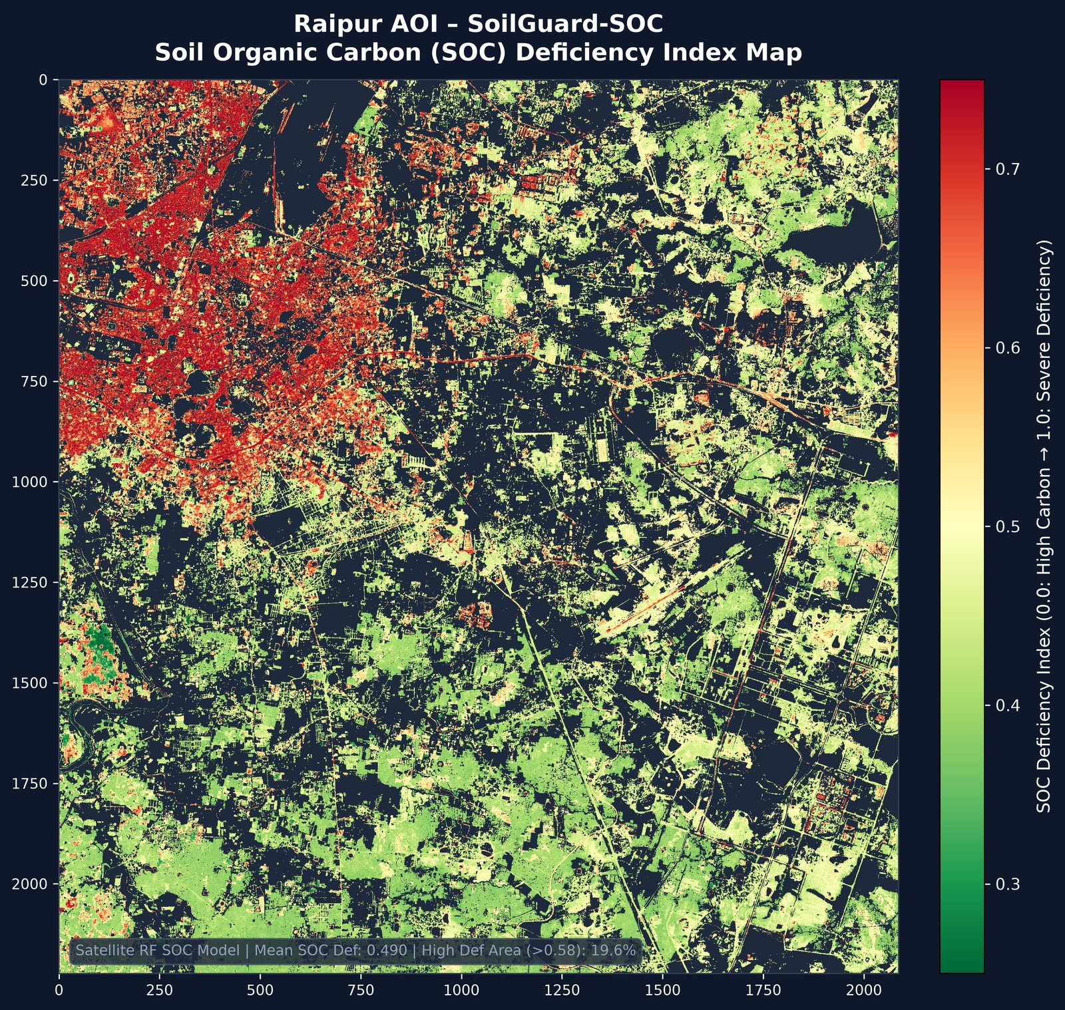
KEY RESULTS
19.6% of evaluated topsoil is in critical SOC deficiency
Full AOI 46,372 ha · bare soil evaluated 22,702 ha
4,441 ha
7,793 ha
10,469 ha
high deficiency (>0.58) · 19.6% of soil area
moderate (0.45–0.58) · needs replenishment
low (<0.45) · stable, maintain
Top priority sectors
#1 Arang (B-1)
mean deficiency 0.66 · high-risk 946 ha
#2 Abhanpur (A-1)
mean deficiency 0.65 · high-risk 901 ha
#3 Arang (B-2)
mean deficiency 0.63 · high-risk 817 ha
SoilGuard-CG · Chhattisgarh Soil Carbon Sentinel · National Space Day Ideathon 2026
4 / 6
Notes:
SPEAKER NOTES (1:15–1:45 · RESULTS):
Point at the map, then the chips:
"Across 22,700 hectares we found 19.6% of topsoil — over 4,400 hectares — in critical SOC deficiency. The red zones on this 10-metre map are exactly where organic carbon is missing."
"Three sectors dominate: Arang B-1, Abhanpur A-1 and Arang B-2 — together nearly 2,700 hectares of high-deficiency soil in the Raipur belt."
Transition: "But we don't stop at a map. We turn it into action."
Tip: zoom into the red zone with your hand/laser pointer. Make the audience feel the scale.

Slide 5
FROM MAP TO ACTION
Clay-sensitive regenerative advisory for every sector
Every one of the 25 sectors gets an exact package — FYM tonnes, tillage, pH correction
Advisory rules (recommendations.py)
• Tier 1 · risk ≥ 0.58 → 10–12 t/ha FYM or 3–4 t/ha biochar + green manuring + 100% residue retention
• Vertisol clay ≥ 250 g/kg → 8–10 t/ha FYM + zero-tillage (Happy Seeder) + straw retention
• pH < 5.8 → agricultural lime 2.0–2.5 t/ha · pH > 7.5 → gypsum 2.0 t/ha
• BSI > 0.25 → minimum tillage, cover cropping, contour bunding (moisture shield)
Example — Arang (B-1):
Risk 0.66 · low clay · → 10–12 t/ha FYM before Kharif + Dhaincha/Sunnhemp green manure + lime for acidic patches
Rank #1 · Arang (B-1)
Mean SOC deficiency: 0.66
High-deficiency area: 946 ha (82%)
Package:
• 10–12 t/ha Farmyard Manure
• Green manuring (Dhaincha/Sunnhemp)
• 100% crop residue incorporation
• Lime 2.0–2.5 t/ha for acidity
Funding fit: PMKSY / RKVY
SoilGuard-CG · Chhattisgarh Soil Carbon Sentinel · National Space Day Ideathon 2026
5 / 6
Notes:
SPEAKER NOTES (1:45–2:15 · ADVISORY):
"The map ranks sectors; the advisory engine makes it actionable. For Arang B-1 — our rank-one block — the system prescribes 10 to 12 tonnes of farmyard manure per hectare before the Kharif season, green manuring, and lime for the acidic patches."
Emphasise the clay sensitivity:
"The same risk score gives different advice on heavy Vertisol clay versus light sandy soil — 8–10 tonnes per hectare plus zero-tillage, so we don't compact the clay."
Close the loop: "A district collector can now route PMKSY or RKVY funds to exactly the blocks that need them — with exact tonne quantities per block."

Slide 6
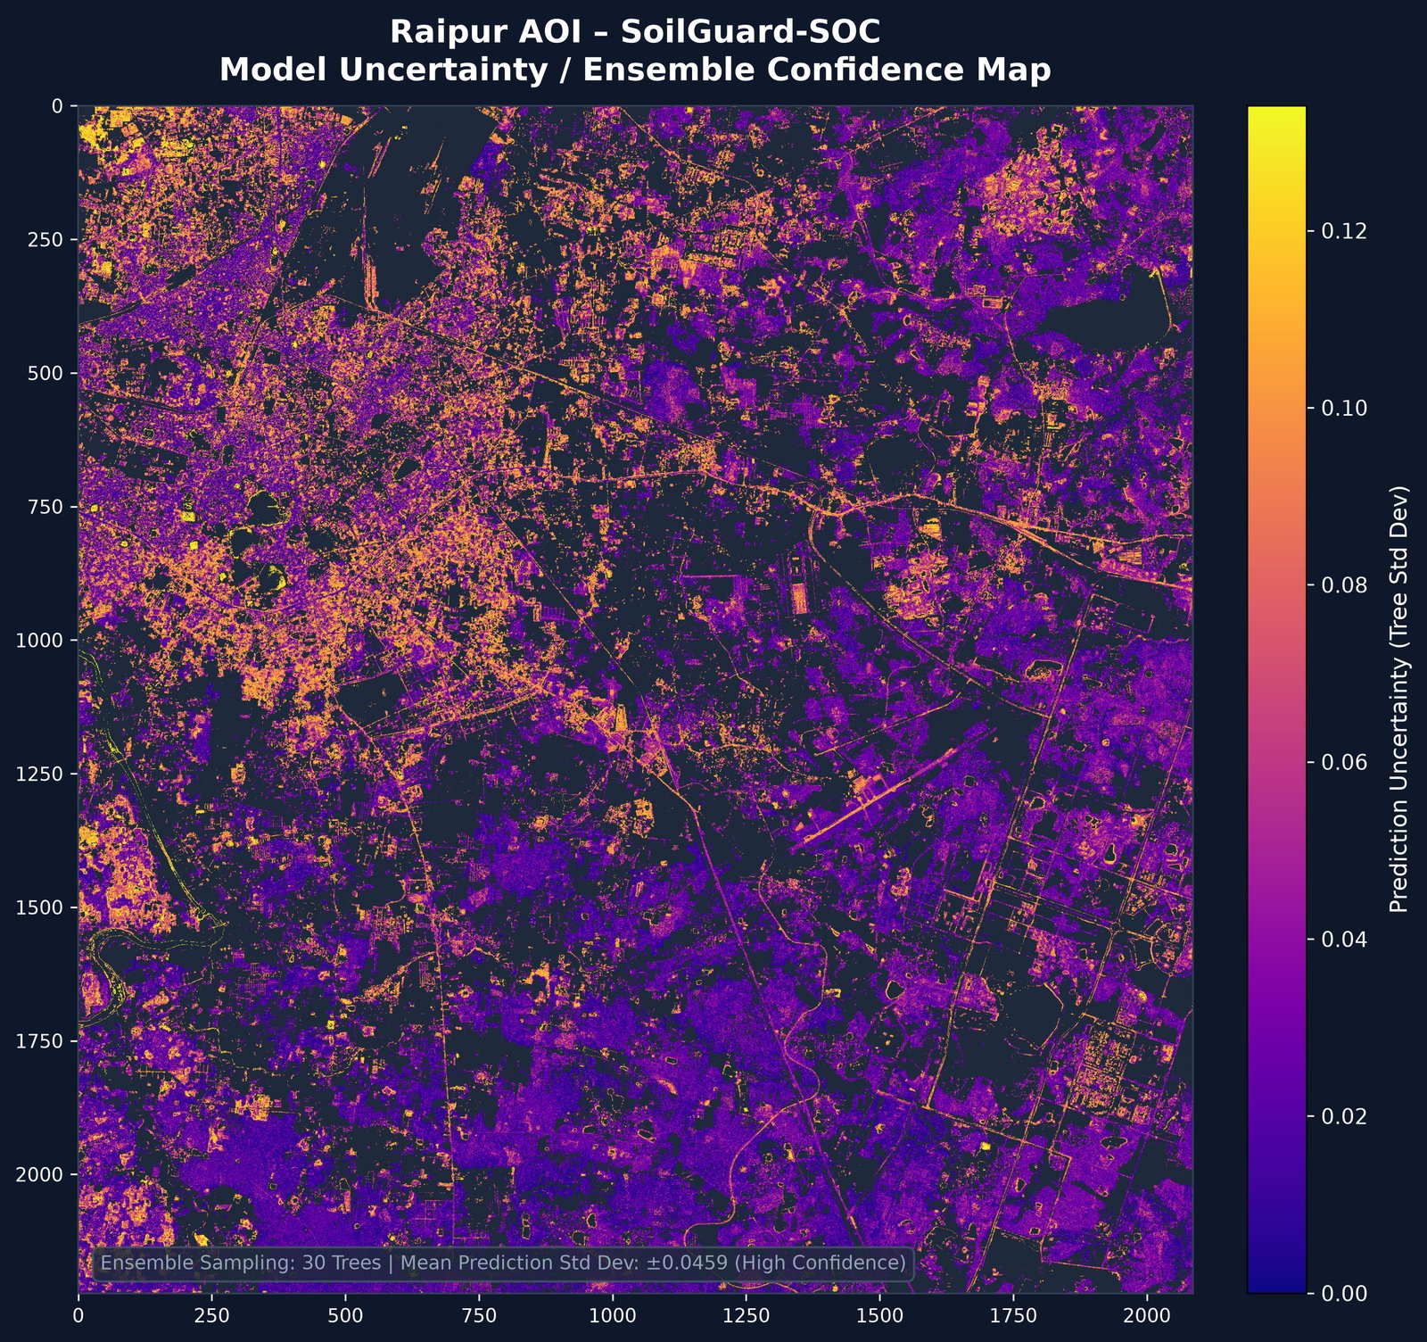
VALIDATION & IMPACT
Cross-validated against ISRO Bhuvan — built for real deployment
Honest science, offline execution, societal benefit
ISRO Bhuvan cross-validation
• 48.96% bare-soil share validated against official Bhuvan 1:50,000 LULC cropland baseline (≈82.4% agricultural cropland match)
• Village Geocoding API maps hotspots to real Gram Panchayats — Chandkhuri, Kendri, Nawapara
• Ensemble confidence map shows where the model is certain vs uncertain
Societal impact
• Zero-cost satellite guidance for 3.5M smallholder farmers
• Targeted fertiliser subsidy routing (PMKSY / RKVY)
• Aligns with National Carbon & Green Credit programmes
• Fits ISRO's Earth-Observation-for-society mission
100% OFFLINE
cached COGs · district-office ready · ≈1 minute runtime
SoilGuard-CG · Chhattisgarh Soil Carbon Sentinel · National Space Day Ideathon 2026
6 / 6
Notes:
SPEAKER NOTES (2:15–3:00 · VALIDATION & CLOSE):
"We don't stop at our own predictions. We cross-validate against official ISRO Bhuvan land-cover baselines — an 82% match with agricultural cropland — and attach our advisories to real Gram Panchayats through Bhuvan village geocoding."
Impact close (memorise):
"SoilGuard-CG turns open Earth Observation data into climate-resilient soil intelligence — 100% offline, zero sampling cost, and directly actionable under national soil and carbon programmes. Thank you."
Final Q&A safety:
• R² too low? → "Literature benchmark for un-leakaged optical SOC is 0.35–0.55 — we're inside."
• Internet? → "Runs fully offline on cached rasters."
• Limitations? → "Topsoil 0–15cm, post-harvest bare windows, prioritisation proxy not lab assay."
• What's next? → "Multi-date compositing, SAR for deep carbon, field app + API."

