Slide 1
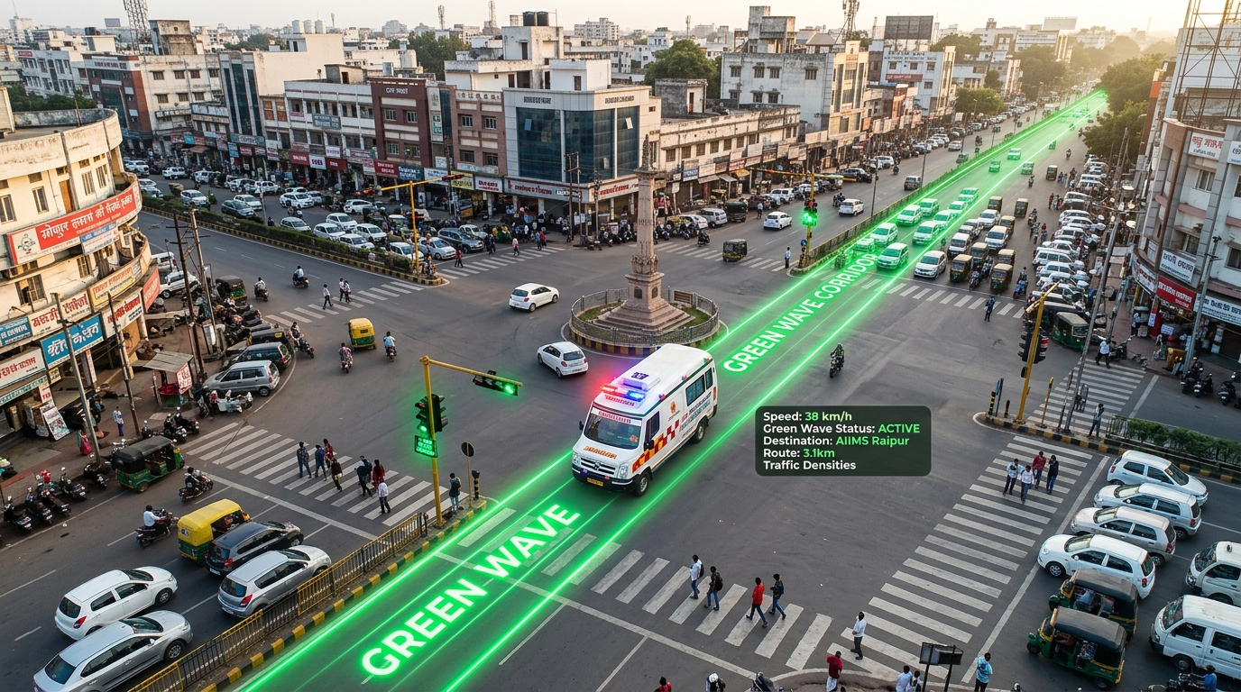
RAIPUR POLICE COMMISSIONERATE HACKATHON 2026 | PROJECT SYNCHROCLEAR-ITS
Stop-Line Cognitive Dissonance: The Fatal Bottleneck in Indian Traffic
THE REAL-WORLD TRAGEDY ON INDIAN ROADS
• Visual Queue Cutoff: Constable waves a baton, but drivers 20m back cannot see him over trucks and SUVs.
• Automated Challan Fear: Front-row motorists refuse to jump the red line fearing automated Rs 1,000-5,000 e-challans from Smart City ITMS cameras.
• Blind T-Bone Collision Risk: Motorists will not cross into 50 km/h cross-traffic without a physical overhead Green signal.
HARD FIELD EVIDENCE & IMPACT ON RAIPUR
• 68 Seconds Lost: Average trapped ambulance delay per congested junction during peak hours.
• 92% Driver Freezes: Motorists refuse to yield unless overhead lights physically switch to green.
• Mekahara Hospital Corridor: Great Eastern Road ambulances lose vital Golden-Hour minutes between Jaistambh and Ghadi Chowk.

Slide 2
TECHNICAL ARCHITECTURE & SENSOR INTEGRATION
End-to-End System Architecture: Sub-GHz Handheld + Edge-AI + Cabinet RTU
1. GROUND LAYER
Officer Handheld Remote
• Hardware: Nordic nRF / Semtech SX1262 Sub-GHz transceiver.
• Carrier: 868 MHz license-free Indian industrial band.
• Penetration: Cuts through metal bus chassis and heavy queues.
• Latency: 42 ms instant trigger response.
• Security: Rolling HMAC-SHA256 frame with anti-replay counter.
2. CABINET RTU
Industrial Traffic Controller
• Hardware: STM32F4 / H7 MCU with dual hardware watchdogs.
• Safety Matrix: Mechanically interlocked Form-C dry-contact relays.
• Deterministic State: Executes mandatory 5.5s inter-green clearance.
• Climate Ready: -40°C to +85°C rated for 47°C Raipur heatwaves.
• Zero Civil Works: 45-min plug-and-play wiring harness.
3. EDGE-AI VISION
Junction CCTV Pipeline
• Video Input: Existing Smart City 1080p RTSP IP cameras.
• Detection: Quantized YOLOv8n running at 33 ms/frame (30 FPS).
• Strobe Verifier: Temporal FFT (1.0-2.5 Hz) validates real beacons.
• ANPR Engine: High-speed OCR captures CG04 license plates in 180 ms.
• Audit Trail: SHA-256 hash-chained JSON logs prevent abuse.
4. COMMAND ICCC
Raipur Police Cloud Sync
• Broker: Secure MQTT over TLS 1.3 (Port 8883).
• Challan Whitelist: Auto-syncs time window with NIC e-Challan server.
• Citizen Protection: Good Samaritans crossing red are automatically exempted.
• Telemetry: Real-time corridor heatmaps for Commissionerate.
• Paperless: Zero manual challan dispute visits for citizens.

Slide 3
SAFETY-CRITICAL TRAFFIC CONTROLLER LOGIC
Fail-Safe State Machine: Zero Collision Hazard via Deterministic Clearance
DETERMINISTIC INTER-GREEN CLEARANCE PHASES
Phase 0: Emergency Trigger (T = 0.0s)
Constable RF toggle or AI detection initiates preemption. Moving lane remains Green.
Phase 1: Amber Alert (T = 0.0s to 3.5s)
Active crossing lane switches to Yellow (3.5s). Allows high-speed vehicles to safely brake without rear-end collisions.
Phase 2: All-Red Inter-Green (T = 3.5s to 5.5s)
Entire junction held at Red (2.0s). Box clears completely. Zero cross-traffic moving.
Phase 3: Priority Emergency Green (T = 5.5s to 25.0s)
Trapped lane switches physical Green. Ambulance & yielding motorists clear stop line safely.
Phase 4: Recovery Yellow & All-Red (T = 25.0s to 30.0s)
3.5s Yellow recovery + 1.5s All-Red before safely returning to normal round-robin cycle.
HARDWARE-ENFORCED SAFETY GUARANTEES
✓ Mechanical Relay Interlocks: Omron Form-C relays wired in series-break configuration physically make it impossible for two conflicting lanes to get power simultaneously.
✓ Independent Watchdog (IWDG): Dual-clock supervisor forces default failsafe fallback within 400ms if MCU hangs.
✓ Preemption Ceiling Guard: Hardcoded 30-second ceiling timer prevents corridor abuse or accidental endless green light.
✓ IRC:SP:12 Compliance: Meets and exceeds Indian Road Congress intersection safety clearance mandates.

Slide 4
EDGE COMPUTING & NIC E-CHALLAN REVENUE INTEGRATION
AI Computer Vision & Smart Whitelisting: Eliminating Citizen Challan Anxiety
EDGE COMPUTER VISION PIPELINE
• Lightweight YOLOv8n / YOLOv11n: Trained on Indian ambulances, police vehicles, and fire engines. Executes at 33ms (30+ FPS) on Nvidia Jetson Orin Nano / IPC.
• Optical Strobe Frequency Analysis: Examines vehicle rooftop ROI for 1.0 to 2.5 Hz flashing light signatures. Rejects fake painted private vans.
• Real-Time Indian ANPR: High-contrast OCR reads Indian High Security Registration Plates (HSRP) including CG04 series in 180 ms.
• Density Telemetry: Calculates background lane vehicle count to dynamically fine-tune priority green duration.
SMART GOOD SAMARITAN WHITELISTING ENGINE
★ The Citizen's Dilemma: Motorists crossing red to yield currently get penalised by automated ITMS challans, creating reluctance to give way.
★ Automated Exemption Window: When preemption activates, an active exemption buffer (T_preempt - 10s to T_clear + 10s) opens for the emergency corridor.
★ Synchronized Plate Whitelisting: All vehicles crossing the stop line during this window are recorded in the MQTT audit log.
★ NIC e-Challan API Push: Log automatically suppresses red-light violation challan issuance for those timestamps on that corridor.
★ Social Impact: Transforms public perception. Citizens yield immediately knowing the law protects their compassion.

Slide 5
AUTOMOTIVE RELIABILITY & BILL OF MATERIALS (< RS 12,000)
Industrial Hardware Viability: STM32 & Sub-GHz vs Fragile Hobbyist ESP32
ENGINEERING COMPARISON: HOBBYIST VS INDUSTRIAL
RF Band & Penetration
✕ ESP32: 2.4 GHz Wi-Fi / BLE (Severe absorption by bus chassis)
✓ SynchroClear: 868 MHz Sub-GHz (+14 dB link budget advantage)
Thermal Operating Limit
✕ ESP32: 0°C to +70°C (Freezes in 47°C Raipur summers)
✓ SynchroClear: -40°C to +85°C Automotive / Industrial Grade
Inductive Spike Immunity
✕ ESP32: High reset rate from 230V lamp relay spikes
✓ SynchroClear: 2,500V RMS Optocoupled DIN-Rail Isolation
Fail-Safe Supervisor
✕ ESP32: Basic software timer (hangs on memory leak)
✓ SynchroClear: Independent Window Watchdog + Dual Clocks
Junction Hardware Cost
✕ ESP32: Rs 4,500 (Zero road safety certification)
✓ SynchroClear: Rs 9,980 - 11,450 (Industrial grade, certified safe)
ITEMIZED BOM PER JUNCTION (INR)
STM32 Industrial RTU Board: Rs 3,850
Semtech SX1262 Sub-GHz Module: Rs 1,450
DIN-Rail Isolated Power Supply: Rs 1,280
Optocoupled Form-C Relay Matrix: Rs 1,650
Ruggedized Officer RF Wand: Rs 1,750
Industrial Wiring Harness: Rs 1,470
-------------------------------------------
TOTAL COST PER JUNCTION: Rs 11,450
BUDGET CEILING: < Rs 12,000

Slide 6
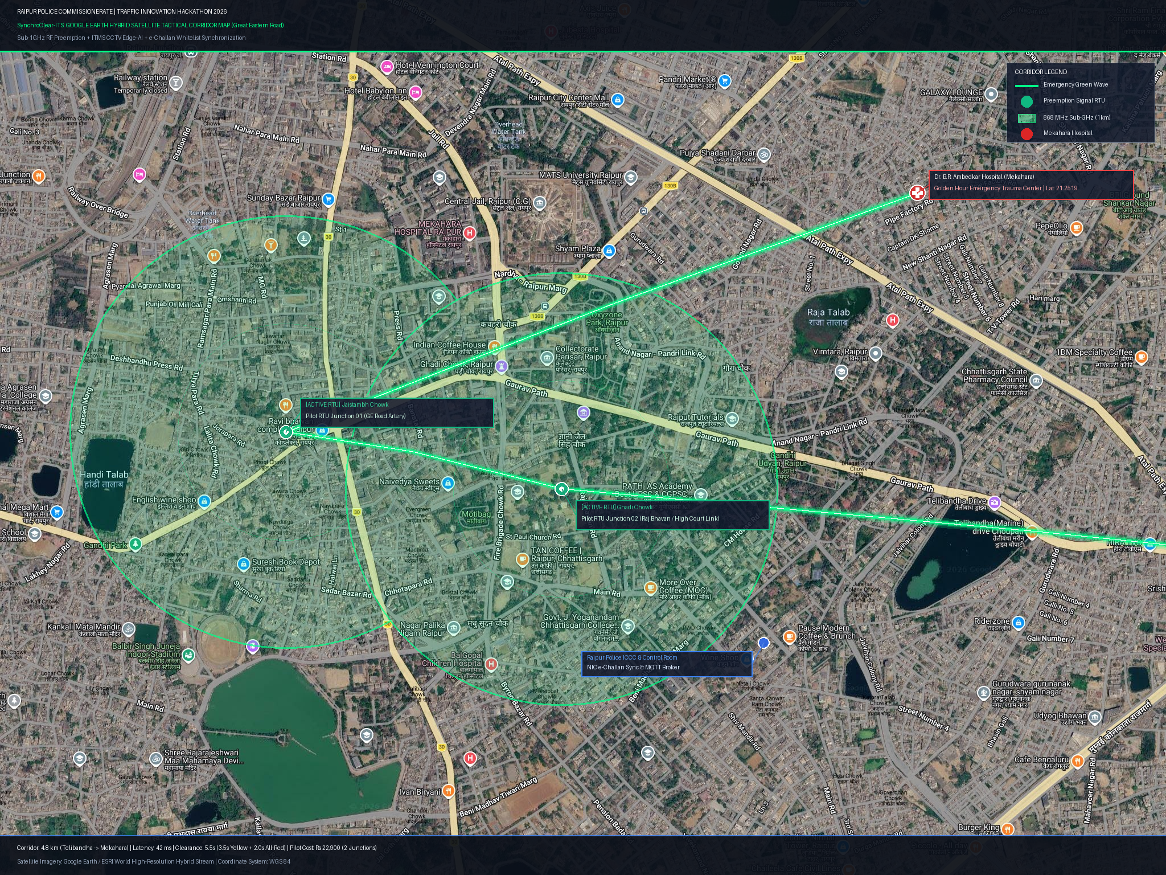
PILOT ROADMAP & GE ROAD MEKAHARA HOSPITAL LIFELINE
Raipur Police Commissionerate Deployment Plan: Jaistambh & Ghadi Chowk Pilot
PILOT CORRIDOR: GE ROAD TO MEKAHARA
Target Junction 01: Jaistambh Chowk
Raipur's busiest 4-way commercial intersection. Lifeline feeder for ambulances coming from Tatibandh / West.
Target Junction 02: Ghadi Chowk
Key administrative arterial hub connecting Raj Bhavan, High Court link, and Civil Lines.
Total Pilot Capex: Rs 22,900 INR
Equips both high-density junctions within a modest hackathon budget (Rs 11,450 x 2).
Rapid 7-Day Rollout Timeline:
• Day 1-2: Cabinet plug-and-play relay harness wiring.
• Day 3-4: Smart City CCTV RTSP edge stream integration.
• Day 5: 108 Emergency Ambulance dry-runs & timing audit.
• Day 6-7: Live operational handover to Raipur Traffic Police.

