Slide 1
Graph-ML Project
Contributors:
Kaizer Rahaman - 19IE35005
Sudheesh Kumar - 20IE35002

Slide 2
Introduction
Graph Representation Learning is a prominent area within the field of Graph Machine Learning, which plays a crucial role in comprehending intricate relationships inherent in data. In the present study, we study unsupervised graph representation learning. Our objective is to obtain significant node embeddings without the need for labeled data.
Our project is centered around the utilization of Variational Graph Auto-Encoders (VGAEs) and Contrastive Learning, as a pioneering approach in the field of Node Classification.
The present study focuses on the pragmatic obstacles associated with a scarcity or absence of annotated data, while also presenting groundbreaking perspectives on Graph Representation Learning.

Slide 3
Motivation
Variational Auto-Encoders (VAEs) : Type of generative DNN that combines ideas from autoencoders and probabilistic modeling. They consist of an encoder network that maps input data to a latent space representation, and a decoder network generates samples from the latent space. VAEs aim to ensure that the latent space follows a specific probability distribution, typically a Gaussian distribution. This enables the generation of new samples by sampling from distribution and decoding the samples using the decoder network.
Contrastive Objective: Incorporating a contrastive objective, manifested through a discriminator, to refine the quality of node embeddings. This strategic enhancement focuses on distinguishing the embeddings of the same node in two distinct views while discerning them from other node embeddings.

Slide 4




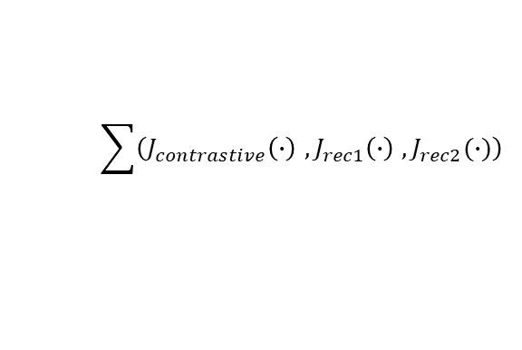













Model Architecture
$$A_{1}∈ ℝ^{N×N}$$
$$X_{1}∈ℝ^{N×F_{1}}$$
$${\tilde{A}}_{1}∈ ℝ^{N×N}$$
$${\tilde{X}}_{1} ∈ℝ^{N×F_{1}}$$
$$A ∈ ℝ^{N×N}$$
$$X ∈ℝ^{N×F}$$
$$Z_{1}∈ ℝ^{N×F_{1}^{′}}$$
$$G_{1} → 〈A_{1}, X_{1}〉$$
$${\tilde{G}}_{1} →〈{\tilde{A}}_{1}, {\tilde{X}}_{1}〉$$
$$Preprocess$$
RE, MF
$$Encoder$$
$$Decoder$$
$$G$$
$$U$$
$$G_{2} →〈A_{2}, X_{2}〉$$
$$V$$
$${\tilde{G}}_{2} →〈{\tilde{A}}_{2}, {\tilde{X}}_{2}〉$$
$$A_{2}∈ ℝ^{N×N}$$
$$X_{2}∈ℝ^{N×F_{2}}$$
$$Z_{2}∈ ℝ^{N×F_{2}^{′}}$$
$$\sum{\left(J_{contrastive}\left(∙\right) ,J_{rec1}\left(∙\right) ,J_{rec2}(∙)\right)}$$
$${\tilde{A}}_{2}∈ ℝ^{N×N}$$
$${\tilde{X}}_{2} ∈ℝ^{N×F_{1}}$$

Slide 5











Encoder Net
$$A_{1}∈ ℝ^{N×N}$$
$$X_{1}∈ℝ^{N×F_{1}}$$
$$Z_{1}∈ ℝ^{N×F_{1}^{′}}$$
$$G_{1} → 〈A_{1}, X_{1}〉$$
$$Encoder$$
$$U$$
$$V$$
$$G_{2} →〈A_{2}, X_{2}〉$$
$$Z_{2}∈ ℝ^{N×F_{2}^{′}}$$
$$A_{2}∈ ℝ^{N×N}$$
$$X_{2}∈ℝ^{N×F_{2}}$$
$$Z_{1}∈ ℝ^{N×F_{1}^{′}}$$
GCNConv
$$U$$
GCNConv1
ReLU
GCNConv2
ReLU
$$V$$
GCNConv
$$Z_{2}∈ ℝ^{N×F_{2}^{′}}$$

Slide 6

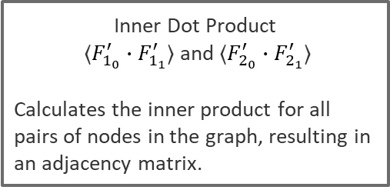



Decoder Net
$$Z_{1}∈ ℝ^{N×F_{1}^{′}}$$
$${\tilde{A}}_{1}∈ ℝ^{N×N}$$
$${\tilde{X}}_{1} ∈ℝ^{N×F_{1}}$$
$$U$$
$${\tilde{G}}_{1} →〈{\tilde{A}}_{1}, {\tilde{X}}_{1}〉$$
$$V$$
$$Decoder$$
$$Z_{2}∈ ℝ^{N×F_{2}^{′}}$$
$${\tilde{G}}_{2} →〈{\tilde{A}}_{2}, {\tilde{X}}_{2}〉$$
(+/-) Edge Index
$${\tilde{A}}_{2}∈ ℝ^{N×N}$$
$${\tilde{X}}_{2} ∈ℝ^{N×F_{1}}$$
Inner Dot Product
〈$F_{1_{0}}^{′}∙F_{1_{1}}^{′}$〉 and 〈$F_{2_{0}}^{′}∙F_{2_{1}}^{′}$〉
Calculates the inner product for all pairs of nodes in the graph, resulting in an adjacency matrix.

Slide 7
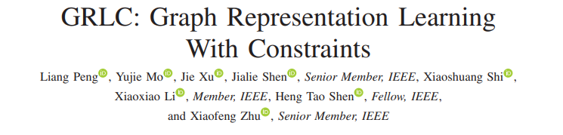
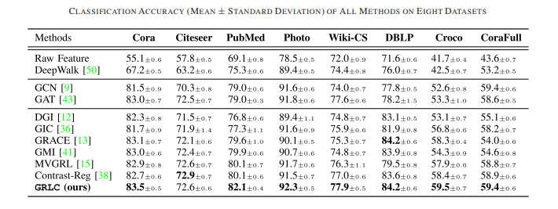
Baselines
The present state of the art is the following paper published in 2022
However, we observe that GRLC is computationally very expensive and hence could not replicate its results. Therefore, we choose GRACE to be our baseline which provides consistently close results across the Cora, Citeseer, PubMed and DBLP datasets.

Slide 8
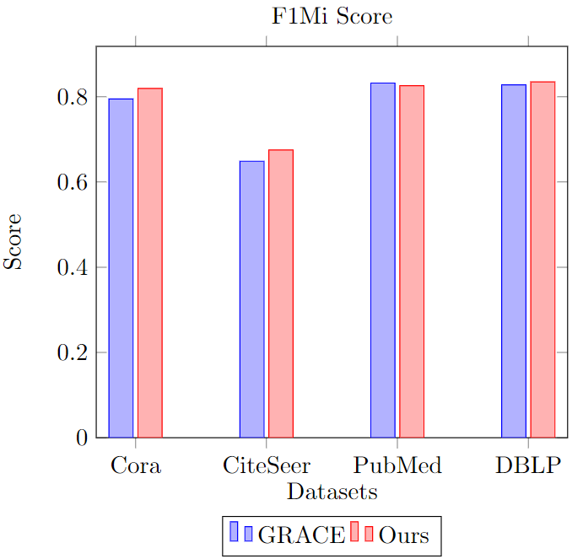
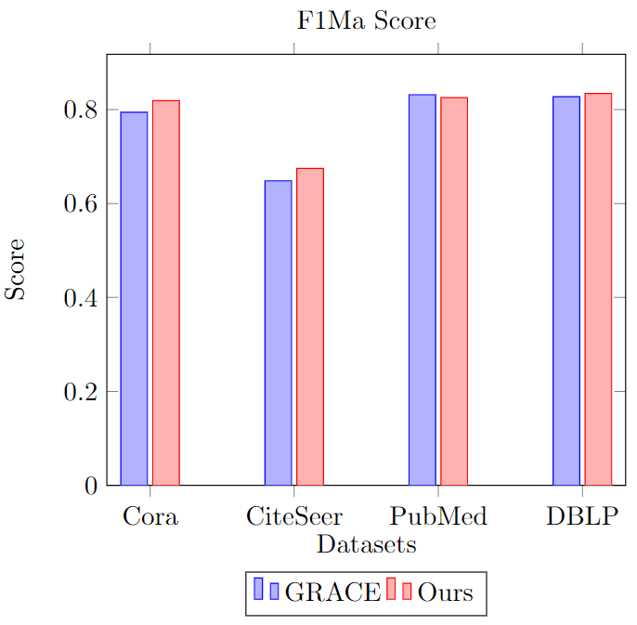
Results

Slide 9
Results
The F1Mi Score Comparison:
Dataset | GRACE | Ours
Cora | 0.7945 | 0.8194
CiteSeer | 0.6485 | 0.6750
PubMed | 0.8319 | 0.8256
DBLP | 0.8277 | 0.8345
The F1Ma Score Comparison:
Dataset | GRACE | Ours
Cora | 0.7819 | 0.8039
CiteSeer | 0.6108 | 0.6288
PubMed | 0.8282 | 0.8188
DBLP | 0.7814 | 0.7894

Slide 10
Conclusion
Our exploration into unsupervised graph representation learning, leveraging Variational Graph Auto-encoders (VGAEs) for Node Classification, has yielded promising results across diverse datasets. The model, referred to as "Ours," has been compared against the established GRACE algorithm.
The F1Mi and F1Ma scores demonstrate the efficacy of our proposed approach, consistently outperforming GRACE across 3 out of 4 datasets. Notably, the model performs better in capturing node classifications, as evidenced by the higher scores.
In conclusion, our proposed VGAE-based approach for unsupervised graph representation learning, when applied to the task of Node Classification, demonstrates significant advancements over the GRACE algorithm. These findings underscore the potential of VGAEs in modelling the intricate structures of graph data, providing a valuable contribution to graph machine learning.

Slide 11
Scopes for the future
We aim to further improve this design by considering different loss functions to train the Autoencoder.
Specifically, in our present decoder we take the inner dot product of the two latent representations of the two corrupted graphs separately. However, we can also take an intra dot product between the latent representations of the two separate corrupted graphs(which are different views of the same graph)
We can have a temporal component considering if a dynamic graph is our input.

Slide 12
References
Deep Graph Contrastive Representation Learning - arXiv:2006.04131 [cs.LG]
An Empirical Study of Graph Contrastive Learning - arXiv:2109.01116 [cs.LG]
Variational Graph Auto-Encoders - arXiv:1611.07308 [stat.ML]
Motivation [1] [2]

Slide 13
THANK YOU

