Slide 1




ML REINFORCEMENT
PROJECT
NAME : SUDHESHNA M
BATCH : JULY-2025

Slide 2


Introduction
Dataset: Heart Disease dataset
Objectives:
  Understand and clean the raw heart data.
  Perform exploratory data analysis to uncover patterns.
  Identify whether heart disease or not.
  Identify best accuracy of the ML model.

Slide 3


Data Understanding
Age, Sex, ChestPainType, RestingBP, Cholesterol, FastingBS, RestingECG, MaxHR, ExerciseAngina, Oldpeak, ST_Slope, HeartDisease
Understanding:
  Import dataset
  head()
  info()
  Shape
  describe()
  columns

Slide 4
Data Cleaning
  No major missing values were found.
  Converted categorical variables like ‘cp’, ‘thal’, and ‘slope’ to numerical using Label Encoding.
  Checked for and removed duplicates if any.
  Standardized feature values using StandardScaler for consistent model performance.

Slide 5
Outlier Handling
  Identification: Outliers in numerical columns were identified using visualization.
  Visualization: Box Plot
  Statistical Method:
    Lower bound = Q1​−1.5×IQR
    Upper bound = Q3​+1.5×IQR

Slide 6
Data Visualization
Importance:
  Visualizations make complex data patterns easily understandable.
  They are essential for identifying trends, outliers.
Types of visualization:
  Box Plot
  Violin Plot
  Bar Plot
  Scatter Plot
  Pair Plot
  Line Plot, etc ...

Slide 7
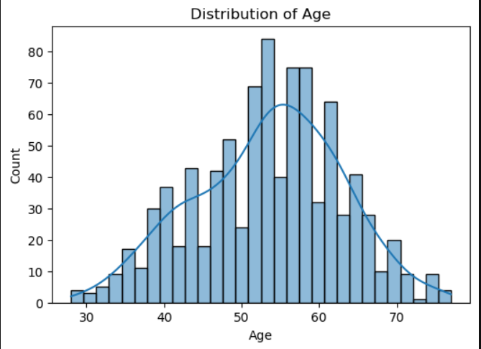
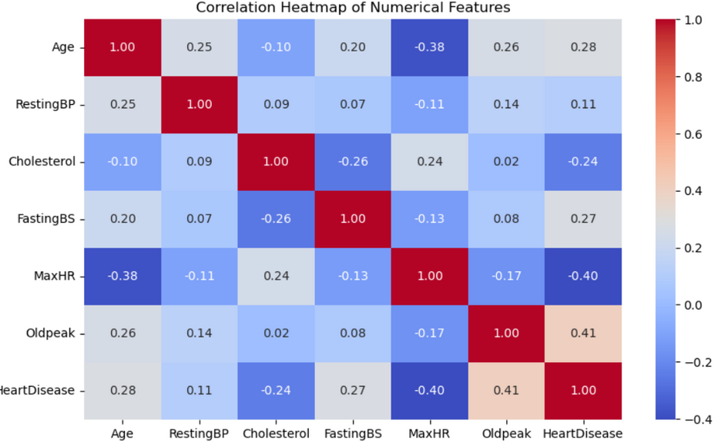
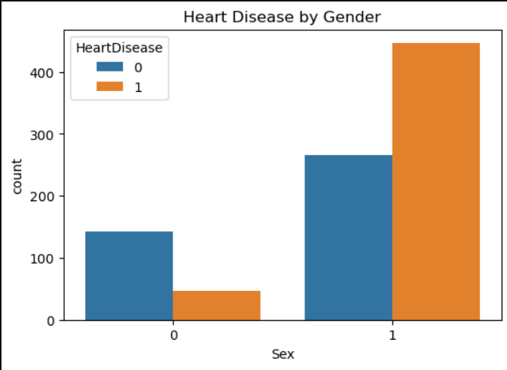

Slide 8
Feature Selection & Preprocessing
  Split dataset into train and test sets (80:20).
  Applied StandardScaler to normalize features.
  Defined feature set X and label y (Target).

Slide 9
Machine Learning Models
  Logistic Regression – Baseline model for binary classification.
  K-Nearest Neighbors (KNN) – Distance-based learning.
  Support Vector Machine (SVM) – Finds optimal decision boundary.
  Decision Tree Classifier – Interpretable tree-based model.
  Random Forest Classifier – Ensemble of decision trees for better accuracy.
  XGBoost Classifier – Gradient boosting algorithm for high performance.

Slide 10
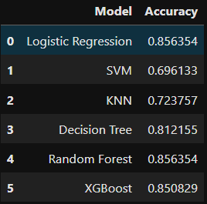
Model Evaluation

Slide 11
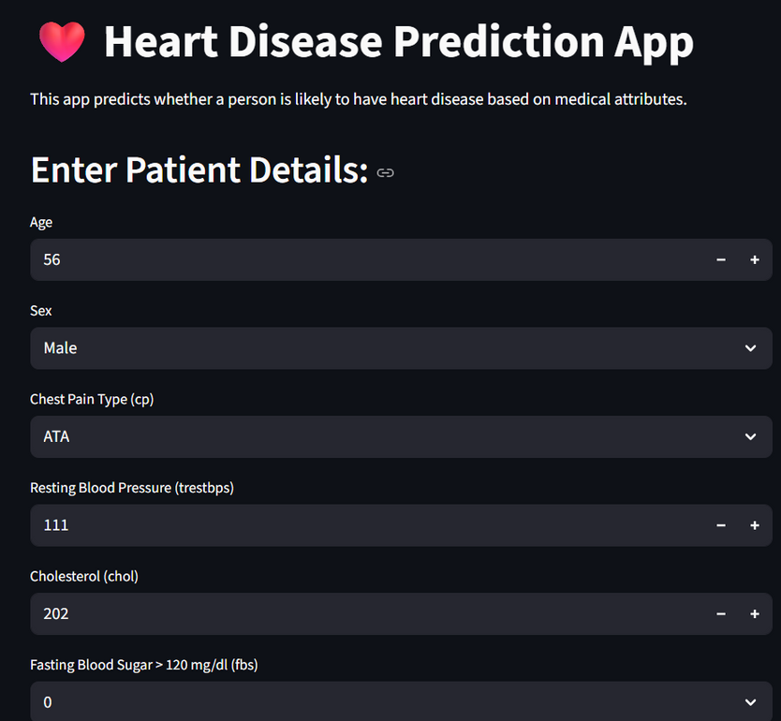
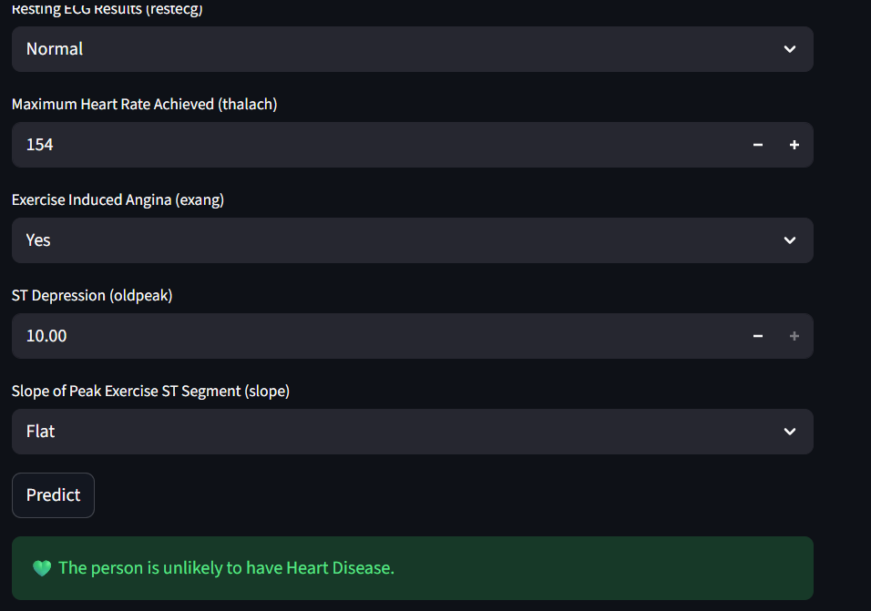
Deployment

Slide 12
Conclusion
  Random Forest achieved the best accuracy (~87%) for predicting heart disease.
  Key predictors: age, chest pain type, max heart rate, and ST depression.
  The model shows strong potential for early heart disease detection.

Slide 13

THANK YOU

