Slide 1


Pytorch yolo-v3 - sudheshna m ( b.tech – ai & ds )

Slide 2
Agenda
PROBLEM STATEMENT
PROJECT OVERVIEW
END USERS
SOLUTION
WOW content
MODELLING
RESULTS

Slide 3
Problem statement
implement the yolo v3 architecture using pytorch, including the backbone network, detection heads, and feature extraction layers.
collect and preprocess a suitable dataset for training and evaluation, ensuring a diverse range of object classes and sufficient variability in object poses, scales, and environments.
explore techniques for optimizing the model's performance in terms of speed and memory usage without compromising detection accuracy. this may involve model quantization, pruning, or other optimization methods.

Slide 4
Project overview
this project aims to implement yolov3 object detection using pytorch, facilitating real-time detection of objects in images and videos.
by leveraging pytorch's flexibility and yolov3's efficiency, the project aims to provide a robust solution for various applications such as surveillance, autonomous vehicles, and augmented reality.
the deliverables will include a pytorch implementation of yolov3, trained model weights, evaluation results, and comprehensive documentation detailing the methodology and implementation specifics.

Slide 5
End users
Developers
Researchers
Autonomous Vehicle Industry
Security and Surveillance Companies
Medical Imaging
Augmented Reality Developers

Slide 6
SOLUTION
Understand the architecture, prepare annotated datasets, implement the model with backbone network and detection heads, define the loss function, set up training pipeline with data loading and optimization, evaluate using metrics like mAP, deploy for inference, optimize for speed and memory usage, and thoroughly document the process. Leveraging PyTorch's flexibility, this solution provides real-time object detection capabilities for various applications, including autonomous vehicles, surveillance, and augmented reality, with the potential for further optimization and customization to meet specific requirements. Numerous open-source implementations are available for reference and integration into projects, facilitating efficient development.

Slide 7
WOW content
Experience the cutting-edge of computer vision with PyTorch YOLOv3, a powerhouse for real-time object detection.
Unleash the potential of YOLOv3's robust feature extraction and detection heads, enabling lightning-fast recognition of diverse objects in images and videos.
From autonomous vehicles navigating complex environments to surveillance systems ensuring public safety, PyTorch YOLOv3 empowers innovation across industries.

Slide 8
MODELLING
Backbone Network
Feature Extraction
Detection Heads
Loss Function
Training Pipeline
Evaluation Metrics
Inference
Optimization
Documentation
Testing and Validation

Slide 9
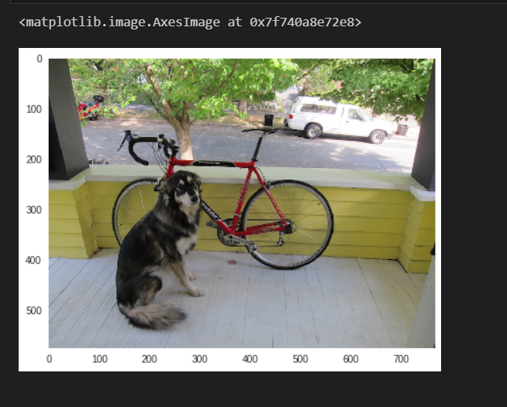
RESULTS

Slide 10
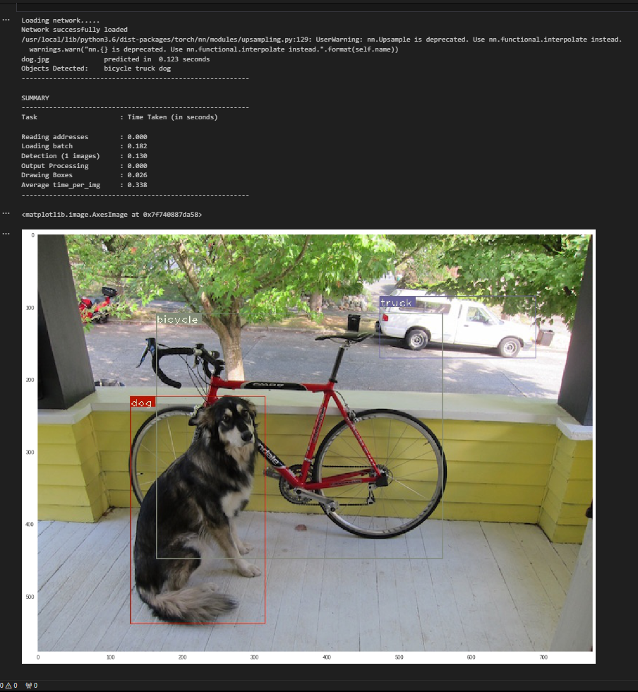

Slide 11
Thank You…

