Slide 1
Karatsuba Algorithm
It is a Fast multiplication algorithm.
It was Discovered by Anatolii Alexeevitch Karatsuba in 1960.
It is a divide-and-conquer algorithm.
The Karatsuba algorithm works by recursively breaking the input numbers into smaller parts, performing multiplication on these parts, and then combining the results.

Slide 2

Time and Space Complexity of Karatsuba algorithm
The time complexity of normal multiplication is O(n^2).
The time complexity of Karatsuba algorithm is O(n^1.585).
The space complexity of normal multiplication is O(n^2)
The space complexity of Karatsuba algorithm is O(n).

Slide 3
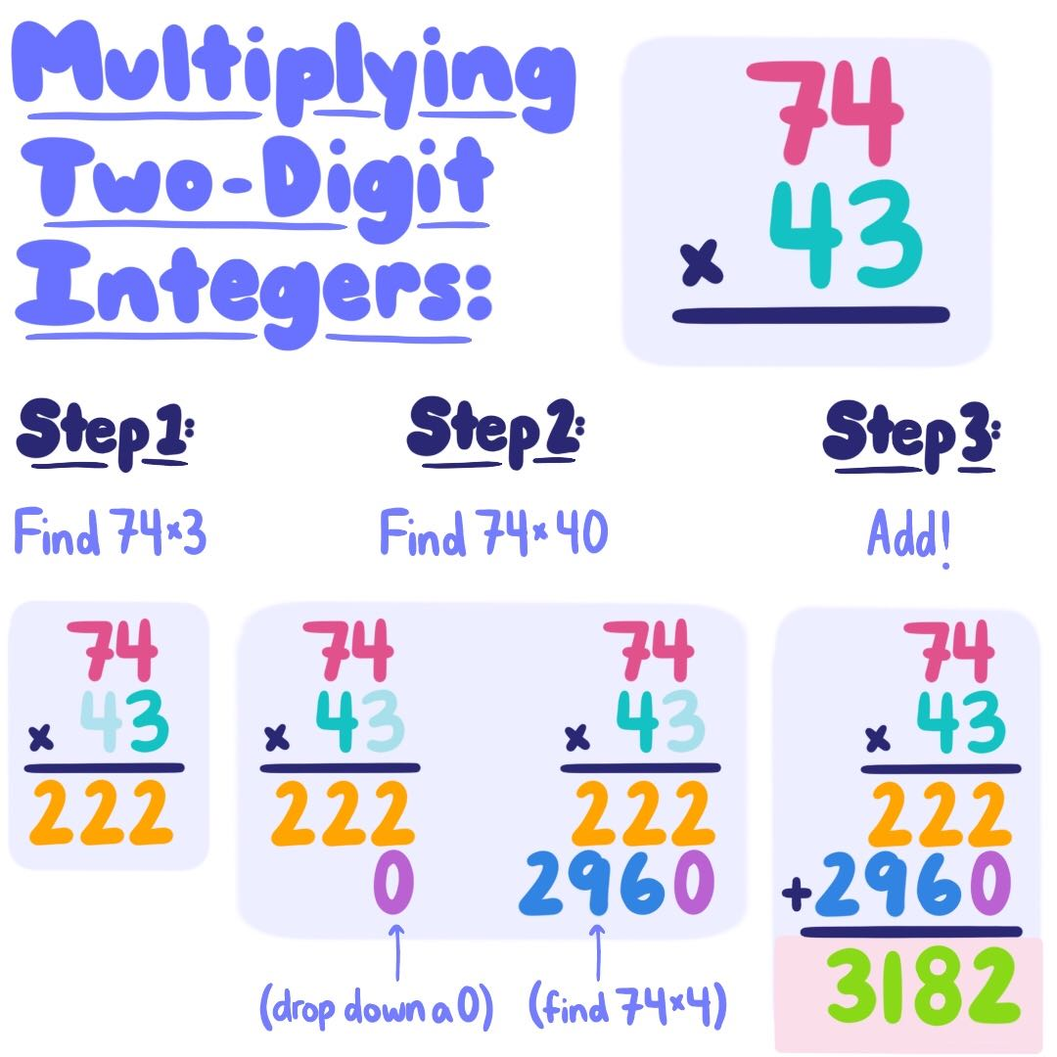
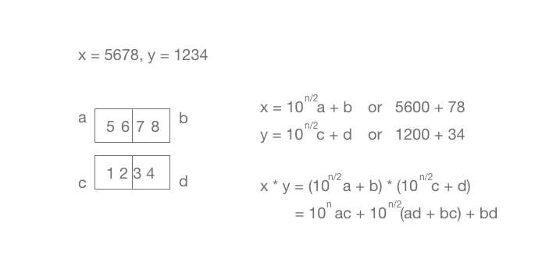
Normal Multiplication Vs Karatsuba Algorithm

Slide 4
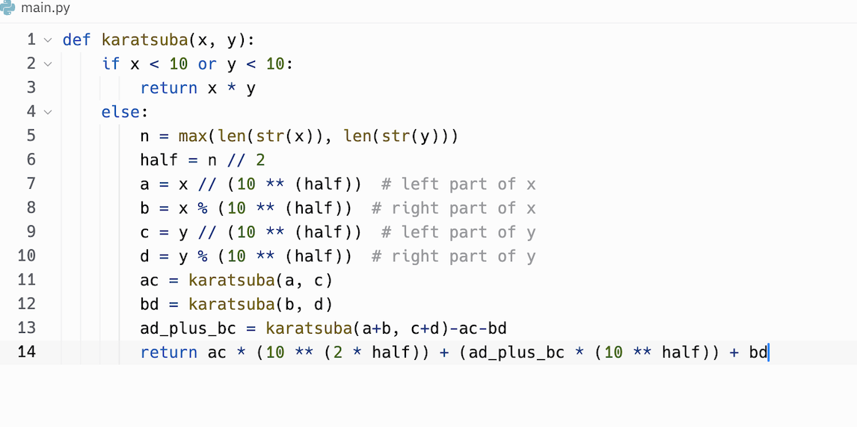
Python Code

Slide 5






Thank You!! Questions?

