Slide 1

Deep Learning Framework for Automated Plant Disease Detection Using Leaf Images
Domain: Agriculture & Plant Disease Detection using Deep Learning
Core Technologies: Convolutional Neural Networks (CNN), Transfer Learning, EfficientNet, TensorFlow/Keras, OpenCV
Dataset: PlantVillage & PlantDoc
Team Structure: 4-Member Collaborative Project (Built using Open-Source & Free Tools)
Development Platform: Python, Google Colab / Jupyter Notebook
Team - 9
2420030377 – V Sudhir Naik
2420080030 –G Akshith Reddy
2420080068 – K Harish Reddy
2420090053 –K Yaswanth Reddy

Slide 2
Problem Statement
Early identification of plant diseases is important to prevent crop loss. However, manually identifying diseases from leaf images requires experience and can take considerable time. Our project aims to develop a deep learning-based system that analyzes a leaf image and predicts whether the plant is healthy or affected by a particular disease.

Slide 3
Objectives
To Develop The Project :
Automated Plant Disease Detection: Develop a deep learning model using EfficientNet and Transfer Learning to classify plant leaf images as healthy or affected by specific diseases.
Disease Classification & Evaluation: Train and evaluate the model using the PlantVillage dataset and measure its performance using Accuracy, Precision, Recall, F1-Score, and Confusion Matrix.
To Enhance The Features :
Confidence-Based Prediction: Provide the predicted plant disease along with a confidence score, helping users understand the reliability of the prediction.
User-Friendly Detection Interface: Develop a simple Streamlit web interface that allows users to upload a leaf image and receive the disease prediction quickly.

Slide 4
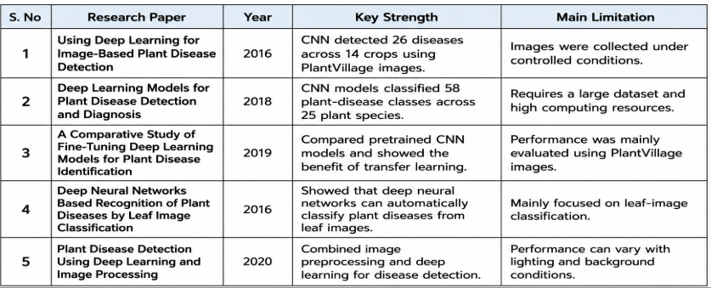
Literature Survey

Slide 5
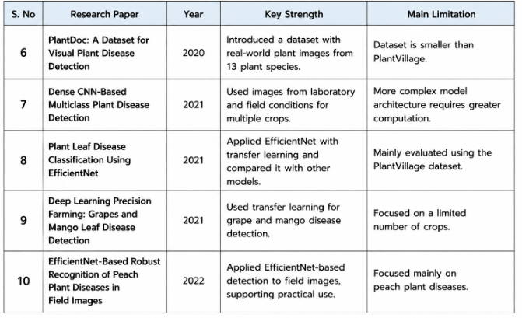
Literature Survey

Slide 6
Research Gap Identification
Gap 1: Limited Real-World Image Generalization: Existing plant disease models often perform well on controlled leaf images, but their performance can decrease when images contain different lighting, backgrounds, angles, or image quality.
•
• Gap 2: High Dependence on Large Datasets: Many existing deep learning approaches require large labeled datasets and high computational resources, making training difficult for resource-limited users.
•
• Gap 3: Lack of User-Friendly Practical Systems: Many studies focus mainly on disease classification and accuracy, while fewer provide a simple system where users can upload a leaf image and directly receive a disease prediction with a confidence score.

Slide 7
Datasets
Datasets
• PlantVillage: Plant disease image dataset — 54,306 healthy and diseased leaf images covering 14 crop species and 26 diseases. Sourced from: GitHub / Hugging Face.
•
• PlantDoc: Real-world plant disease image dataset — 2,598 images covering 13 plant species and up to 17 disease classes. Sourced from: GitHub.

Slide 8
Innovation (Technical Advancements)
• Transfer Learning: Uses a pre-trained EfficientNet model to extract important visual features from plant leaf images and reduce training time.
• Image Augmentation: Applies image transformations such as rotation, flipping, and scaling to improve the model's ability to handle different leaf image conditions.
Creativity (Unique Features & UX)
• Simple Leaf Image Upload: Allows users to upload a plant leaf image and receive a disease prediction without requiring technical knowledge.
• Confidence-Based Prediction: Displays the predicted disease along with a confidence score, making the result easier to understand.
Novelty (Unique Value Proposition)
• Efficient End-to-End Framework: Combines image preprocessing, augmentation, EfficientNet-based transfer learning, classification, and prediction into a single system.
• Practical & Low-Cost Solution: Uses PlantVillage, Python, TensorFlow/Keras, and Google Colab, making the system possible to develop using mostly free and open-source tools.

Slide 9
Feasibility Analysis
Technical Feasibility: Uses EfficientNet with Transfer Learning, which reduces training requirements and can be trained using GPU resources available through Google Colab..
• Data Feasibility: Uses publicly available PlantVillage and PlantDoc datasets containing labeled plant leaf images for disease classification.
• Operational & Cost Feasibility: Uses Python, TensorFlow/Keras, OpenCV, and Google Colab, which are freely available and require minimal additional cost.
• Time Feasibility: The project can be completed in phases covering data preparation, model development, evaluation, and web interface development within the academic project schedule.

Slide 10
Project Plan
Phase 1: Dataset Preparation & Environment Setup — V Sudhir Naik
Set up Python and Google Colab environment.
Download and organize the PlantVillage dataset.
Resize, normalize, and augment leaf images.
Split the dataset into training, validation, and testing sets.
Phase 2: Model Development — G Akshith Reddy
Select EfficientNet as the main model.
Apply Transfer Learning using the pretrained model.
Train the model on plant leaf images.
Fine-tune the model for disease classification.
Phase 3: Model Evaluation & Analysis — K Harish Reddy
Test the trained model on unseen images.
Calculate Accuracy, Precision, Recall, and F1-Score.
Generate the Confusion Matrix.
Analyze incorrect predictions and model performance.

Slide 11
Project Plan
Phase 4: Application Development & Integration — K Yaswanth Reddy
Develop the Streamlit web interface.
Connect the trained model to the application.
Implement leaf image upload and disease prediction.
Display disease name and confidence score.
Final Integration & Presentation — All Members
Integrate all project modules.
Perform final testing.
Prepare documentation, PPT, and project demonstration.
Prepare for viva and final presentation.

Slide 12
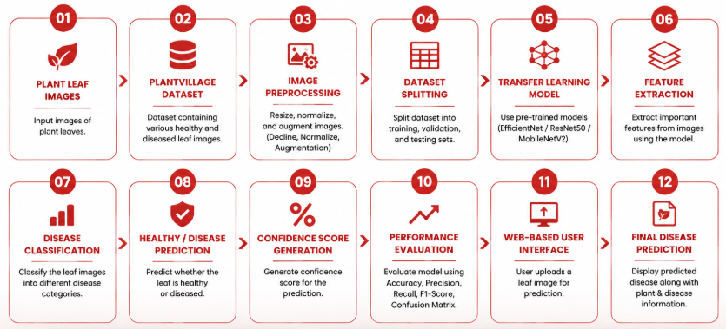
Project Plan

Slide 13
.
Thank you

