Slide 1
IBM Hack Challenge 2020 Sentiment Analysis of COVID-19 Tweets – Visualization Dashboard
Animesh Singh
Aaditya Kapoor

Slide 2
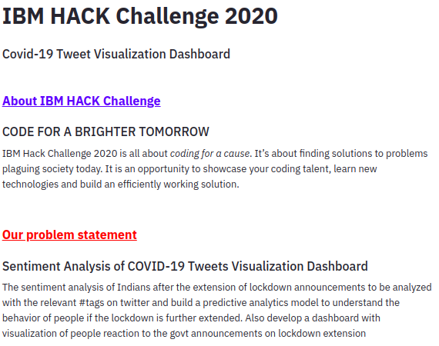
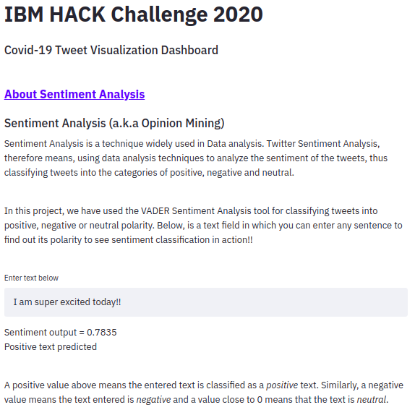

Slide 3
Approach
Data Mining and Collection
Cleaning and Pre-processing the Raw Data
Sentiment Analysis
Visualization of the Processed Data
Dashboard Creation
Using GetOldTweets Api
Using Python Libraries (Regular Expressions and langid)
Using VADER
Using Plotly and PyDeck
Using Streamlit and Heroku

Slide 4
Flowchart
Data Extraction and Cleaning
Used GetOldTweets3 API for extraction of Historical Twitter Data
Done Preprocessing and Cleaning using Langid and re (Regular Expression) Python Libraries
Calculating Sentiment Score
Used VADER to calculate the Sentiment Score based on the emotions in the Tweets
Classification of the Tweets
Classified into Positive, Negative and Neutral Emotions based on the Sentiment Score
Visualization
Created different types of graphs based to visualize the Output
Used Plotly and PyDeck for graph creation
Deployment
Created a Dashboard using Streamlit and Heroku (a Python Framework for creating Dynamic Apps)

Slide 5
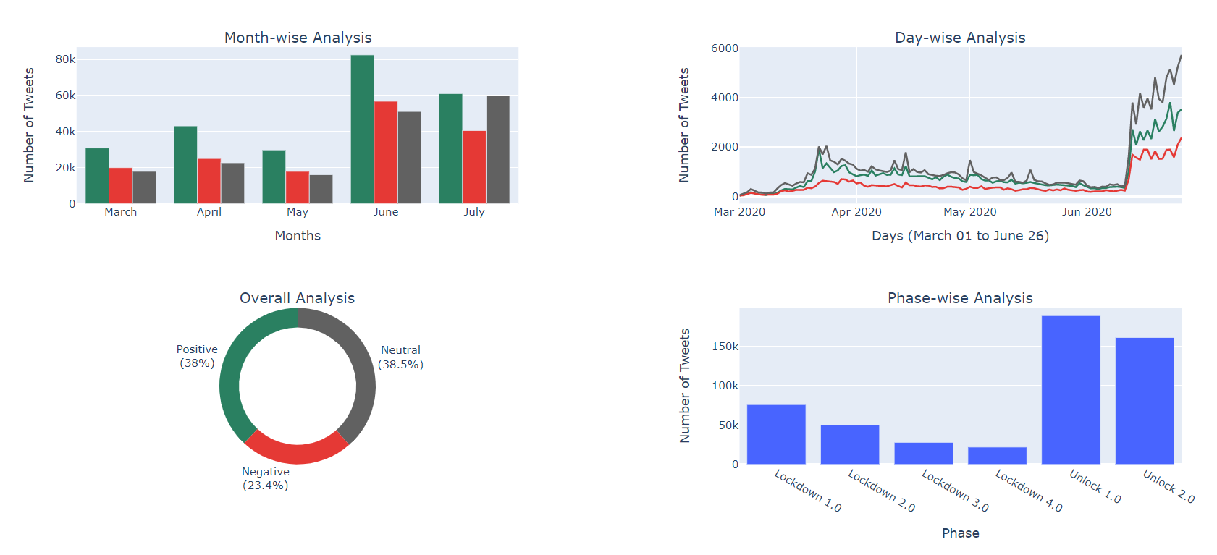
Dashboard

Slide 6
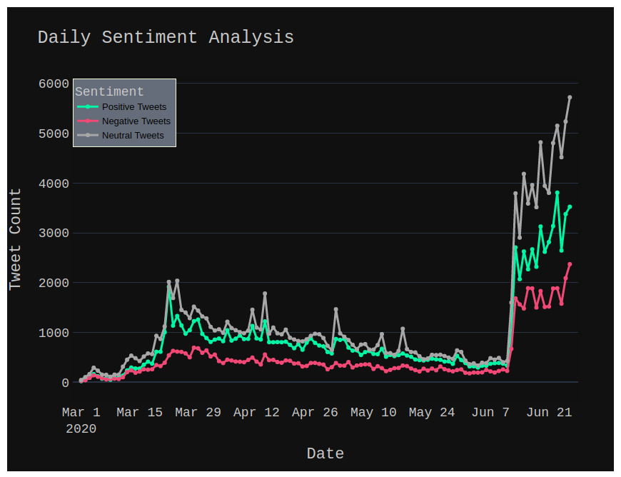
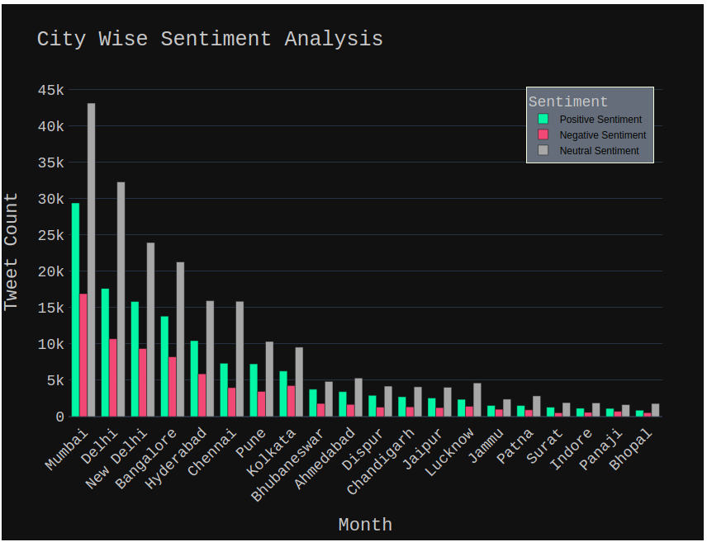
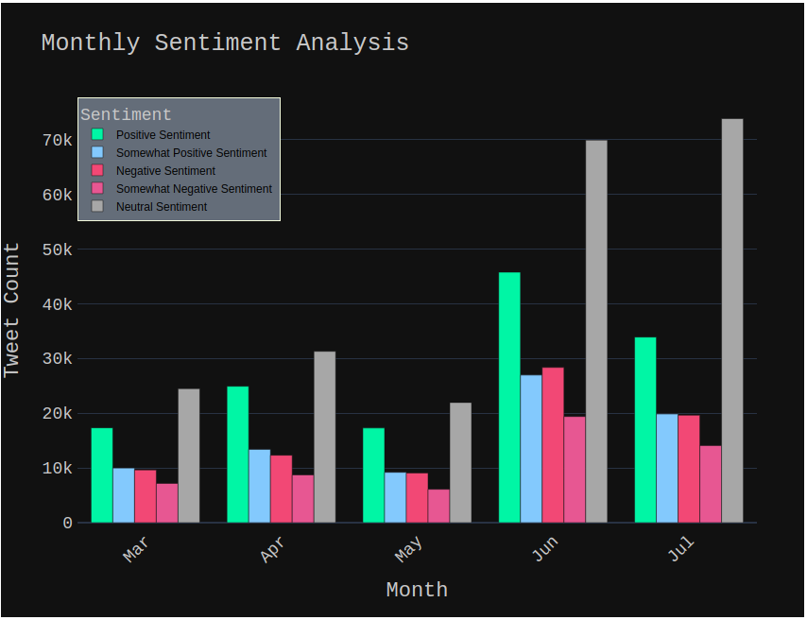
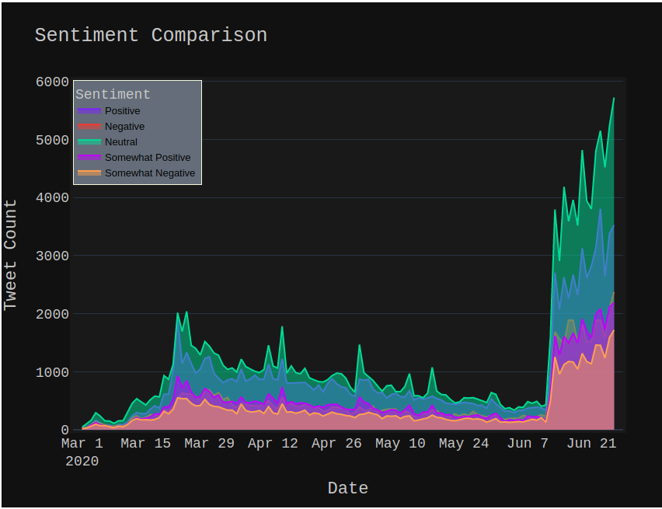
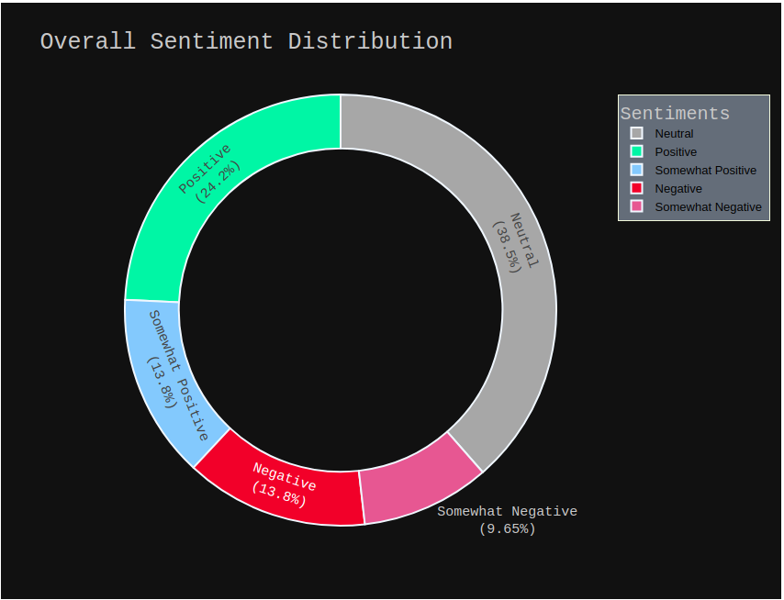
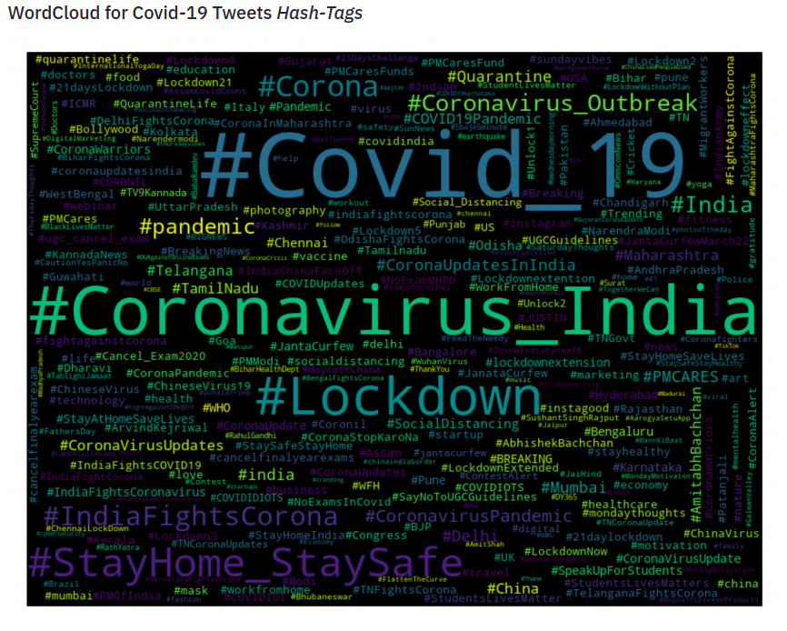
Graphs

Slide 7
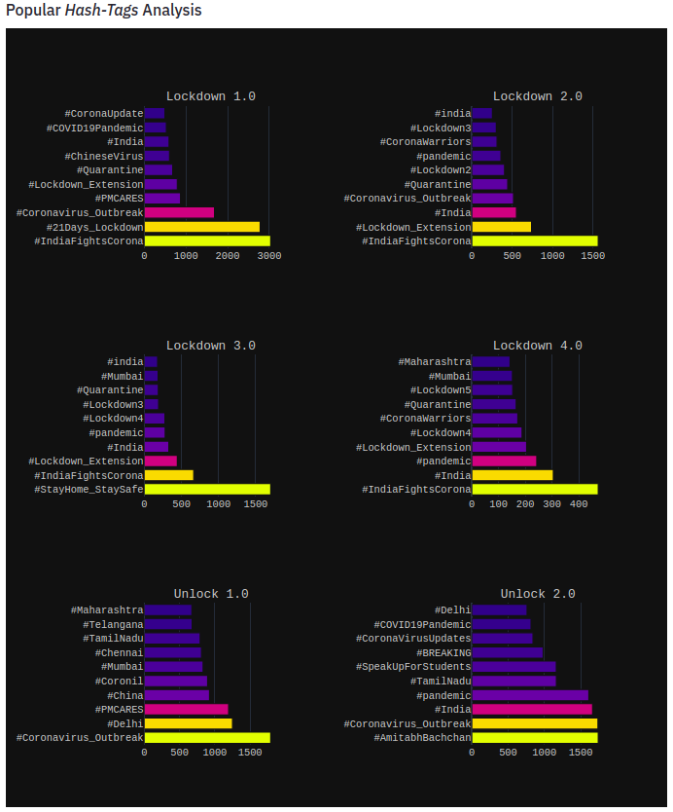
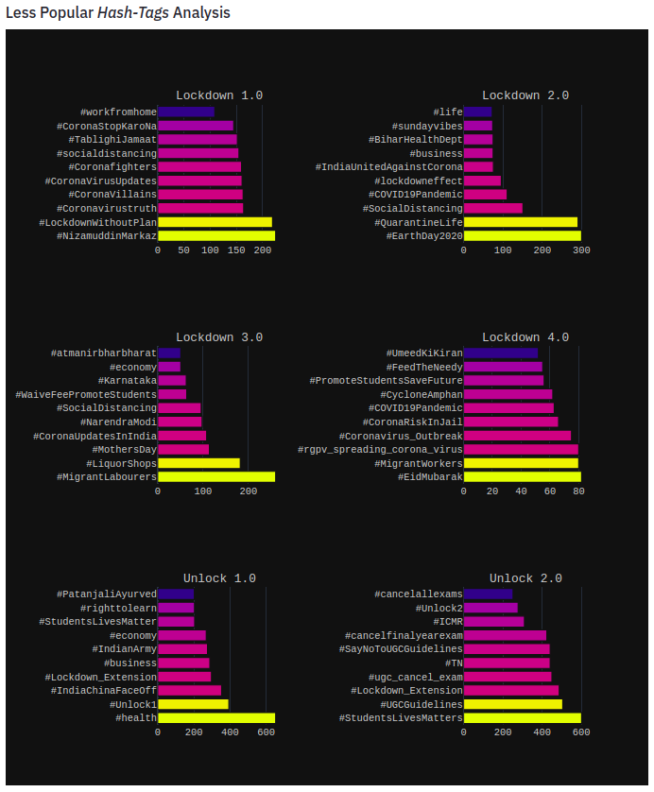

Slide 8
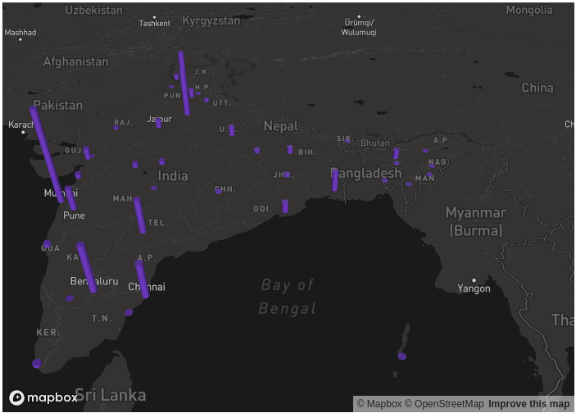
3D Graph

Slide 9
Pros and cons
Some Advantages:
Works exceedingly well on social media type text such as public opinion.
Doesn’t require any training data but is constructed from a generalizable, valence-based, human-curated gold standard sentiment lexicon.
Fast enough to be used online with streaming data.
Does not severely suffer from a speed-performance trade-off.
Efficient at analysing large datasets.
Can identify whether a phrase is positive, negative or neutral, which in turn can be used to determine a customer’s sentiment towards a brand or service. This helps the businesses to identify their strengths and weaknesses.
It can also help to identify marketing campaigns that are not working well.
Some Disadvantages:
Spellings and grammatical mistakes may cause the analysis to overlook important words or usage.
Sarcasm and irony may be misinterpreted.
Analysis is language-specific.
Discriminating jargon, nomenclature, memes, or turns of phrase may not be recognized.
Unavailability of Twitter Historical Data.

Slide 10
applications
This automated machine learning driven sentiment analysis could help the following people and industries:
Health Professionals.
Policy makers.
State and Central Governments to understand and identify rapidly changing psychological risks in the population.
Timely responses and initiatives taken by the agencies to mitigate and prevent adverse emotional and psychological consequences will significantly improve public crisis and phenomenon.
Provide valuable insights on attitudes, perceptions and behaviours for critical decision making for business, political leaders and societal representatives.
Corporations and small businesses can also benefit through such analyses and machine learning models to better understand consumer sentiment and expectations.

Slide 11
conclusion
Overall, it can be seen that Indians have taken the fight against COVID19 positively and the majority are in agreement with the government for announcing the lockdown to flatten the curve. It could be seen from the tweets that several people were angry that the lockdown came a bit late. It should have been announced a week prior. Also, some tweets expressed concerns that the passengers from abroad who flew in should have been quarantined before letting them reunite with their families. Nevertheless, as of now, the lockdown response seems positive and indicates that India has succeeded in controlling the coronavirus spread to a great extent.

Slide 12
Future scope
Future studies can look into pre and post lockdown tweets and understand whether there was a change in sentiments from the beginning to the end of the lockdown. Also, future studies can look into factors that affect mental health during lockdowns and pandemic spreads. Another area for future research could be tackling of fake news that gets circulated through social media, impacting the mental health of the receivers. Many private and public industries can also research to create products for the post lockdown situation of the country.

