Slide 1
Transformation in CSS

Slide 2
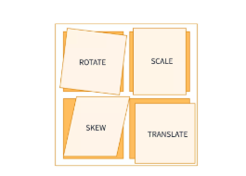
Transform
The CSS3 2D transform property allows us to scale, skew, move, translate, and rotate HTML elements. It transforms the element without affecting other elements on the page.

Slide 3
translate()
It moves an element from its current position according to the given x and y-axis values.
transform: translate(X, Y);
transform: translateX(n);
transform: translateY(n);
rotate()
It rotates an element clockwise or counter-clockwise according to a given argument.
transform: rotate(angle);
transform: rotateX(angle);
transform: rotateY(angle);
scale()
It increases or decreases the size of an element according to the given parameter.
transform: scale(X, Y);
transform: scaleX(n);
transform: scaleY(n);
skew()
It skews an element according to the given parameter.
transform: skew(X-angle, Y-angle);
transform: skewX(angle);
transform: skewY(angle);

