Slide 1
Soudabeh Rafiei
Sample Data Presentation
Two-Way Anova test

Slide 2



Which instructor’s intervention worked to increase score between the tests?
Between-Subject Factor
Instructor intervention
Before Score
After Score
1
2
3
4
5
Within-Subject Factor
11 students
11 students
11 students
11 students
11 students

Slide 3
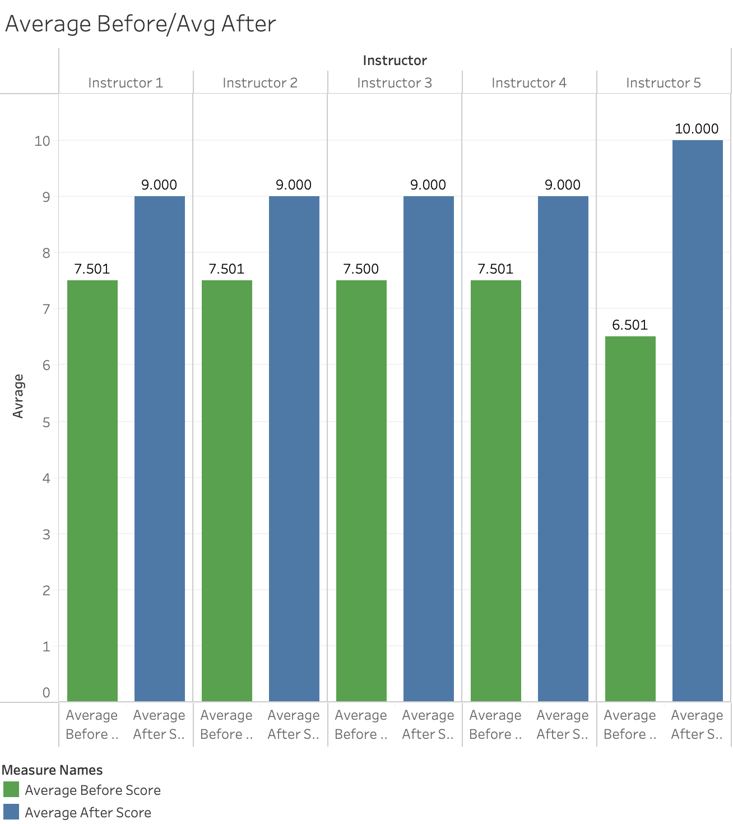
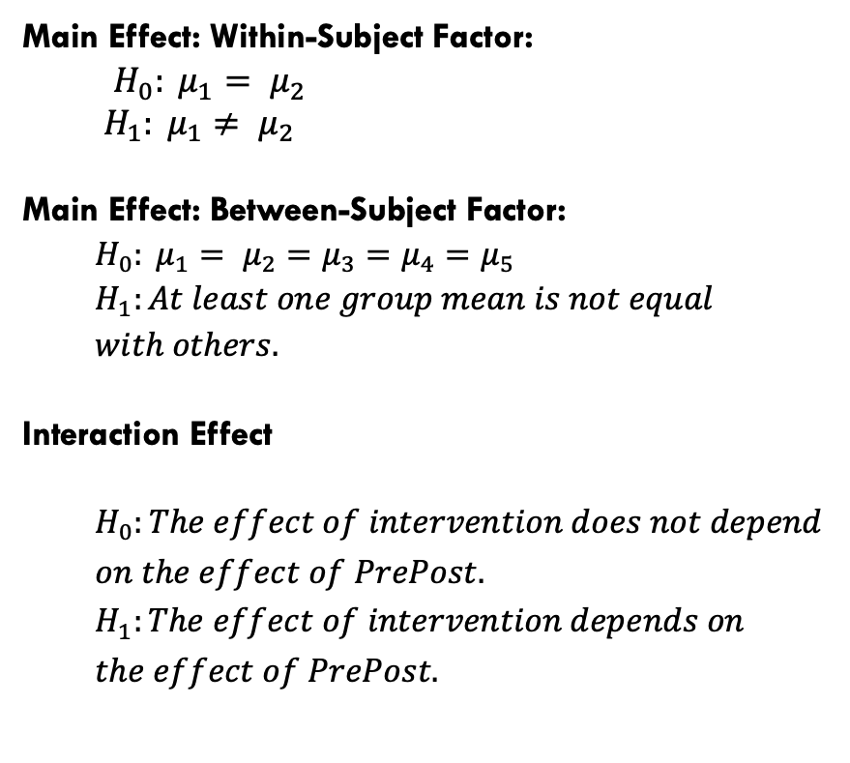
Hypotheses
Main Effect: Within-Subject Factor:
$H_{0}: μ_{1}= μ_{2}$
$H_{1}: μ_{1}≠ μ_{2}$
Main Effect: Between-Subject Factor:
  $$H_{0}: μ_{1}= μ_{2}=μ_{3}=μ_{4}=μ_{5}$$
  $$H_{1}:At least one group mean is not equal$$
  $$with others.$$
Interaction Effect
  $$H_{0}:The effect of intervention does not depend$$
  $$on the effect of PrePost.$$
  $$H_{1}:The effect of intervention depends on$$
  $$the effect of PrePost.$$

Slide 4
Comparison test
A Repeated Measure Two-way ANOVA with Instructor as a between-subject factor and PrePost as a within-subjects factor was run.
*Note: The Sphericity Assumption is not violated (Mauchly’s W (0)=1).

Slide 5

Main Effect: Within-Subject Factor: F(1, 50) = 48.08, p < .001
$H_{0}: μ_{1}= μ_{2}$
$H_{1}: μ_{1}≠ μ_{2}$
Main Effect: Between-Subject Factor: F(4, 50) = 0.00, p = 1
$H_{0}: μ_{1}= μ_{2}=μ_{3}=μ_{4}=μ_{5}$ $H_{1}:At least one group mean is not equal with others.$
Interaction Effect F(4, 50) = 2.132, p =.091
$$H_{0}:The effect of intervention does not depend on the effect of PrePost$$
$$H_{1}:The effect of intervention depends on the effect of PrePost$$

Slide 6

THANK YOU!

