Slide 1

CUSTOMER CHURN PREDICTION
T&T Lab Project
Presented By : Sudip Chakrabarty (21053329)
Shreyas Nayak (2105408)
Himaghna Das (2105545)
Adarsh Patro (21051791)
Rishik Suddapalli (21052093)
College Name : Kalinga Institute of Industrial Technology
Department : Computer Science and Engineering
Date : 30.03.24
1

Slide 2
OUTLINE
Problem Statement
Proposed System/Solution
Development Approach
Algorithm
Result
Conclusion
Future Scope
References
2

Slide 3
PROBLEM STATEMENT
In today's competitive business landscape, reducing customer churn is vital for sustained growth and profitability. Our project focuses on analyzing customer churn using historical data and metrics to identify patterns and key drivers. The goal is to provide actionable insights to effectively retain customers and mitigate revenue loss.
3

Slide 4
PROPOSED SOLUTION
The proposed system aims to address the challenge of predicting telecom customer churn to enhance customer retention strategies. This involves leveraging data analytics and machine learning techniques to accurately forecast the likelihood of a customer churning. The solution will consist of the following components:
Data Collection:
Dataset taken from Kaggle: Kaggle Churn Dataset
Data Preprocessing:
Clean and preprocess the collected data to handle missing values, outliers, and inconsistencies.
Feature engineering to extract relevant acoustic features from the data that might impact on customer churn.
Machine Learning Algorithm:
We'll implement Logistic Regression, Decision Tree, and Random Forest classifiers to predict customer churn based on historical data.
By training and optimizing these models, we aim to proactively identify customers at risk of churn and improve overall retention rates.
4

Slide 5
PROPOSED SOLUTION
Evaluation:
Assess the model's performance using appropriate metrics, such as precision, recall, and F1 score, tailored to the characteristics of the customer churn prediction task.
Refined the predictive models based on feedback and continuous monitoring of prediction accuracy, integrating insights from business experts and data analysts. By incorporating domain knowledge from customer retention specialists and analyzing feedback from model performance, we aim to enhance the effectiveness of our churn prediction models.
Ultimately, our goal is to develop robust and reliable models that contribute to sustainable growth and profitability by reducing customer churn.
Result:
The implemented solution for customer churn prediction demonstrates an accuracy rate exceeding 80%, aiding businesses in proactively identifying customers at risk of churn. Real-time predictions offer valuable insights to businesses, enabling them to implement targeted retention strategies and maintain customer loyalty. Continuous evaluation and refinement of the model ensure its effectiveness in reducing churn rates and sustaining business growth.
5

Slide 6
SYSTEM APPROACH
System requirements
Hardware : 8GB Ram
Intel core i3 processor
Software : Windows 10 , 11
Jupyter Notebook or Google Collab or VS Code
Library required to build the model
Pandas and NumPy,Scipy, TensorFlow, Pickle, Scikit-learn, Matplotlib and Seaborn.
6

Slide 7
ALGORITHM
Data Input:
Each row represents a customer, each column contains customer’s attributes described on the column Metadata.
The raw data contains 7043 rows and 21 columns (features).
The “Churn” column is our target.
Algorithm Selection and Training Process:
Model: LogisticRegression
Hyperparameters: C=100, max_iter=100
Model: RandomForestClassifier
Hyperparameters: n_estimators=120, criterion='gini', max_depth=15, min_samples_leaf=10, min_samples_split=5
Model: DecisionTreeClassifier
Hyperparameters: criterion='gini', splitter='random', min_samples_leaf=12
Evaluation Process:
Performance Metrics: Accuracy Score, Confusion Matrix, CLassification Report
7

Slide 8
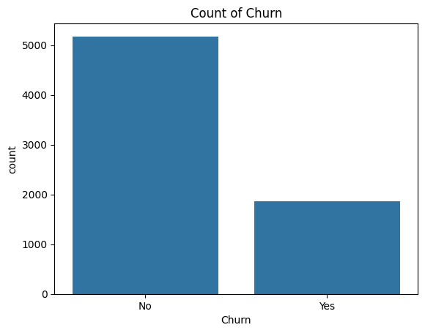
Count Of Churn
8

Slide 9
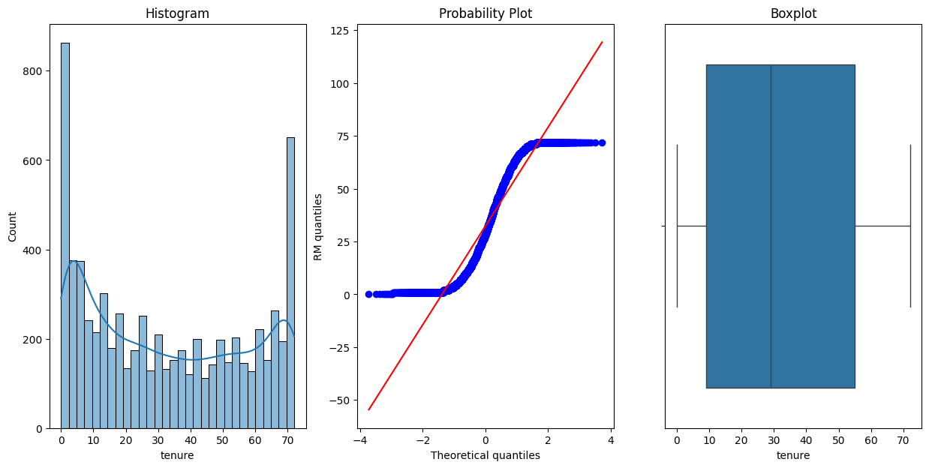
Plotting Numerical Features With Probability Distribution And Checking outliers
9

Slide 10
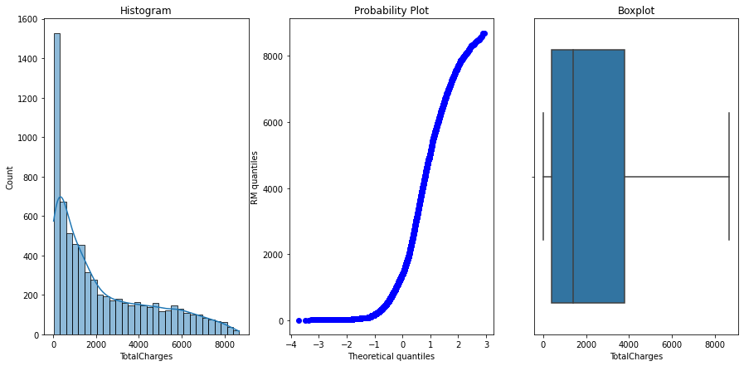
10

Slide 11
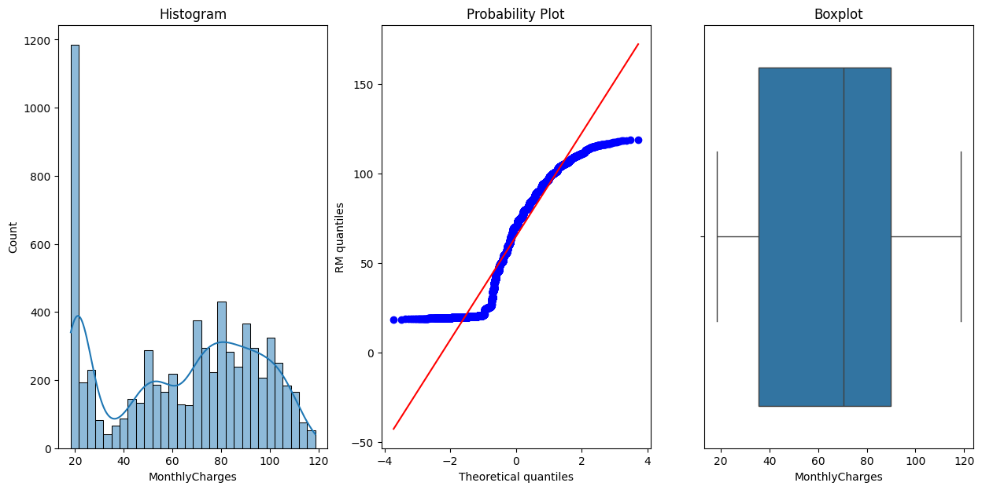
11

Slide 12
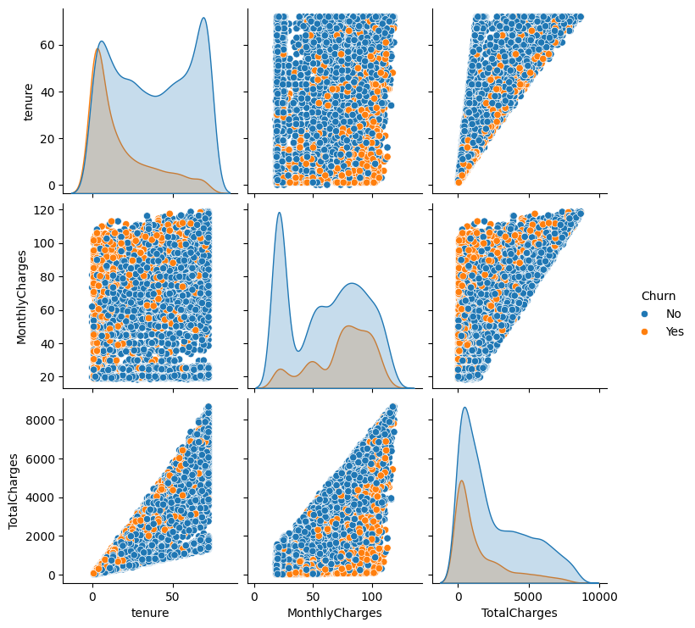
Scatter Plot On How The Churn Is
12

Slide 13
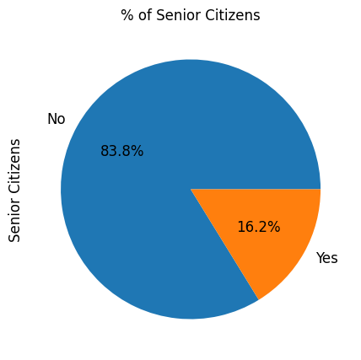
Pie Chart To Show The Percentage Of Senior Citizen
13

Slide 14
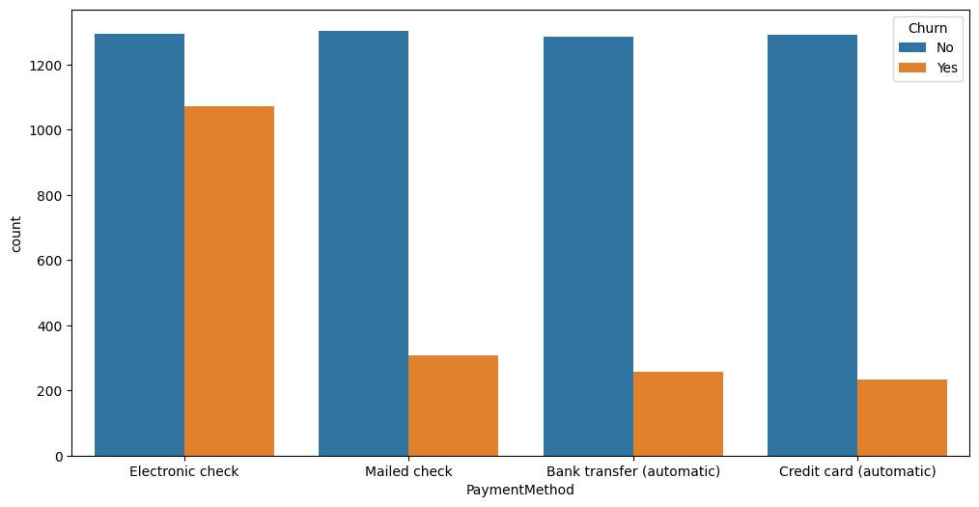
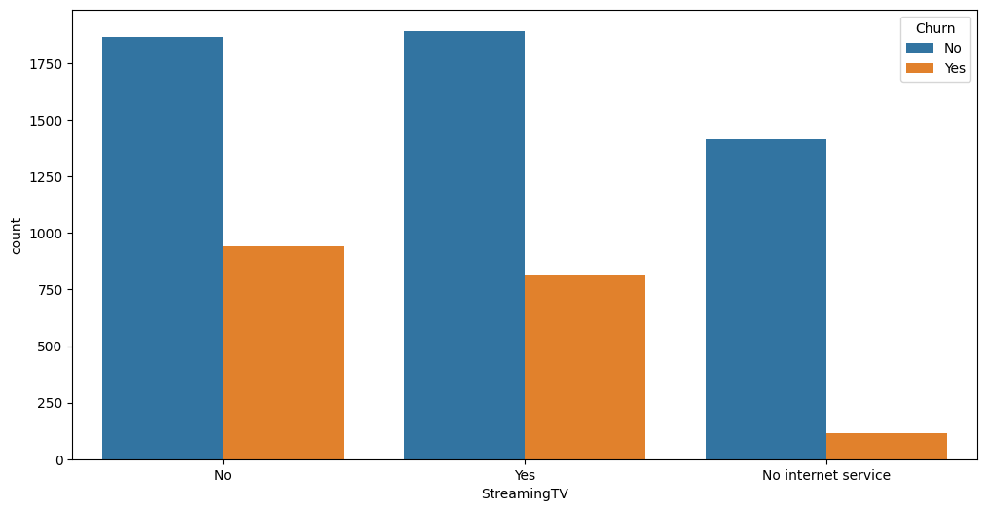
Plotting Of Graph According To which The user Are Taking The Subscription
14

Slide 15
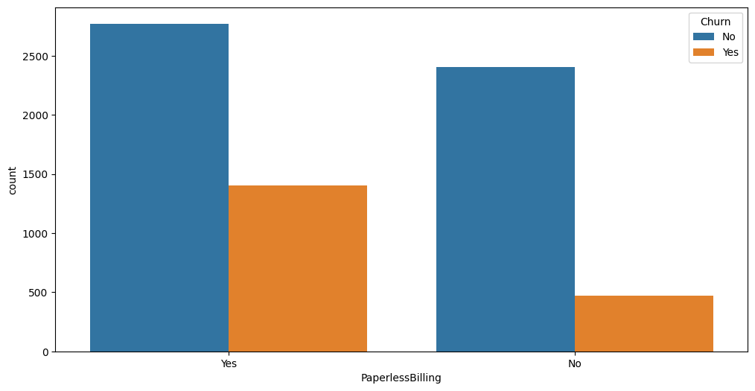
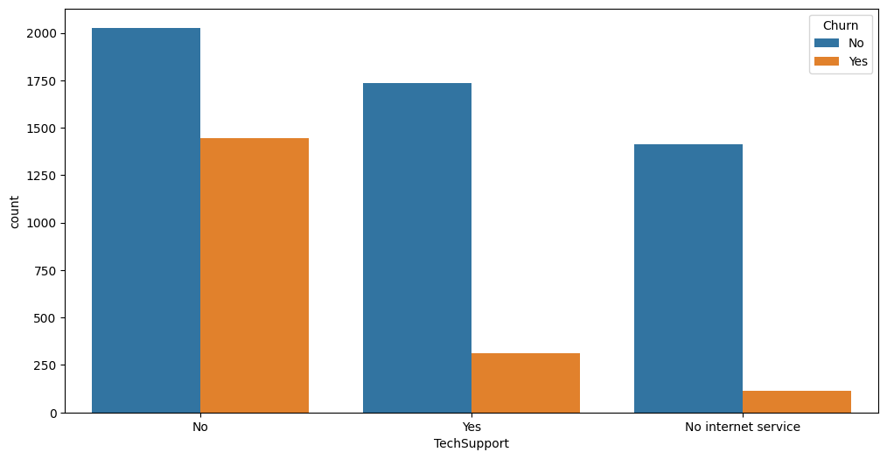
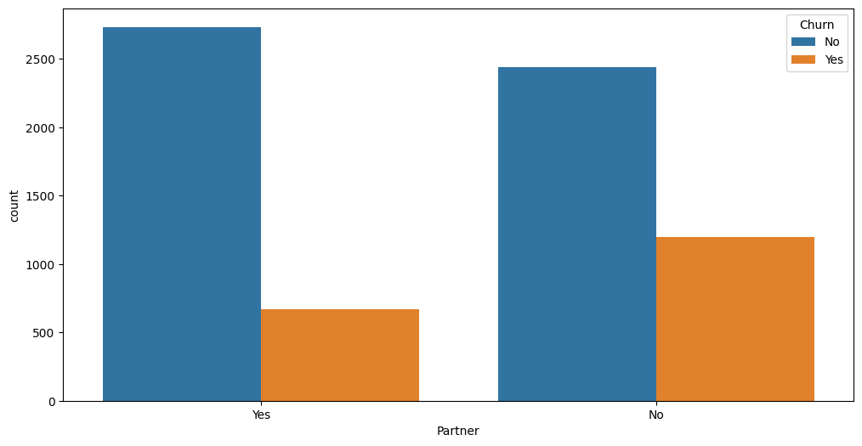
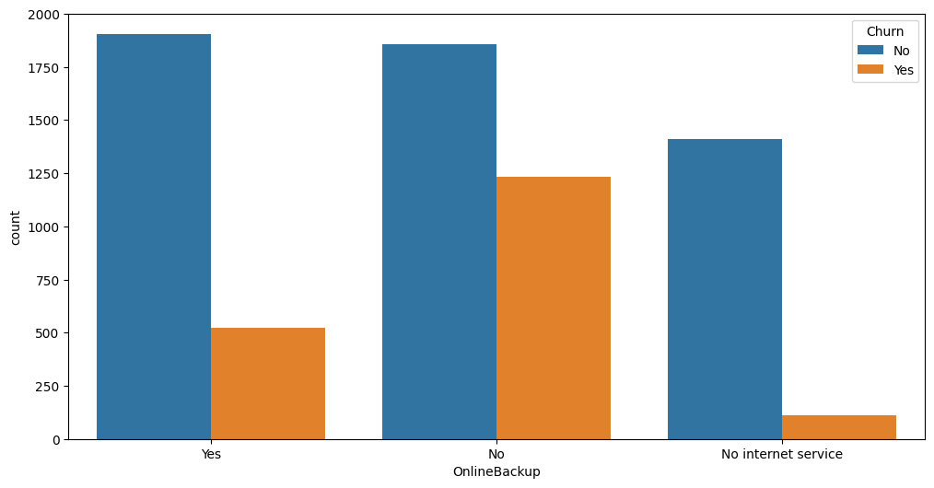
20

Slide 16
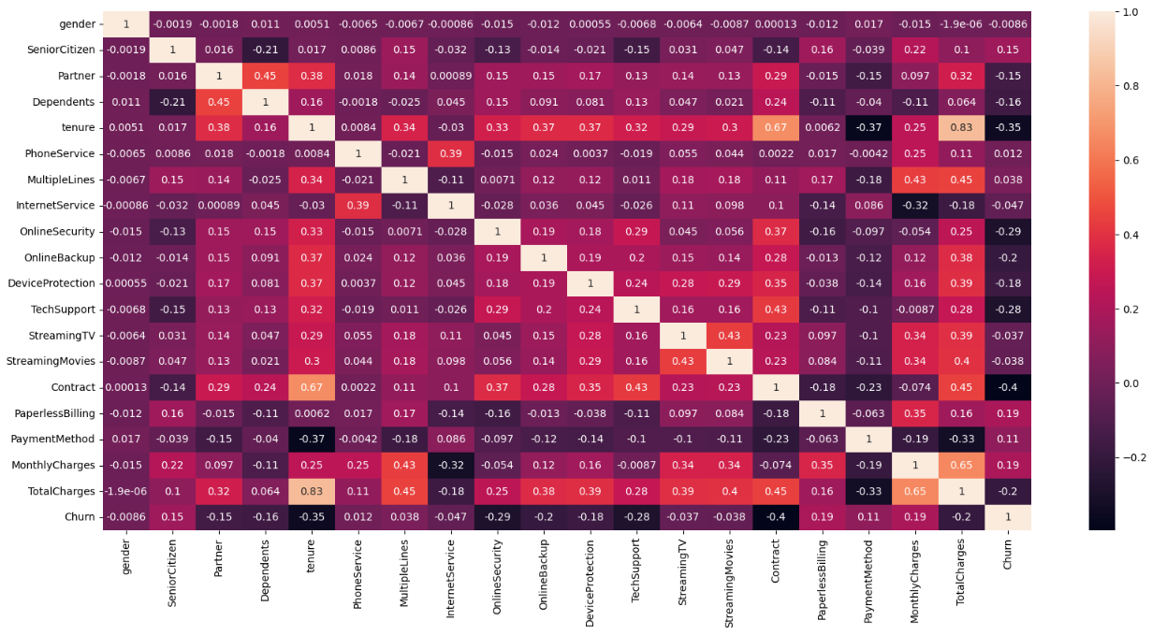
CORRELATION MATRIX
22

Slide 17
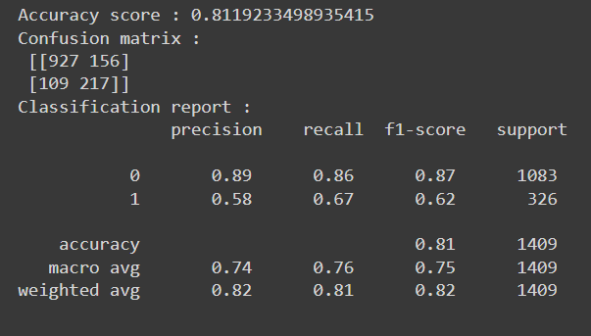
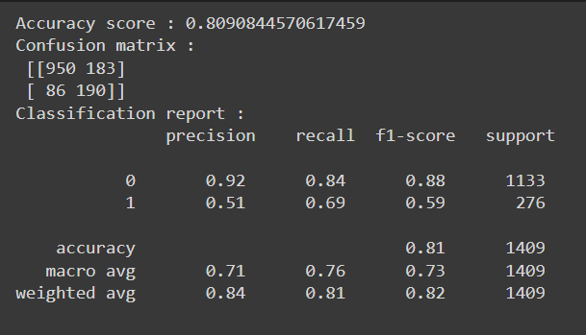
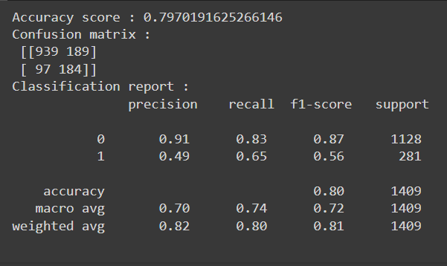
RESULT
Output Logistic Regression
Output - Random Forest
Output - Decision Tree
23

Slide 18
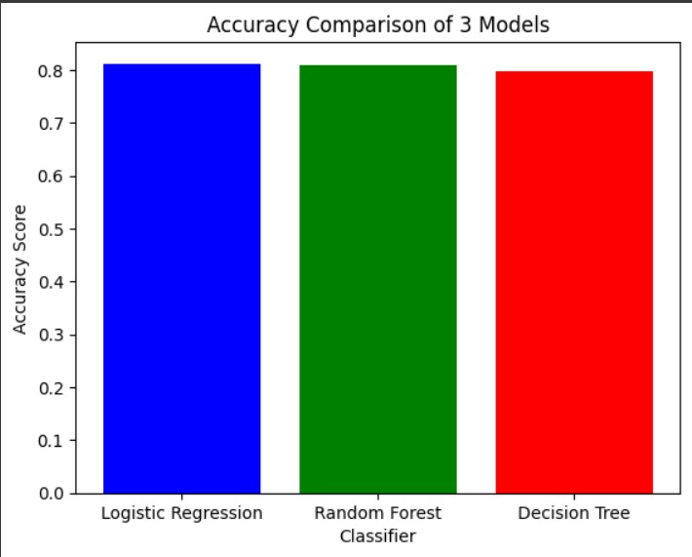
Comparison
24

Slide 19
CONCLUSION
In conclusion, the field of churn prediction stands as a vital pillar in modern business analytics, offering profound insights into customer behavior and retention strategies. Through meticulous analysis of churn patterns and predictive modeling techniques, businesses can unravel valuable information about customer preferences, satisfaction levels, and potential churn triggers. Moreover, the impact of churn prediction extends beyond business strategy, fostering enhanced customer experiences and loyalty. By proactively identifying at-risk customers, cultivate stronger relationships, and ultimately drive sustainable growth. In essence, the ability to predict and manage churn holds far-reaching significance, intertwining the realms of data analytics, customer relations, and business sustainability.
25

Slide 20
FUTURE SCOPE
Looking forward, churn prediction is set to evolve dramatically, driven by advances in machine learning and big data analytics. Integrating AI-powered models and real-time data processing will enhance predictive accuracy, offering deeper insights into customer behavior. This future scope extends to blending churn prediction with personalized marketing and proactive customer service, reshaping strategic decision-making and fostering lasting customer loyalty. Embracing these innovations, businesses can leverage churn prediction to drive sustained growth and gain a competitive edge in dynamic market environments.
26

Slide 21
REFERENCES
Dataset : https://www.kaggle.com/blastchar/telco-customer-chur
Google Colab Link : https://shorturl.at/mzA23
GitHub Link: https://github.com/NotShrey/Customer-Churn
Extras: https://www.tensorflow.org/
27

Slide 22
THANK YOU
28

