Slide 1
Commercial Building Energy Dataset Analysis using Data Science
Sudip Bandopadhyay
Emp id 887790
Notes:
Hello Everyone, I am Sudip, I am working in TCS for more than 7 years with overall experience of 10+ years. I have created one project analyzing the Commercial Building Energy Dataset using Data Science.

Slide 2
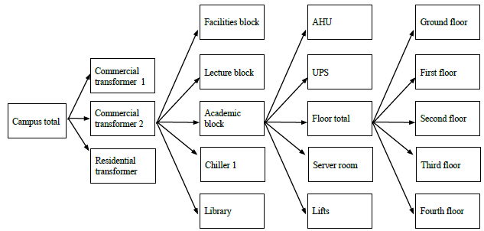
Problem Statement
IIIT Delhi is a modern educational campus established in 2008 and spreads over 25 acres. The Campus consists of 8 building.
Academic Block
Lecture Block
Library
Facilities building
Mess building
Faculty housing
Male and female dormitories
Raspberry Pi is used as controller to collect the data from the Smart Meters and stores the same.
Data set attribute | Value
# Smart meters | 200
# Electrical parameters measured | 8 3 Important(Current, Energy and Power)
# Buildings instrumented | 6
Sampling interval | 30 s
Deployment period | Aug 2013-present
The target is to get some insights out of the collected data
Notes:
This dataset belongs to IIIT Delhi. The Campus of which is equipped with modern electrical equipment to monitor and collect the data from the installed Smart Meters using Raspberry Pi across multiple buildings. The details of the same are mentioned in the above slide.
Our target is to analyze the data and extract some information out of it which can be useful in understanding the patterns in the energy consumption and helpful predicting the future from those known patterns. This will help running the campus smoothly.

Slide 3
Exploratory Analysis and Feature Engineering (Data Analyzed: Academic Block → AHU → 0)
Important information gathered from the collected data
Max Current Consumption: 8.053977012634277 at 2014-06-22 12:48:18
Min Current Consumption: 1.2000004272077216e-17
Mean Current Consumption: 2.047353882242044
Median of Current Consumption: 1.2000004272077216e-17
Max Power Consumption: 4367.14111328125 at 2014-06-22 07:13:00
Min Power Consumption: 1.2000004272077216e-17
Mean Power Consumption: 1108.174470019525
Median of Power Consumption: 1.2000004272077216e-17
Max Energy Consumption: 2919778.5 at 2014-07-01 03:59:47
Min Energy Consumption: 2122005.25
Mean Energy Consumption: 2498458.914761982
Median of Energy Consumption: 2457087.5
Notes:
The dataset contains data for all the buildings, floors and rooms. For the sake of simplicity we have considered only some of them for our analysis here.
We have done the exploratory analysis on data for AHU(0) of Academic block and extracted the important numbers out of it. Those are documented in the above slide.

Slide 4
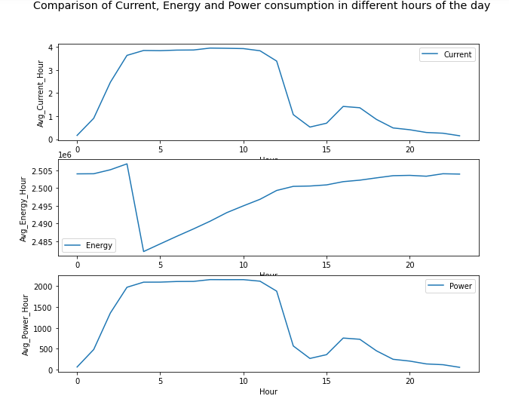
Exploratory Analysis and Feature Engineering (Data Analyzed: Academic Block → AHU → 0)
Plots created from the data
Average Current, Energy and Power consumption in different hours of the day
Observation: Power and Current are related to each other but Energy is somewhat inversely related
Notes:
We have created one plot to see the changes in Power, Energy and Current with the change in time in different hours of the day. We have observed that with change in time Current and Power are changing in the same way but the change in Energy is not in the same way. But to some extent it is opposite to Current and Power

Slide 5
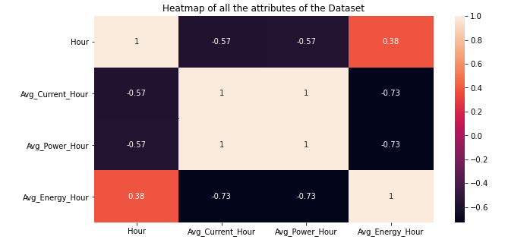
Exploratory Analysis and Feature Engineering (Data Analyzed: Academic Block → AHU → 0)
Heatmap to check for correlation
Observation:
Current and Power are Highly correlated, Energy is not correlated with Hour
Notes:
To check the correlation between the parameter we have created Heatmap. We can see from the heatmap that Current and Power are almost 100% correlated but both of them have some correlation with the time and Energy. However Energy has very minimum correlation with time.

Slide 6
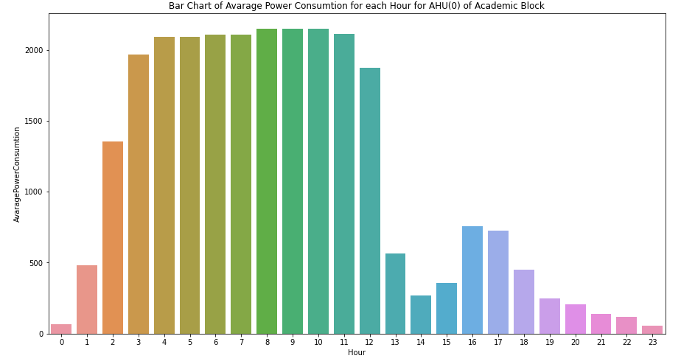
Exploratory Analysis and Feature Engineering (Data Analyzed: Academic Block → AHU → 0)
Average Power consumption for each hour
Observation:
Power Consumption is high mainly between 2-12 o’clock and very low from 7PM to Midnight
Notes:
We have plotted the change in power consumption here in this graph. We can see that the Power consumption is high mainly between 2-12 o’clock in the morning and very low from 7PM to Midnight

Slide 7
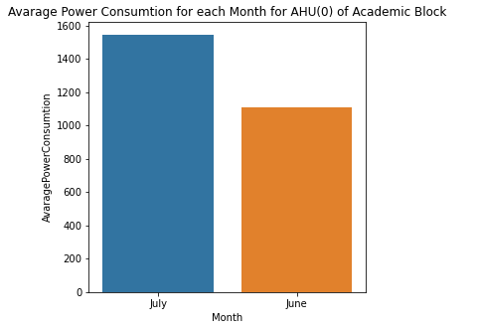
Exploratory Analysis and Feature Engineering (Data Analyzed: Academic Block → AHU → 0)
Average Power consumption for each Month
Observation:
Power Consumption is high in July as compared to June
Notes:
This plot is showing the average Power consumption in the different month of the year. We had only two months data so from the data we can see that Power consumption is high in July as compared to June

Slide 8
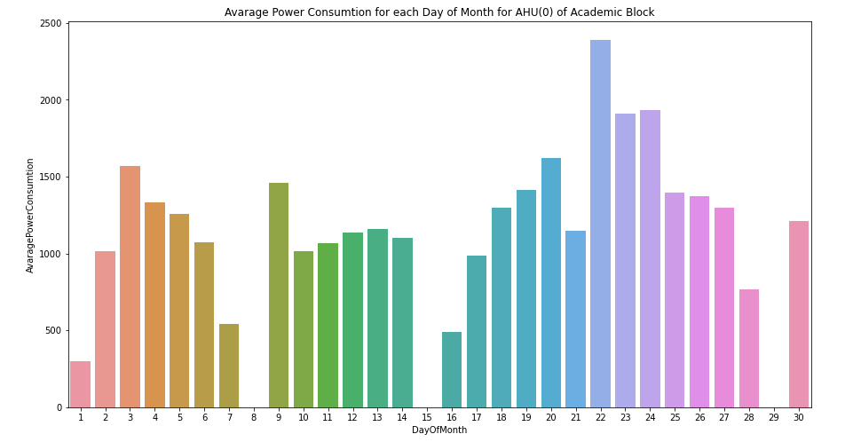
Exploratory Analysis and Feature Engineering (Data Analyzed: Academic Block → AHU → 0)
Average Power consumption for each Day of Month
Observation: Power consumption is maximum at the end of the month and almost zero on 8th,15th and 29th
Notes:
We can see from the above figure, where average Power consumption across different days of month is plotted, that Power consumption is maximum at the end of the month and almost zero on 8th,15th and 29th

Slide 9
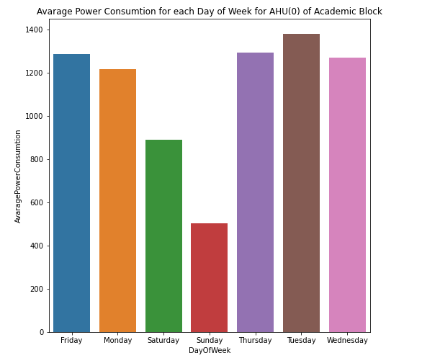
Exploratory Analysis and Feature Engineering (Data Analyzed: Academic Block → AHU → 0)
Average Power consumption for each Day of Week
Observation:
Power Consumption is minimum on Sunday and maximum on Tuesday
Notes:
Se can observe from this plot that power consumption is Maximum on Tuesday and less on weekends. It is Minimum on Sunday.

Slide 10
Exploratory Analysis and Feature Engineering (Data Analyzed: Lecture Block → AHU → 0)
Important information gathered from the collected data
Max Current Consumption: 7.965205192565918 at 2014-06-06 06:47:37
Min Current Consumption: 0.0
Mean Current Consumption: 0.7226439835113802
Median of Current Consumption: 2.000000132986441e-17
Max Power Consumption: 2984.92431640625 at 2014-06-06 06:33:07
Min Power Consumption: 0.0
Mean Power Consumption: 251.96503620798015
Median of Power Consumption: 2.000000132986441e-17
Max Energy Consumption: 3071038.0
Min Energy Consumption: 2896553.25
Mean Energy Consumption: 3007466.624384697
Median of Energy Consumption: 3012618.0
Notes:
We have done the exploratory analysis on data for AHU(0) of Lecture block also and extracted the important numbers out of it. Those are documented in the above slide.

Slide 11
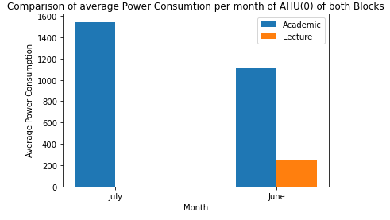
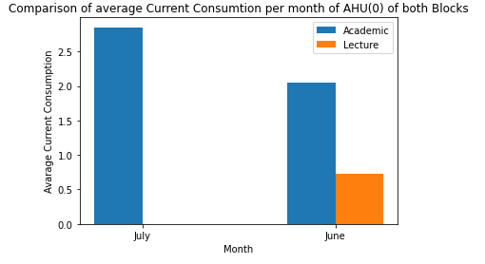
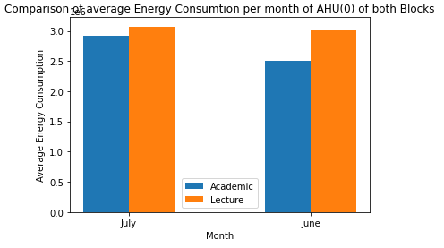
Exploratory Analysis and Feature Engineering (Data Comparison: Lecture Block(AHU → 0) and Academic Block(AHU → 0)
Comparison of average consumption per month of AHU(0) of both Blocks
Academic block(AHU(0)) has higher Power and Current consumption but less monthly Energy consumption than the Lecture block(AHU(0))
Notes:
Now we have done some comparison of monthly average overall power consumption of AHU(0) of both the Academic and Lecture block.
We can see Academic block(AHU(0)) has higher Power and Current consumption but less monthly Energy consumption than the Lecture block(AHU(0))

Slide 12
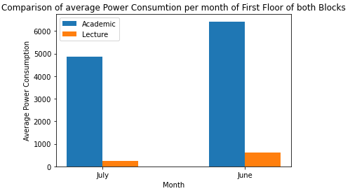
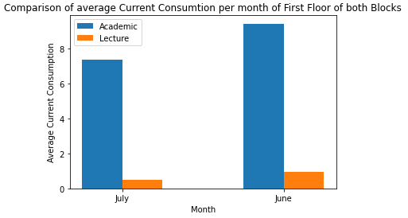
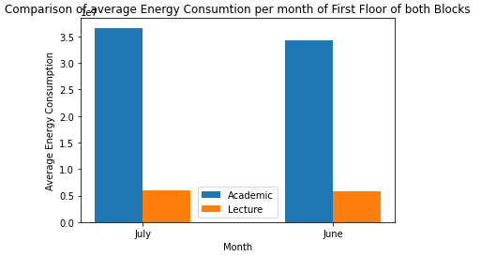
Exploratory Analysis and Feature Engineering (Data Comparison: Lecture Block(Floor Total → 1) and Academic Block(Floor Total → 1)
Comparison of average consumption per month of First Floor of both Blocks
Floor 1 in Academic block has much more average monthly Power, Energy and Current consumption than Floor 1 in Lecture block
Notes:
We have done the same kind of comparison between Floor 1 of both Academic and Lecture block and found that Floor 1 in Academic block has much more average monthly Power, Energy and Current consumption than Floor 1 in Lecture block

Slide 13
Building Models(Model1)
Model Built for Power estimation on Academic block
Known Attributes: Datetime, Current and Energy
Target Attributes : Power
Data set used: Academic Block-->AHU-->0
MinMaxScaler is used to scale data to scale the data for Current, Energy and Power as those were is different scales
Converted Datetime to numeric field
Split the data in Train : Test in 80 : 20 ratio
Model used: Linear Regression
Validation Result in test set
Root Mean Squared Error | Mean Squared Error | Mean Absolute Error | R Squared | Adj R Squared
0.034 | 0.001 | 0.025 | 0.986 | 0.986
Notes:
Now the next step, Building models. We have built two types of model for predicting Power consumption.
Lets discuss model 1 here. In this model we will be predicting power consumption for a given time when we know the Current and Energy consumption. The dataset used here is of AHU(0) of Academic block
We had to use MinMaxScaler to scale the data for Current, Energy and Power as those were in different scales. Then we converted the Datetime field to numeric so that we can use the same in the model.
Data is now split into train and test in 80:20 ratio and Fitted the model.
Linear Regression model is used here as this is a regression problem.
We have validated the model on the test dataset and calculated Mean Squared Error(MSE), Root Mean Squared Error(RMSE), Mean Absolute Error(MAE), R Squared and Adjusted R Squared for the same. The Results are captured in the above table here.

Slide 14
Building Models(Model1)
Same model then validated with the new set of data
New Validation Dataset: AHU → 1 of Academic Block
Same reprocessing steps performed
Validation Result
Root Mean Squared Error | Mean Squared Error | Mean Absolute Error | R Squared | Adj R Squared
0.041 | 0.002 | 0.032 | 0.986 | 0.986
Notes:
We have used another completely new dataset for 2nd round of validation for our model. The dataset used here is AHU(1) of Academic block.
Same kind reprocessing is performed on the data and validated the result on the actual Power for that given time, Current and Energy with the predicted value by the model.
The result of the same validation is captured in the above table.

Slide 15
Building Models(Model2)
Model Built for Power estimation on Academic block
Known Attributes: Datetime
Target Attributes : Power
Data set used: Academic Block-->AHU-->0
MinMaxScaler is used to scale data to scale the data for Power
Converted Datetime to numeric field
Split the data in Train : Test in 80 : 20 ratio
Model used: Lasso Regression
Validation Result in test set
Root Mean Squared Error | Mean Squared Error | Mean Absolute Error | R Squared | Adj R Squared
0.291 | 0.085 | 0.282 | 0.007 | 0.007
Notes:
Now lets discuss model 2. In this model we will be predicting power consumption for a given time only. The dataset used here is of AHU(0) of Academic block
We had to use MinMaxScaler to scale the data for Power to change the scale. Then we converted the Datetime field to numeric so that we can use the same in the model.
Data is now split into train and test in 80:20 ratio and Fitted the model.
Lasso Regression model is used here as this is a regression problem.
We have validated the model on the test dataset and calculated Mean Squared Error(MSE), Root Mean Squared Error(RMSE), Mean Absolute Error(MAE), R Squared and Adjusted R Squared for the same. The Results are captured in the above table here.

Slide 16
Building Models(Model2)
Same model then validated with the new set of data
New Validation Dataset: AHU → 1 of Academic Block
Same reprocessing steps performed
Validation Result
Root Mean Squared Error | Mean Squared Error | Mean Absolute Error | R Squared | Adj R Squared
0.34 | 0.115 | 0.309 | 0.009 | 0.009
Notes:
Here again we have used another completely new dataset for 2nd round of validation for our model. The dataset used here is AHU(1) of Academic block.
Same kind reprocessing is performed on the data and validated the result on the actual Power for that given time with the predicted value by the model.
The result of the same validation is captured in the above table.

Slide 17
Conclusion
Analysis of this dataset is very important as it can give many insights of the Electricity consumptions in the commercial buildings in IIIT Delhi
The pattern of the power consumptions can be identified and accordingly the required hardware and support system can be implemented to handle the high consumption times and carry out maintenance work in the off load periods
Load balancing can also be arranged according to the same
Here two types of model is prepared on one type of building to predict the Power consumption for a given time
Similar kind of many more models can be prepared to predict other parameters for other buildings as well which can help in planning and managing the uninterrupted service efficiently in the campus across 24*7
Notes:
Now we are at the last step of the presentation.
We have seen from the analysis that we have identified some very important features of the data and established the correlation between the attributes. We have also got to know the pattern of the overall consumption. We know the peak time also we know the off load periods. We can also predict the Power consumption for a given time with or without the knowledge of other factors like Current and Energy.
This analysis shown here is done on very small section of data. Same kind of analysis can be done for other sections and other parameters as well.
So knowing these insights will help the management of the IIIT Delhi plan properly during maintenance and allocate hardware instruments accordingly. So at a glance knowing these details information on the data of electricity consumption will help them to plan and manage uninterrupted and efficient supply across 24*7.

Slide 18
Thank You

