Slide 1
Information Management System(IMS)
Supervisor:
Md. Nurul Ahad Tawhid
Assistant Professor
By:
Sudip Kumar Sah
Roll#1040

Slide 2
Introduction
The project “Information Management System” about the information of Student and their management system. Handle details about student enrolled At Institute Of Information Of Technology ,includes academic as well as personal details.

Slide 3
The project to computerize the manually operated task since a long period of time. The track record of student are ready to handle and can be accessed at any time.
The performance of this project has a wide range like new student information will be added. Search for certain student data results into instant data retrieve. Delete operation can be performed when someone’s data need to delete. Overall
data is being erased related to particular student from existing recorded data.

Slide 4
Task performed
Insertion of student related information after when programs ask for roll number of respective student.
Deletion of student information when user provides their roll number to the programs.

Slide 5
Continued..
Searching operation performed when user gives their roll number with all information.
All of the roll number of students are considered as nodes of the B-tree. Nodes will hold information of student.

Slide 6
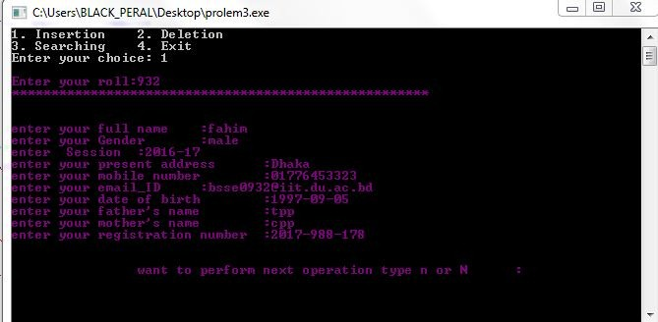
While inserting, it turns purple

Slide 7
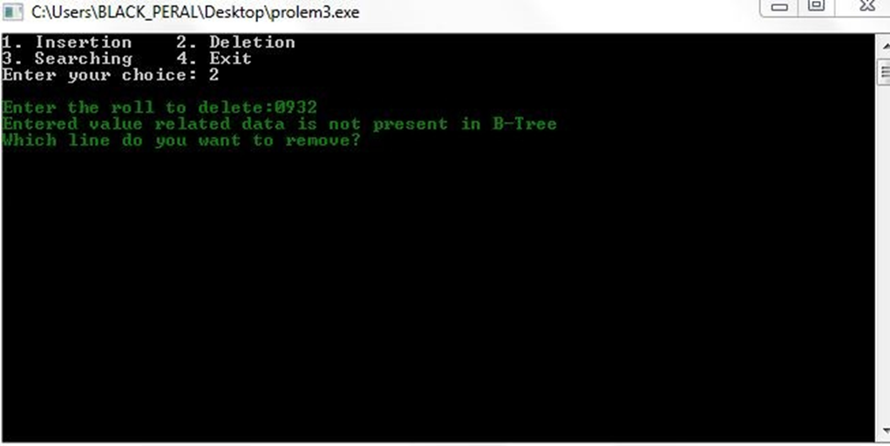
When user enters for deletion, it turns into green

Slide 8
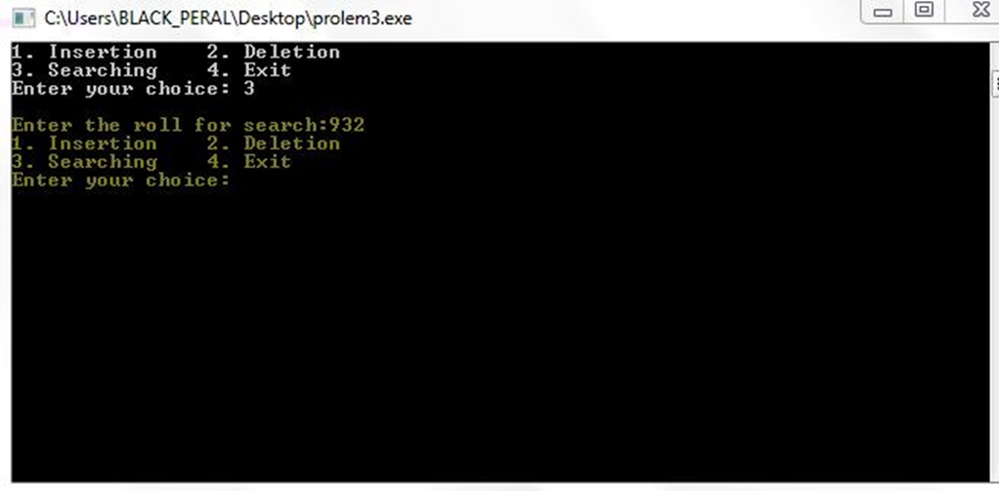
When user want to search, it turns yellow

Slide 9
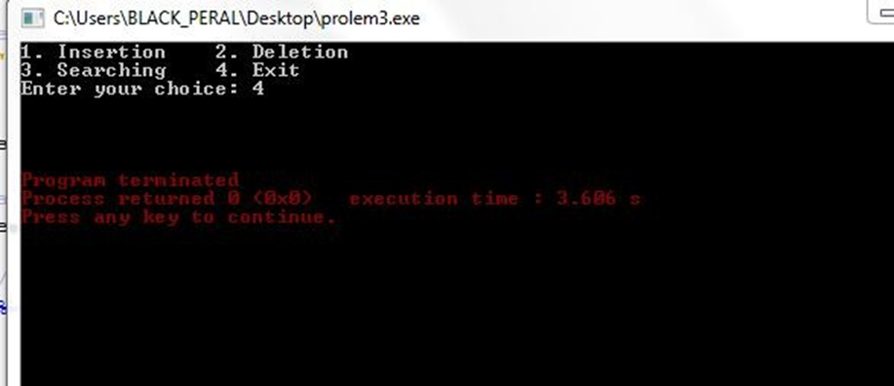
For exit, it turns red

Slide 10
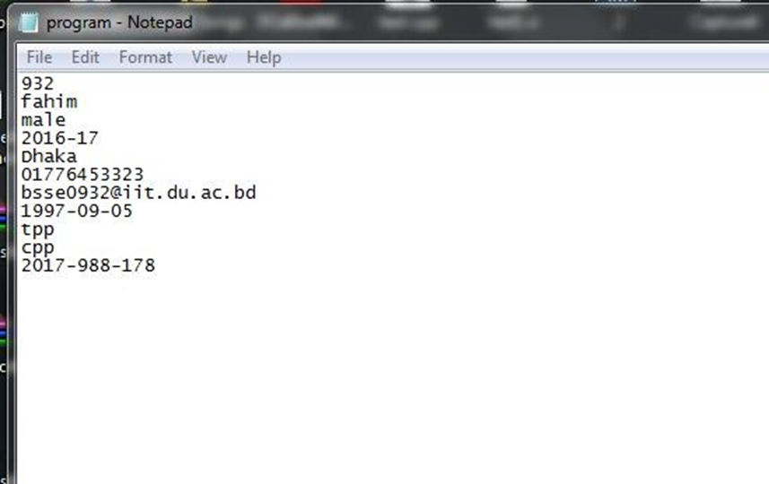
Sample output text file

Slide 11
Objectives
To reduce the irrelevant paper work in maintaining student’s information.
Fast and convenient way to handle huge data.
Maintains the database of the students in any educational organization across the globe.
Instant in response of overall information for particular student.

Slide 12
Github Repository Link:
https://github.com/SudipKumarSah-0934/SPL-1/blob/master/prolem1.cpp
References:
http://gousios.org/courses/algo-ds/book/b-trees-b-trees.html
https://uxmankabir.wordpress.com/2017/05/08/cpp-program-to-perform-insertion-deletion-and-traversal-in-b-tree/

Slide 13
Thank You!!!

