Slide 1
Student Management System
Supervisor:
Md. Nurul Ahad Tawhid
Assistant Professor
By:
Sudip Kumar Sah
Roll#0934

Slide 2
Introduction
The project “Student Management System” about the information of Student and their management system. Handle details about student enrolled At Institute Of Information Of Technology ,includes academic as well as personal details.

Slide 3
The project to computerize the manually operated task since a long period of time. The track record of student are ready to handle and can be accessed at any time.
The performance of this project has a wide range like new student information will be added, finally results the total number of student’s record are updated. Search for certain student data results instant overall information stored .

Slide 4
Objectives
To reduce the irrelevant paper work in maintaining student’s information.
Fast and convenient way to handle huge data.
Maintains the database of the students in any educational organization across the globe.
Instant response of overall information for particular student.

Slide 5
Work done so far
Display All records
Output On Console
Student Information from console
Text File
New Student Record
Append
Search By Students Roll#

Slide 6
Rest of operation on Student Record
What to do next
Updating student’s particular information i.e. either in case of recorded wrong data or newly updated information like mobile numbers, address etc.
Deleting records of particular student.

Slide 7
Non-functional Requirements
To perform previous operation, user needs to authenticate with given username and password.
Text color and font at console.

Slide 8
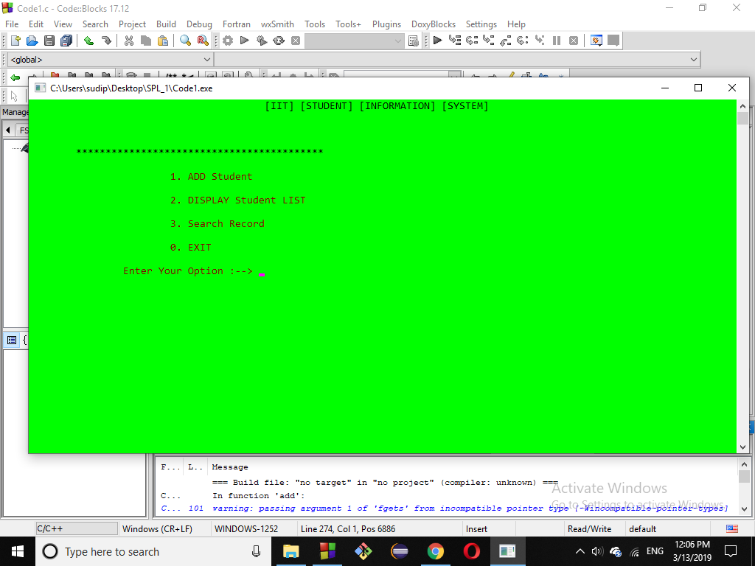
Sample output

Slide 9
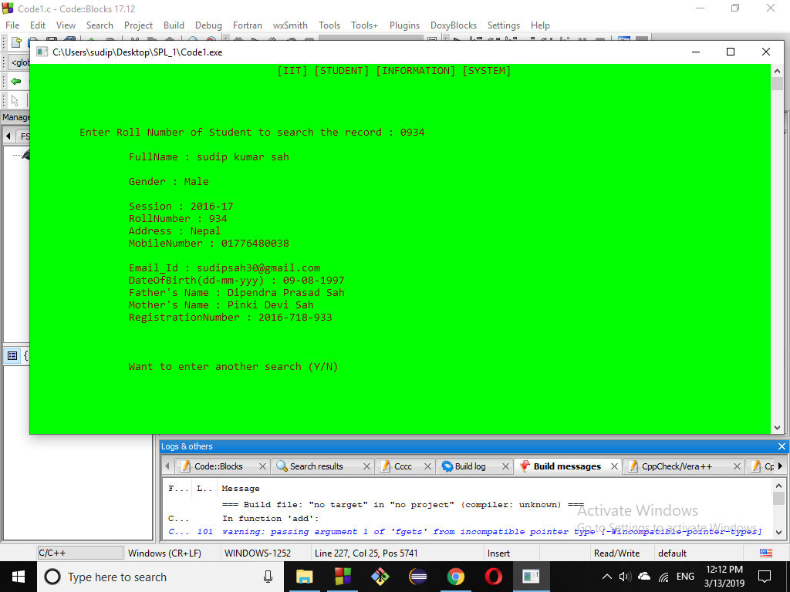
To be continued…

Slide 10
Github Repository Link:
https://github.com/SudipKumarSah-0934/SPL-1/blob/master/Code1.c
References:
https://www.slideshare.net/jarajana/student-management-systemstms
https://www.slideshare.net/kumarrjv1/students-management-system

Slide 11


