Slide 1
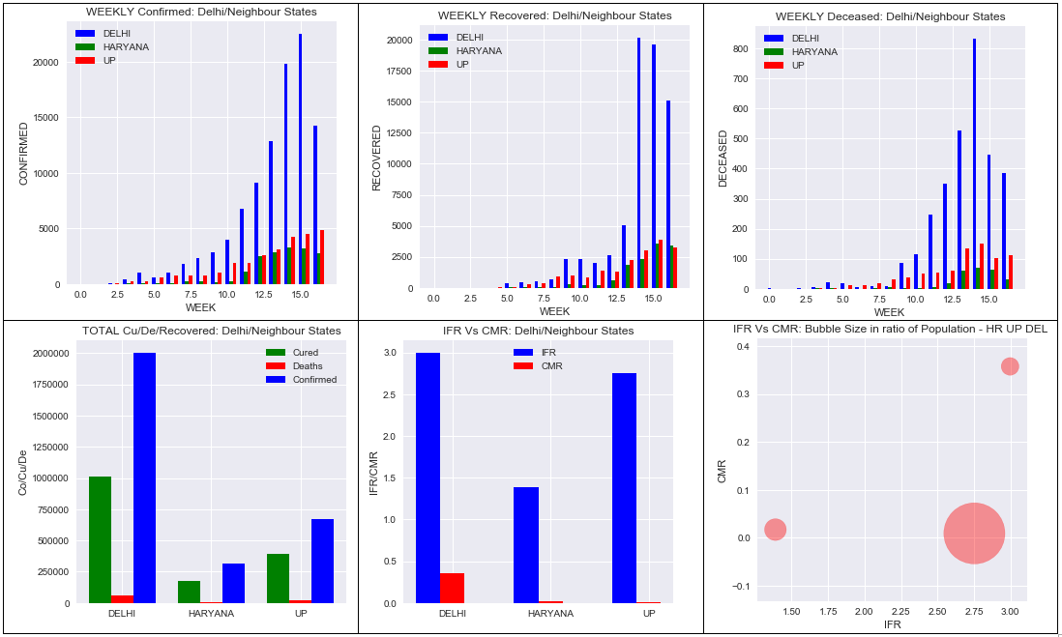
DELHI COVID-19 DASHBOARD FOR HONBLE. CM- DELHI --- 07 JULY 2020 INDIA

Slide 2
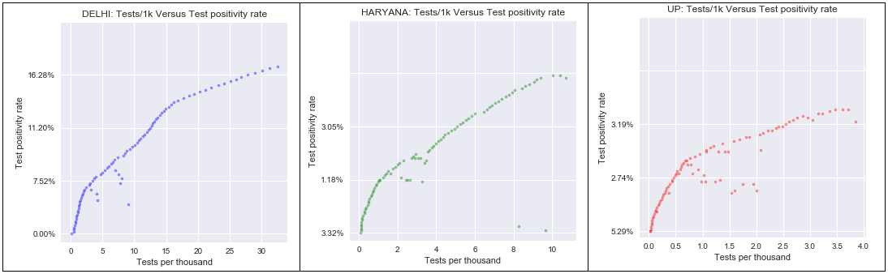
DELHI COVID-19 DASHBOARD FOR HONBLE. CM (DELHI) --- 07 JULY 2020 INDIA
THANK YOU!
Data Source: COVID-19 in India | Kaggle → www.kaggle.com (Updated till 05 JULY 2020)
Prepared under the guidance of Management Dept. Lovely Professional University, Jalandhar, India

