Slide 1
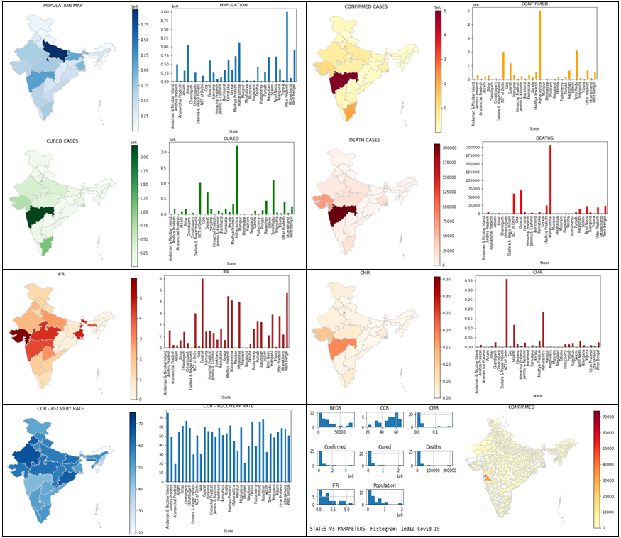
COVID PRESENT STATE: INDIA (DATA TILL 03.07.2020)

Slide 2
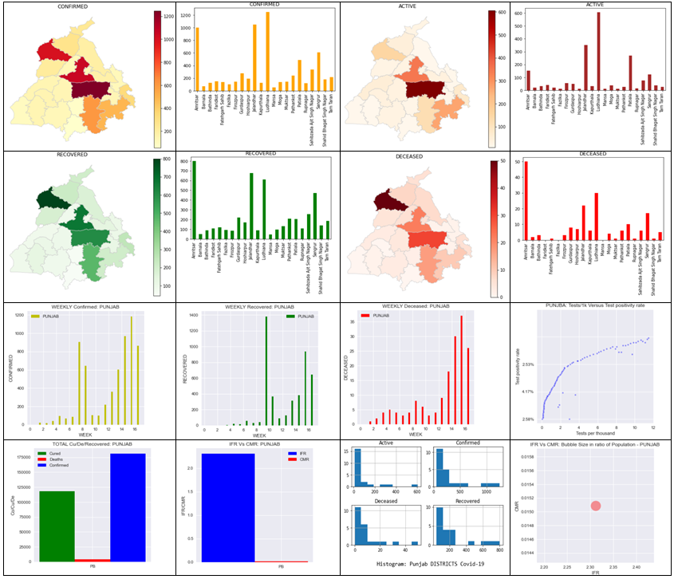
COVID PRESENT STATE: PUNJAB (DATA TILL 03.07.2020)

Slide 3
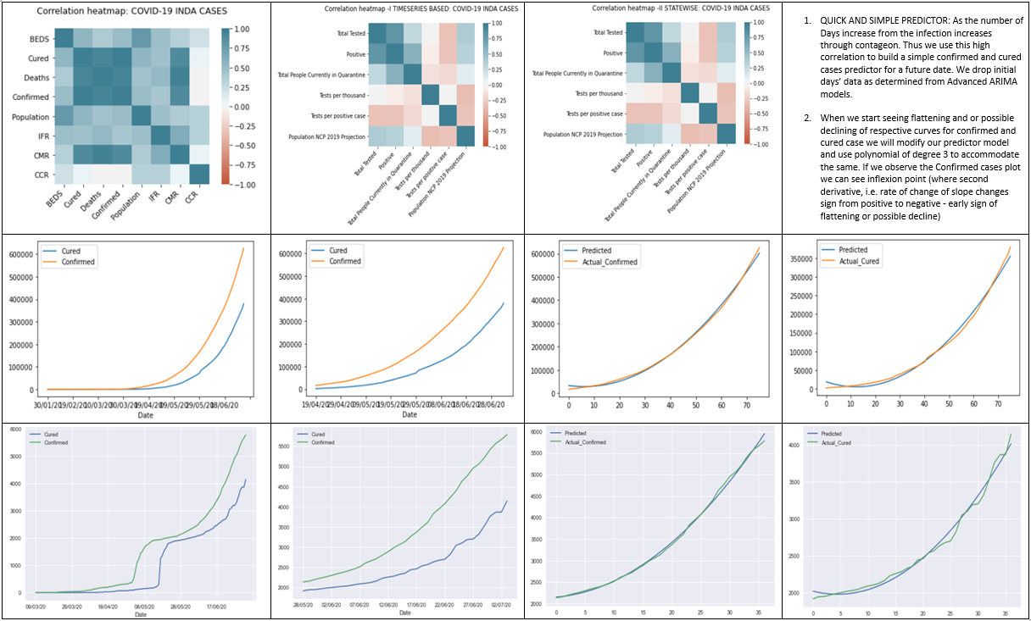
CORRELATAION HEATMAP FOR COVID-19 PARAMETERS & CASES PREDICTED (DATA TILL 03.07.2020)
INDIA →
PUNJAB →

Slide 4
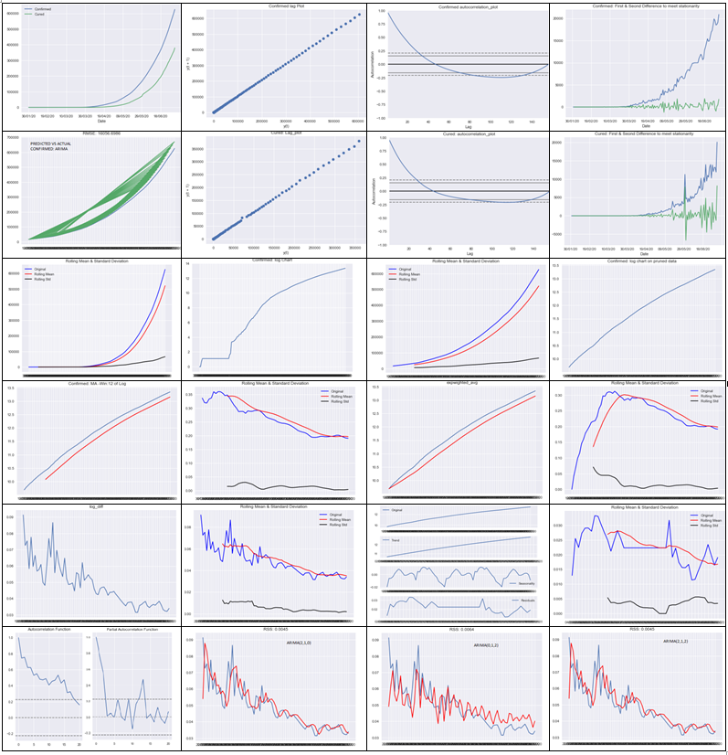
ARIMA MODEL FOR CONFIMED AND CURED CASES PREDICTION ON A FUTURE DATE
Confirmed
Cured
Confirmed
INDIA →
PUNJAB →

Slide 5
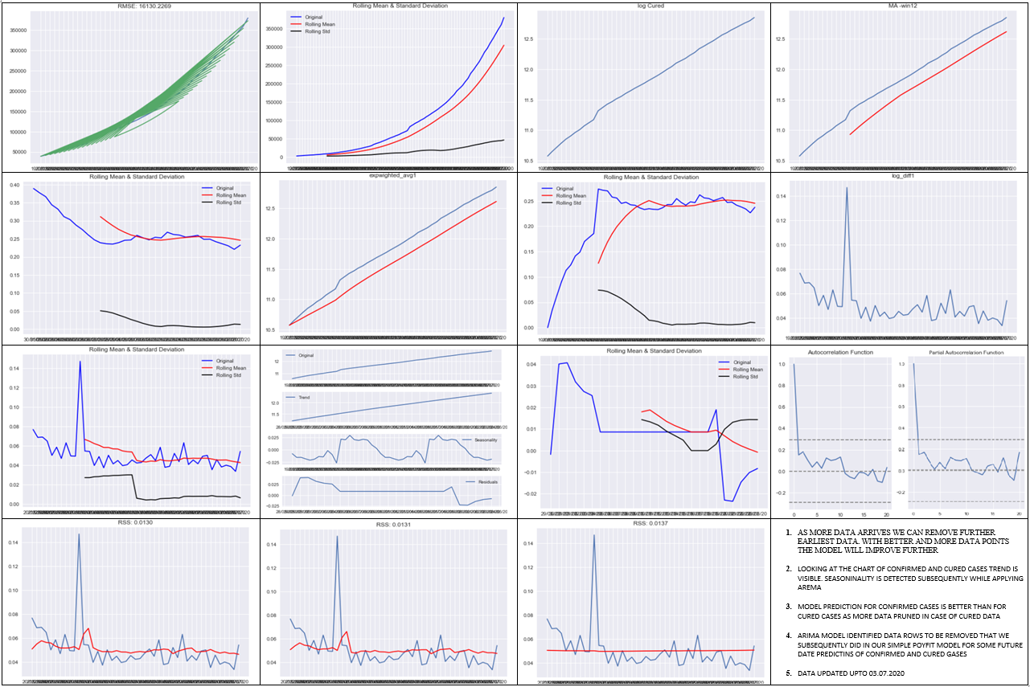
ARIMA MODEL FOR CONFIMED AND CURED CASES PREDICTION ON A FUTURE DATE
CURED →
INDIA →
PUNJAB →

Slide 6
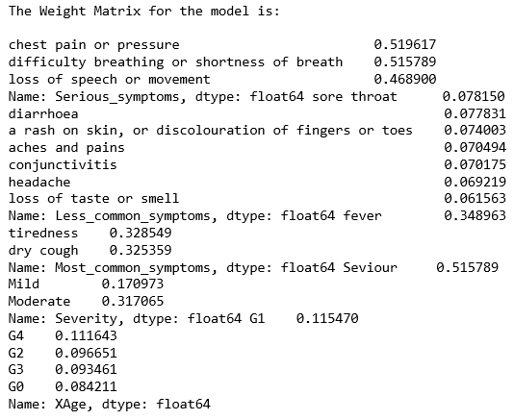
CLASSIFIER: COVID VERSUS FLU AND STATE OF THE WORLD
AGE GROUPS (BINS OF SIZE 20)
THANK YOU!
Data Source: COVID-19 in India | Kaggle → www.kaggle.com (Updated till 03 JULY 2020)
Prepared under the guidance of Management Dept. Lovely Professional University, Jalandhar, India

