Slide 1
DESIGN AND ANALYSIS OF ANTENNAS FOR NANO-SATELITE
-SUDIP NAYAK, 3RD YEAR (6TH SEM,B220061)

Slide 2

INTRODUCTION
Small satellite is of low mass and size, usually between 1-10kg(2-22 lbs).
A majority of the nano-satellites launched so far are intended to operate in the amateur VHF (144-146 MHz) and UHF (435-438 MHz) frequency bands.
Pursuing cost-effective space missions for the future.
Miniaturized satellites provide a cost-effective design option that can be mass-produced easily.
Creating opportunities for accomplishing missions that were previously impossible with larger satellites, including:
Facilitating accessibility for companies of all sizes and types.
Reducing development times.
Incorporating the latest technology advancements.

Slide 3
INTRESTS AND ADVANTAGES
Nano-satellites have revolutionized the space industry by providing a cost-effective way to explore and study space.
These small satellites are equipped with various instruments, including antennas, that enable them to communicate with Earth and other satellites.
Antennas play a critical role in the success of a nano-satellite mission as they facilitate communication and data transfer.
Designers have begun to address these promises by leveraging new technologies and implementing highly efficient designs, aiming to align with the low-cost model while offering remarkable capabilities at exceptionally affordable prices.
Recognizing the immense possibilities arising from maximizing this trend, the scientific community has already acknowledged the requirement for multiple small-scale and cost-effective spacecraft to fulfill a wide range of missions.

Slide 4

TYPES OF ANTENNAS FOR NANO-SATELITE
There are several types of antennas used in nano-satellites, including patch antennas, helical antennas, and dipole antennas. Patch antennas are commonly used due to their small size and low weight. They are also easy to manufacture and can be integrated into the satellite's structure.
Helical antennas are another type of antenna used in nano-satellites. They have a higher gain than patch antennas, making them ideal for long-range communication. However, they are larger and heavier than patch antennas and require more power to operate.

Slide 5
SOME IMPORTANT TOPICS IN NANO-SATELITE MECHANISMS
Launch loads: often categorized into four types with different frequency domains.
Quasi-static acceleration load: The acceleration in the direction of flight caused by an engine’s thrust (about 10G).
Sine vibration load: Caused by rocket vibration with a large peak at 10 to 30 Hz, under 100Hz.
Random vibration load = acoustic load: The acoustic vibrations from the engine jets are propagated from the mechanical interface. Additionally, in the atmosphere, acoustic loads are applied directly through the fairing.
Shock load: Shocks caused by explosions of pyrotechnics and separation of spacecraft.

Slide 6
Tribology: Tribology is the science and engineering of interacting surfaces in relative motion, including lubrication, friction, wear, galling, and bearing design. The high vacuum environment in space has the following effects on sliding parts of a mechanism.
Evaporation of lubricants: In low pressure, even solid state lubricants evaporate. Evaporation should be considered, especially for liquid lubricants such as oil and grease.
Cold welding: Metal surfaces stick together due to an increase in the friction coefficient. This is caused by delays in the formation of molecular absorption layer/oxidized layer (protective layer = low friction).
After the protective layer is worn off on a metal contact surface due to launch vibrations, etc. (=fretting wear), in the air, oxidation occurs quickly and the protective layer is repaired.
In contrast, in a vacuum, repair is slow and the worn surfaces touch each other, resulting in high friction.

Slide 7
AS WE KNOW………
Antennas designed for nano-satellite communications primarily focus on achieving coverage for concealed areas. However, the stringent weight and size limitations of nano-satellites impose significant constraints on antenna design options. In particular, the space available for antennas is often shared with solar cells, further limiting the available area. Additionally, certain antenna designs for nano-satellites require deployment mechanisms, such as wire antennas like monopole antenna and dipole antenna, as well as patch antennas.
A critical consideration in antenna deployment is the potential impact on the overall system and mission success. Any issues or failures in the deployment mechanism can result in mission failure. One possible solution to address this deployment challenge is the utilization of planar antennas, specifically slot antennas and micro-strip patch antennas. However, these planar antennas often exhibit low gains and efficiency.

Slide 8
For instance, currently available 2.5 GHz patch antennas suitable for nano-satellites typically exhibit a maximum gain of only 0.9 dB, with a bandwidth of 1500 MHz. In the case of slot antennas, the maximum gain reaches 4 dB, but the resulting bandwidth is significantly narrower at only 110 MHz. Consequently, the low gain is a consequence of their bidirectional radiation patterns.
In summary, nano-satellite antenna design faces the challenge of optimizing coverage within the limited space available while ensuring reliable deployment mechanisms and considering the trade-offs between gain, efficiency, and available bandwidth.

Slide 9
SOME SAYING
Rajat Mathur, Randy Haupt Charles, and Swenson presented a comprehensive analysis of the nanosatellite program at Utah State University (USUsat). The paper provided detailed insights into the communication link budget and antenna designs specifically developed for the nano satellite.
S Y Prahyang, M Z Dhiya'Ulhaq, and O P Golim have contributed to the advancement of nanosatellite technology, enabling the development of satellites with diverse capabilities for specific missions in a short duration and at a reduced cost. This progress has demonstrated the effectiveness of satellite communications in delivering information due to their extensive coverage area.
Abdul Halim Lokman, Ping Jack Soh, and Saidatul Norlyana Azemi conducted a thorough review of antennas suitable for nanosatellite applications. Their research included an overview of nanosatellite applications, followed by a discussion on the antenna requirements. The study further delved into the materials and antenna topologies utilized in nanosatellites, and finally presented various deployable configurations.

Slide 10
OBJECTIVE
The objectives of this project are:
1)Utilize CST Software for the design of communication systems in nano-satellites.
2) Conduct a quantitative analysis of different monopole antenna designs, focusing on their ability to effectively overcome challenges specific to nano-satellites.
3) Perform a thorough and qualitative analysis of monopole antennas, considering parameters such as mass, size, gain, beam steerability, polarization style, operational bandwidth, and losses.

Slide 11
PROBLEM STATEMENT
Due to the special environment in space and the requirements of modern small satellites, antenna designs for modem small satellites have many challenges. The main challenges include:
1) Antennas must be highly reliable, as it is difficult to replace the antenna in space. Antennas must be very small, have low mass, be highly efficient, and be low cost, due to the stringent requirements of small size, low mass, and low cost of modem small satellites.
2) High data rates require a high antenna gain. However, the very limited space available on modem small satellites makes it difficult to accommodate a high-gain antenna, which usually consists of bulky and complicated reflector antennas or antenna arrays. Costly pointing will also be needed for high-gain antennas
In summary, the antenna design for modern small satellites must address the challenges of high reliability, compact size, low mass, high efficiency, and affordability, while also finding innovative solutions to enable high data rates within the limitations of limited space and complex deployment mechanisms.

Slide 12
SOFTWARE USED FOR DESIGNING
CST Studio Suite® stands as a prominent electromagnetic simulation tool, offering a diverse set of solvers suitable for a wide range of applications. One notable application of CST Studio Suite involves the design and positioning of antennas and other radio-frequency components. Specifically, the software enables the simulation of antenna radiation patterns, performance evaluation, and assessment of antenna coupling within realistic environments.
CST Studio Suite serves as a comprehensive tool for creating various antenna types, encompassing horns, reflectors, wire antennas, printed antennas, and arrays. Its versatile capabilities facilitate the design and optimization of these antenna configurations to meet specific requirements.
Primarily utilized across industries such as telecommunications, defense, automotive, aerospace, electronics, and medical equipment, CST Studio Suite serves as a powerful electromagnetic design tool. Its application spans diverse sectors where electromagnetic simulations are crucial for achieving optimal performance and reliability.

Slide 13
IMPLEMENTATION
Given below are the three formulas used for designing the monopole
antenna :
L = 142.5 / f ( MHz)
Pole Length = L/2
Radius = 0.008 * ( c/f )
Here we are designing a monopole antenna operating in the frequency of 2.5GHz .
Frequency Minimum:2 GHz
Frequency Maximum: 3 GHz
Lamda=119.5mm
Radius=lambda/1000
Gap=2mm

Slide 14
For reflector antenna
Reflector spacing = 0.25λmm
Lambda(for 2.4GHz)=0.89*119.92mm
Gap=2mm
The PEC type of material was taken into consideration for designing our monopole antenna due to its strength of weight ratio ,having very low coefficient of friction and also because being a nice conductor. 50 Ohm impedance was taken to match the transmission line.

Slide 15
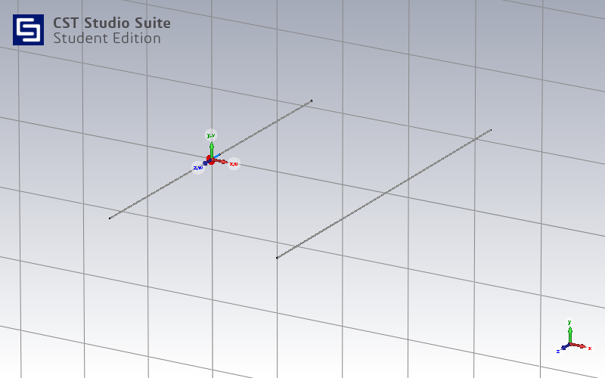
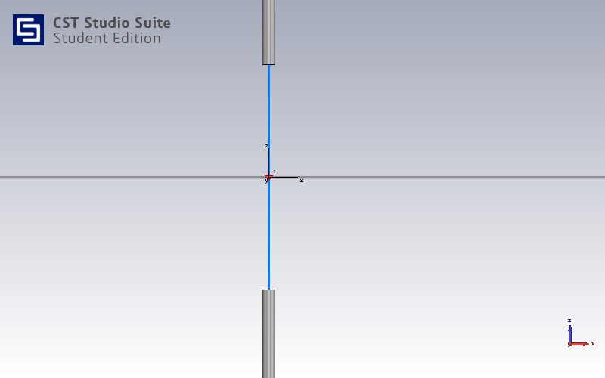
SIMULATION AND ANALYSIS
Fig : Monopole Antenna with Reflector antenna
Fig : Junction of two monopole antenna

Slide 16
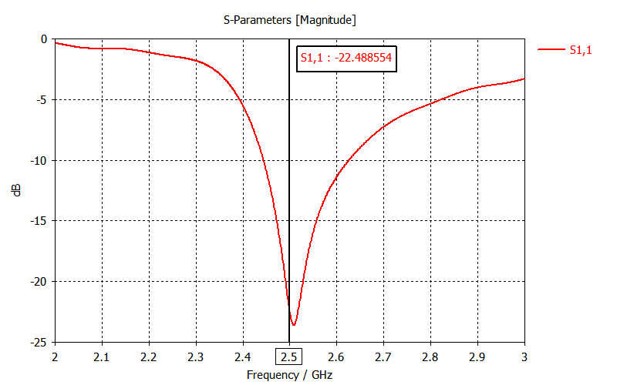
RESULT
Fig : S11 of the monopole antenna

Slide 17
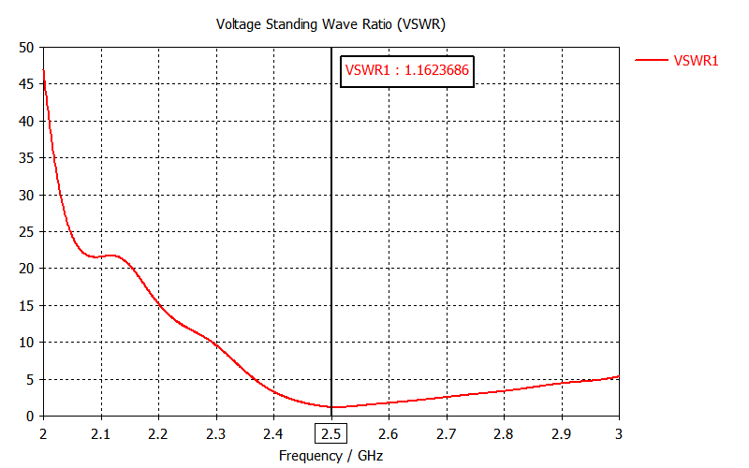
Fig : Monopole Voltage Standing Wave Ratio (VSWR).

Slide 18
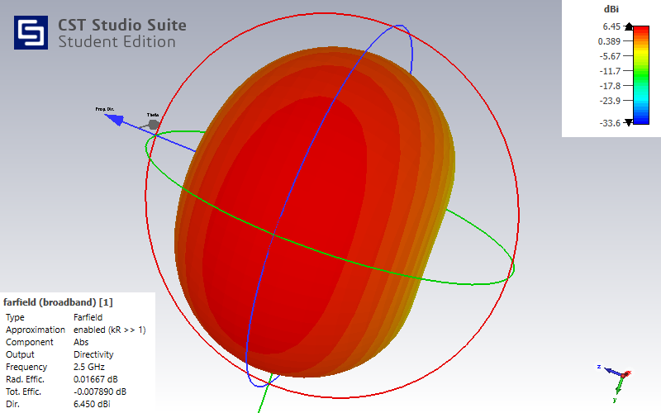
Fig : Farfield directivity for monopole antenna

Slide 19
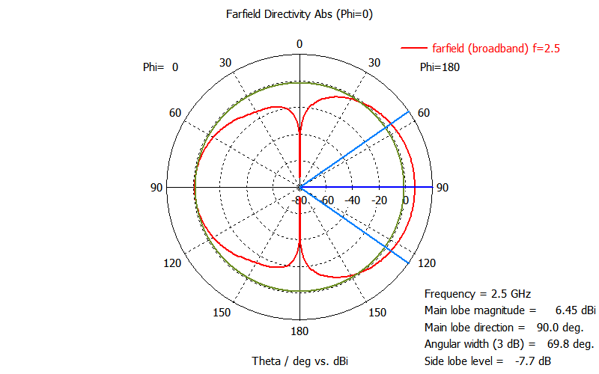
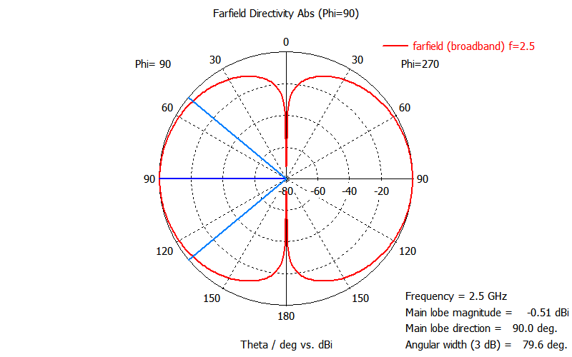
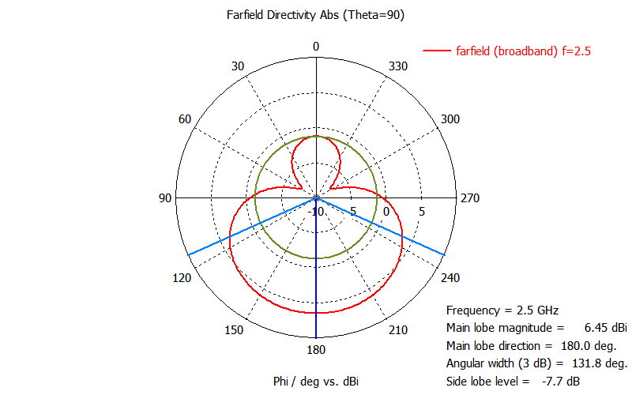
Far field directivity at absolute phi=0
Far field directivity at absolute phi=90
Far field directivity at absolute theta=90

Slide 20
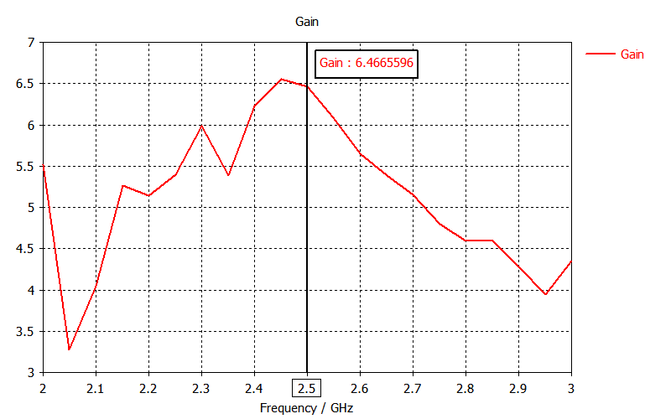
Fig : Farfield directivity for monopole antenna

Slide 21
EXPECTATIONS IN FUTURE
Nano Satellite technology is an attractive emerging alternative to conventional satellites in radio astronomy, earth observation, weather forecasting, space research, and communications.
Its relatively short development time and cost efficiency are the attractive features.
Nano satellites are ideal for testing new technologies in space (In-Orbit Demonstration).
Typical uses of Nano-satellites call for high data processing and transmission capacities.
These small satellites provide affordable access to space for small companies, research institutes and universities

Slide 22
CONCLUSION
This project focuses on the simulations and analysis conducted on a monopole antenna designed specifically for nano-satellites operating in the S-band frequency range. The antenna's performance was simulated using CST Software, allowing for the calculation of parameters such as S11, VSWR, and gain at the intended frequency of operation. The simulated results exhibited a close resemblance to the expected outcomes.
The monopole antenna showcased an omnidirectional radiation pattern, meaning it emitted power equally in all azimuthal directions perpendicular to the antenna. However, the power distribution varied with the elevation angle, resulting in a gradual decrease of radiation towards the zenith of the antenna axis. Additionally, the monopole antenna primarily radiated vertically polarized radio waves.
In summary, through CST Software simulations and analysis, the monopole antenna's performance in terms of its radiation pattern, power distribution, and polarization characteristics were successfully evaluated, aligning with the anticipated outcomes for nano-satellite applications.

Slide 23
REFERENCES
S. Gao et al., "Antennas for Modern Small Satellites", IEEE Antennas and Propagation Magazine, vol. 51, no. 4, pp. 40-56, 2009.
N. Annavarapu, B. S. Cheela and K. S. Sadasivan, "A robust low power communications architecture for nano- satellites," 2016 IEEE Aerospace Conference, Big Sky, MT, 2016, pp. 1-9
Design and analysis of antennas for a nano-satellite; Kshitij Sandeep Sadasivan; Srinivasan N. Shalini; Bhagath Singh Cheela; Nirav Annavarapu https://ieeexplore.ieee.org/document/7943809
New S / C band Monopole antenna design for satellite application, Conference: 2021 IEEE International Conference on Design & Test of Integrated Micro & NanoSystems (DTS)https://www.researchgate.net/publication/354126021_New_S_C_band_Monopole_ante nna_design_for_satellite_application
Compact Antenna for Small Satellite Applications [Antenna Applications Corner], M. T. Islam; Mengu Cho; M. Samsuzzaman; S. Kibria, https://ieeexplore.ieee.org/abstract/document/7109243

Slide 24
Technology Trends and Challenges of Antennas for Satellite Communication Systems, YahyaRahmatSamii;ArthuC.Densmore,https://ieeexplore.ieee.org/abstract/document/6945379
Issue Small Satellites, Steven Gao; Martin N. Sweeting; Shinichi Nakasuka; Simon Peter Worden, https://ieeexplore.ieee.org/abstract/document/8303878
UHF Deployable Helical Antennas for CubeSats, Joseph Costantine; Youssef Tawk; Ignacio Maqueda; Maria Sakovsky; Gina Olson; Sergio Pellegrino; https://ieeexplore.ieee.org/abstract/document/7496961
Antenna Designs for CubeSats: A Review; Suhila Abulgasem; Faisel Tubbal; Raad Raad;PanagiotisIoannisTheoharis;SininLu;Saeid\Iranmanesh, https://ieeexplore.ieee.org/abstract/document/9380228
Characteristic Modes Analysis of Non-Uniform Metasurface Superstrate for Nanosatellite Antenna Design, Francesco Alessio Dicandia; Simone Genovesi, https://ieeexplore.ieee.org/document/9207886

Slide 25
THANK YOU

