Slide 1










E-Commerce Sales Performance Analysis: A Power BI Dashboard Solution
Submitted by : Sudipta Mitra
Roll No. : 23440523027
Bachelor of Science in Data Science
Paper Code: FYBMS581
NSHM Knowledge Campus, Kolkata

Slide 2
TABLE OF CONTENTS
01
02
03
Introduction
KPI OVERVIEW
Sales Distribution
04
05
06
Monthly Breakdown
YTD vs. PYTD Sales Trend
Limitations and future work

Slide 3
Introduction & Project Overview
The main purpose of my project was to convert raw e-commerce sales data into meaningful insights using Power BI.
Through this dashboard, we can understand total sales, profit, monthly trends, regional performance, product-wise contributions, and customer behavior.
This helps in making informed business decisions and optimizing operations.
Data Collection & Sourcing: The e-commerce sales data was collected from Kaggle in CSV format. Data Processing : Power Query was used to clean the data, handle missing values, and format columns. Data Modeling & DAX (Power Pivot) : Tables were connected using relationships, and DAX was used to create KPIs. Visualization & Design : An interactive Power BI dashboard was created using charts, maps, and slicers.

Slide 4
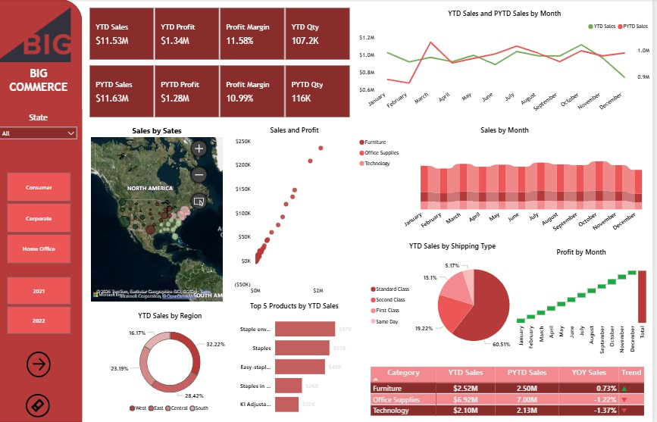

Slide 5
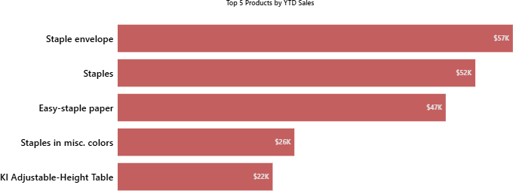
Key Performance Indicators
KPI cards that show YTD sales, total profit, profit margin, and quantity sold.
Sales have slightly decreased compared to last year
Even though sales decreased slightly, profit increased, which shows better cost control or pricing strategy
Profit margin increased from 10.99% to 11.58%, which indicates improved business efficiency
Quantity sold decreased from 116K to 107.2K, meaning fewer items were sold but more profit was generated per item.

Slide 6
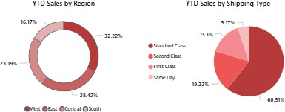
Sales Distribution
This pie chart shows sales contribution by shipping method.”
Insight:
Standard Class dominates with around 60% of sales
Same Day shipping has very low contribution
Conclusion:
“Customers prefer cost-effective shipping over faster delivery.”
This chart shows sales distribution across regions.
Insight:
West region has the highest sales
Central and South contribute less
Business action:
“Companies can target weaker regions for growth.”

Slide 7
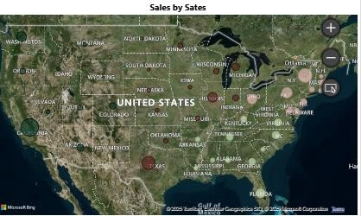
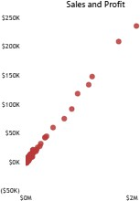
Sales Distribution
This map shows state-wise sales distribution.
Darker and larger bubbles indicate higher sales.
Insight: Some states contribute significantly more revenue, helping the business focus marketing and logistics on high-performing regions.
This scatter plot shows the relationship between sales and profit by category.”
Meaning:
Categories with high sales and high profit are ideal
High sales but low profit indicates pricing or cost issues
Business use:
“Helps identify which product categories are truly profitable.”

Slide 8
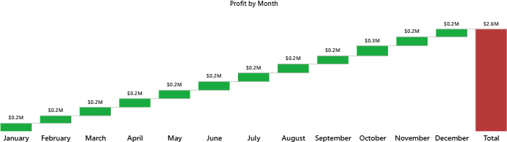
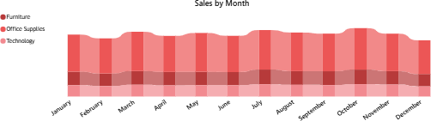
Monthly Profit and Sales Breakdown
Green bars show profit increase
Red bars show profit decrease
Final bar shows total annual profit
This chart shows monthly sales trends by category—Furniture, Office Supplies, and Technology.
The chart helps understand seasonal patterns and category-wise sales performance.

Slide 9
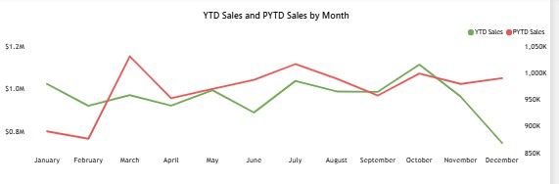
YTD vs. PYTD Sales Trend
This chart compares monthly sales of the current year (YTD) with last year (PYTD).
In some months like March and July, sales increased
In December, sales dropped compared to last year
Conclusion:
Sales performance fluctuates across months, showing seasonal trends
‘

Slide 10
Limitations and future work
Dependency on Data Quality :
Dashboard accuracy depends on clean, complete data; errors or missing values can mislead insights.
Limited Scope of Analysis :
Focuses only on sales, profit, region, category, and shipping; ignores customer satisfaction, returns, marketing, and market conditions.
Tool and Licensing Constraints :
Advanced features like sharing, real-time dashboards, and row-level security need a paid Power BI Pro/Premium license..
Future Work: Add customer feedback, returns, marketing data, and real-time updates.

Slide 11
Conclusion
The E-Commerce Sales Performance Dashboard, developed using Microsoft Power BI, effectively transforms raw sales data into interactive and actionable insights. By integrating key performance indicators, visual trends, and filters for dynamic exploration, the dashboard empowers business stakeholders to monitor performance, identify growth opportunities, and make data-driven decisions.
With its interactive and user-friendly interface, the dashboard supports strategic planning, marketing optimization, inventory control, and performance tracking. It bridges the gap between data and decision-making, enabling better business outcomes through clear, data- driven storytelling.
Regular updates and future enhancements, such as predictive sales forecasting and automated alerts, will further strengthen its value, making it an essential tool for ongoing business intelligence in the eCommerce domain.

Slide 12



Thank You

