Slide 1
Heating Circuit
COMSOL

Slide 2
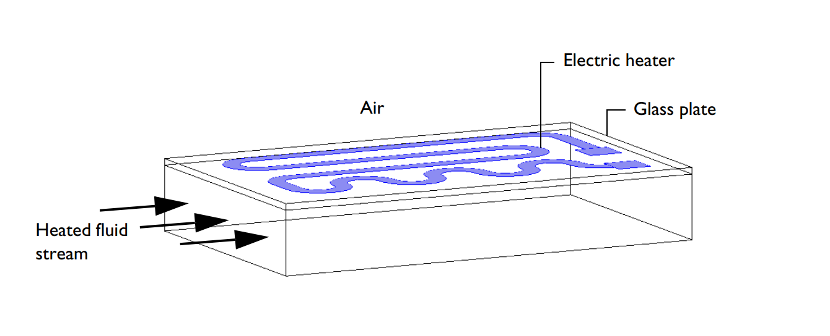
Introduction
Small heating circuits find use in many applications
For example, in manufacturing processes they heat up reactive fluids
The figure illustrates a typical heating device for this model
The device consists of an electrically resistive layer deposited on a glass plate
The layer causes Joule heating when a voltage is applied to the circuit
The layer’s properties determine the amount of heat produced
Geometry of a heating device

Slide 3
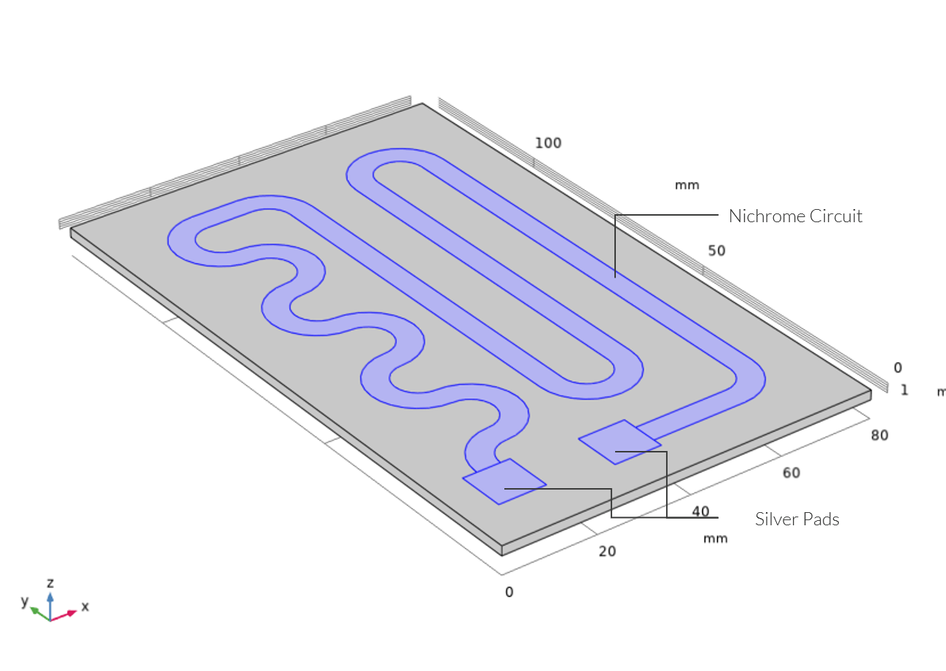
Model Definition
The figure shows a drawing of the modeled heating circuit
Drawing of the heating circuit deposited on a glass plate

Slide 4
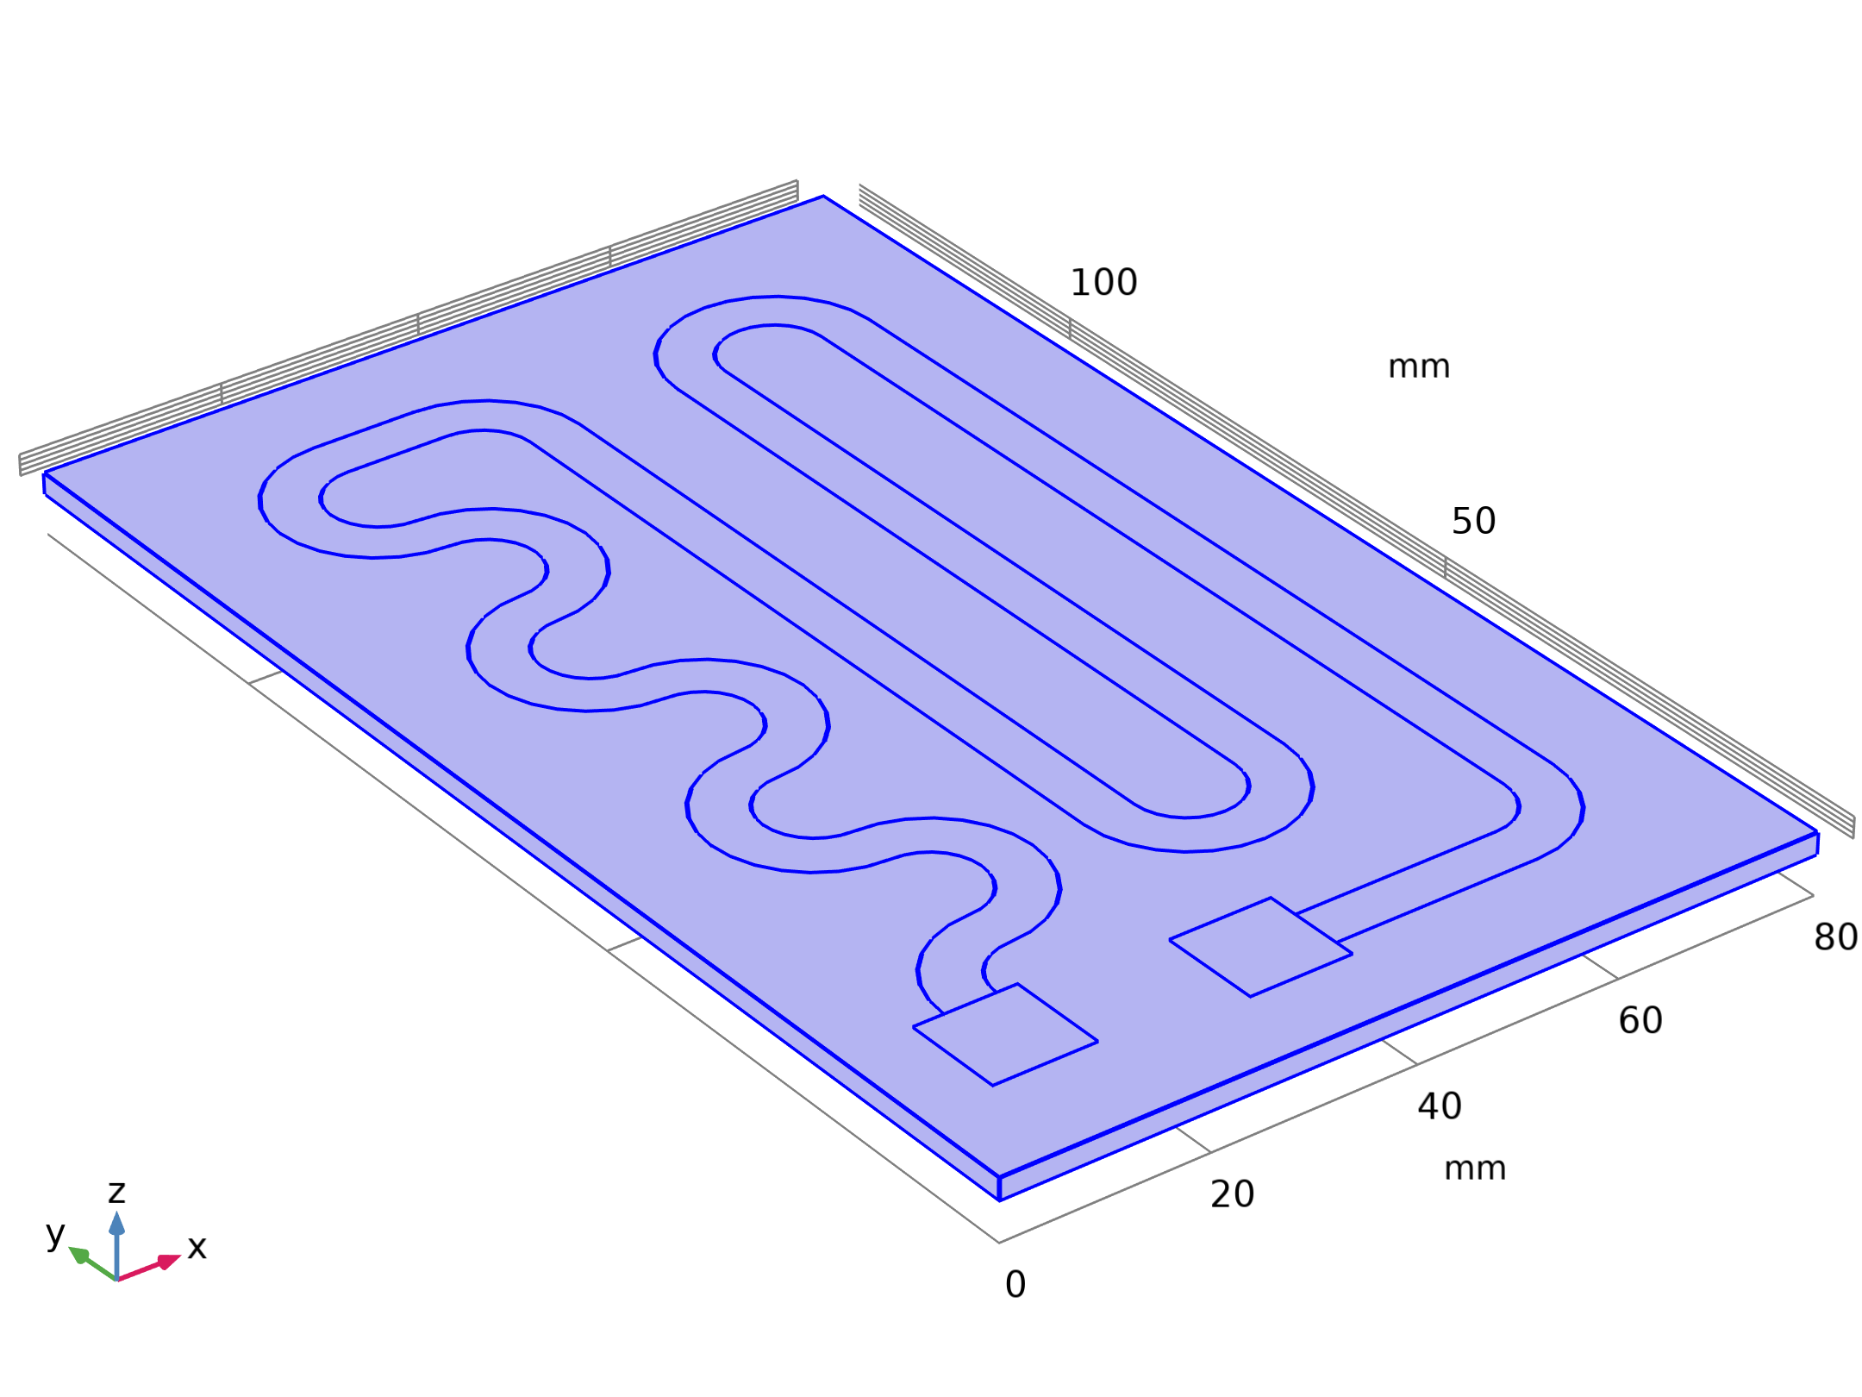

Model Definition
Solid Mechanics

Slide 5

Model Definition
Heat Transfer in Solids

Slide 6
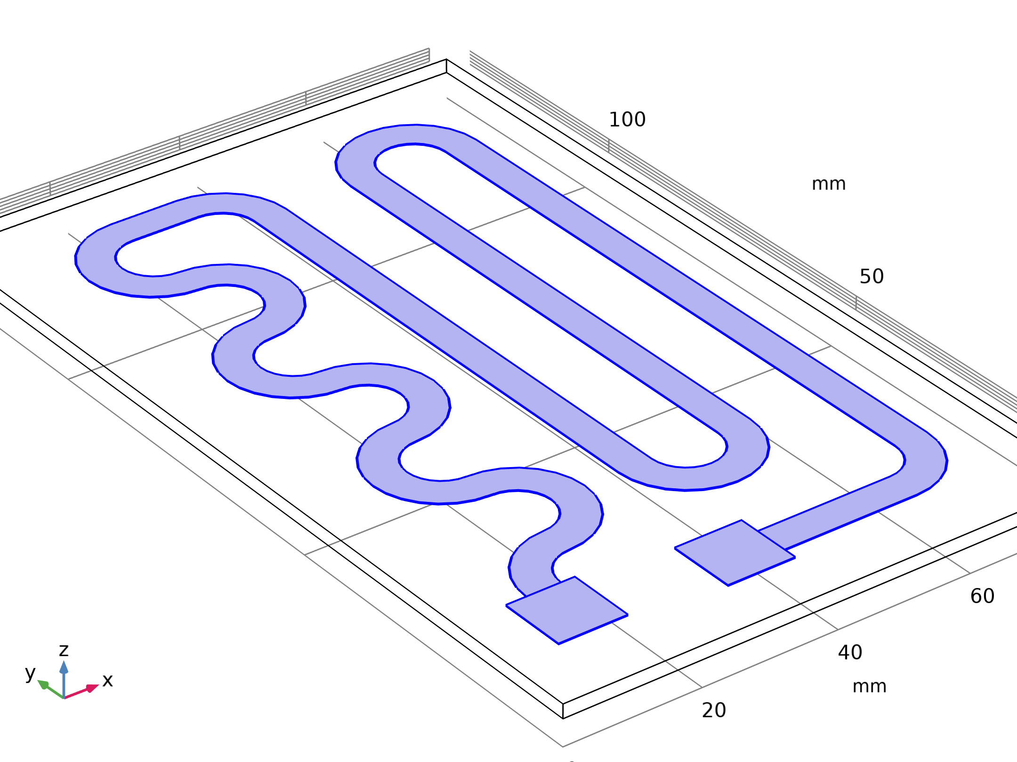
Model Definition
Electric Currents in Layered Shells

Slide 7
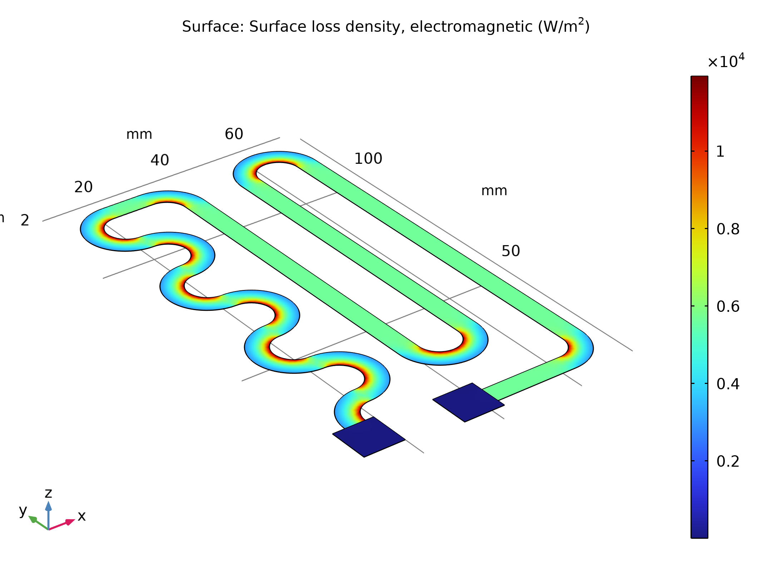
Results
The figure shows the heat that the resistive layer generates
The highest heating power occurs at the inner corners of the curves due to the higher current density at these spots
The total generated heat, as calculated by integration, is approximately 13.8 W
Stationary heat generation in the resistive layer when 12 V is applied

Slide 8
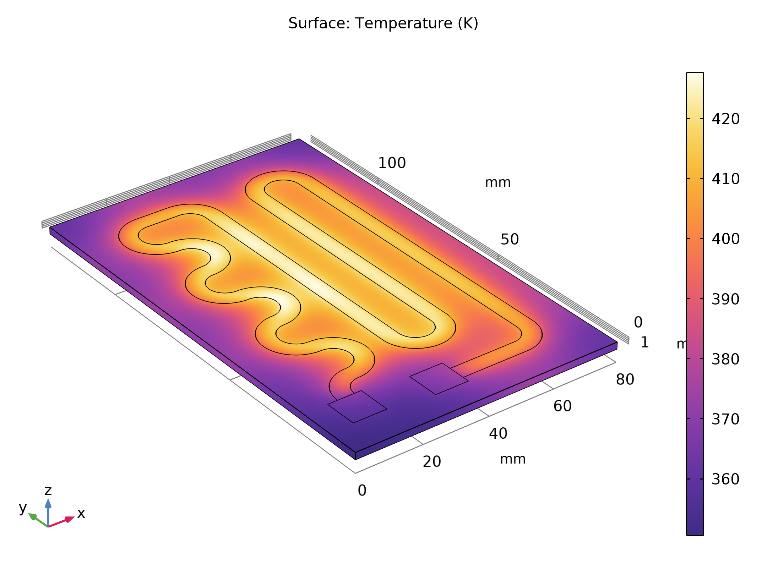
Results
The figure shows the temperature of the resistive layer and the glass plate at steady state
Temperature distribution in the heating device at steady state

Slide 9
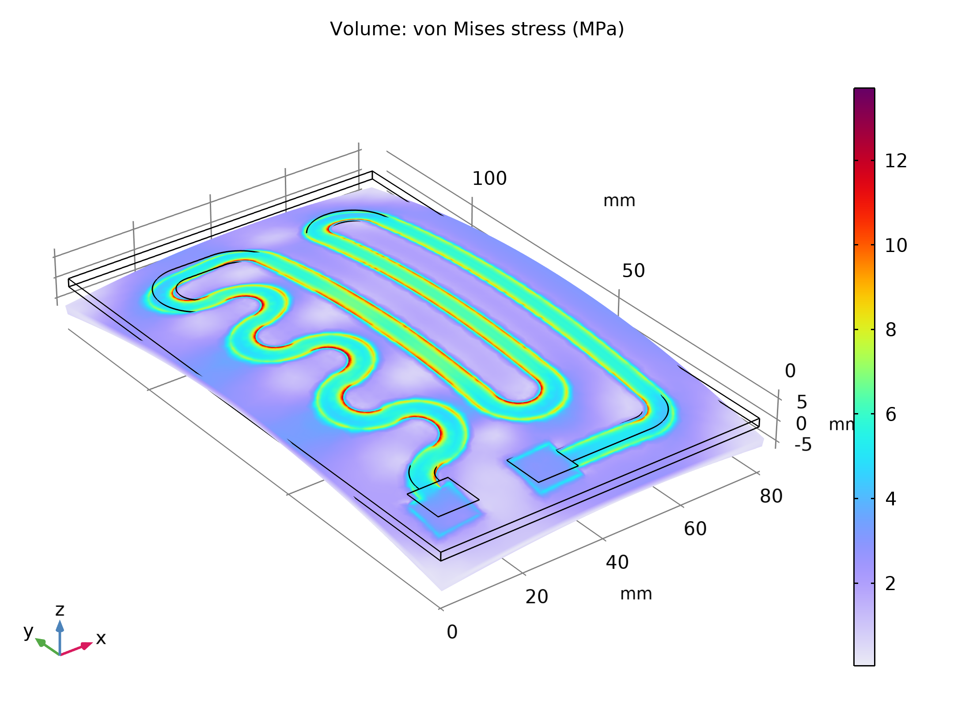
Results
The temperature rise also induces thermal stresses due the materials’ different coefficients of thermal expansion
As a result, mechanical stresses and deformations arise in the layer and in the glass plate
The figure shows the equivalent stress distribution in the device and the resulting deformations
During operation, the glass plate bends toward the air side
The thermally induced von Mises stress plotted with the deformation

Slide 10
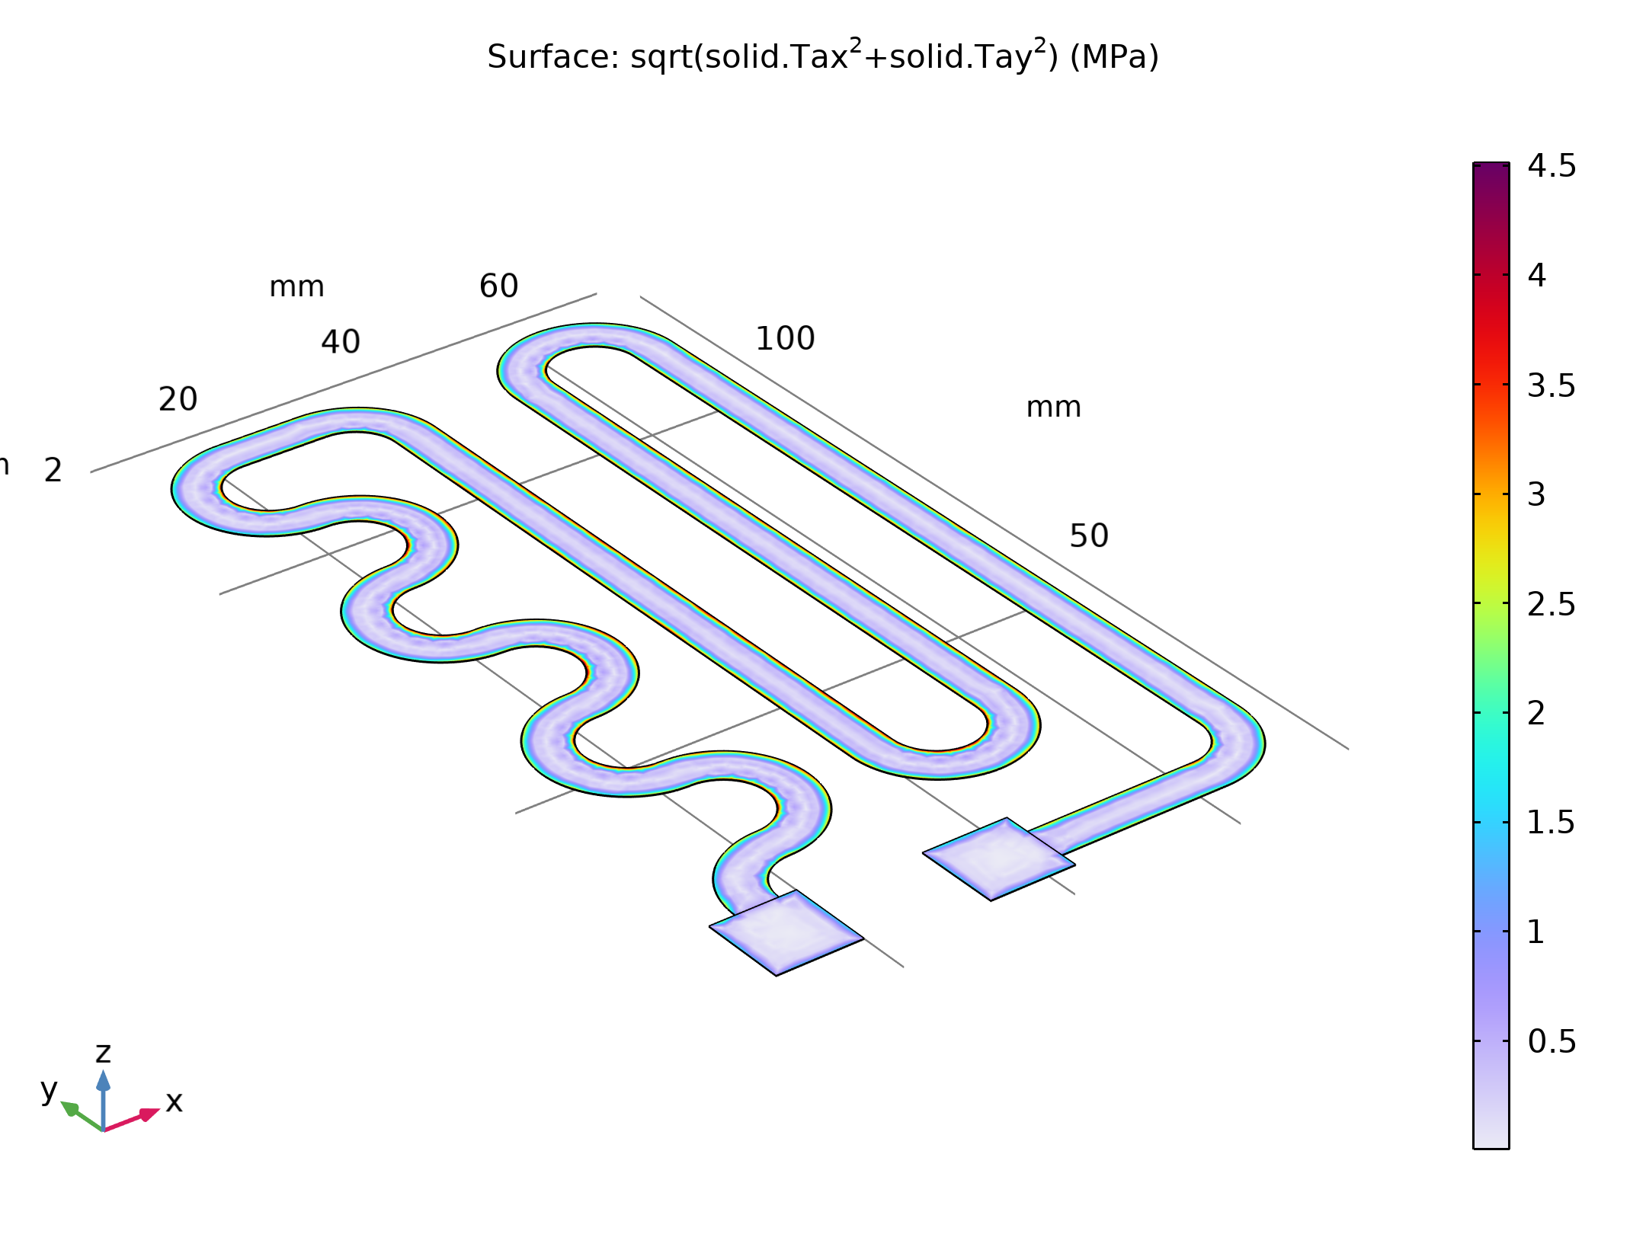
Results
The figure displays the effective forces acting on the adhesive layer during heater operation
As the figure shows, the device experiences a maximum interfacial stress that is an order of magnitude smaller than the yield stress
This means that the device are OK in terms of adhesive stress
The effective forces in the interface between the resistive layer and the glass plate

Slide 11
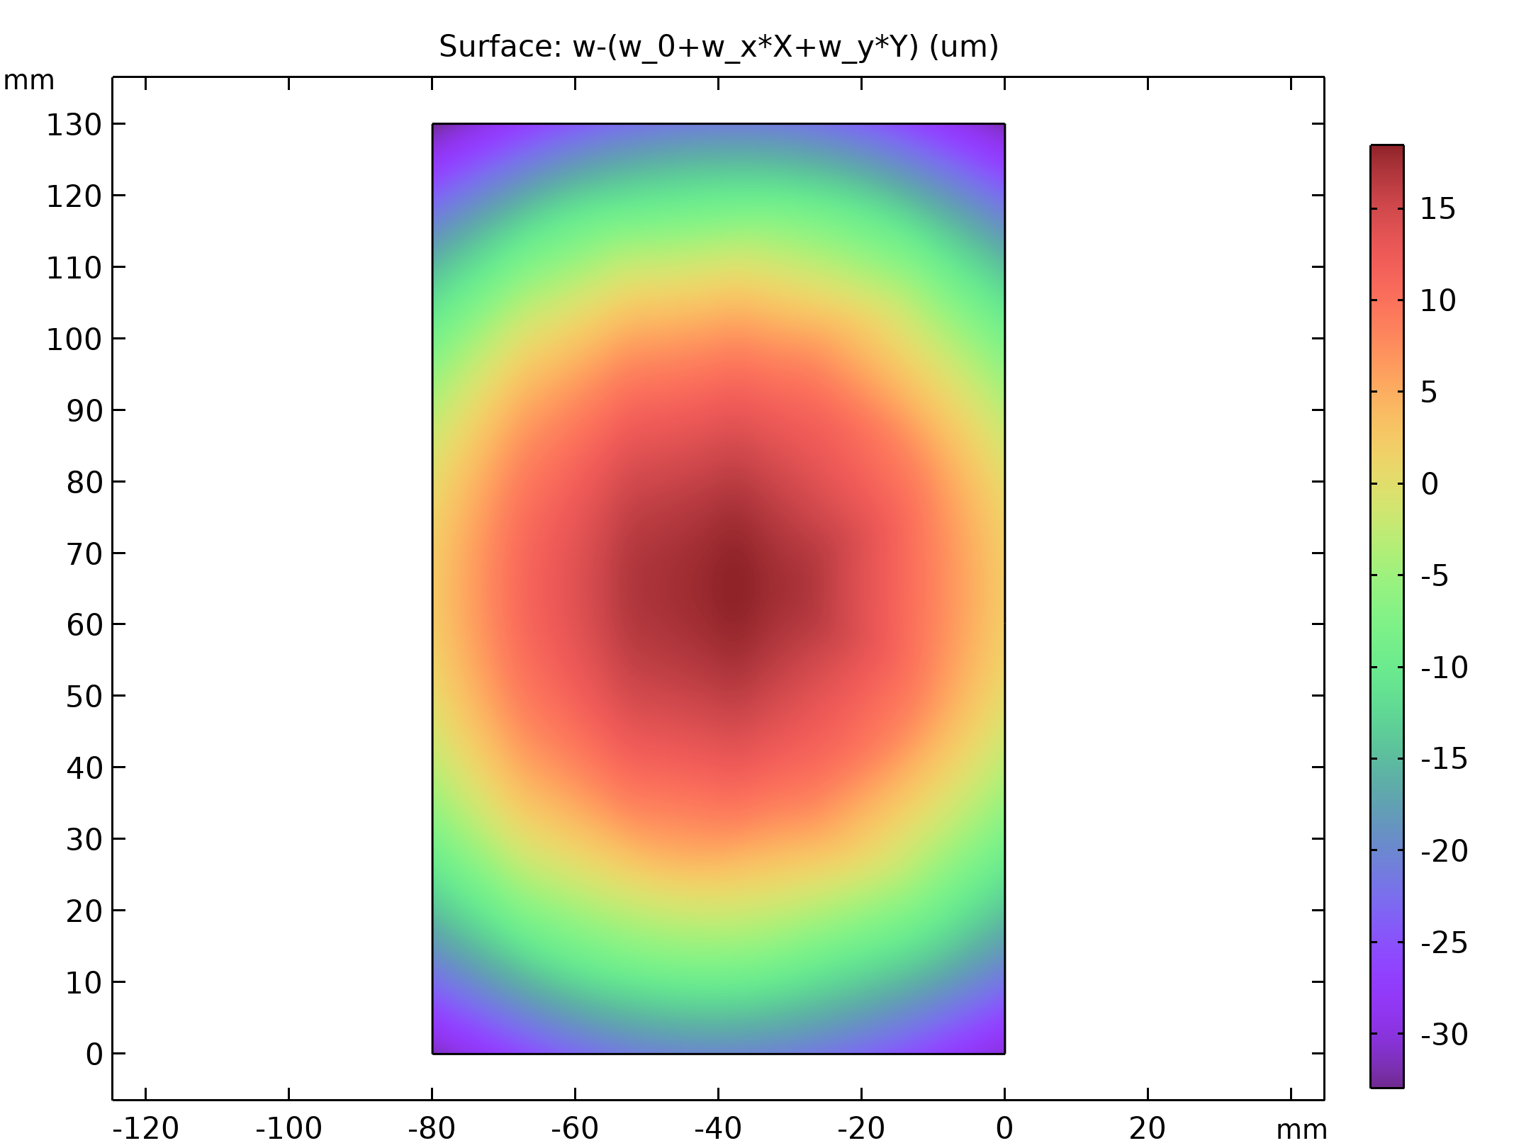
Results
Finally study the device’s deflections shown in the figure
Deviation from a plane surface on the fluid side of the glass plate

