Slide 1
WAVECON TELECOM
5G Launch Impact Analysis
Revenue • KPI • Plan Performance • City Performance
Analysis period: Jan–Sep 2022 | 5G launch: May 2022
Prepared by – Sudipta Roy

Slide 2
Executive Summary
The 5G launch was broadly revenue-neutral, but customer mix and retention shifted materially.
Pre-5G Revenue
₹16.0 Bn
Jan–Apr 2022
Post-5G Revenue
₹15.9 Bn
May–Sep 2022
Revenue Change
-0.50%
~₹18M absolute decline
ARPU Change
+11.05%
~₹190 → ₹211
WHAT THE DATA SAYS
Management takeaway
• Protect the growing 5G/high-value plan base.
• Reduce churn and migrate users from weak legacy plans.
• Use city-level targeting instead of a one-size-fits-all rollout.
• Revenue remained almost flat after the launch, masking significant differences across cities and plans.
• Total active users fell 8.28%, while unsubscribed users increased 23.5% — the clearest retention warning.
• P1 and new 5G-oriented plans P11/P12 gained traction; P7 suffered the sharpest decline.
• Growth was stronger in several Tier-2/3 markets, while Delhi, Chennai and Ahmedabad weakened.
Source: Wavecon PBIX dashboard; figures corroborated with public project walkthroughs.

Slide 3
1. Impact of the 5G Launch on Revenue
Overall revenue declined only marginally, but the impact was uneven across markets.
Revenue Change
-0.50%
₹16.0Bn → ₹15.9Bn
Monthly Average
~₹4.0Bn
post-launch volatility
INTERPRETATION
• The headline impact is a small revenue decline, not a collapse.
• The bigger issue is mix: some cities and plans grew while others lost revenue.
• Revenue dipped after launch and later stabilized toward Aug–Sep.
Source: Wavecon PBIX dashboard; figures corroborated with public project walkthroughs.

Slide 4
2. KPI Performance After 5G
Customer retention weakened even though monetization per user improved.
KPI | Before 5G | After 5G | Change
Revenue | ₹16.0 Bn | ₹15.9 Bn | -0.50%
ARPU | ~₹190 | ~₹211 | +11.05%
Total Active Users | 84.4 M | 77.4 M | -8.28%
Unsubscribed Users | 5.6 M | 7.0 M | +23.5%
Primary concern
Unsubscribed users
↑ 23.5% = churn pressure
Secondary concern
Active users
↓ 8.28% = engagement risk
Positive signal
ARPU
↑ 11.05% = better monetization
Source: Wavecon PBIX dashboard; figures corroborated with public project walkthroughs.

Slide 5
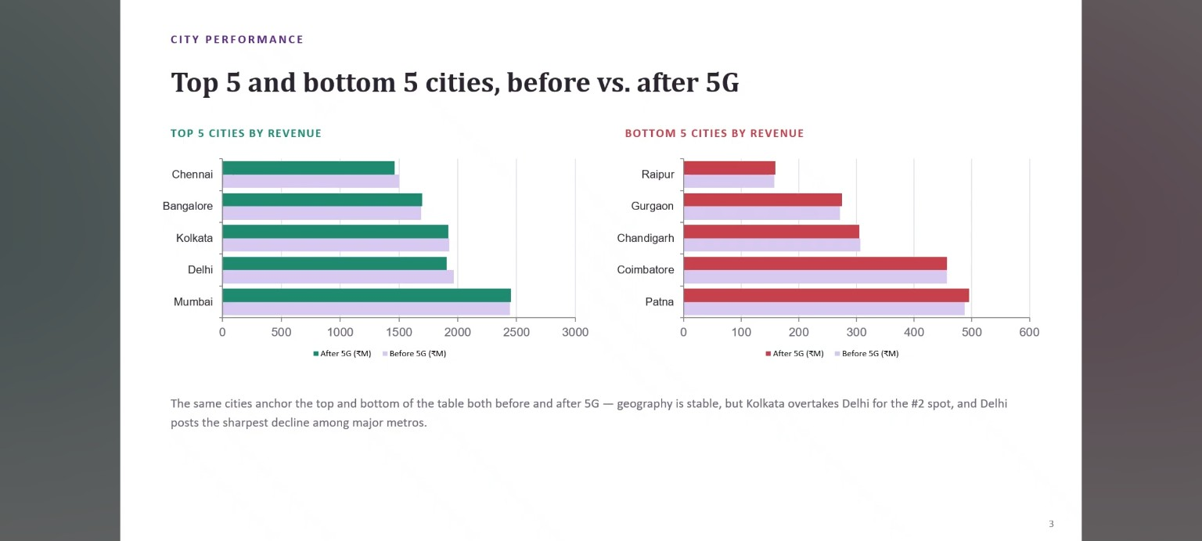

Slide 6
3. Plan Performance After 5G
Customers shifted toward higher-data, longer-validity packs — while short-validity legacy offers lost traction.
P1 • Smart Recharge Pack
2 GB/day • 90 days
₹1.8Bn → ₹2.4Bn
+33.3% • Strong growth
P11 • Ultra Fast Mega Pack
3 GB/day • 80 days
New after 5G
₹1.9Bn post-5G • Strong adoption
P12 • Ultra Duo Data Pack
1.8 GB/day • 55 days
New after 5G
₹1.2Bn post-5G • Strong adoption
Revenue movement by key plan
What changed in the plan portfolio?
P7
25 GB • 3G/4G combo
₹582.4M → ₹155.6M
−73.3%
P8
1 GB/day • 1 day
₹434.3M → ₹0
Discontinued
P9
₹49.5 talktime + 300 MB
₹226.8M → ₹0
Discontinued
P10
6 GB/day • 3 days
₹131.1M → ₹0
Discontinued
Pattern: higher daily data + longer validity = stronger post-5G revenue; very short / low-data offers lost relevance.
Source: Wavecon dashboard; plan specifications and performance figures corroborated with public project walkthroughs.

Slide 7
4. Plan Most Affected by 5G: P7
P7 experienced the clearest post-launch deterioration and should be managed through migration rather than immediate broad-based replacement.
P7 Revenue
₹582.4M → ₹155.6M
-73.28%
ACTION
• Phase down P7 gradually and migrate customers to stronger 5G-compatible plans.
• Use targeted migration offers rather than an abrupt cut-off.
• Track retention, revenue per migrated user and adoption of replacement plans.
Source: Wavecon PBIX dashboard; figures corroborated with public project walkthroughs.

Slide 8
6. Plans Discontinued After 5G
P8, P9 and P10 disappeared after the launch; their low revenue contribution and limited fit with 5G usage patterns explain the portfolio change.
P8
Profile: Low-data / short-duration
Reason: Low contribution
Decision: Phase out
P9
Profile: Limited talktime + data
Reason: Low contribution
Decision: Phase out
P10
Profile: Short-duration / low-value
Reason: Low contribution
Decision: Phase out
Portfolio shift: P11, P12 and P13 were introduced to serve the post-5G customer mix.
Source: Wavecon PBIX dashboard; figures corroborated with public project walkthroughs.

Slide 9
Recommendations & Action Plan
Translate the dashboard findings into a focused 90-day operating agenda.
1
Protect the customer base
Launch targeted retention/win-back offers where unsubscribes are rising; monitor active-user recovery.
2
Scale winning plans
Prioritize P1 and new 5G plans; strengthen high-value data and OTT bundles.
3
Migrate weak plans
Phase down P7 and legacy low-value plans with migration incentives to stronger 5G propositions.
4
Differentiate by city
Defend Delhi/Chennai/Ahmedabad with localized pricing/value offers; invest in high-growth cities such as Lucknow/Gurgaon/Patna.
North-star: improve retention + shift customers into higher-value 5G propositions while protecting city-level growth.
Source: Wavecon PBIX dashboard; figures corroborated with public project walkthroughs.

Slide 10
Appendix: Analysis Framework
How the dashboard comparison was interpreted.
• Comparison window: Jan–Apr 2022 (pre-5G) vs May–Sep 2022 (post-5G).
• Core KPIs: Revenue, ARPU, Total Active Users (TAU), and Total Unsubscribed Users (TUsU).
• Plan analysis: compare pre/post revenue by plan and identify plans introduced or discontinued after launch.
• City analysis: compare revenue change percentage by city to identify growth and decline pockets.
• Interpretation principle: distinguish overall KPI movement from localized effects; a positive ARPU change can coexist with higher churn and weaker active-user counts.
• The city chart highlights the verified movements most useful for the story rather than implying that unlisted cities had zero change.
Source: Wavecon PBIX dashboard; figures corroborated with public project walkthroughs.

