Slide 1
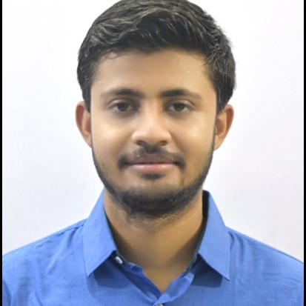


Sudipta Sen
Analyst/Software Engineer
Bachelor of Technology, Computer Science : 2016 - 2020
Skills
C# | C#Basics,OOPS,Generics,Collections, Array,Loops,LINQ
.NET | ADO.NET with,Entity Framework And LiINQ
React | Components, Modules, Routing, Formik,Hooks,
Java | Oops Concept
Database | SQL Server MangementStudio,Oracle
UI Tech | HTML 5 & CSS 3,JavaScript, ES6
Tools | Git, Postman
Add On skills | Peer learning
Bangalore
sudipta.a.sen@capgemini.com
+91 9051952300
A4
Hands on experience on C#,Asp.net Core,ADO.NET,LINQ,Entity framework,Sql Server.
Proficient in creating Single page Web Application in React.
Hands on experience in developing web pages using HTML5, CSS3, Java script, ES6, JSON, XML. Good understanding of Document Object Model (DOM) and DOM Functions.
Currently completing the Course On iTransform-Microsoft .Net Core and Azure Fundamentals
Completed Case study On Pharmacy Management System Which is basically mange the drugs and as well as Supplier details and User can also login and order drugs and admin will be verify that order.
Web-App Link:Click
Video Link: Click
Click Here

