Slide 1
Sensors and Transducers ICE-2155

Slide 2
Definitions
• Transducer: a device that converts one form of energy into another.
• Sensor: a device that converts a physical
parameter to an electrical output.

Slide 3
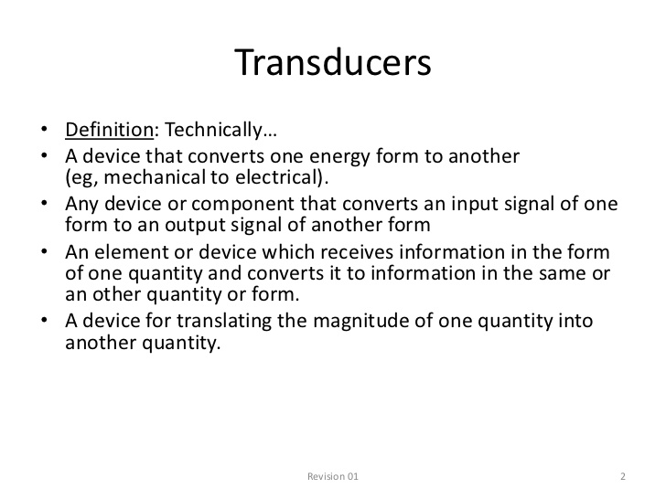

Slide 4
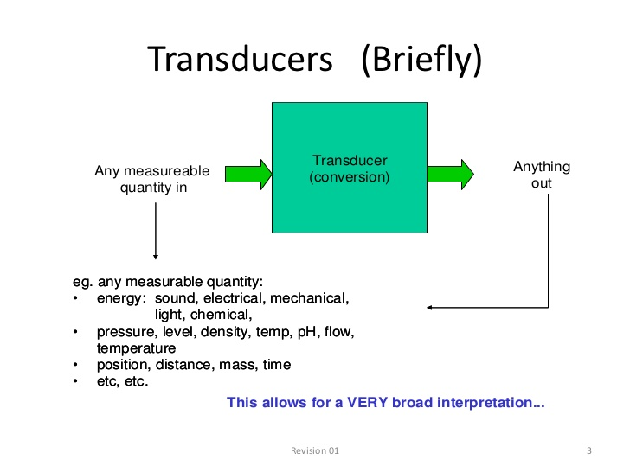

Slide 5
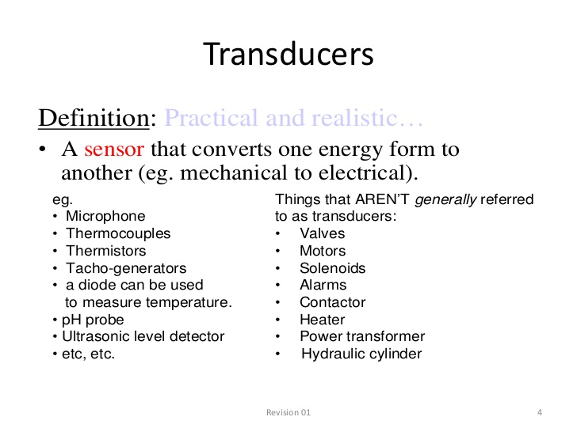

Slide 6
What to look for in a Sensors and Transducers ?
• Dynamic range
– Min and max range of the measured physical quantity
– Min and max range for electric output
• Input/output relation
• Sensitivity/Resolution
– Smallest change to be detected
• Power requirements
– Passive vs active
– Power consumption/requirements
• Band width and frequency response
• How to calibrate

Slide 7
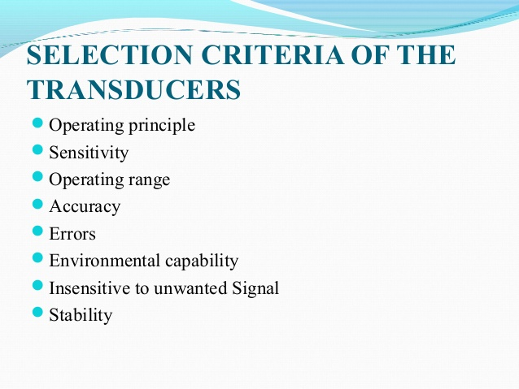

Slide 8
WHAT IS TRANSDUCER
The transducer is defined as the device which convert the one form of energy into another form of the energy
Example:
 Temperature transducers
 Thermocouples
 Resistance-Temperature Detectors (RTD)
 Thermistors
 Resistive position transducers
 Displacement transducers
 Strain gauge

Slide 9

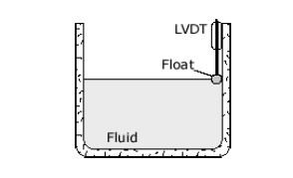
ELECTRICAL TRANSDUCERS
The electrical transducers is one which converts the nonelectrical quantity into the equivalent electrical quantity.
Non-electrical quantity such as force, displacement,stress, temperature.
Electrical quantity such as current , voltage

Slide 10
CLASSIFICATION OF
TRANSDUCERS
On the basis of transduction form used.
As primary and secondary transducers.
As passive and active transducers.
As analog and digital transducers.
As transducers and inverse transducers

Slide 11
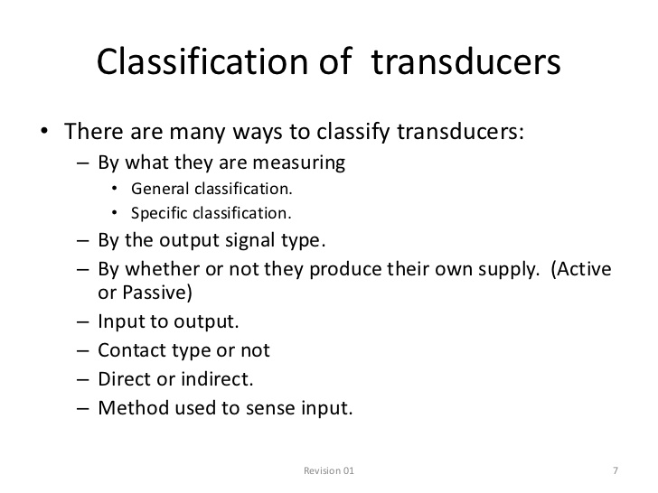

Slide 12
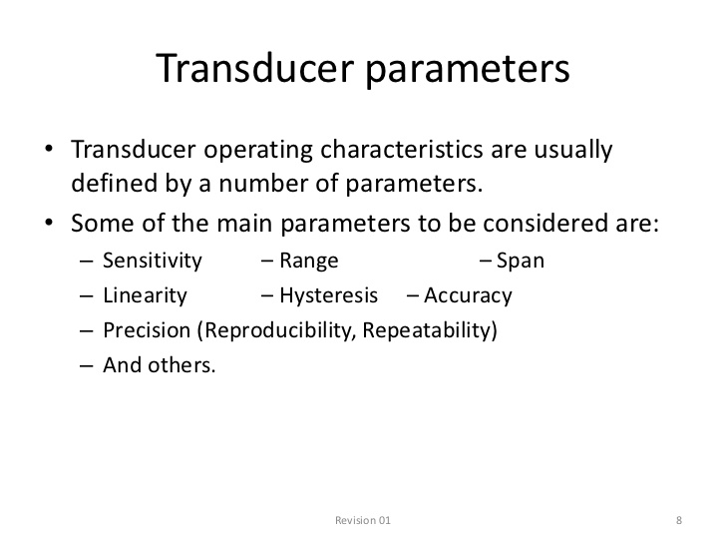

Slide 13
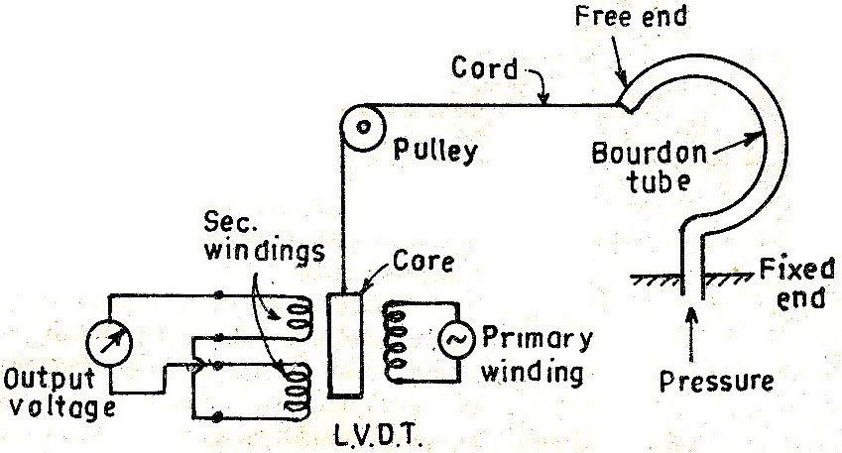
Primary and secondary transducers
LVDT and bourdon tube

Slide 14
Passive and Active Transducers
If transducers derive the power require for transduction from an power source, then this kind of transducer are known as passive transducer
Example
POT- Potentiometer
LVDT- Linear Variable Differential Transducer

Slide 15
When there is no need for any source then these type of transducers are Active transducers
Example are :
➢Thermocouple
➢Piezoelectric crystal

Slide 16
Inverse Transducers
These type of transducers convert a electrical quantity into non-electrical quantity.
Example
➢Piezoelectric crystal
➢Analog ammeter
➢voltmeter

Slide 18
Introduction
An electronic instrumentation system consisting of number of components to perform a measurement system and record it’s results.
The generalized measurement system consists of 3 major components:-
1. An input device
2.Signal conditioning device
3. Output device

Slide 19
The input device receives the quantity under measurement and delivers a proportional or analogous electrical signal to signal conditioning device.
Here the signal is amplified, attenuated, filtered in format acceptable to the output device.
The input quantity for most instrumentation system is a non-electrical quantity. The non-electrical quantity is general quantity, and is converted to electrical form by a transducer.
A transducer is defined as a device which converts energy from one form to another.

Slide 20
Classification
1. On the basis of transduction form used.
2. As on the basis form used as primary and secondary transducer.
3. Passive and active transducer
4. Analog and digital
5. Transducer and inverse transducer.

Slide 21
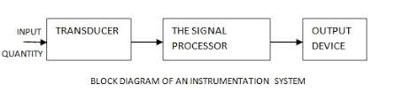

Slide 22
Block diagram of a Transducers
Before understanding what a transducer is or diving into the different types of Transducers, consider the following setup of a measuring system. In this block diagram of a simple measuring system, there are three basic elements
Sensor
Signal Conditioning Unit
Data Representing Device

Slide 23
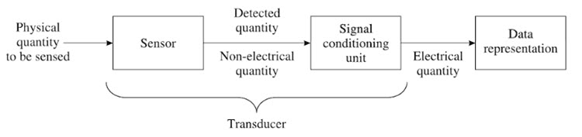

Slide 24
Sensor
A Sensor is a device that is used to detect changes in any physical quantity like Temperature, Speed, Flow, Level, Pressure, etc. Any changes in the input quantity will be detected by a Sensor and reflected as changes in output quantity.
Signal Conditioning Unit
The non-electrical output quantity of the Sensor makes it inconvenient to further process it. Hence, the Signal Conditioning Unit is used to convert the physical output (or non-electrical output) of the sensor to an electrical quantity.

Slide 25
Some of the best known Signal conditioning units are:
Analog to Digital Converters
Amplifiers
Filters
Rectifiers
Modulators

Slide 26
Data Representation Device
A Data representation device is used to present the measured output to the observer. This can be anything like
A Scale
An LCD Display
A Signal Recorder

Slide 27
Transducer
In the above example, consider a Strain Gauge as the Sensor. Any changes in the strain will reflect as changes in its resistance. Now, in order to convert this change in resistance into equivalent voltages, you can use a simple Wheatstone Bridge circuit, which acts as the Signal Conditioning Unit.
The combination of Strain Gauge (Sensor) and Wheatstone Bridge (Signal Conditioning Unit) is Known as a Transducer.

Slide 28
Electrical Transducer
It gives an output that is electrical in nature . The electrical signal maybe current , voltage or frequency.
TYPE | PRINCIPLE OF OPERATION | APPLICATIONS
A. Resistive 1. Potentiometer 2. Resistance thermometer 3. Thermistor 4. Resistance Strain gauge | Positioning of slider by an external force varies the resistance in a potentiometer in a big circuit Resistance varies with temperature Resistance varies with temperature Resistance of wire is changed by elongation | Pressure and displacement Temperature measurement Temperature measurement and flow measurement Force and torque

Slide 29
B. Capacitance 1. Variable capacitance pressure gauge | Distance between two parallel plates is varied by an external applied source | Displacement, pressure
C. Inductance 1. Magnetic circuit transducer | Self-inductance/mutual inductance | Pressure , displacement
D. Voltage and current 1.photo emissive cell | Electron emission due to incident radiation upon photo emissive surface | Light and radiation

Slide 30
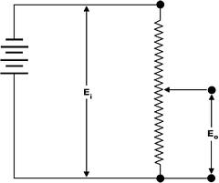
Passive Transducers
In the absence of external power, the transducer cannot work, hence it’s passive.
Electrical passive consists of combination of 3 passive elements, Resistors, inductors and capacitors.
Ex: Linear potentiometer, used for measurement of displacement
E₀=(x_{i}/L)E_{i}
X_{i}= Linear displacement
E_{i}= Source voltage
L= Total length

Slide 31
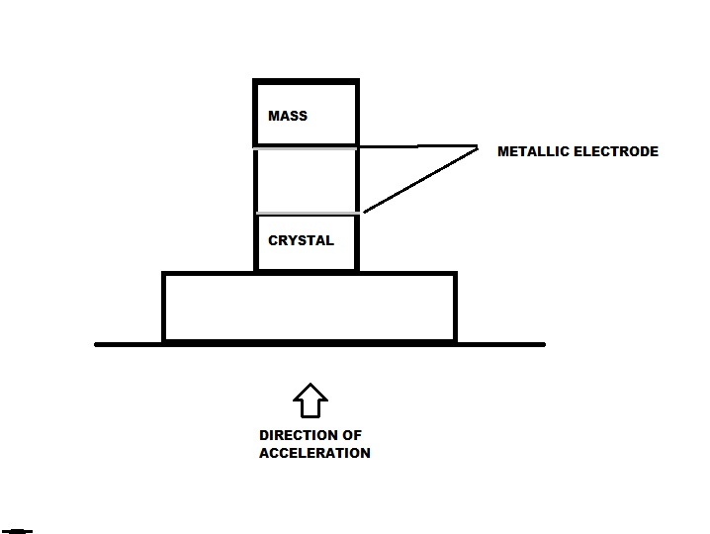
Active
They are those which do not require an auxiliary power device to produce an output
Piezo electrical crystal measuring acceleration is an example.

Slide 32
In this diagram, the crystal is sandwiched between 2 metallic electrodes, a fixed mass is placed on top of the sandwich. The property is that when a force is applied to them, it produces output voltage, The mass is fixed , force is proportional to acceleration, the output voltage is proportional to force and hence to acceleration. This is also called accelerometer, which converts the acceleration to electrical voltage

Slide 33
Comparison between electrical and mechanical transducer
Electrical transducer | Mechanical transducer
Output signals are electrical in nature | Output signals are mechanical in nature
Electrical quantities are voltage, resistance, capacitance , inductance , phase angle etc. | They are temperature pressure, force, torque, density
Electrical or electronic components are used | Spring elements, bellows are used
Flow measurement isn’t possible | Flow measurement is possible
It is used for pressure and displacement measurement | Orifice, ventury tubes are used for velocity and pressure measurement

Slide 34
Generalized Measurement System

Slide 35
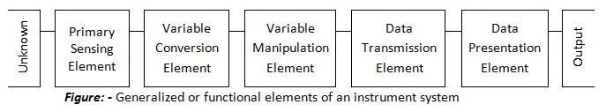
An instrument may be defined as a device or a system which is designed to maintain a functional relationship between the prescribed properties of physical variables and must include ways and means of communication to a human observer.

Slide 36
The performance of a measurement system can be described in terms of static and dynamic characteristics. Most of the measurement systems contain three main functional elements: i) Primary sensing elements ii) Variable conversion elements iii) Data presentation elements

Slide 37
1.Primary sensing element: The quantity under measurement makes its first contact with the primary sensing element of a measurement system.
The measurand is first detected by a primary sensor. This is done by a transducer. 2.Variable conversion element: The output of a primary sensory element may be an electrical signal of any form. It may be voltage, frequency or other electrical parameters. Sometimes this output is not suited to the system for the instrument to perform the desired function. It may be necessary to convert this output to some other suitable form. Eg. Suppose output is analog form, then we have to convert it into digital form.

Slide 38
3.Variable manipulation element:
The function is to manipulate the signal presented to it preserving the original nature of the signal. Manipulation means change in numerical value of signal. 4.Data transmission element: When the functional elements of the measuring system are spatially separated then it becomes necessary to transmit signals from one element to another. This function is performed by data transmission element. It is an essential functional element where remote control operation is desired.

Slide 39
5.Data presentation element: The information about the quantity under measurement has to be conveyed to the person handling the instrument or the system for monitoring, control or analysis. This function is done by data presentation element. Eg. Ammeters, voltmeters, etc.

