Slide 1
BASIC ELECTRONICS ECE 1051

Slide 2
Course Outcomes:
At the end of this course, student will be able to:
CO1: Describe the characteristics of various electronic devices.
CO2: Describe the working of rectifier, voltage regulator and R-C coupled amplifier.
CO3: Explain the concept of Op-Amp and its basic applications using suitable circuits.
CO4: Simplify Boolean expressions and implement simple digital circuits using logic gates.
CO5: Describe the principles of analog and digital communication.

Slide 3
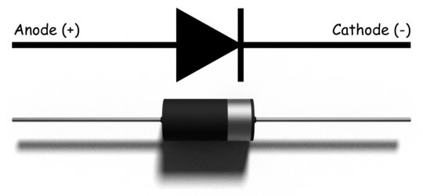
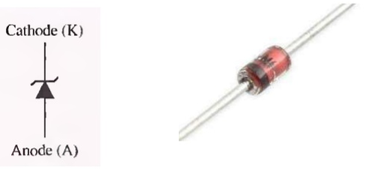
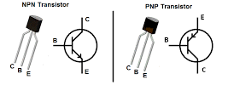
CO1: Describe the characteristics of various electronic devices and analyze simple circuit applications using them.
Diode
Zener Diode
Transistor

Slide 4
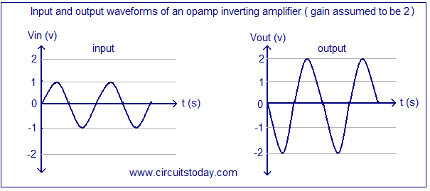
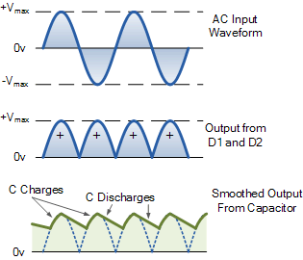
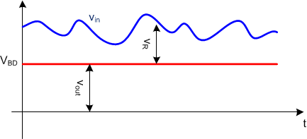
CO2: Describe the working of rectifier, voltage regulator and R-C coupled amplifier.
Rectifier
Voltage regulator
R-C coupled amplifier.

Slide 5
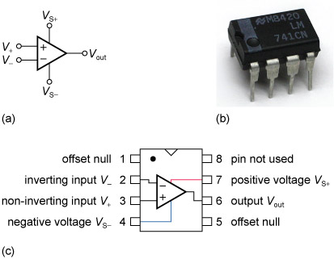
CO3: Explain the concept of Op-Amp and its basic applications using suitable circuits.
Inverting and non-inverting amplifier
Adder
Subtractor
Integrator
Differentiator
Comparator
Square wave generator.

Slide 6
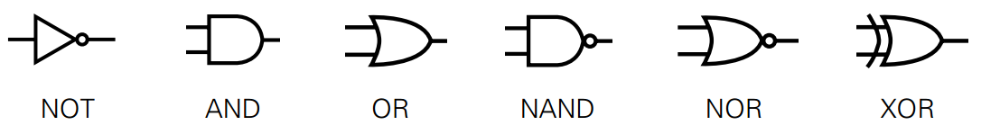
CO4: Simplify Boolean expressions and implement simple digital circuits using logic gates.
Number systems
Boolean algebraic
Logic gates
Implementation of Boolean expressions
Simplification of Boolean expressions
Flip flop

Slide 7
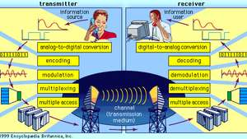
CO5: Describe the principles of analog and digital communication.
Modulation
Analog Modulation
Digital Modulation
Data Communication and
Communication Networks

Slide 8
References
Albert P Malvino, David J Bates – Electronic Principles,7th edition, TMH,2007
Robert L. Boylestad, Louis Nashelsky- Electronic Devices & Circuit Theory, 11th Edition, PHI, 2012
Malvino and Leach- Digital Principles & applications, 7th edition, TMH, 2010.
Morris Mano- Digital design, Prentice Hall of India, Third Edition.
George Kennedy, Bernad Davis- Electronic Communication Systems, 4thedition, TMH, 2004.
Dennis Roddy & John Coolen , "Electronic Communications" ,4th edition, Pearson Education,2009
Garcia and Widjaja, “Communication Networks”, McGraw Hill, 2006
Raj Pandya, “Mobile and Personal Communication Services and Systems”, Wiley-IEEE Press, 1999

Slide 9
CHAPTER-1: DIODES AND APPLICATONS
Part – I : Analog Electronics
Reference:
Robert L. Boylestad, Louis Nashelsky, Electronic Devices & Circuit Theory, 11th Edition, PHI, 2012

Slide 10
Learning outcomes
At the end of this module, students will be able to:
Explain the operation of PN junction diode under different biasing condition.
Draw the I-V characteristic of diode and differentiate between ideal and practical diodes
Explain the concept of static and dynamic resistance of the diode.
Explain various breakdown phenomenon observed in diodes.
Describe the working of Zener diode and its I-V characteristic.
Explain the operation of diode as capacitor

Slide 11
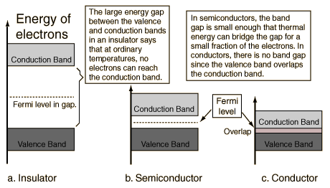
Classification of Materials Based on Energy Band Theory
Classification of materials based on Electrical property
Conductor
Insulator
Semiconductor

Slide 12
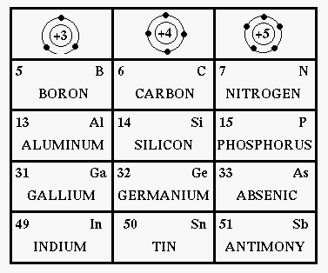
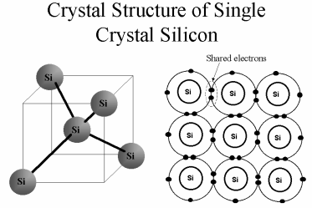
Semiconductors
Common semiconducting materials
Crystal structure of silicon
http://fourier.eng.hmc.edu/e84/lectures/ch4/node1.html
http://www.austincc.edu/HongXiao/overview/basic-semi/sld007.htm

Slide 13
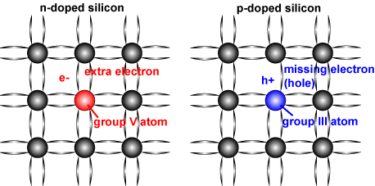
Doping in Semiconductors
Characteristics of semiconductor materials can be altered significantly
By the addition of certain impurity atoms (doping)
Into the relatively pure semiconductor material.
Although only added to 1 part in 10 million,
Can alter the band structure sufficiently
To totally change the electrical properties of the material.
Schematic of a silicon crystal lattice doped with impurities to produce n-type and p-type semiconductor material.
[http://www.pveducation.org/pvcdrom/pn-junction/dopingl].

Slide 14
Self test
1.Why silicon is preferred over germanium for semiconductor devices?
2.List different elemental and compound semiconductors.

Slide 15
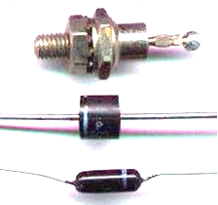
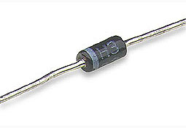
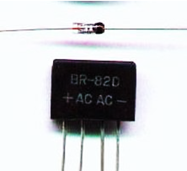
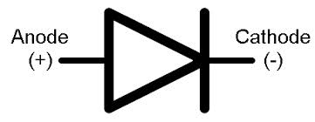
P-N Junction Diode
Common practical diodes available in market
Anode
P
N
Cathode

Slide 16
P-N Junction Diode
Used in numerous applications
Switch,
Rectifier,
Regulator,
Voltage multiplier,
Clipping,
Clamping, etc.

Slide 17
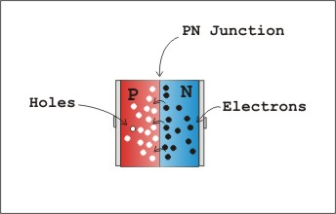
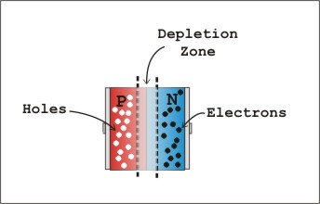
P-N Junction Diode under biasing
(a) P-N junction in contact
(b) formation of depletion region

Slide 18
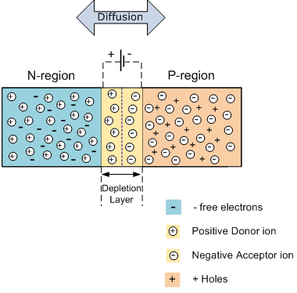
P-N Junction Diode under biasing condition
Diode under zero bias conditions

Slide 19
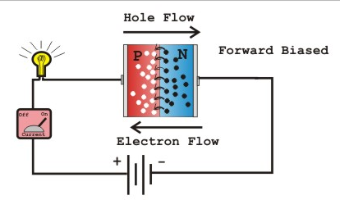
Forward bias
Positive of battery connected to p-type (anode)
Negative of battery connected to n-type (cathode)
Diode under forward biasing conditions

Slide 20
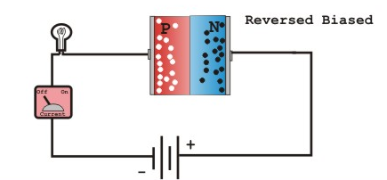
Reverse bias
Positive of battery connected to n-type material (cathode)
Negative of battery connected to p-type material (anode)
Diode under reverse biasing conditions

Slide 21
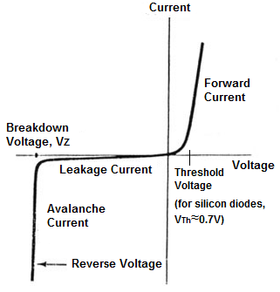
I-V characteristic of practical diode
V_{th} or V_{γ} is
0.6 ~ 0.7 Vfor Si
0.2 ~ 0.3 V for Ge
I-V characteristic of Practical diode

Slide 22
Self test
1. The arrow direction in the diode symbol indicates
a. Direction of electron flow.
b. Direction of hole flow (Direction of conventional current)
c. Opposite to the direction of hole flow
d. None of the above
2. When the diode is forward biased, it is equivalent to
a. An off switch b. An On switch
c. A high resistance d. None of the above

Slide 23
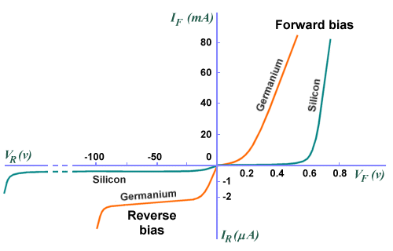
Silicon vs. Germanium
I-V characteristic of silicon and germanium practical diode
http://www.technologyuk.net/physics/electrical_principles/the_diode.shtml

Slide 24
Diode current equation
I_{D} is diode current
I_{o} is reverse saturation current
V_{D} is voltage across diode
V_{T} is thermal voltage = T / 11600
η is a constant = 1 for Ge and 2 for Si
For positive values of V_{D} (forward bias),
For large negative values of V_{D} (reverse bias), I_{D} ≈ –I_{o}

Slide 25
Effect of Temperature on the Reverse current
Reverse current doubles for every 10 degree rise in temperature.
I (mA)
–75ºC
125ºC
25ºC
V (volts)
I (μA)

Slide 26
Effect of Temperature on the Reverse current
Q. A Silicon diode has a saturation current of 1pA at 20⁰C. Determine (a) Diode bias voltage when diode current is 3mA (b) Diode bias current when the temperature changes to 100⁰C, for the same bias voltage.
A.

Slide 27
Diode resistances
Static or DC resistance:
ratio of diode voltage and diode current
AC resistance:

Slide 28

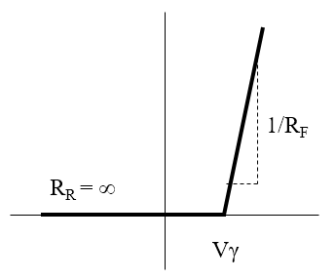
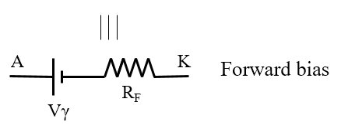

Diode Equivalent Circuit
Used during circuit analysis
Characteristic curve replaced by straight-line segments

Slide 29
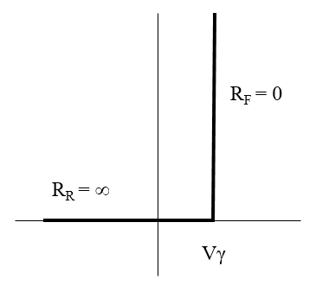
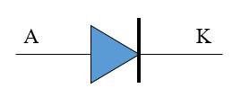
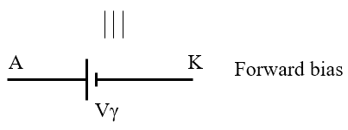

Diode Equivalent Circuit
As further approximation, we can neglect the slope of the characteristic i.e., R_{F} = 0

Slide 30
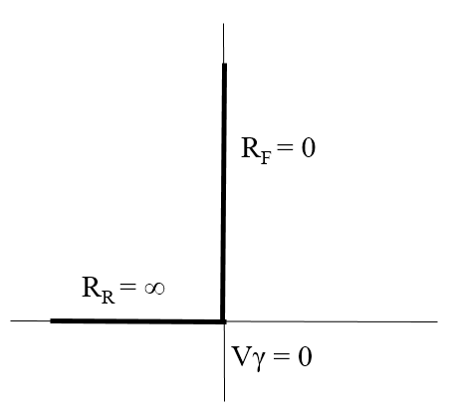

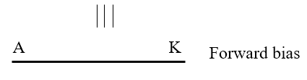

Diode Equivalent Circuit
As third approximation, even the cut-in voltage can be neglected (Ideal diode)

Slide 31
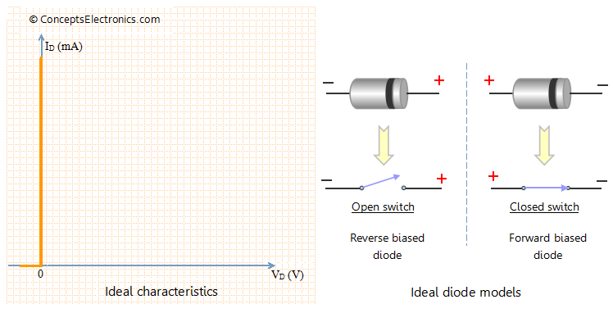
Ideal diode : I-V characteristics
I-V characteristic of Ideal diode and ideal models
[http://conceptselectronics.com/diodes/diode-equivalent-models/].

Slide 32
Self test
1. The break-point voltage of Si diode is
a. 0.2V b. 0.7V c. 0.8V d. 1.0V
2. Why would you use silicon diodes instead of germanium diodes?

Slide 33
Breakdown phenomenon in diodes
Two breakdown mechanisms:
Avalanche breakdown :
Occurs in Lightly doped diodes,
Occurs at high reverse Voltage.
Zener Breakdown:
Occurs in heavily doped diodes.
at lower reverse bias voltages.

Slide 34
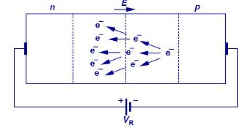
Avalanche Breakdown
Schematic of Avalanche phenomenon
http://shrdocs.com/presentations/12656/index.html

Slide 35
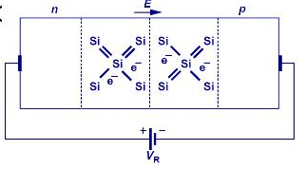
Zener Breakdown
Schematic of Zener phenomenon
http://shrdocs.com/presentations/12656/index.html

Slide 36
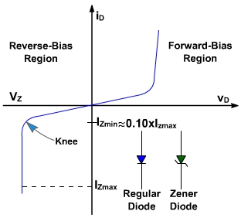
Zener Diode and its characteristics
P
N
Anode
Cathode
I_{ZK} or I_{Zmin}
I_{ZM} or I_{ZMax}
P_{ZM} or P_{ZMax}
P_{ZM} = V_{Z}.I_{ZM}
I-V characteristics of Zener diode

Slide 37
Equivalent circuit
Equivalent circuits of Zener diode
Forward Reverse Breakdown
Note: R_{Z} is usually very small, can be neglected

Slide 38

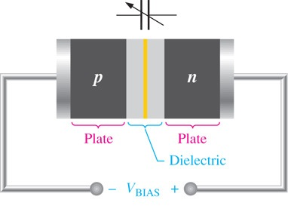
Diode as capacitor- Varactor diode

Slide 39
Self test
1. Explain the principle of PIN diode.
2.What is the difference between PN diode and Schottky diode.
3.Which type of diode exhibits negative resistance and why?
4. Which of the following is not an essential element of a dc power supply
a. Rectifier
b. Filter
c. Voltage regulator
d. Voltage amplifier

Slide 40
Self test
5. What is true about the breakdown voltage in a Zener diode?
a. It decreases when current increases.
b. It destroys the diode.
c. It equals the current times the resistance.
d. It is approximately constant
6. Which of these is the best description of a Zener diode?
a. It is a rectifier diode.
b. It is a constant voltage device.
c. It is a constant current device.
d. It works in the forward region.

Slide 41
Exercises
A germanium diode has reverse saturation current of 0.19μA. Assuming η=1, find the current in the diode when it is forward biased with 0.3 V at
27ºC. (Ans: 19.5mA)

Slide 42
Exercises
The forward current in a Si diode is 15 mA at 27ºC. If reverse saturation current is 0.24nA, what is the forward bias voltage?
(Ans: 0.93V)

Slide 43
Exercises
A germanium diode carries a current of 10mA when it is forward biased with 0.2V at 27ºC. (a) Find reverse sat current. (b) Find the bias voltage required to get a current of 100mA.
(Ans: 4.42μA, 0.259V)

