Slide 1
Part – I : Analog Electronics
Chapter-2: BJT and its Applications
Reference:
Robert L. Boylestad, Louis Nashelsky, Electronic Devices & Circuit Theory, 11th Edition, PHI, 2012
MODULE 1: BJT Characteristics

Slide 2
BIPOLAR JUNCTION TRANSISTOR
Objectives
Discuss the operation of BJT.
Draw CB and CE configuration of transistor.
Explain input and output characteristics of CB and CE Configurations of transistor.
Derive expressions for current gains in transistor.

Slide 3
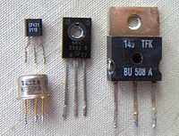
INTRODUCTION
IMAGES OF TRANSISTOR
( Courtesy : wikipedia.org )
Notes:
Invented by a team of scientists at Bell laboratories during 1947-48.
Advantages of Transistors
Small size and light weight
Low power consumption and operating voltages
Low price

Slide 4
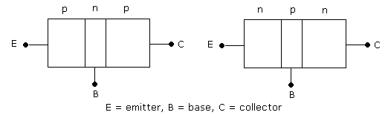
INTRODUCTION
BJT has two junctions – Emitter-Base (EB) Junction and Collector-Base (CB) Junction.
Two types of transistors: NPN and PNP
Notes:
The device is called “bipolar junction transistor” because current is due to motion of two types of charge carriers – free electrons & holes.

Slide 5
INTRODUCTION
The three layers of BJT are called Emitter, Base and Collector
Base is lightly doped. Emitter is heavily doped. Collector is moderately doped
NPN – Emitter and Collector are N-type
semiconductors, Base is P-type
PNP – Emitter and Collector are P-type
semiconductors, Base is N-type
Notes:
The width of emitter is more compared to collector region but less compared to base region.

Slide 6
INTRODUCTION
Transistor symbols:
NPN Transistor PNP Transistor

Slide 7
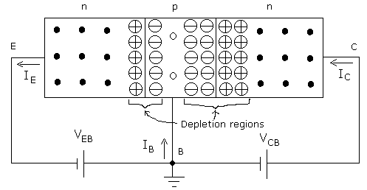

NPN TRANSISTOR OPERATION
http://www.learnabout-electronics.org/bipolar_junction_transistors_05.php
Notes:
Operation of PNP is similar with roles of free electrons and holes interchanged.

Slide 8
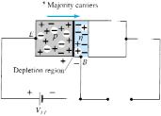
NPN TRANSISTOR OPERATION
Notes:
Operation of PNP is similar with roles of free electrons and holes interchanged.

Slide 9
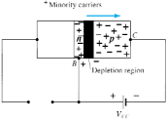
NPN TRANSISTOR OPERATION
Notes:
Operation of PNP is similar with roles of free electrons and holes interchanged.

Slide 10
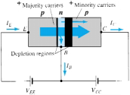
NPN TRANSISTOR OPERATION
Notes:
Operation of PNP is similar with roles of free electrons and holes interchanged.

Slide 11
CURRENTS IN TRANSISTOR
For both NPN and PNP transistor:
Collector current:
: Current due to injected charge carriers from
emitter
: Current due to thermally generated minority
carriers
Neglecting reverse saturation current I_{CBO} ,
α_{dc} : Common-base dc current gain
Notes:
Value of α_{dc} < 1, since I_{E}>I_{C}

Slide 12
CURRENTS IN TRANSISTOR
β_{dc} : Common emitter dc current gain
link\CURRENT RELATION.docx
Reverse saturation current in CE configuration
Note I_{CEO} >> I_{CBO}
Notes:
Β>1, since I_{B} < I_{C}

Slide 13
TRANSISTOR CONFIGURATIONS
BJT has three terminals
Accordingly three configurations exist:
Common Base (CB) configuration
Common Emitter (CE) configuration
Common Collector (CC) configuration
(The last one is not discussed in this course)

Slide 14
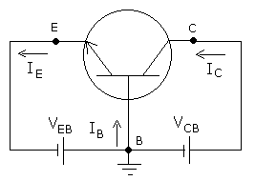
COMMON BASE CONFIGURATION
Base is common between input and output terminals

Slide 15
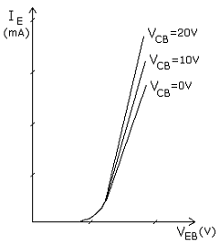
CB CONFIGURATION INPUT CHARACTERISTICS
CB Input characteristics
A plot of I_{E} versus V_{EB} for various values of V_{CB.}
link\CB CHARACTERISTICS.docx

Slide 16
CB CONFIGURATION OUTPUT CHARACTERISTICS
A plot of I_{C} versus V_{CB} for various values of I_{E} .
Divided into three regions:
Active Region
Saturation Region
Cutoff Region
link\CB CHARACTERISTICS.docx
Notes:
Active region: E-B junction is forward biased and C-B junction is reverse biased.
Saturation region: E-B junction forward biased and C-B junction is forward biased.
Cut-off region: E-B junction is reverse biased and C-B junction is reverse biased.

Slide 17
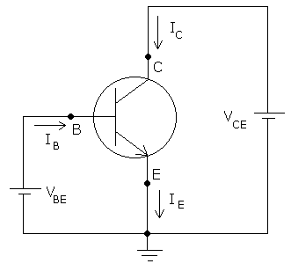
COMMON EMITTER CONFIGURATION
Emitter is common between input and output terminals

Slide 18
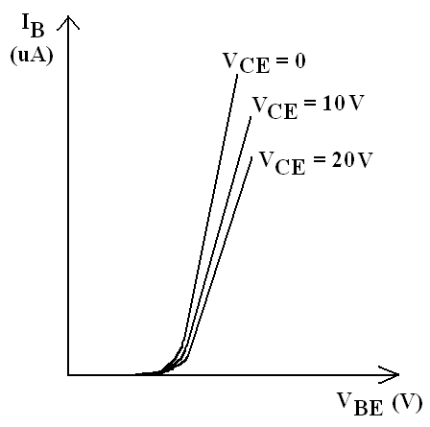
CE CONFIGURATION INPUT CHARACTERISTICS
Plot of I_{B} versus V_{BE} for
various values of V_{CE}
link\CE Characteristics.docx

Slide 19
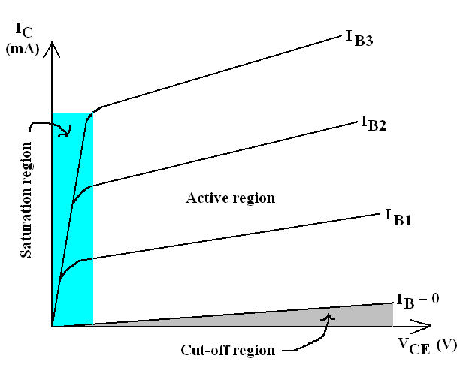
CE CONFIGURATION OUTPUT CHARACTERISTICS
A plot of I_{C} versus V_{CE} for various values of I_{B} .
Divided into three regions:
Active Region
Saturation Region
Cutoff Region
link\CE Characteristics.docx

Slide 20
Exercise Problems
An NPN transistor has collector current 4mA and base current 10 μA. Calculate the alpha and beta values of the transistor, neglecting the reverse saturation current I_{CBO.}
(Ans: 0.9975, 400)
In a transistor, 99% of the carriers injected into the base cross over to the collector region. If collector current is 4mA and collector leakage current is 6 μA, Calculate emitter and base currents. (Ans: 4.034 mA, 34μA)
In a transistor circuit, when the base current is increased from 0.32 mA to 0.48 mA, the emitter current increases from 15 mA to 20 mA. Find α_{ac} and β_{ac} values. (Ans: 0.968, 30.25)

Slide 21
Summary
In this module we have learnt:
The operation of a transistor and the relevant current components.
To plot the input and output characteristics of CB and CE Configuration transistor.
To find current gains in different configurations of transistor.

Slide 22
Part – I : Analog Electronics
Chapter-2: BJT and its Applications
Module 2: Transistor Biasing
Reference:
Robert L. Boylestad, Louis Nashelsky, Electronic Devices & Circuit Theory, 11th Edition, PHI, 2012

Slide 23

Module 2: Transistor Biasing
Objectives
Discuss the concept of biasing of the transistor.
Analyse the fixed and self bias circuits.
Identify the circuit parameters that effect Q point.
2
Department of Electronics and Communication Engineering, MIT, Manipal

Slide 24
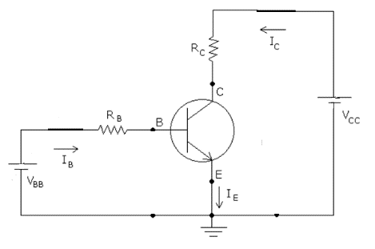
Biasing
Applying external dc voltages to ensure that transistor operates in the desired region.
Transistor circuit in CE Configuration
Applying KVL collector loop
Coordinates of load line
V_{CE} =V_{CC} ; I_{C} = 0 mA
V_{CE} =0 ; I_{C} = V_{CC}/R_{C}

Slide 25
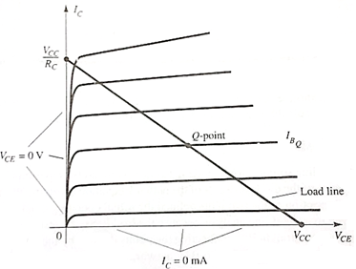
Load line and Operating point
Notes:
Operating Point: Intersection of load line with the base current results in operating point or Q point.

Slide 26
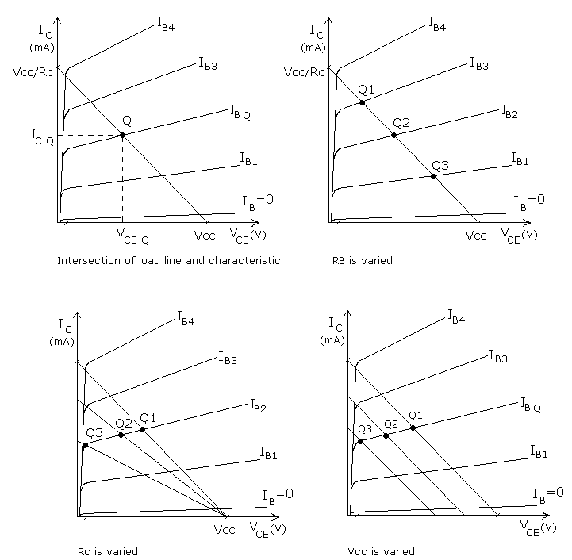
Load line and Operating point
Variation in load
line with circuit
parameters V_{CC},
R_{C} and R_{B}

Slide 27
Types of Biasing
Two types
Fixed bias
Voltage divider bias (self bias)

Slide 28
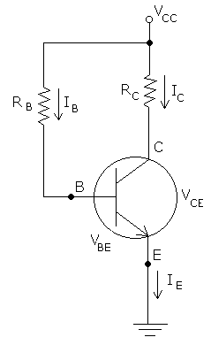
Transistor biasing
Fixed bias
link\fixed bias.docx
2
Department of Electronics and Communication Engineering, MIT, Manipal
Notes:
The value of I_{B} is “fixed” by choosing proper value for R_{B.}

Slide 29
Exercise Problems
A Si transistor is biased for a constant base current. If β = 80, V_{CEQ} = 8 V, R_{C} = 3 kΩ and V_{CC} = 15 V, find I_{CQ} and the value of R_{B} required. ( Ans: 2.33mA, 493KΩ)
Repeat the above problem , if the transistor is a Germanium device. ( Ans: 2.33mA, 507KΩ)
2
Department of Electronics and Communication Engineering, MIT, Manipal

Slide 30
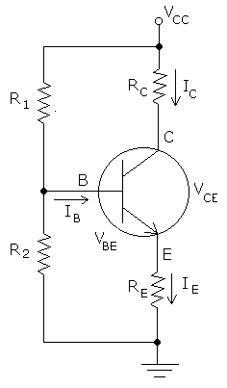
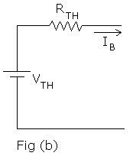
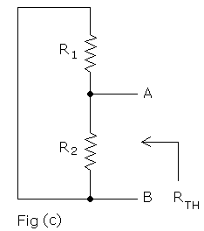
Transistor Biasing
2. Voltage divider bias (self bias)
2
Department of Electronics and Communication Engineering, MIT, Manipal
Notes:
--Voltage-divider resistors R₁ & R₂ replace R_{B.} of fixed bias.

Slide 32
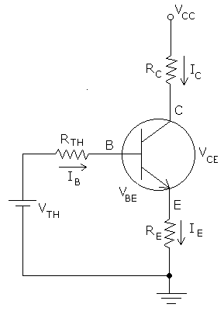
Transistor Biasing
Equivalent circuit :
link\self bias.docx
2
Department of Electronics and Communication Engineering, MIT, Manipal
Notes:
Since I_{C} is almost independent of β, Q-point is stable

Slide 34
Exercise Problems
For a self-bias circuit using silicon transistor, R_{E} = 300 Ω, R_{C} = 500 Ω, V_{CC} = 15 V, β = 100 and β R_{E} = 10R₂. Find the values of R₁ and R₂ to get V_{CEQ} = V_{CC} / 2.
(Ans: 9.03KΩ)
For a self-bias circuit, the transistor is a Si device, R_{E} = 200 Ω, R₁ = 10R₂ = 10 kΩ, R_{C} = 2 kΩ, β = 100 and V_{CC} = 15 V. Determine the values of I_{CQ} and V_{CEQ}.
( Ans: 3.13mA, 8.11V)
2
Department of Electronics and Communication Engineering, MIT, Manipal

Slide 35
Summary
In this module we have learnt:
Importance of biasing in transistors
Concept of load line, operating point and their significance
Operating point dependent on the circuit parameters such as supply voltage and resistor values as well as operating temperatures.
To analyse fixed bias circuit to obtain the operating point and plot the load line.
Finding the equivalent circuit for self bias circuit and analyse it to obtain the Q point.

Slide 36
Part – I : Analog Electronics
Chapter-2: BJT and its Applications
Module 3: Transistor as an Amplifier
Reference:
Robert L. Boylestad, Louis Nashelsky, Electronic Devices & Circuit Theory, 11th Edition, PHI, 2012

Slide 37
Module-3 : Transistor as an Amplifier
Objectives
Discuss the basic concepts of an amplifier.
Analyze the RC coupled amplifier circuit with and without feedback.
Plot the frequency response of an amplifier and define the bandwidth.

Slide 38
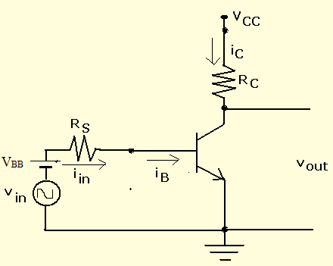
Transistor Amplifier
Collector current
Output voltage
V_{out} = Vcc-i_{C}Rc
Voltage gain ,
A_{V}= V_{out} /V_{in} .
link\amplifier.docx
2
Department of Electronics and Communication Engineering, MIT, Manipal
Notes:
Amplifier: Device which gives larger swing in output voltage proportional to the input voltage swing.
Biasing the circuit fixes the operating point in the middle of active region required for faithful amplification.
current direction through R_{L} is from bottom to top, the output voltage is 180º out of phase with input.

Slide 39
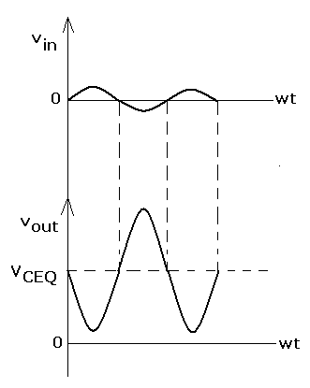
Transistor Amplifier
Input and output waveforms of amplifier
2
Department of Electronics and Communication Engineering, MIT, Manipal
Notes:
Gain dependent on β, R_{C} and other physical parameters of the transistor.
There is a dc shift in the output voltage waveform.
Output voltage is 180º out of phase with input voltage.

Slide 40
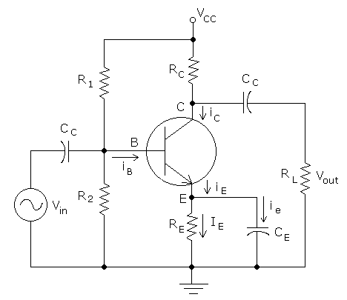
Transistor Amplifier
RC Coupling
link\RC coupling.docx
2
Department of Electronics and Communication Engineering, MIT, Manipal
Notes:
C_{C} is coupling capacitor (to block dc ), C_{E} is emitter bypass capacitor (to prevent feedback).
R₁ ,R_{2,} ,R_{E} ,R_{C} are used for biasing

Slide 41
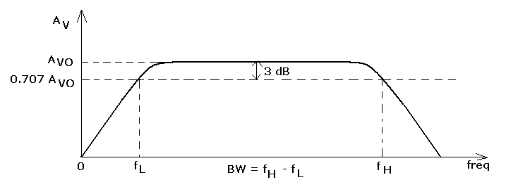
Transistor Amplifier
Frequency response of amplifier:
Bandwidth of amplifier : f_{H} - f_{L}.
link\freqency response.docx
2
Department of Electronics and Communication Engineering, MIT, Manipal
Notes:
Frequency response is a plot of gain versus frequency.
3 dB frequency: The frequency were gain reduced by 3 dB of its maximum value.

Slide 42
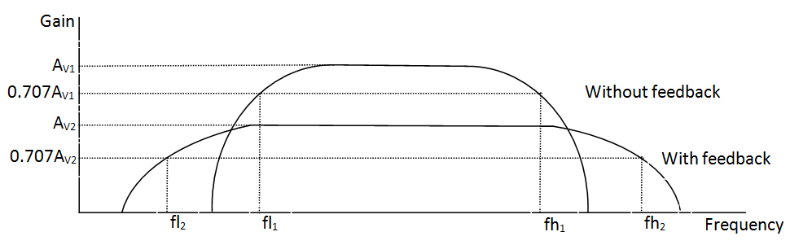
Transistor Amplifier
Frequency response of amplifier:
Bandwidth of amplifier : f_{H} - f_{L}.
link\freqency response.docx
2
Department of Electronics and Communication Engineering, MIT, Manipal
Notes:
Frequency response is a plot of gain versus frequency.
3 dB frequency: The frequency were gain reduced by 3 dB of its maximum value.

Slide 43
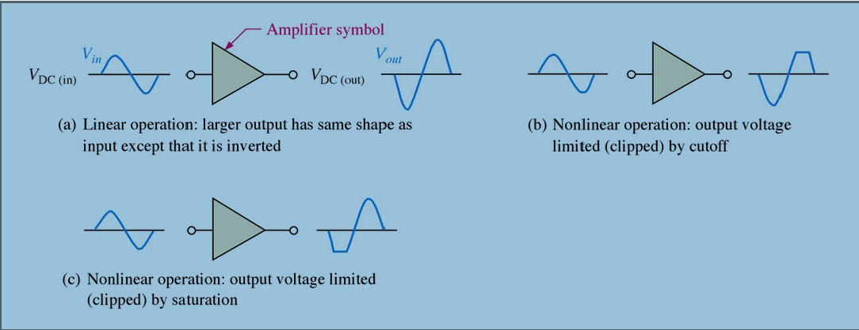
Transistor Amplifier
Effect of biasing in an amplifier.
2
Department of Electronics and Communication Engineering, MIT, Manipal

Slide 44
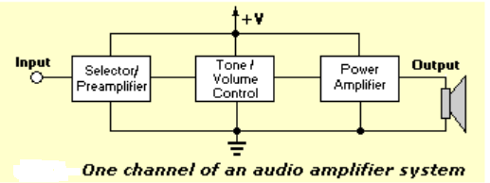
Transistor Amplifier application
Source: www.sentex.ca
.
2
Department of Electronics and Communication Engineering, MIT, Manipal

Slide 45
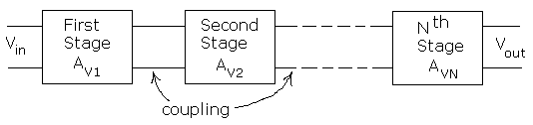
Multistage Amplifier
Gain in decibels,
(A_{V})_{dB} = 20 log₁₀ | A_{V} |
Multistage transistor
2
Department of Electronics and Communication Engineering, MIT, Manipal
Notes:
Up to gain of 100 (i.e., 40 dB) is obtained with single transistor.
For larger gain, more amplifier stages are to be cascaded.

Slide 46
Summary
In this module we have learnt:
Amplifier circuits are used for increasing the strength of week signal.
The working of an RC coupled amplifier with and without feedback.
The Gain of the amplifier defined as ratio of output signal to input signal.
The frequency response is a plot of frequency v/s gain of the amplifier and defines the bandwidth.
Gain of multistage amplifiers will be obtained by multiplying gain of each individual stage.

Slide 47
Part – I : Analog Electronics
Chapter-2: BJT and its Applications
Module 4: Transistor as a Switch
Reference:
Robert L. Boylestad, Louis Nashelsky, Electronic Devices & Circuit Theory, 11th Edition, PHI, 2012

Slide 48
Module 4: Transistor as Switch
Objectives
Explain the use of transistor as switch.
Application of transistor switch as LED driver and Inverter.

Slide 49
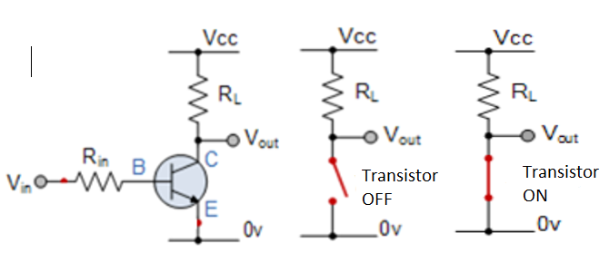
Transistor as switch
Transistor operate as “ON/OFF” type switch.
link\switch.docx
Notes:
When Input voltage V_{IN} is ZERO , transistor is OFF(cut-off region), V_{out} = V_{CC.}
When Input voltage V_{IN} is HIGH , transistor is ON (saturation region) , V_{out} = 0.

Slide 50
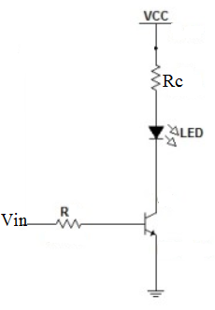
Transistor as LED driver
2
Department of Electronics and Communication Engineering, MIT, Manipal
Notes:
When Input voltage V_{IN} is ZERO , transistor is OFF(cut-off region), LED is OFF..
When Input voltage V_{IN} is HIGH , transistor is ON (saturation region) , LED turns ON.

Slide 51
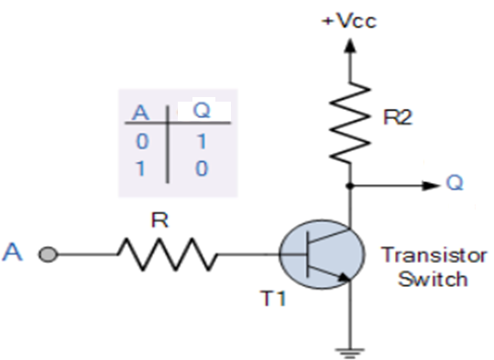
Transistor as Inverter
Notes:
When A = 0 , transistor is OFF(cut-off region), Output Q = 1.
When A = 1, transistor is ON (saturation region) , Output Q = 0.

Slide 52
Summary
In this module we have learnt:
The transistor can be used as switch by operating it in either saturation region (when the switch is said to be ON) or in cut off region (when the switch is said to be OFF).
The applications of transistor switch as LED driver and inverter.

