Slide 1
CAMS & followers

Slide 2
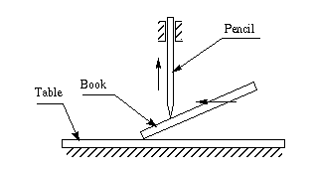

Slide 3
Cams & Followers
Cams are mechanical devices that are used to convert rotatory motion to oscillatory motion and oscillatory motion to rotatory motion.
There are two links: cam acts like an input member and follower that acts like an output member.
In a cam-follower pair, the cam usually rotates while the follower translates or oscillates.
Complicated output motions which are otherwise difficult to achieve can easily be produced with the help of cams.

Slide 4
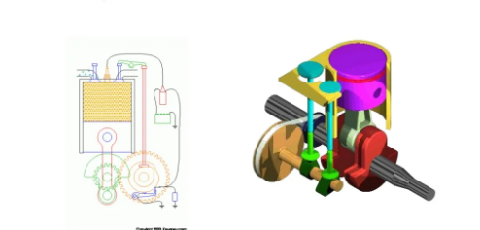
Cams & Followers

Slide 5
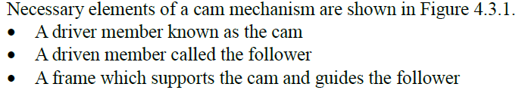
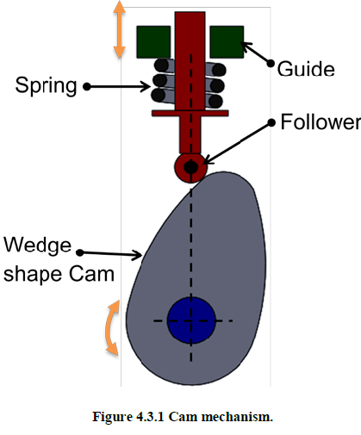

Slide 6
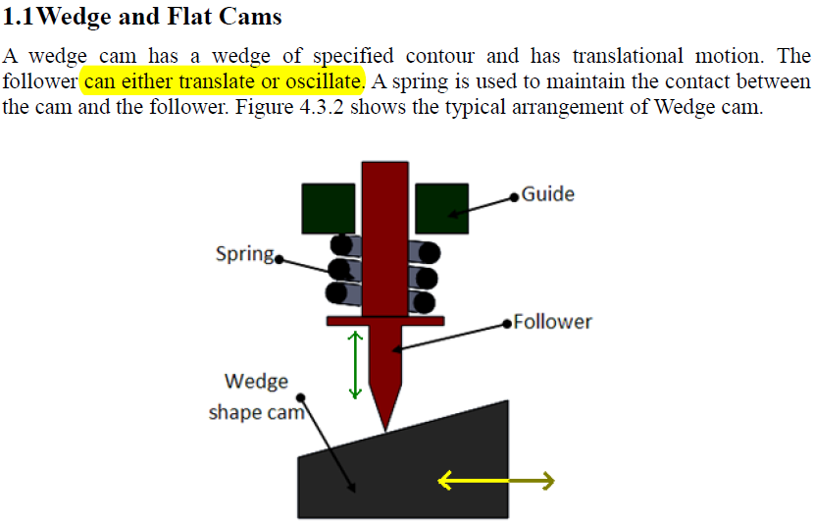

Slide 7
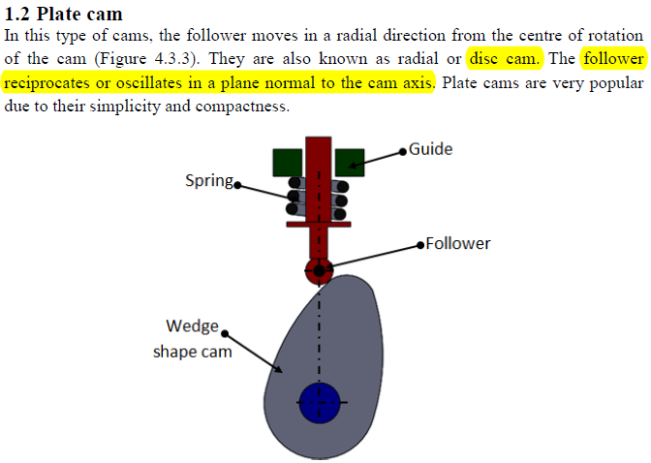

Slide 8
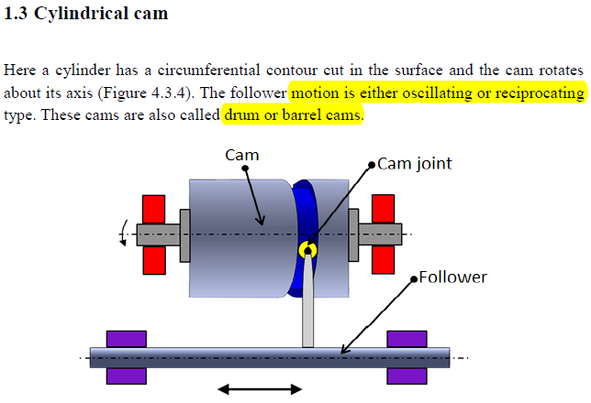

Slide 9
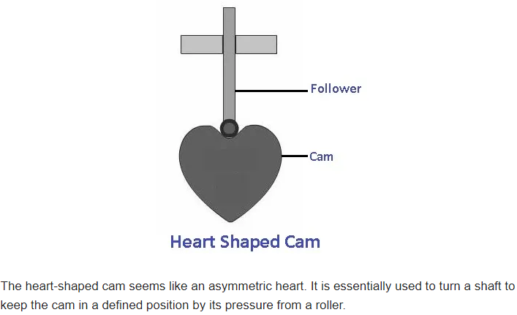
Heart shaped Cam

Slide 10
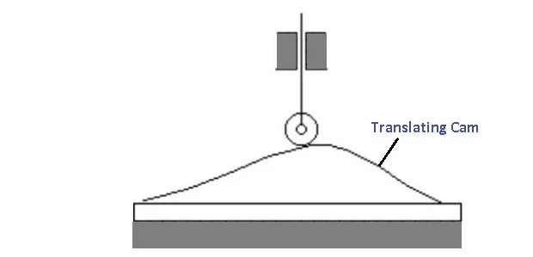
Translating Cam

Slide 11
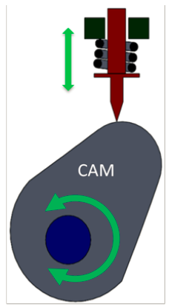
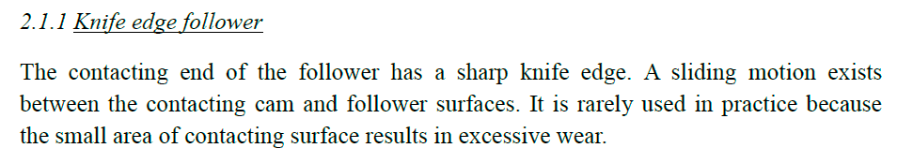
Classification based on type of surface contact between cam and follower

Slide 12
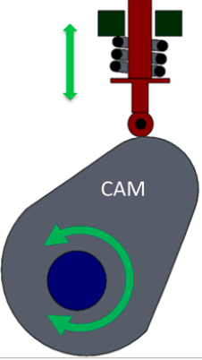
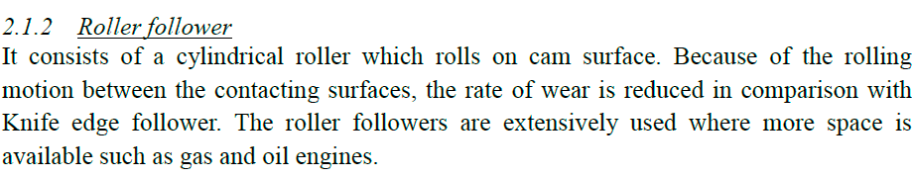
Classification based on type of surface contact between cam and follower

Slide 13
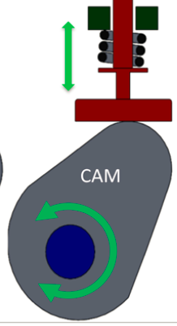

Classification based on type of surface contact between cam and follower

Slide 14
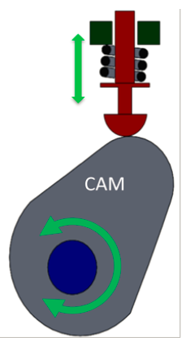

Classification based on type of surface contact between cam and follower

Slide 15
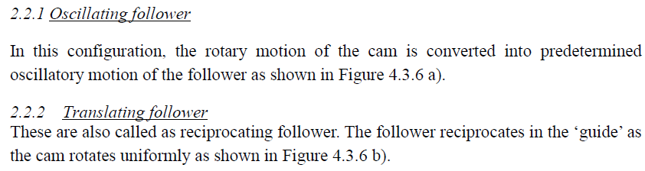
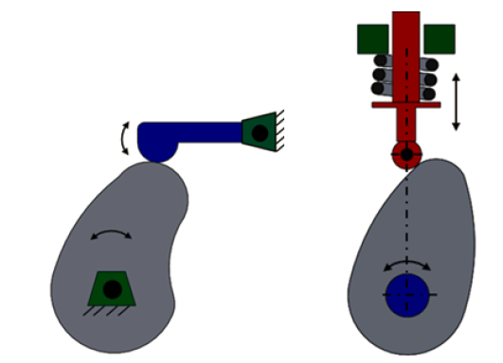
Classification based on followers’ motion

Slide 16
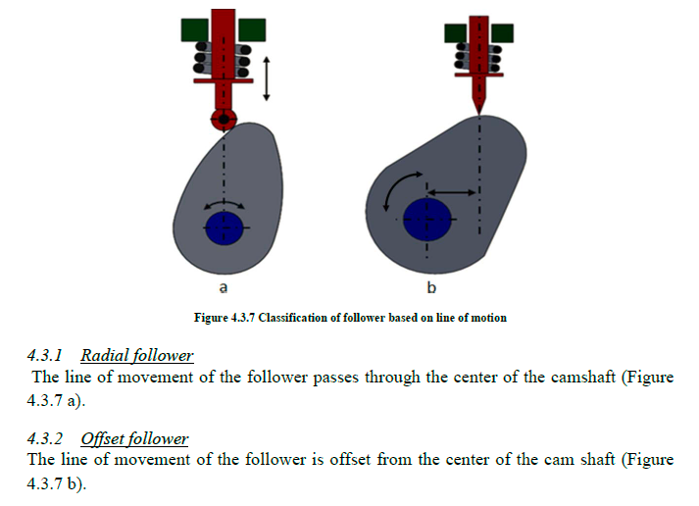
Classification based on line of motion

Slide 17
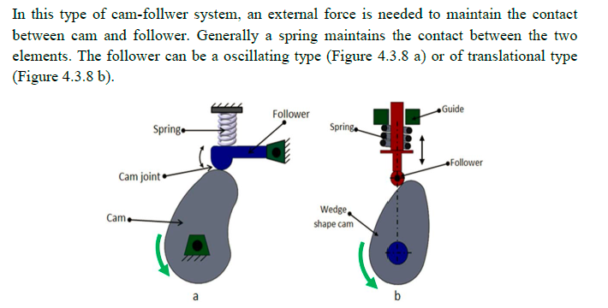
Forced closed cam follower system

Slide 18
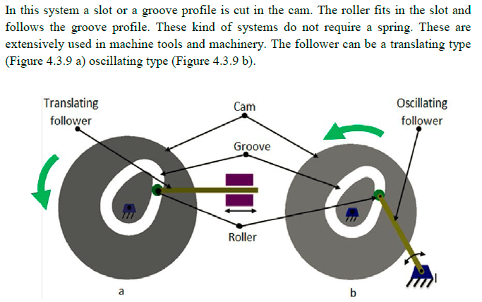
Form closed cam follower system

Slide 19
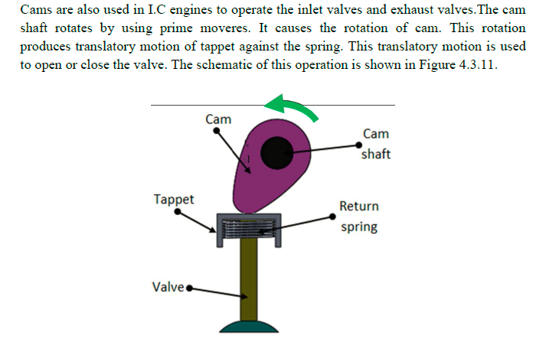

Slide 20
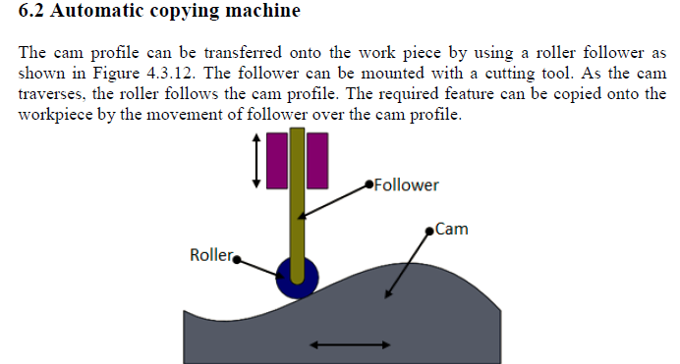

Slide 21

