Slide 1
GYROSCOPES
Dr. K Ramakrishna Kini
&
Mr. C. R. Srinivasan

Slide 2
Gyroscope
A device consisting of a wheel or disc mounted so that it can spin rapidly about an axis which is itself free to alter in direction.
It is used for measuring or maintaining orientation and angular velocity.
A mechanical gyroscope is essentially a spinning wheel or disk whose axle is free to take any orientation. This orientation changes much less in response to a given external torque than it would without the large angular momentum associated with the gyroscope's high rate of spin.

Slide 3
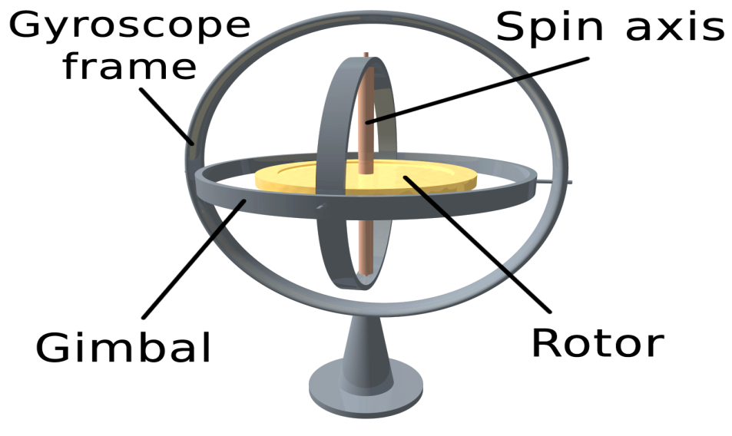
Gyroscope

Slide 4
Mechanical Gyroscope
A mechanical gyro is comprised of a massive disk free to rotate about a spin axis which itself is confined within a framework that is free to rotate about one or two axes.
The two qualities:
a) the spin axis of a free gyroscope will remain fixed with respect to space, provided there are no external forces to act upon it.
b) a gyro can be made to deliver a torque (or output signal) that is proportional to the angular velocity about an axis perpendicular to the spin axis.

Slide 5
Mechanical Gyroscope
A mechanical gyro is comprised of a massive disk free to rotate about a spin axis which itself is confined within a framework that is free to rotate about one or two axes.
The two qualities
a) the spin axis of a free gyroscope will remain fixed with respect to space, provided there are no external forces to act upon it.
B) a gyro can be made to deliver a torque (or output signal) that is proportional to the angular velocity about an axis perpendicular to the spin axis.

Slide 6
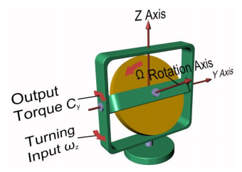
Mechanical Gyroscope

Slide 7
Gyroscope
Gyroscopes have two basic properties:
Rigidity and Precession
These properties are defined as follows:
RIGIDITY: The axis of rotation (spin axis) of the gyro wheel tends to remain in a fixed direction in space if no force is applied to it.
PRECESSION: The axis of rotation has a tendency to turn at a right angle to the direction of an applied force.

Slide 8
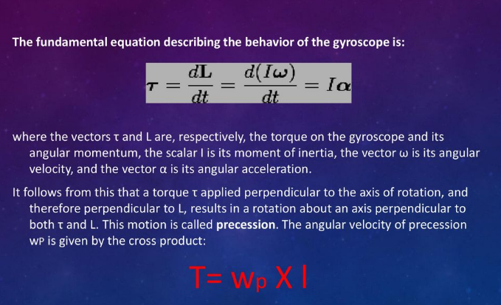
Gyroscope

Slide 9
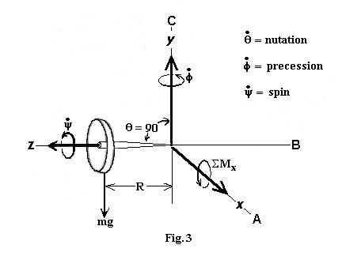
Principle of mechanical Gyroscope
By convention, these three vectors, torque, spin, and precession, are all oriented with respect to each other according to the right-hand rule.

Slide 10
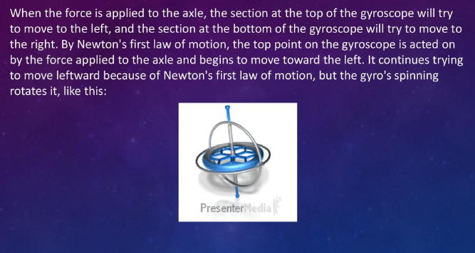
Gyroscope – Principle of working

Slide 11
Mechanical Gyroscope - Applications
The primary application of gyroscopic effects consists in the measurement of the angular position of a moving vehicle.
The gimbaled frame of the gyroscope is attached to the vehicle and it is free to rotate, while the rotation axis of the spinning mass keeps its angular position during the motion of the vehicle.
The variation of the absolute angle of the vehicle can be simply associated to the relative variation of the angle between the rotation axis of the mass and a fixed direction on the frame of the gyroscope.

Slide 12
Mechanical Gyroscope - Applications
Another applications is Gyrocompass
When external torques are not applied to the frame, the gyrocompass keeps the angular position of a pointer to North direction, independently of the path followed by the vehicle.
The advantage of such a mechanical system is that it is immune to magnetic fields that can cause deviations in pointer angle.

Slide 13
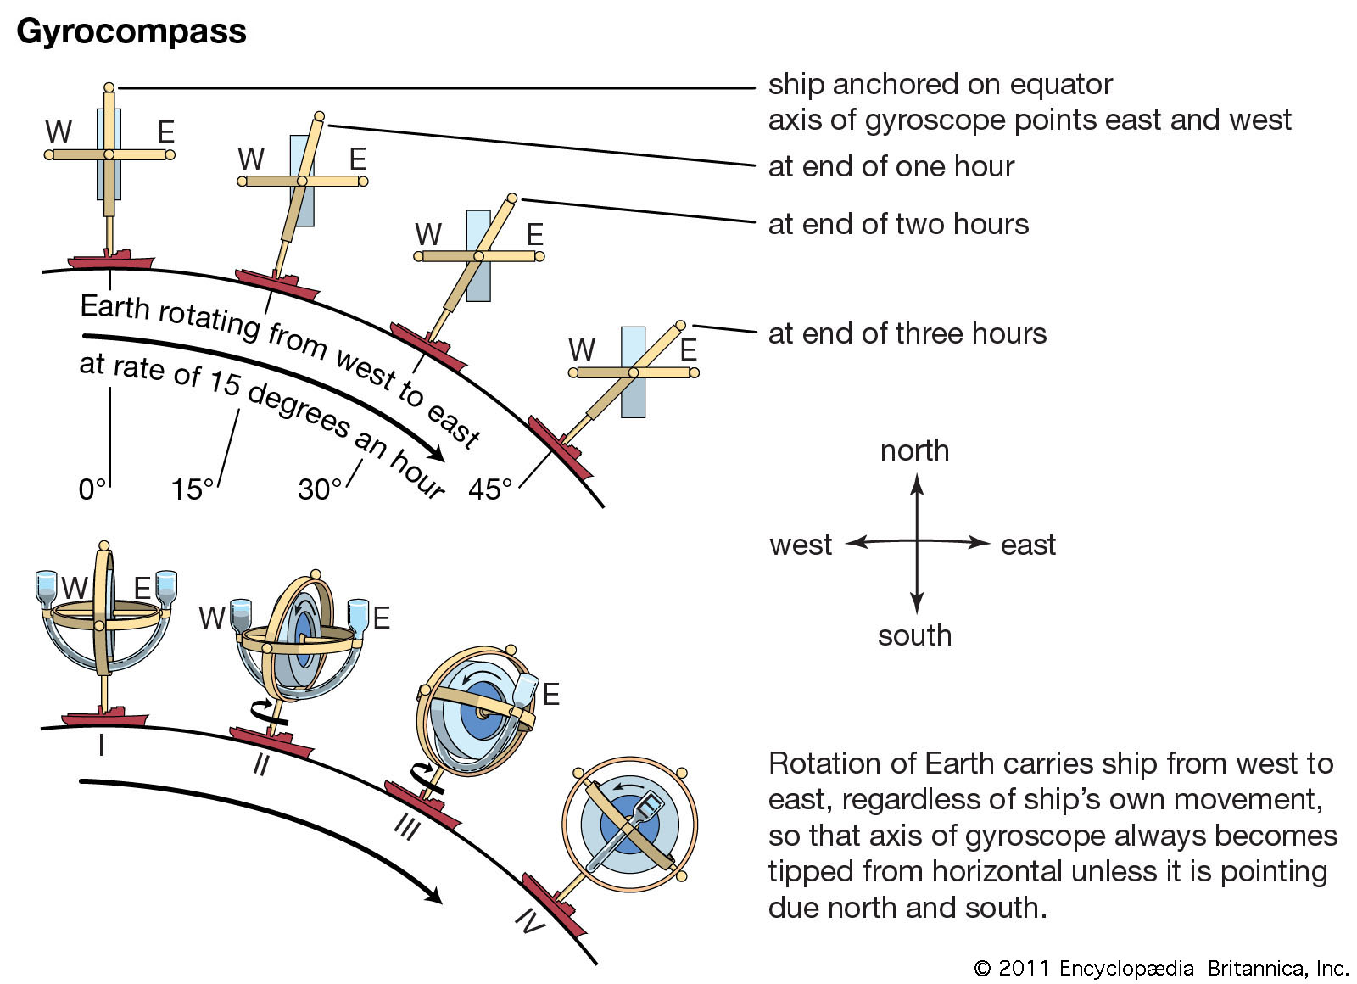
Mechanical Gyroscope - Applications

Slide 14
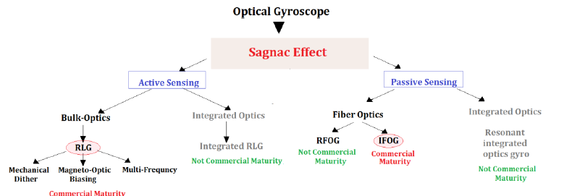
Optical Gyroscopes- Working principle

Slide 15
Optical Gyroscopes
Optical gyroscopes operate by sensing the difference in propagation time between counter-propagating beams travelling in opposite directions in closed or open optical paths.
A rotation-induced change in the path lengths generates a phase difference between the counter-propagating light beams.
This rotation-induced phase difference physically consists in the Sagnac effect, being the basic operating principle of all optical gyroscopes.

Slide 16
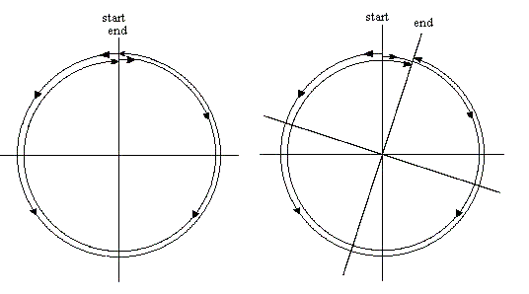
Optical Gyroscopes- Working principle

Slide 17
Ring Laser Gyroscopes (RLG)
Based on a ring laser (i.e., a annular cavity) where, due to the Sagnac effect, two independent counter-propagating resonant modes, intrinsically generated within the cavity through a gain medium, show of a frequency shift if the cavity undergoes a rotation.
the difference in the frequencies is used to detect rotation.
Interference between the counter-propagating beams, observed externally, results in motion of the standing wave pattern, and thus indicates rotation.

Slide 18
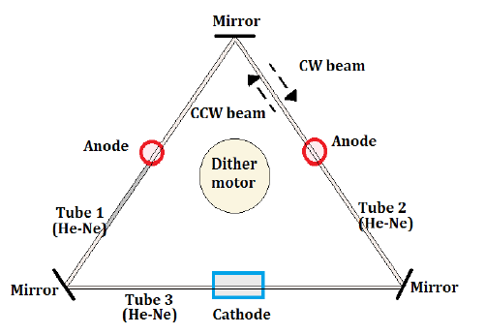
Ring Laser Gyroscopes (RLG)

Slide 19
Ring Laser Gyroscopes (RLG)
Three air channels are drilled in the glass body and three mirrors are placed at each corner to create a triangular optical resonator.
A low pressure He-Ne gas mix fills the three tubes. A high voltage electrical discharge is applied through the two anodes and the cathode for electrically pumping the optical cavity.
Due to action of electrical pump, two independent counter-propagating laser beams (i.e., clockwise CW and counter-clockwise CCW), resonating at the same frequency, are generated inside the optical cavity.

Slide 20
Ring Laser Gyroscopes (RLG)
By making a partially reflecting mirror, it is possible to detect the angular velocity of the rotating system by reading the frequency change of the resonant behavior of the device or the interference pattern generated by the interaction of the CW and CCW laser beams.
At very low rotation rates, the mirrors, being imperfect, produce backscattered light, which couples energy from a CW to a CCW.
The backscattered light acts as a mechanism of frequency synchronization—lock-in of the two resonant beams at low rates of rotation.

Slide 21
Ring Laser Gyroscopes (RLG) – Critical parameters
Size: Larger ring lasers gyroscope can measure lower rotation rates.
Mirrors: The mirrors are fundamental elements for focusing and directing the laser beams to form the optical cavity.
Stability: The gyroscope body must be built within a substance that changes minimally in response to temperature fluctuations.
Gas: He-Ne generates beams with the most desirable features for large ring lasers.

Slide 22
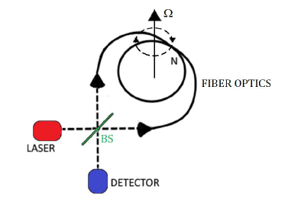
Interferometer Fiber Optic Gyroscopes (IFOG)

Slide 23
MEMS Gyroscopes – Coriolis effect
The underlying physical principle is that a vibrating object tends to continue vibrating in the same plane even if its support rotates.
The Coriolis effect causes the object to exert a force on its support, and by measuring this force the rate of rotation can be determined.
In physics, the Coriolis force is an inertial or fictitious force that seems to act on objects that are in motion within a frame of reference that rotates with respect to an inertial frame.
In a reference frame with clockwise rotation, the force acts to the left of the motion of the object.
In one with anticlockwise (or counterclockwise) rotation, the force acts to the right.
Deflection of an object due to the Coriolis force is called the Coriolis effect.

Slide 24
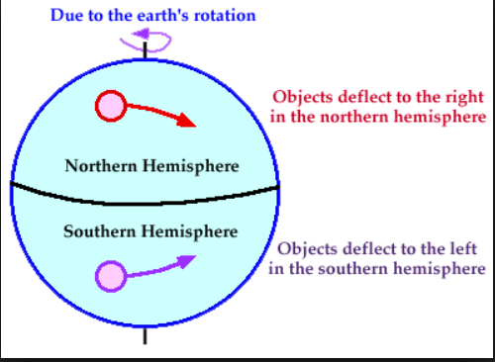
MEMS Gyroscopes – Coriolis effect

Slide 25
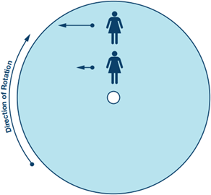
MEMS Gyroscopes – Coriolis effect
Coriolis acceleration example. A person moving northward toward the outer edge of a rotating platform must increase the westward speed component (blue arrows) to maintain a northbound course. The acceleration required is the Coriolis acceleration.

Slide 26
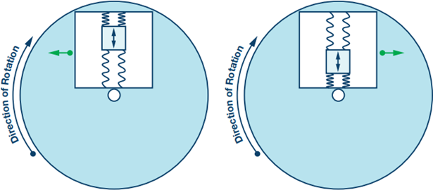
MEMS Gyroscope sensor

Slide 27
MEMS Gyroscope sensor
This sensor enables precision angular rate (rotation speed) measurement even in the presence of shock and vibration and is rated for temperatures up to 175°C.
When the resonating mass moves toward the outer edge of the rotation, it is accelerated to the right and exerts on the frame a reaction force to the left.
When it moves toward the center of the rotation it exerts a force to the right, as indicated by the green arrows.
To measure the Coriolis acceleration, the frame containing the resonating mass is tethered to the substrate by springs at 90° relative to the resonating motion.
Coriolis sense fingers are used to sense displacement of the frame through capacitive transduction in response to the force exerted by the mass.

Slide 28
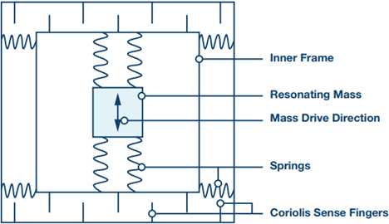
MEMS Gyroscope sensor

Slide 29
MEMS Gyroscope sensor
As the resonating mass moves and as the surface to which the gyroscope is mounted rotates, the mass and its frame experience the Coriolis acceleration and are translated 90° from the vibratory movement.
As the rate of rotation increases, so does the displacement of the mass and the signal derived from the corresponding capacitance change. It should be noted that the gyroscope may be placed anywhere on the rotating object and at any angle, so long as its sensing axis is parallel to the axis of rotation.
The displacement of the resonating mass is measured through capacitive sensing elements attached to the sensor.

Slide 30
Key Gyro performance factors
ANGLE RANDOM WALK
In the output of a gyro, there is always a broadband white noise element.
Noise is one of the most important differences between optical and MEMS gyro performance, resulting in different precision and accuracy in measurements.
Angle Random Walk describes the error resulting from this noise element.

Slide 31
Key Gyro performance factors
BIAS OFFSET ERROR
When input rotation is null, the output of the gyro could be nonzero.
The equivalent input rotation detected is the Bias Offset Error.

Slide 32
Key Gyro performance factors
BIAS INSTABILITY
Bias Instability is the instability of the bias offset at any constant temperature and ideal environment.
Bias instability introduces errors that may not be easy to calibrate.
It can lead to heavy inaccuracy.

Slide 33
Key Gyro performance factors
TEMPERATURE SENSITIVITY
A characterization of parameters such as noise, bias offset and scale factor over temperature is necessary to verify that gyro performance meets system targets.

Slide 34
Key Gyro performance factors
SHOCK & VIBRATRION SENSITIVITY
Noise and Bias offset of gyros also degrade under vibration and shock input
Vibration performance is critical in many military and industrial applications, because of the presence of numerous factors such as engines or gunfire.

